Slide 1
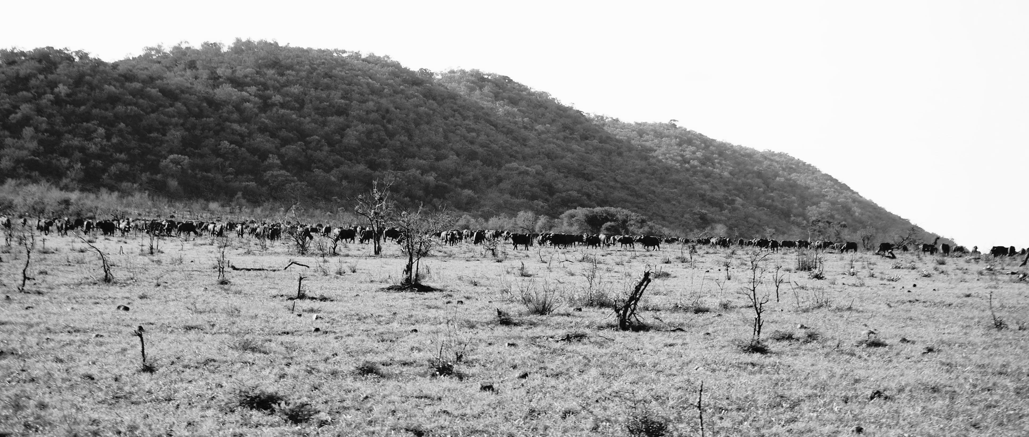
FMD in African Buffalo (Syncerus caffer): Differences in host responses between SAT 1,2 and 3 in experimentally infected and contact infected individuals
Brianna Beechler, Eva Perez, Bryan Charleston, Caroline Glidden, Nick Juleff, LinMari de Klerk-Lorist, Francois Maree, Katherine Scott, Louis van Schalkwyk, Fuquan Zhang, Anna Jolles

Slide 2
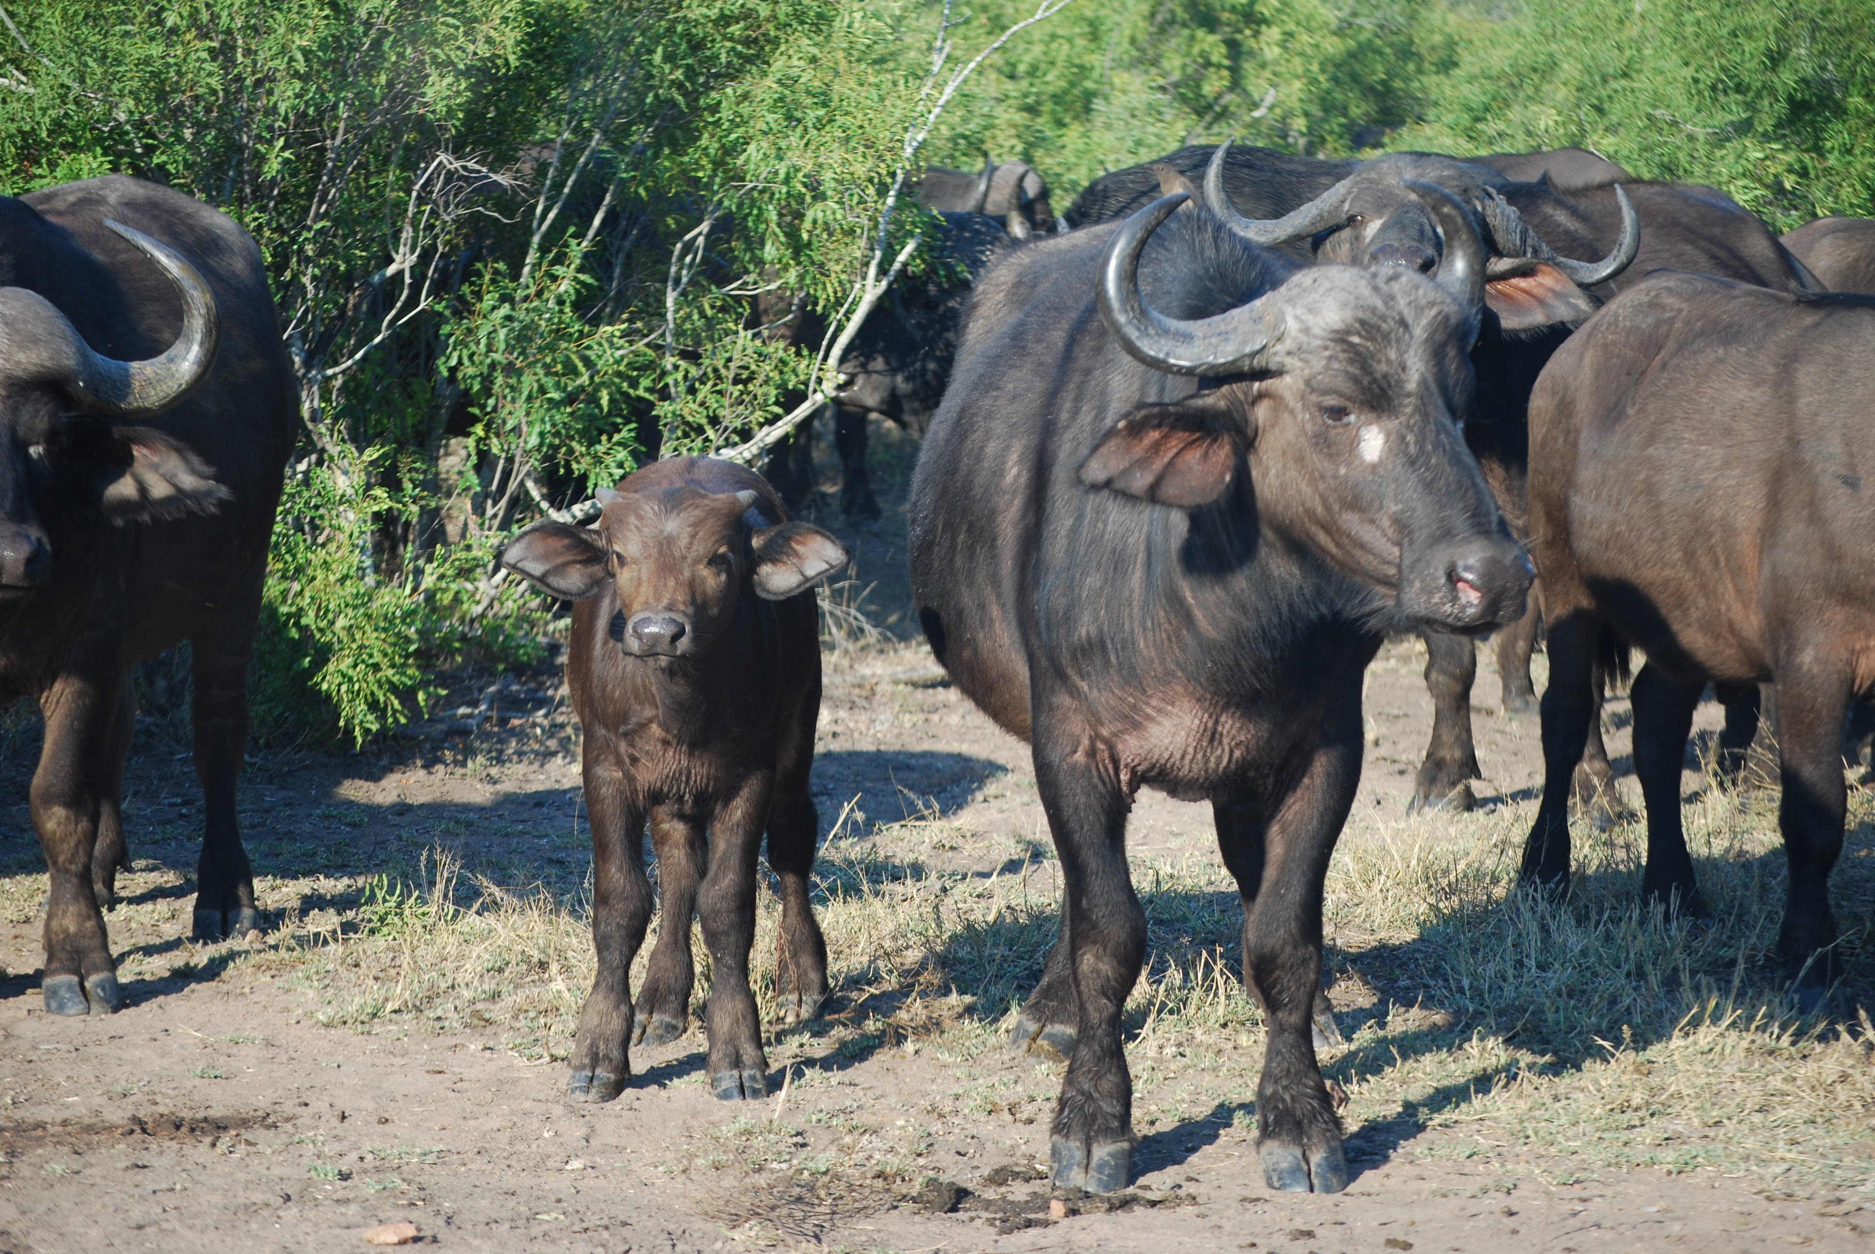
FMDV in African Buffalo
SAT 1,2,3 are endemic in buffalo in KNP, South Africa
Typically “sub-clinically infected” unlike cattle
  But what does sub-clinically mean in wildlife?
  Does it differ by SAT type or by infection style?
Notes:
Buffalo are an iconic species in Southern Africa, known to be infected with SAT 1,2 and 3 – considered the “host the disease evolved in”. Circulates in population in Kruger National Park – hence the vaccination and trade resitriction zone for cattle around Kruger. Part of a longterm study to understand the dynamics and persistence in buffalo.

Slide 3
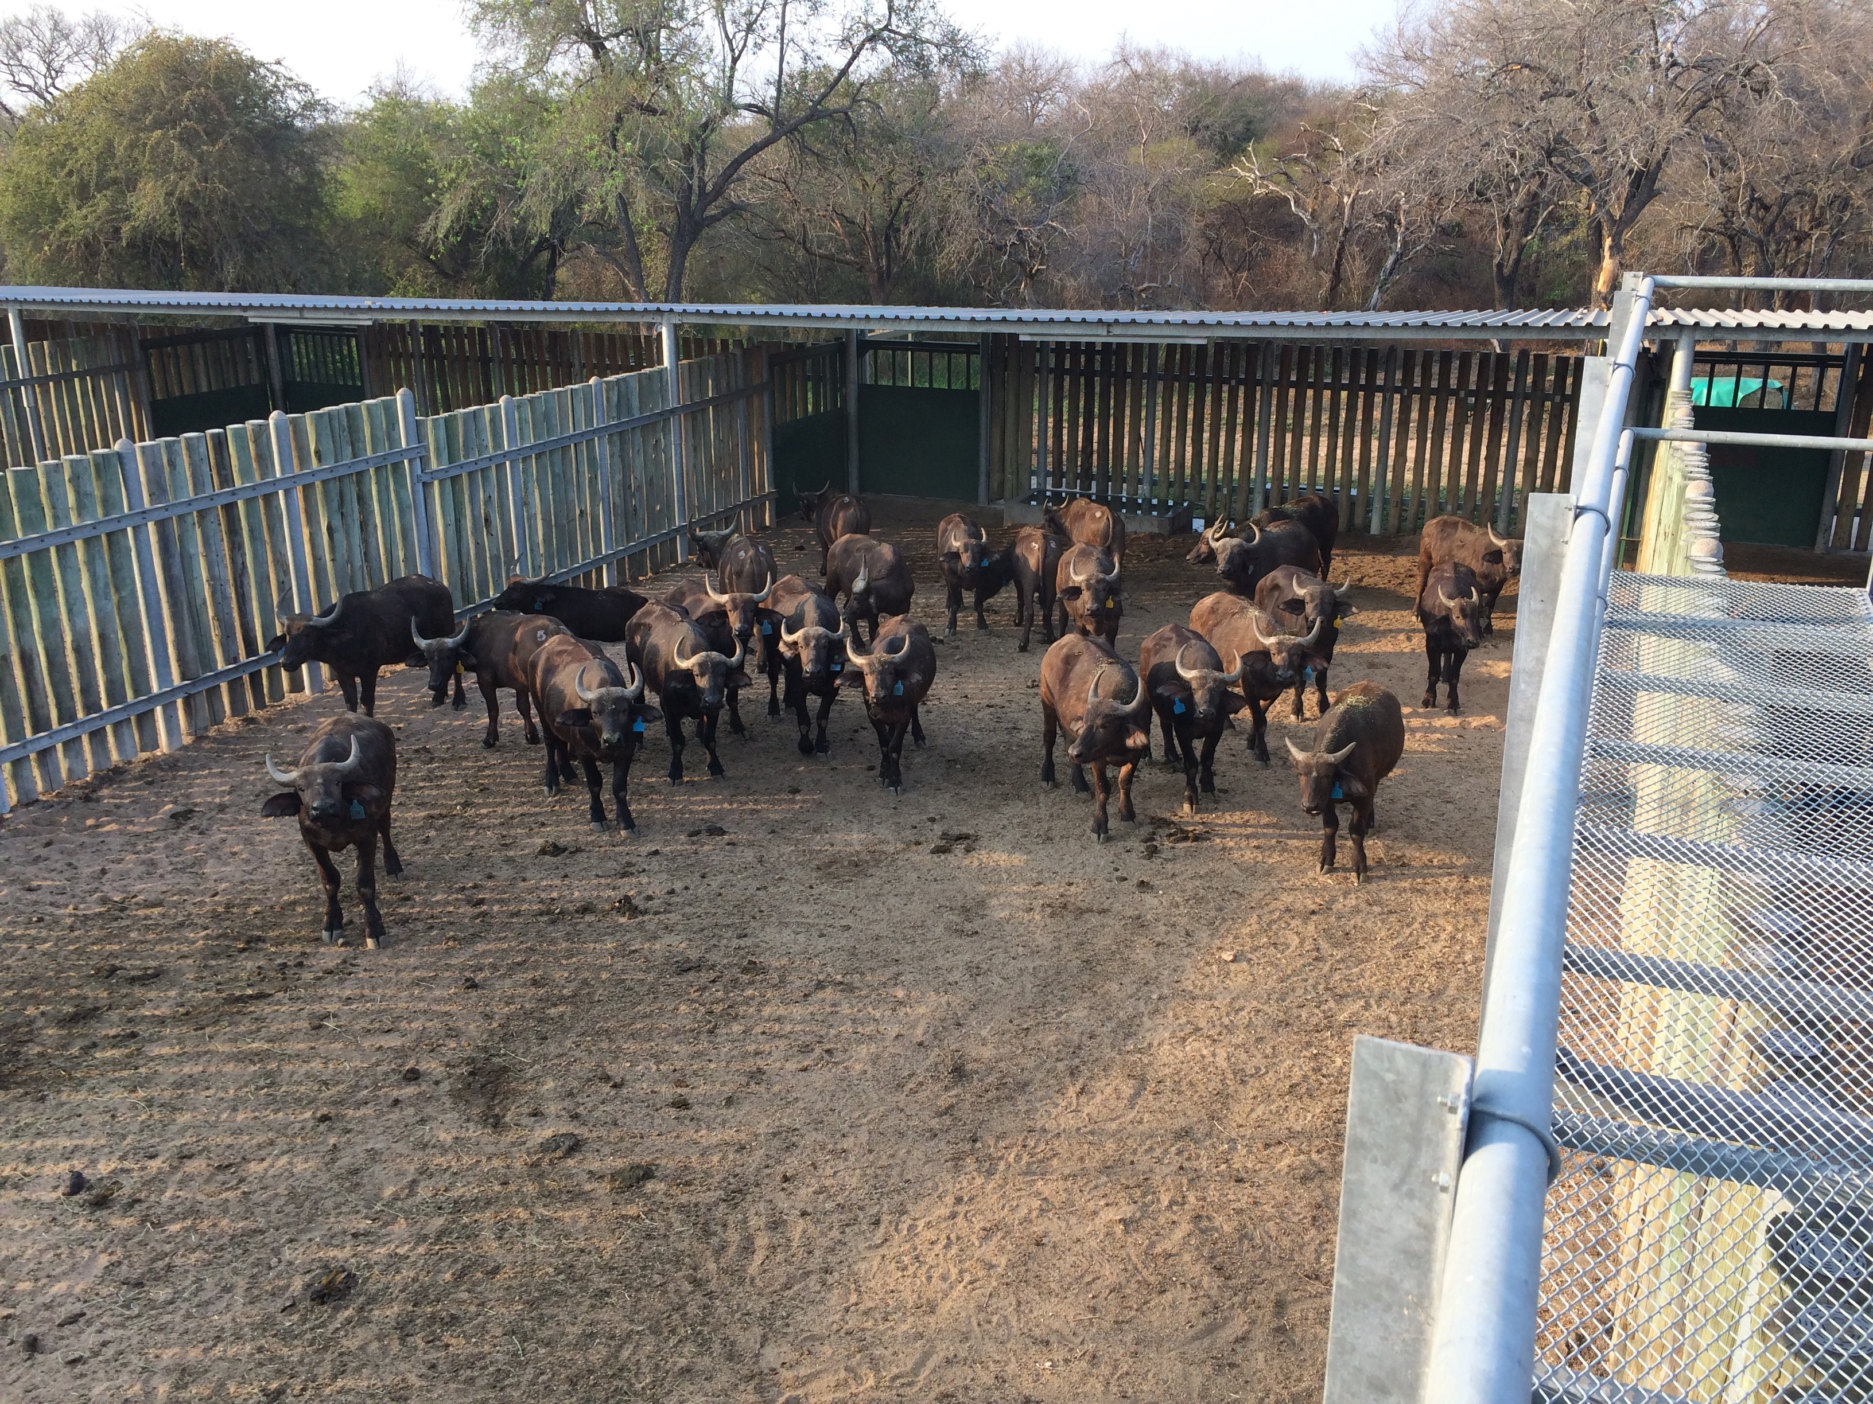
Study Design – Experimental set-up
12 FMDV naïve young buffalo obtained from HIP were needle infected with SAT 1,2,3 (4 with each serotype)
  Virus prepared by OVI - F. Maree
  kept in separate bomas
On day 2 - 12 FMDV naïve young buffalo (4 per group) were introduced
Monitored for FMDV and clinical signs on day 4, 6, 8, 11, 14, 30

Slide 4
Measured parameters
Viremia (by PCR) – by Pirbright Institute
Body temperature (via intraruminal temperature loggers that report every 15 minutes)
Presence/Absence of mucosal lesions
Acute Phase Proteins: Haptoglobin & Serum Amyloid A
  In cattle are elevated after FMDV infection, peak correlates with the development of mucosal lesions (Stenfeldt 2011)
Inflammatory Cytokines: TNF alpha & IFN gamma

Slide 5
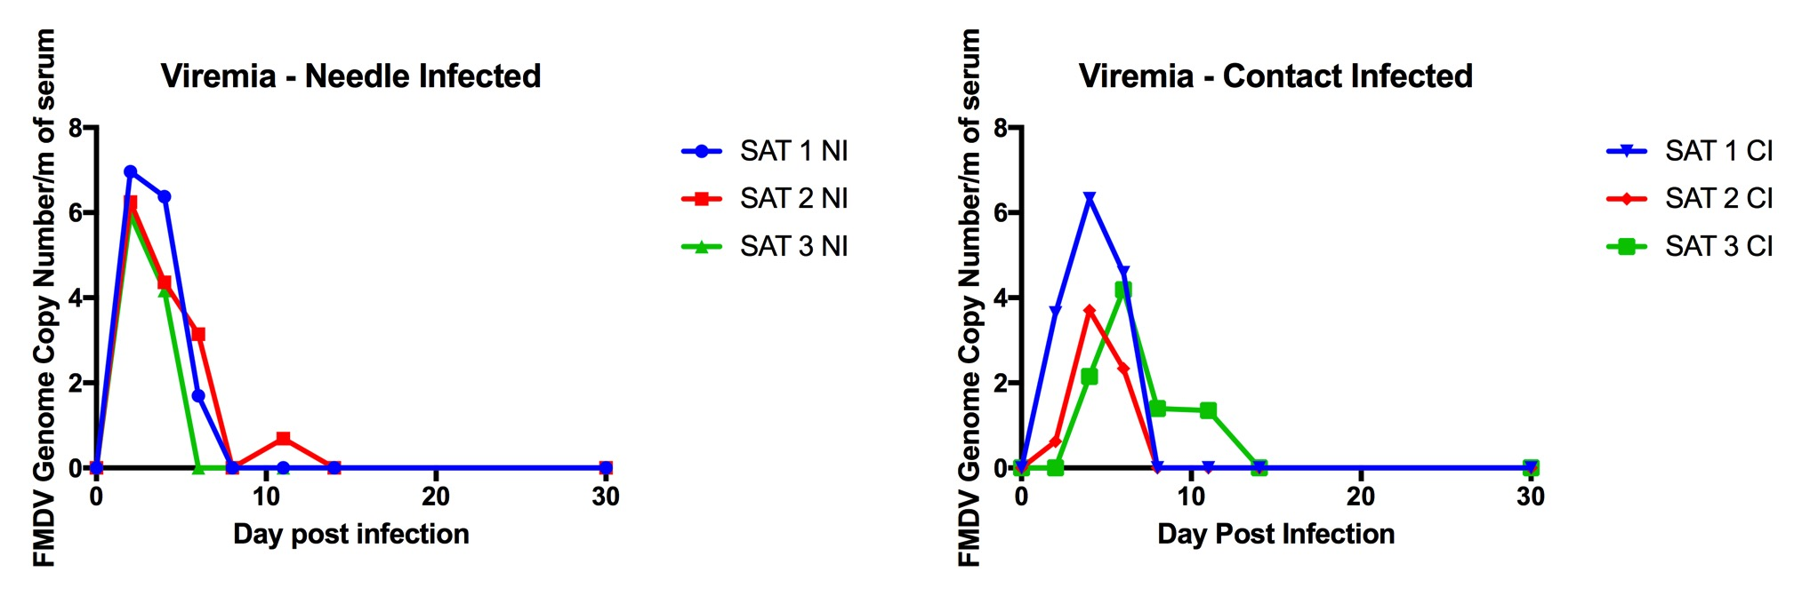
Results of infection
Contact buffalo rapidly infected with FMDV from needle infected
  Carrier information & transmission – Eva Perez
  Measuring transmission rate – Anna Jolles & Jan Medlock
Notes:
PCR verified the strains transmitted, only SAT 1 animals got SAT 1, SAT 2 animals only got SAT 2, etc. None of the animals were infected prior to exposure. All developed antibody titers between day 8-14.

Slide 6
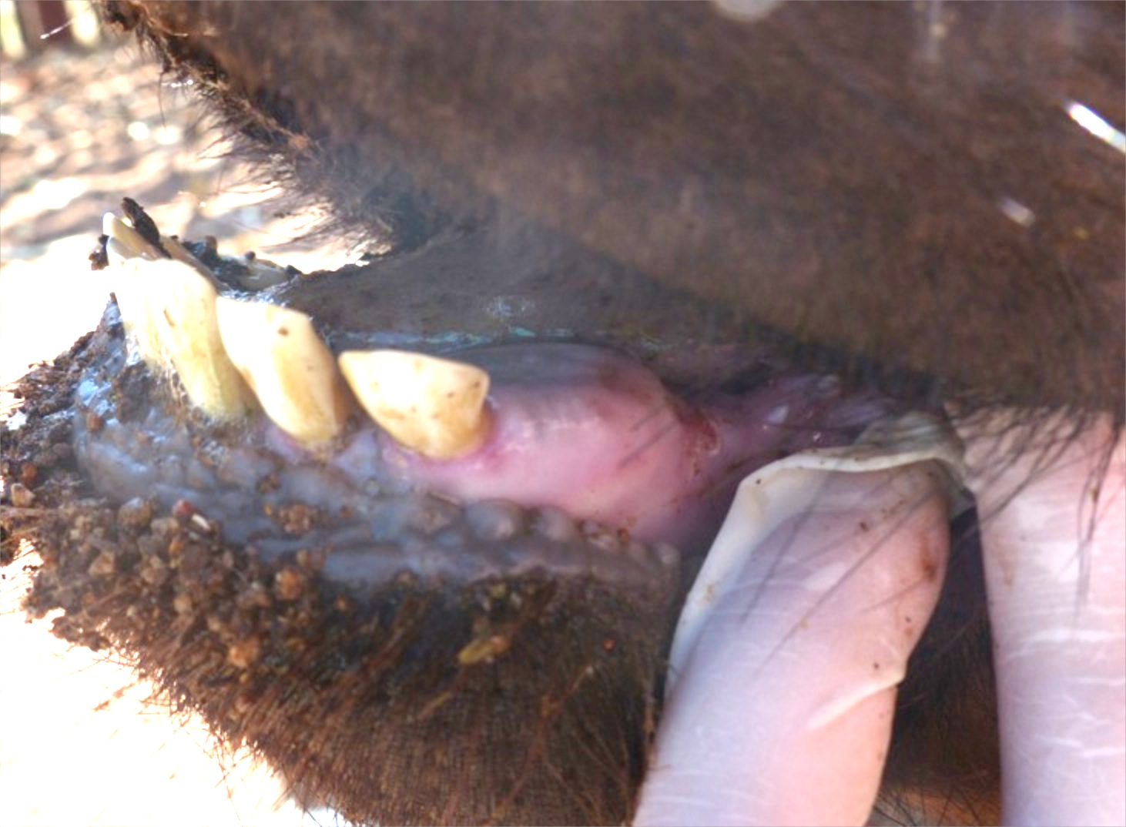
Host Response – Development of Oral Mucosal Lesions
 | Needle Infected | Contact Infected
SAT 1 | 2/4 | 1/4
SAT 2 | 1/4 | 0/4
SAT 3 | 0/4 | 1/4
Very small lesions developed infrequently
Notes:
PICTURE FROM EVA?

Slide 7
Host Response – Acute Phase Proteins
Haptoglobin and Serum Amyloid A –elevated in cattle post infection
Buffalo?
Needle Infected
Contact Infected

Slide 8
Host Response – Acute Phase Proteins
Haptoglobin and Serum Amyloid A –elevated in cattle post infection (Stenfeldt 2011)
Buffalo?
Needle Infected
Contact Infected

Slide 9
Does the magnitude of the response differ between SAT types and infection route

Slide 10
Host Response - Fever
Preliminary Data
  All SAT 1 needle infected buffalo mounted a fever response detectable ~24-36 hours after infection
    Analysis of peak and duration still in progress
  Some of the SAT 2 and 3 needle infected buffalo mounted a fever response but it was more variable in timing
    Analysis of peak and duration still in progress
  Data for contact infected individuals not analyzed yet

Slide 11
Summary so far
Buffalo rarely develop oral vesicles
Buffalo do mount fever responses
They do mount an inflammatory response
  SAT 3 contact infected buffalo had a reduced haptoglobin response (peak) to FMDV infection compared to SAT 3 needle infected.

Slide 12
Host Response – Inflammatory Cytokines
Are TNFalpha and IFNgamma elevated post-infection
Needle Infected
Contact Infected

Slide 13
Host Response – Inflammatory Cytokines
Are TNFalpha and IFNgamma elevated post-infection
Needle Infected
Contact Infected

Slide 14
Does the magnitude of the response differ between SAT types and infection route

Slide 15
Take Home Points
Buffalo rarely develop oral vesicles
Buffalo do mount fevers
They do mount an inflammatory response
  SAT 3 contact infected buffalo had a reduced haptoglobin response (peak) to FMDV infection compared to SAT 3 needle infected.
Buffalo have elevated TNFa and IFNy when needle infected
  But no TNFa infection when contact infected

Slide 16
Remaining Questions
Why do buffalo seldom show oral vesicles or severe clinical signs but do mount very high inflammatory immune responses?
  What does this mean for transmission?
Are the differences between needle infected and contact infected (no TNFa response, reduced haptoglobin response in SAT 3) relevant to progression and transmission?

Slide 17










Thank you! - Acknowledgements
Jan Medlock
Brian Dugovich
Caroline Glidden
Hannah Tavalire
Julie Rushmore
Erin Gorsich
Danielle Sisson
Claire Couch
Henri Combrink
Kath Forssman
Darryn Knobel
Courtney Coon
Francois Maree
Katherine Scott
Lorens Maake
Peter Buss
Markus Hofmeyr
Marius Kruger
Simon Gubbins
Eva Perez
Fuquan Zhang
Bryan Charleston
Lin-Mari de Klerk-Lorist
Louis van Schalkwyk
Dan Haydon
Michele Miller
Funding:

