Slide 1
Complete Genome Sequences of Three African Foot-and-Mouth Disease Viruses, Directly from Clinical Samples
S Van Borm, T Rosseel, A Haegeman, M E Fana, L Seoke, J Hyera, G Matlho, F Vandenbussche, K De Clercq

Slide 2
The Study
Can unbiased RNASeq produce complete FMDV genome sequences directly from clinical samples?
3 strong positive epithelial samples (C_{T} range 14,63 – 16,18) from Zambia and Namibia

Slide 3
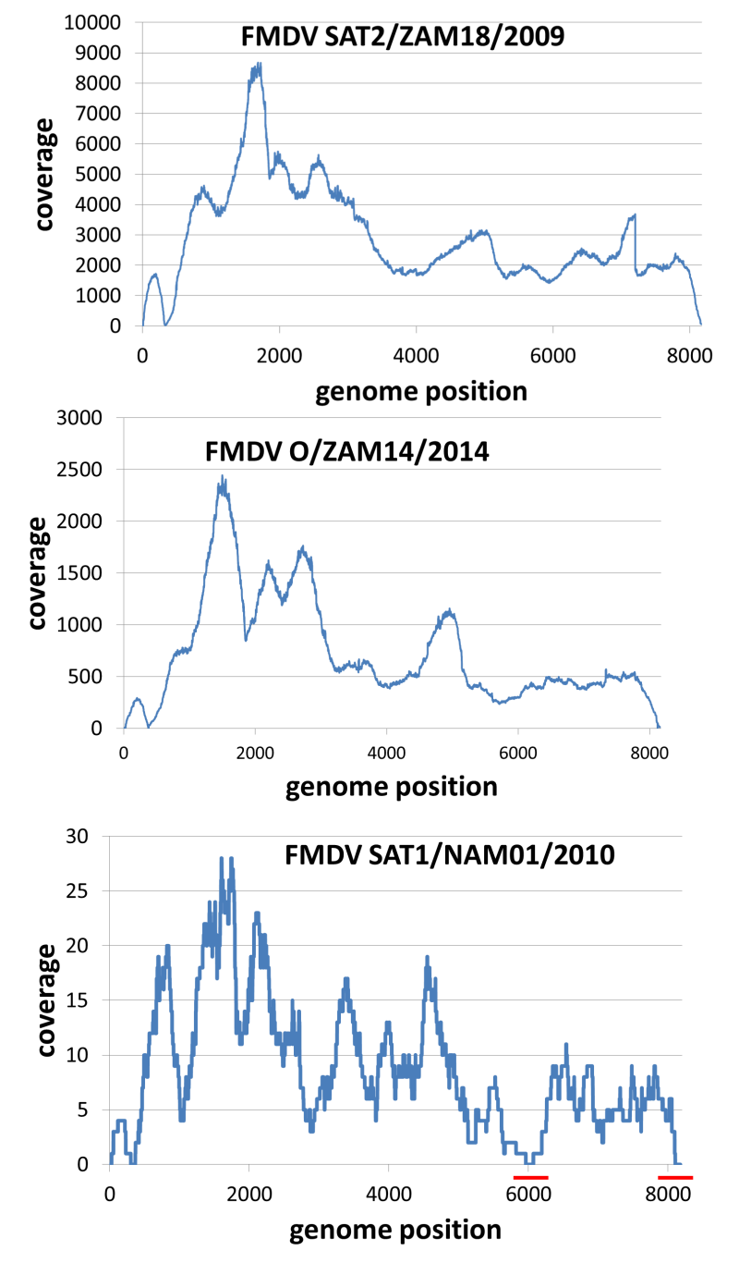
Results
Unbiased RNASeq produces complete genomes with high average coverage in 2/3 samples
limited gap closure (Sanger sequencing) needed in 3rd sample due to low coverage (limited % of FMDV reads).
Potential for unbiased detection of co-infections
If only targeting FMDV, targeted approaches may produce better coverage.
e.g. Logan G, Freimanis GL, King DJ, Valdazo-Gonzalez B, Bachanek-Bankowska K, Sanderson ND, Knowles NJ, King DP, Cottam EM. (2014) BMC Genomics 15:828

Slide 4
Conclusion
These data demonstrate the feasibility of direct sequencing of complete FMDV coding sequences from samples from symptomatic animals
The complete genome sequences of O/ZAM14/2010, SAT1/NAM01/2010 and SAT2/ZAM18/2009 were obtained

