Slide 1
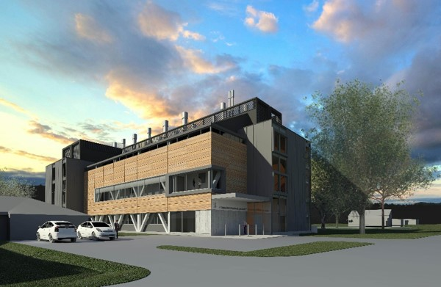

A PROCESS MODELLING APPROACH TO ESTIMATE FMD DIAGNOSTIC CAPACITY FOR OUTBREAK MANAGEMENT DECISION-MAKING.
Kylee Walker^{1*}, Rudolfo Bueno², Richard Clough², David Pulford², Richard Swainsbury², Peter Winquist³, Abbas Munshi³, and Paul Bingham¹.
¹Surveillance and Incursion Investigation (Animals and Marine) Team, Investigation and Diagnostic Centres and Response Directorate (IDC&R), Ministry for Primary Industries, New Zealand.
²Animal Health Laboratory, IDC&R, Ministry for Primary Industries, New Zealand.
³LIMS Project Team, IDC&R, Ministry for Primary Industries, New Zealand.
*Author for correspondence. Email: Kylee.Walker@mpi.govt.nz

Slide 2
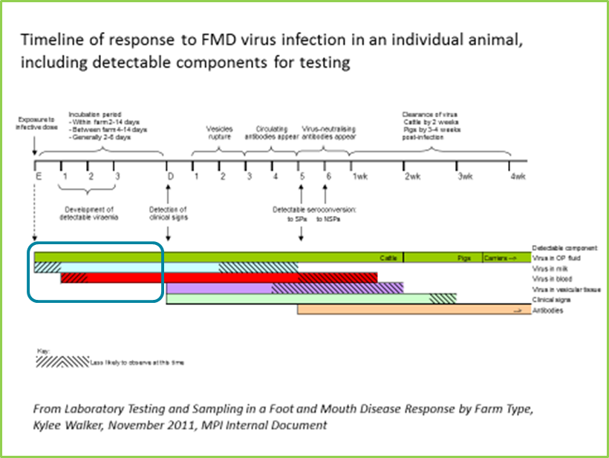
Diagnostic Surveillance Strategy
New Zealand has a surveillance strategy in place designed to improve efficiency and accuracy of diagnosis in an FMD outbreak.
Plans for eradication and
proof-of-freedom phases.
Key features:
Decision-making for sampling and testing is pre-determined for the farm and laboratory.
Eradication phase: Targeted diagnostics and enhanced pre-clinical diagnosis, for faster delimitation of an outbreak, improved management, reduced spread of infection, avoidance of ‘culling on suspicion’, etc.
Proof-of-freedom phase: Sample numbers and the testing algorithm are pre-validated for the statistical confidence necessary for a claim of freedom.

Slide 3
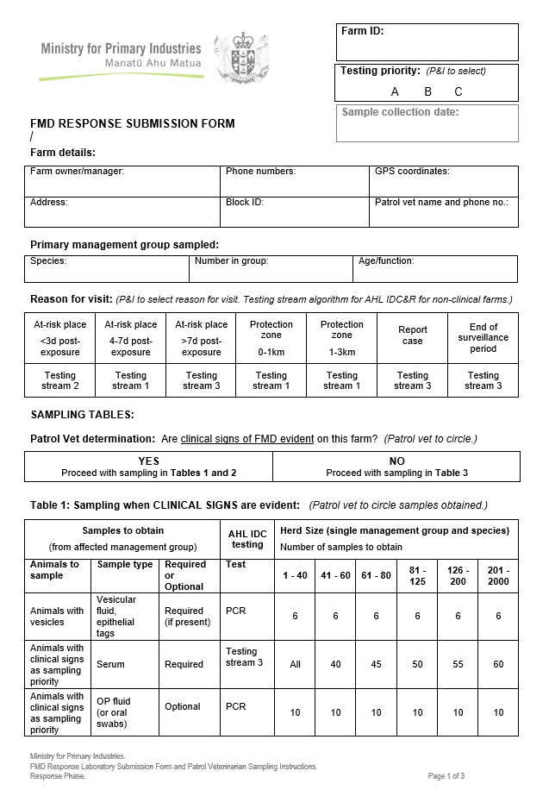
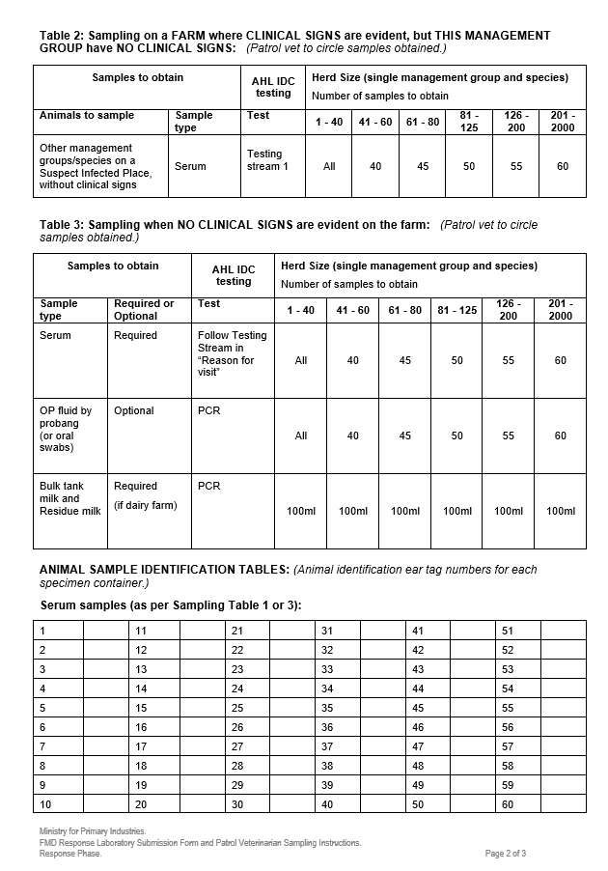
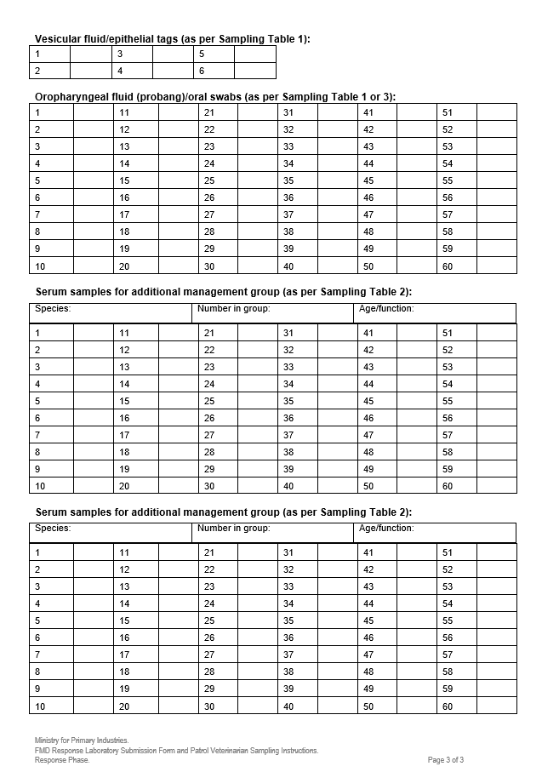
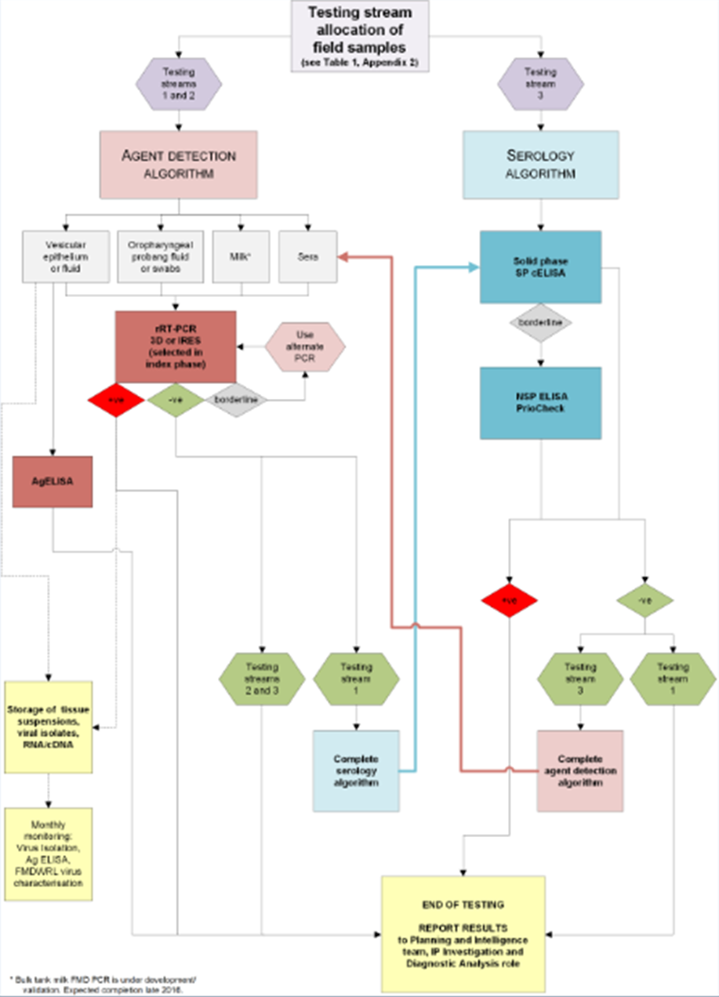
Diagnostic Surveillance Strategy – Eradication phase
Consisting of:
A property risk categorisation and priority determined by the planning team
An FMD submission form (electronic and integrated into LIMS) which instructs vets which sample types and how many to take, and records presence/absence of clinical signs
One of 3 testing streams assigned to each property before the samples arrive at the laboratory
= Testing is targeted per property for the highest likelihood of virus or antibody based on exposure risk timing and type and presence/absence of clinical signs.

Slide 4
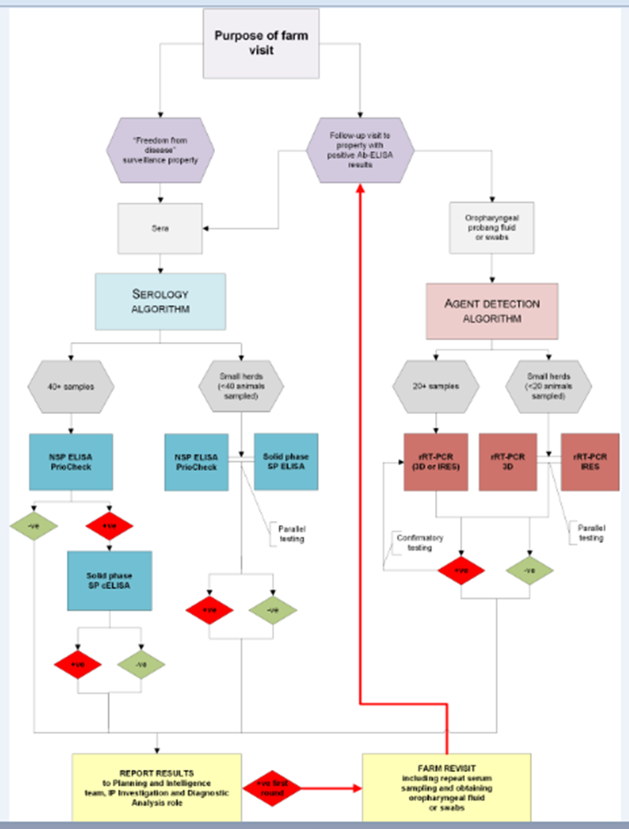
Diagnostic Surveillance Strategy – POF phase
Based on OIE guidelines for statistical confidence in diagnostic results, taking into account test sensitivities and specificities and calculated sample numbers.
Serological testing with positive results followed up.
DIVA testing algorithm for vaccinated animals as well.

Slide 5
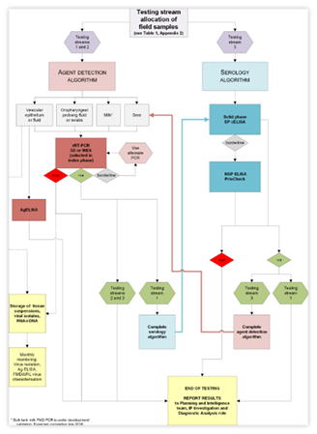
Laboratory Capacity Modelling
Combination of process simulation and outbreak scenario modelling.
Process simulation involves breaking the testing algorithms down into every step and assigning parameters of resources, personnel, and times to each of those steps.
For example, this test involves:
Sample reception (many steps);
PC3 sample processing (many steps);
and the SP ELISA test itself:
MPI AHL FMD Eradication Phase Testing Algorithm

Slide 6
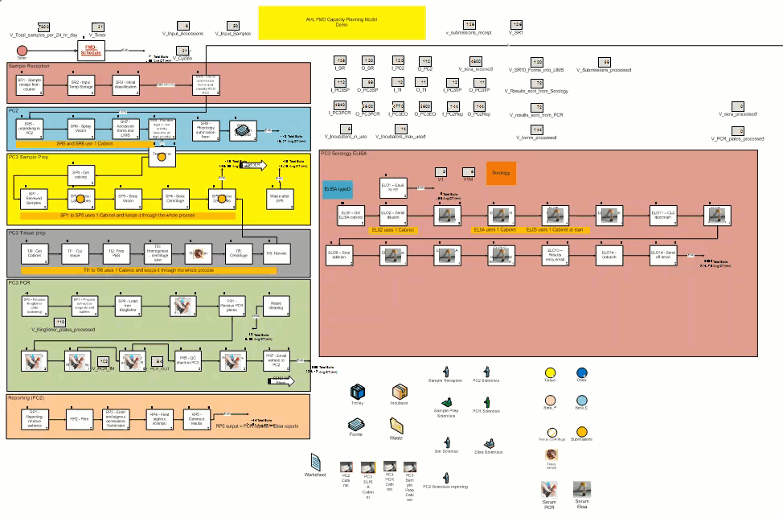
Process modelling
The outputs are measured and adjustments to resources can be made to see their effect.
Software: ‘Process Simulator’ (ProModel Corporation, USA).

Slide 7
Objectives (Understanding capacity)
Laboratory capacity and resources
Identify:
the significant constraints and bottlenecks in the testing processes
resources, including staff, needed to overcome these and maximise efficiency and capacity
analyse whether additional high throughput machinery would significantly improve capacity
= with realistic resourcing, estimate the number of samples we can test per day.

Slide 8
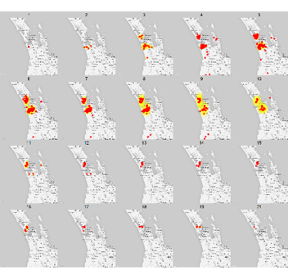
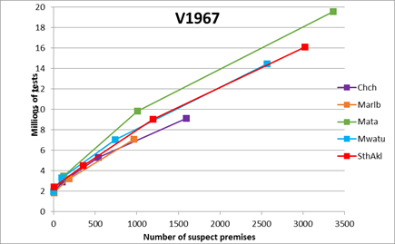
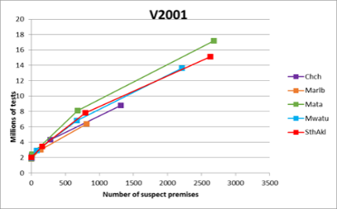
Objectives (Understanding demand)
Requiring epidemic simulation modelling and analysis as well:
Software: ‘InterSpread Plus’ (EpiSoft, Massey University, New Zealand)
To estimate:
the daily submitted volumes of samples for surveillance testing during different stages/sizes of an epidemic
the proportion of these that would be assigned to each arm of a testing algorithm
likely positive and negative rates (true and false) of samples submitted, and samples requiring confirmatory or further testing as specified in the algorithms

Slide 9

Objectives (Eradication phase)
Main aim for the Eradication phase:
Develop a prioritisation system to align the estimated submitted volume of samples per day with the laboratory capacity to test them.
Necessary so that the laboratory is not overwhelmed with samples and the diagnostic surveillance plan does not become compromised
An effective prioritisation system that allows for the most important properties for control of an outbreak to be tested, if surveillance samples exceed capacity
Define trigger points (e.g. number of IPs) for activating or standing down prioritisation systems.

Slide 10

Objectives (Proof-of-freedom phase)
For the proof-of-freedom phase, to answer the questions:
Using our estimates of testing demand and laboratory capacity, how long will proof-of-freedom testing take? Can we achieve it within the OIE’s 3 month minimum period?
At which trigger points might we outsource POF testing to regional laboratories?
Can we manage POF testing for a free zone at the same time as outbreak control surveillance, if this policy was adopted by the OIE?

Slide 11
Objectives (Vaccination and DIVA testing)
Using epidemic scenario modelling with vaccination compared to without, in conjunction with capacity modelling for DIVA testing:
What is our estimate for the additional demand on the laboratory for DIVA testing if vaccinate-to-live is adopted, and will this extend the time (beyond the current 6 month minimum) before we could make a claim for freedom with vaccination?
If the OIE policy on this vaccinate-to-live stand-down time was reduced to 3 months, would we be able to complete DIVA and POF surveillance testing during this time?
Would the additional DIVA testing time and resources be likely to be offset by a reduced epidemic size and duration from vaccination (so less eradication phase testing)?

Slide 12
Objectives (Vaccination and DIVA testing)
Important for informed policy decisions on vaccination:
consider alongside the other factors in vaccination decision-making
the possible implications of vaccinate-to-live on the length of time the country cannot trade while POF diagnostic surveillance is completed (if it exceeds the stand-down period)
avoid a worst case scenario of adopting vaccinate-to-live without this information, during POF testing finding we do not have capacity to conduct DIVA testing without an extended delay -> change to vaccinate-to-die (reputational risks, disposal and compensation costs), or having to manage an unforeseen delay in return to trade?

