Slide 1
ORGANISATION OF RAW MILK COLLECTION DURING A FMD-OUTBREAK
Y. Tempelman

Slide 2
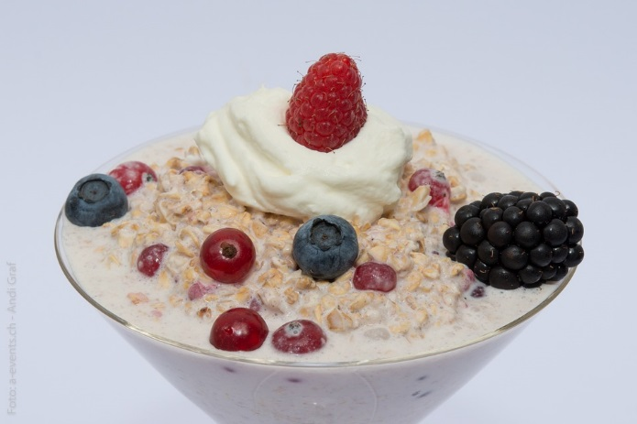
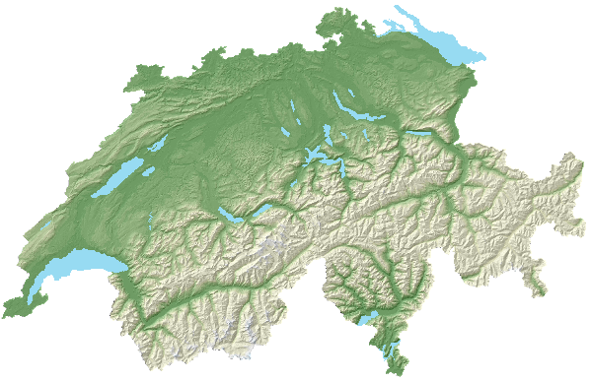
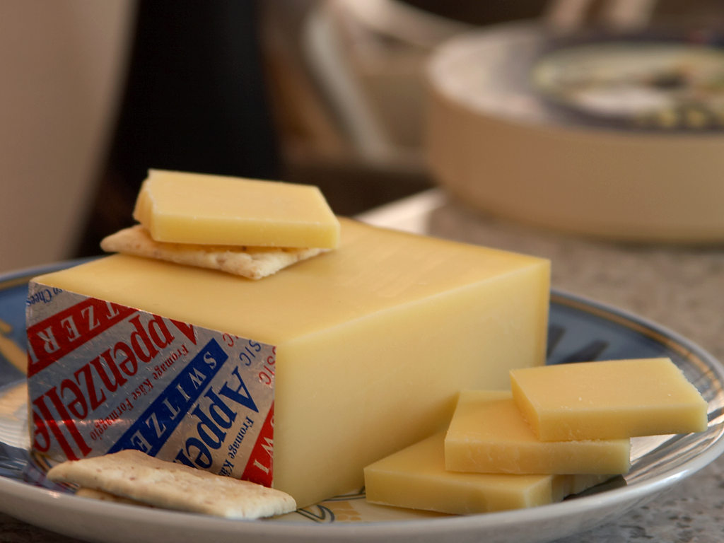
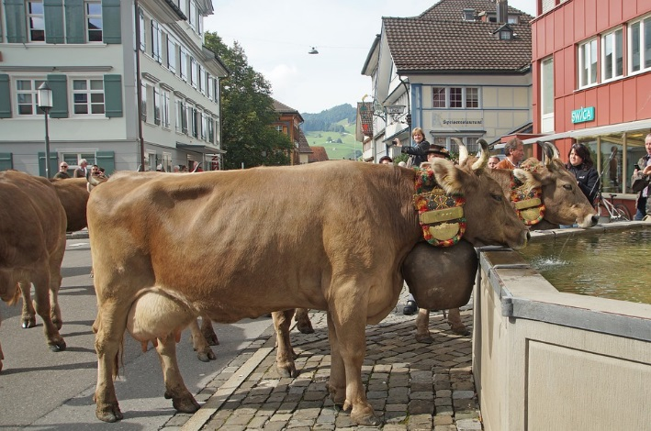
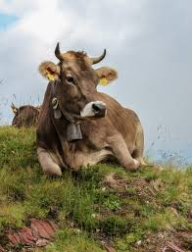
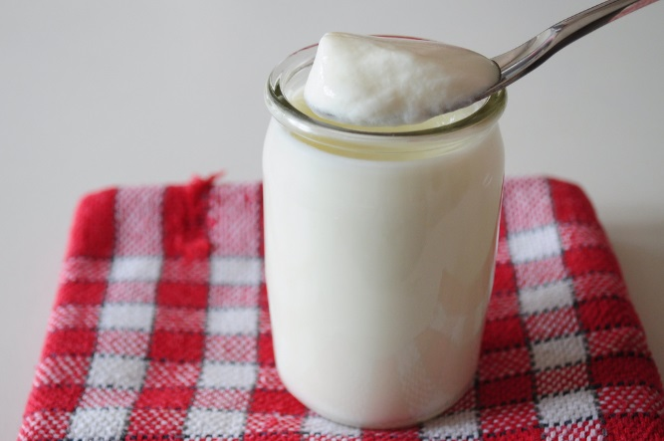
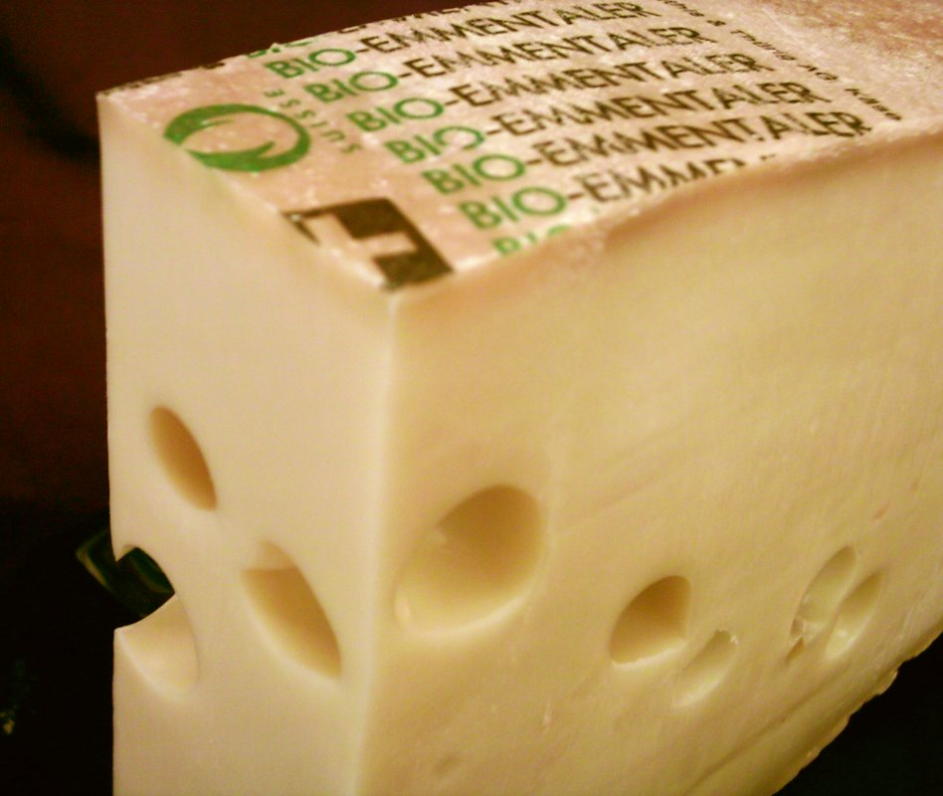
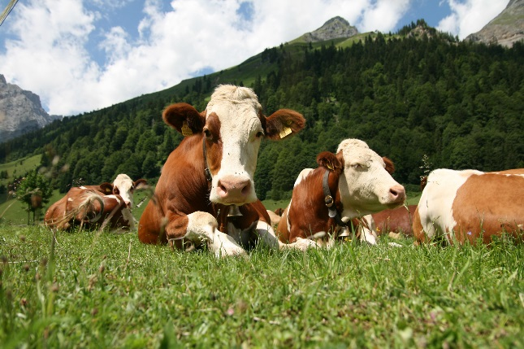
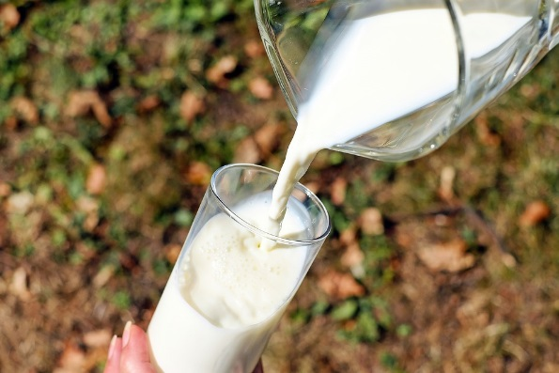
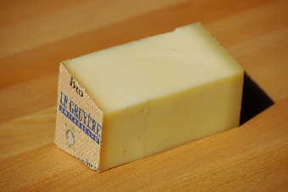
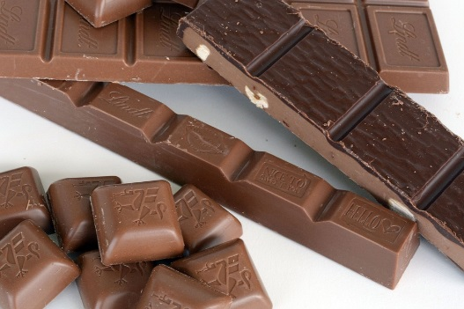
Switzerland has a long and important tradition in dairy farming …
By PDPhoto.org
CC BY-SA 3.0
by fred_v
By © Rolf Krahl / CC BY-SA 3.0 DE

Slide 3
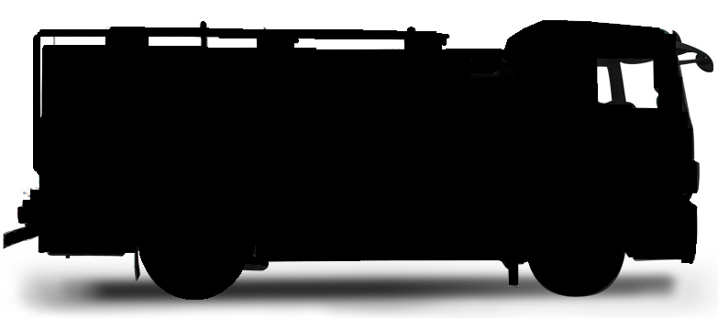
The structures of the Swiss dairy market are complex and highly dynamic:
23’500 dairy farms
Milk collection on the farm
Large dairy plants
Milk delivery in collection centre or cheese dairy
Cheese dairies
Milk collection centres

Slide 4
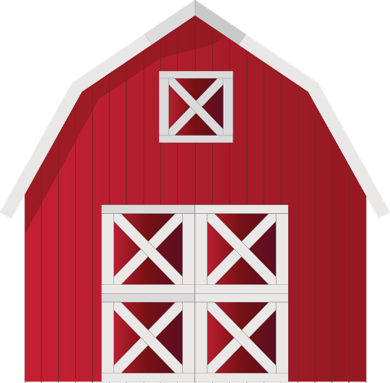
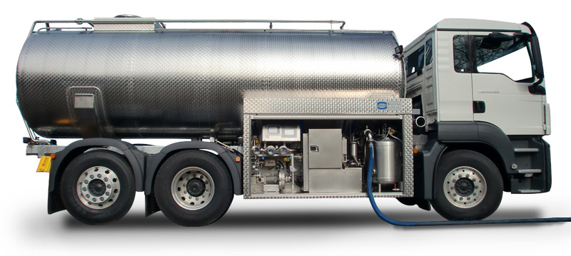
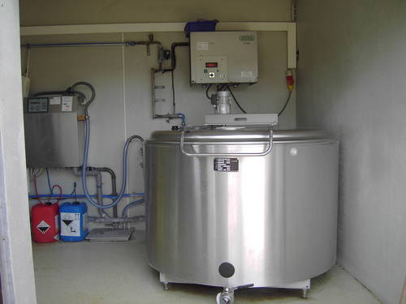
New fmd milk collection concept in Switzerland
Why is it important to control raw milk collection and the trade and transport routes of milk during a fmd outbreak?
Raw milk of affected animals is contagious!
fmd virus can spread through milk trucks or circulate through contacts at milk collection centres or dairies.

Slide 5
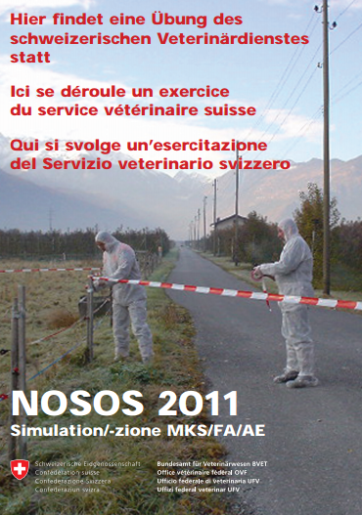
New fmd milk collection concept in Switzerland
During the national fmd exercise «NOSOS2011» the control of milk trade during an outbreak was identified as one of the major points to be solved.

Slide 6
New fmd milk collection concept in Switzerland
In mai 2014 a working group was established to develop a «milk collection concept» for fmd.
- Headed by the FSVO
- Three cantonal veterinary services
- Four industry representatives:
Dairy farmers
Dairy industry
Milk transport companies
Cheese dairies

Slide 7
New fmd milk collection concept in Switzerland
The first draft of the new fmd milk collection concept was completed by end of 2014.
It has since then…
been presented to various committees,
submitted to consultation, (cantonal veterinary offices and important stakeholders of the swiss dairy market)
and tested in a tabletop exercise. (with local players along the milk chain)
It is now being finalised and will be operative in 2017.
presented
consultation
tabletop exercise

Slide 8
First measures in case of a fmd outbreak…
?

Slide 9
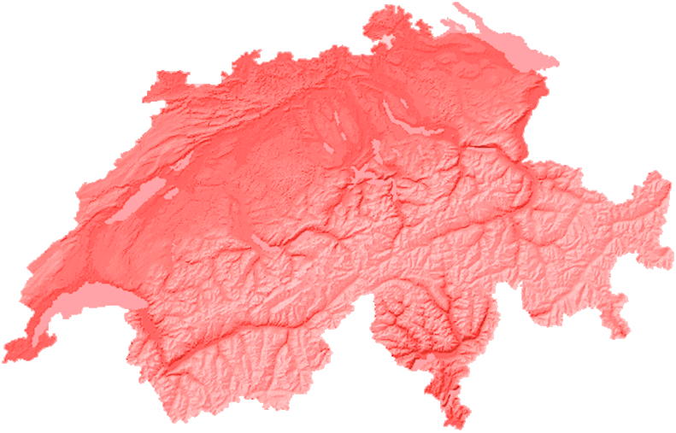
First measures in case of a fmd outbreak…
Standstill
 Stop the spread of the virus !

Slide 10
First measures in case of a fmd outbreak…
Standstill
Get a grip on the situation. Get an overview.

Slide 11
First measures in case of a fmd outbreak…
Standstill
Define the protection and surveillance zones.

Slide 12
First measures in case of a fmd outbreak…
Standstill
Prepare / organise transport conditions for animals and goods in the zones.

Slide 13
First measures in case of a fmd outbreak…
Standstill
How long …?
Depending on the situation… but at least 72 hours !
at least

Slide 14
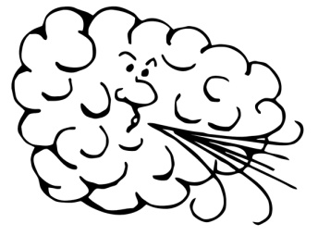
Basic principles of the new fmd milk collection concept :
1.
 After culling all animals and cleaning/disinfection of the farm, risk of virus spreading should be small.
Some basic principles…
1.
Interrupt ALL transmission paths of the virus.
ALL
Standstill

Slide 15
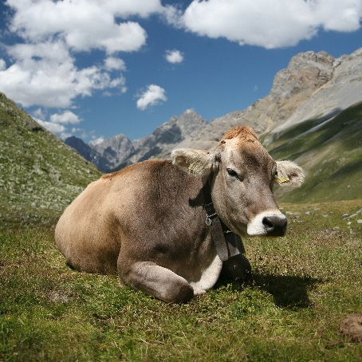
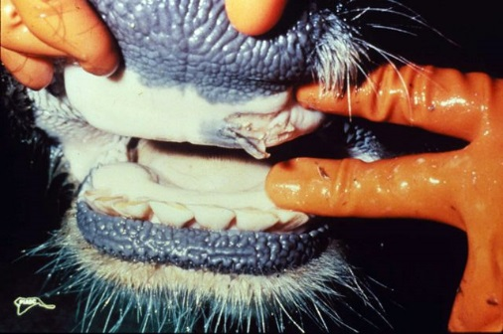
Basic principles of the new fmd milk collection concept :
2.
Wait for 7 days after all animals have been culled and 3 days after cleaning/disinfection of affected farms.
 By the end of the incubation period of fmd for cattle clinical signs should appear on infected farm.
2.

Slide 16
Basic principles of the new fmd milk collection concept :
3.
Milk collection on farms can now resume, with a variety of safety measures in restriction zones.
 You should have a first sufficiently good overview on which farms are affected and which are not.
3.
restriction zones
which farms are affected and which are not

Slide 17
Basic principles of the new fmd milk collection concept :
All major stakeholders of the dairy sector have agreed to this new approach.
Recap
1.
Stop all transmission paths of the virus.
2.
Let the incubation period for cattle pass
after culling all animals and cleaning/disinfecting affected farms.
3.
Resume milk collection
under secure conditions in the restriction zones.

Slide 18
The structure of the new fmd milk collection concept :
The fmd milk collection concept is structured such as to reflect the duties and responsi- bilities of four groups of actors in the milk chain:
The Veterinary Services
Milk producers / dairy farmers
Milk merchants / milk transporters
Dairy industry / cheese dairies
The annex of the concept contains specific checklists and instruction leaflets for these groups.
four groups of actors
checklists and instruction leaflets

Slide 19
FMD-outbreak on a farm in Switzerland
Veterinary Services
Milk producers / dairy farmers
Milk merchants / milk transporters
Dairy industry / cheese dairies
1.
Counselling committee with stakeholders from the milk sector
Movement ban
Define the protection and surveillance zones
No milk delivery
No milk collection
No receiving of milk
Stop all transmission paths of the virus
Standstill
Killing and disposal
Information / instructions to the stakeholders
2.
Cleaning and disinfection
Let the incubation period pass
⬇ Wait for at least 7 days until all animals from FMD premises have been culled ⬇
Milk collection in protection zones
3.
Resume milk collection under secure conditions
Milk collection in surveillance zones

Slide 20
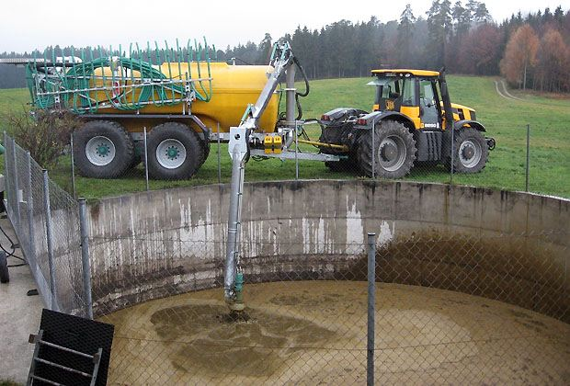
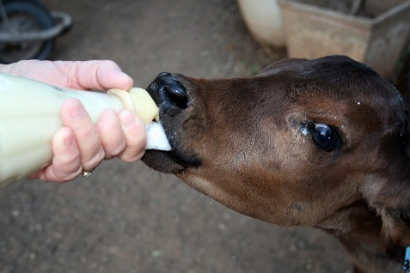
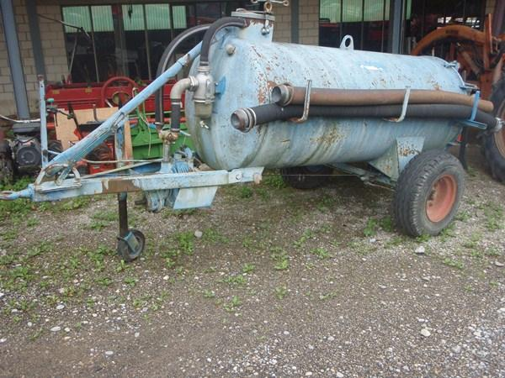
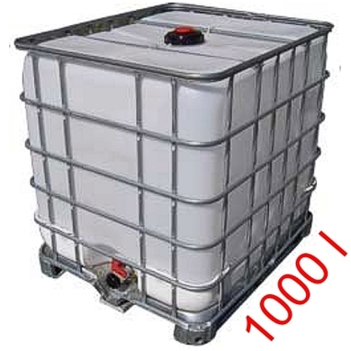
FMD-outbreak on a farm in Switzerland
Veterinary Services
Milk producers / dairy farmers
Milk merchants / milk transporters
Dairy industry / cheese dairies
Veterinary Services
Dairy industry / cheese dairies
1.
Counselling committee with stakeholders from the milk sector
Movement ban
Define the protection and surveillance zones
No milk delivery
No milk collection
No receiving of milk
Stop all transmission paths of the virus
Standstill
Killing and disposal
Information / instructions to the stakeholders
Storage of raw milk on the farm
2.
Cleaning and disinfection
Let the incubation period pass
⬇ Wait for at least 7 days until all animals from FMD premises have been culled ⬇
Potential solutions:
Milk collection in protection zones
- Feeding on the farm and reduction of milk production (premature dry cow treatment)
3.
- Pouring into cesspit
Resume milk collection under secure conditions
- Storage in approriate reservoirs:
· slurry tank (if available)
· water tanks
Milk collection in surveillance zones

Slide 21
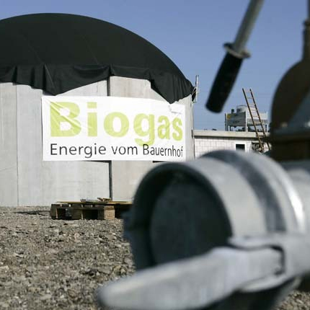
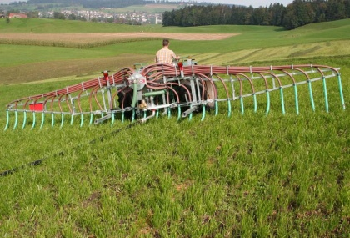
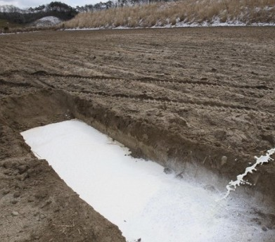
FMD-outbreak on a farm in Switzerland
Veterinary Services
Milk producers / dairy farmers
Milk merchants / milk transporters
Dairy industry / cheese dairies
1.
Counselling committee with stakeholders from the milk sector
Movement ban
Define the protection and surveillance zones
No milk delivery
No milk collection
No receiving of milk
Stop all transmission paths of the virus
Standstill
Killing and disposal
Information / instructions to the stakeholders
Storage of raw milk on the farm
Potential solutions:
2.
Cleaning and disinfection
Let the incubation period pass
⬇ Wait for at least 7 days until all animals from FMD premises have been culled ⬇
- Spreading on the fields (under certain conditions)
- Valorising in local biogas plants
Milk collection in protection zones
(- Pouring in a pit)
3.
Resume milk collection under secure conditions
Safe disposal of raw milk
Milk collection in surveillance zones

Slide 22
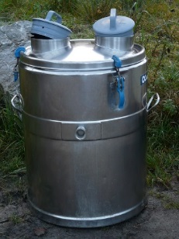
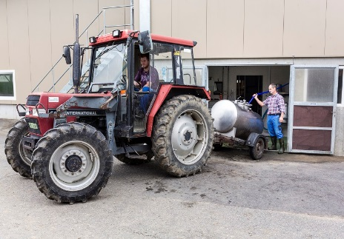
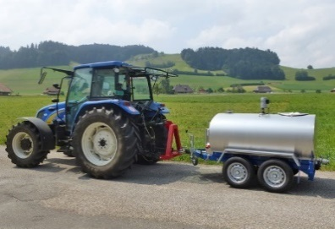
FMD-outbreak on a farm in Switzerland
Veterinary Services
Milk producers / dairy farmers
Milk merchants / milk transporters
Dairy industry / cheese dairies
1.
Counselling committee with stakeholders from the milk sector
Movement ban
Define the protection and surveillance zones
No milk delivery
No milk collection
No receiving of milk
Stop all transmission paths of the virus
Standstill
Killing and disposal
Information / instructions to the stakeholders
Storage of raw milk on the farm
2.
Cleaning and disinfection
Let the incubation period pass
⬇ Wait for at least 7 days until all animals from FMD premises have been culled ⬇
Milk collection possible?
Milk cans/tank trailers available on farm?
Milk collection in protection zones
Clarifications on dairy farms by official veterinarian
Yes
Yes
3.
No
No
Installing of a hand-over point
Resume milk collection under secure conditions
Milk collection only directly from farm
Safe disposal of raw milk
Safe disposal of raw milk
Delivery in collection centre / cheese dairy?
Milk delivery in compliance with the instructions of the Veterinary Services
Milk collection in surveillance zones
Yes
No
Milk collection according to the instructions of the Veterinary Services

Slide 23
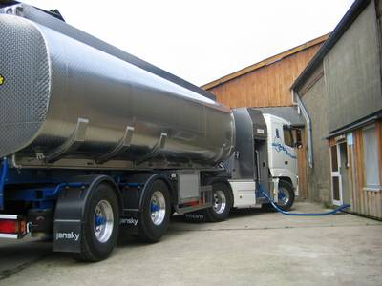
FMD-outbreak on a farm in Switzerland
Veterinary Services
Milk producers / dairy farmers
Milk merchants / milk transporters
Dairy industry / cheese dairies
1.
Counselling committee with stakeholders from the milk sector
Movement ban
Define the protection and surveillance zones
No milk delivery
No milk collection
No receiving of milk
Stop all transmission paths of the virus
Standstill
Killing and disposal
Information / instructions to the stakeholders
Storage of raw milk on the farm
Application for milk collection in protection zones
Application for receiving and processing milk from protection and surveillance zones
2.
Cleaning and disinfection
Let the incubation period pass
⬇ Wait for at least 7 days until all animals from FMD premises have been culled ⬇
Organising / conducting training
Dealing with/ treating applications
Milk collection possible?
Milk cans/tank trailers available on farm?
Permission obtained?
Permission obtained?
Clarifications on dairy farms by official veterinarian
Yes
Yes
No
No
Milk collection in protection zones
No
No
Yes
Yes
3.
No milk collection
No receiving of milk from restriction zones
Installing of a hand-over point
Resume milk collection under secure conditions
Milk collection only directly from farm
Milk collection according to instructions set by Veterinary Services
Milk from restriction zones must be pasteurised
Safe disposal of raw milk
Permission obtained?
Delivery in collection centre / cheese dairy?
Milk delivery in compliance with the instructions of the Veterinary Services
Milk collection according to instructions set by Veterinary Services
No
Milk collection in surveillance zones
Yes
No receiving of milk from restriction zones
Yes
No
Milk collection according to the instructions of the Veterinary Services
Milk from restriction zones must be pasteurised

Slide 24
Next steps
FMD-outbreak on a farm in Switzerland
Veterinary Services
Milk producers / dairy farmers
Milk merchants / milk transporters
Dairy industry / cheese dairies
1.
Counselling committee with stakeholders from the milk sector
Movement ban
Define the protection and surveillance zones
No milk delivery
No milk collection
No receiving of milk
Stop all transmission paths of the virus
Standstill
Killing and disposal
An important principle of the fmd milk collection concept is preparedness:
Crisis management concepts and contingency plans
Regular, regional contacts between the cantonal Veterinary Services and the local actors of the dairy sector
Information / instructions to the stakeholders
Storage of raw milk on the farm
Application for milk collection in protection zones
Application for receiving and processing milk from protection and surveillance zones
preparedness
2.
Cleaning and disinfection
Let the incubation period pass
⬇ Wait for at least 7 days until all animals from FMD premises have been culled ⬇
Organising / conducting training
Dealing with/ treating applications
Organising / conducting training
Dealing with/ treating applications
Milk collection possible?
Milk cans/tank trailers available on farm?
Permission obtained?
Permission obtained?
Clarifications on dairy farms by official veterinarian
Yes
Yes
No
No
Milk collection in protection zones
No
No
Yes
Yes
3.
No milk collection
No receiving of milk from restriction zones
Installing of a hand-over point
Resume milk collection under secure conditions
Milk collection only directly from farm
Milk collection according to instructions set by Veterinary Services
Milk from restriction zones must be pasteurised
Safe disposal of raw milk
Permission obtained?
Delivery in collection centre / cheese dairy?
Milk delivery in compliance with the instructions of the Veterinary Services
Milk collection according to instructions set by Veterinary Services
No
Milk collection in surveillance zones
Yes
No receiving of milk from restriction zones
Yes
No
Milk collection according to the instructions of the Veterinary Services
Milk from restriction zones must be pasteurised

Slide 25
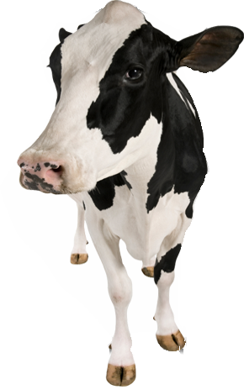
Thank you for your attention.

Slide 26
Questions:
yuval.tempelman@blv.admin.ch

