Slide 1


Non-geographic approaches to FMD risk management
Gavin Thomson
(gavin@tadscientific.co.za)
EuFMD Commission – Open session
Cascais, Portugal; 26 October 2016

Slide 2
Management of infectious diseases
Depends on 3 crucial factors:
the epidemiology of the disease
the ease and accuracy of detection (diagnosis and surveillance)
effective intervention measures (bearing cost and practicality in consideration)
Corollary: If these factors collectively differ significantly between different forms of the same disease, the measures used against each form also need to differ
Finding: Statistically significant differences in these respects – individually & collectively – have been shown to exist between the Eurasian & SAT serotypes of FMDV, in southern Africa at least (Thomson et al., 2015)
We are therefore attempting to develop more regionally appropriate approaches to management of SAT infections in southern Africa
Two sets of guidelines in preparation in association with FAO Sub-Regional Office, Harare: Intended to complement existing international guidelines
  Regional guideline for commercial beef enterprises located in FMD endemic areas of southern Africa
  (2) Management of SAT serotype FMD in southern Africa

Slide 3
  Beef guideline
Decision tree contained in ‘Regional guideline for commercial beef enterprises located in FMD endemic areas’
To be released for comment next week; interested? If so, send e-mail to Shirley Atkinson (satkinson@wcs.org)
Take-home message: A number of potential non-geographic FMD management & risk strategy combinations exist for ‘safe’ beef production, i.e. attainment of ‘an appropriate level of protection’ (ALOP)

Slide 4
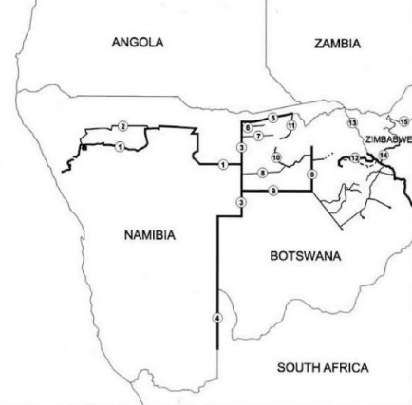
  Geographic vs non-geographic management of FMD in southern Africa
Geographic management of FMD in southern Africa (creation of FMD-free countries and zones, i.e. regional freedom) has provided economic benefit but has also been environmentally costly & has resulted in socio-economic injustice (also generally unsuccessful, particularly since turn of 21st Century – Thomson et al. 2013a; Maree et al., 2014)
Non-geographic methods can be effective in managing FMD but are ‘less costly’; therefore more appropriate and sustainable (Barnes, 2013; Cassidy et al., 2013)
However, understanding of non-geographic approaches is complicated by poorly understood concepts and confusing terminology
Cordon fences for the control of FMD in Botswana & Namibia
Cordon fences for the control of FMD in Botswana & Namibia

Slide 5
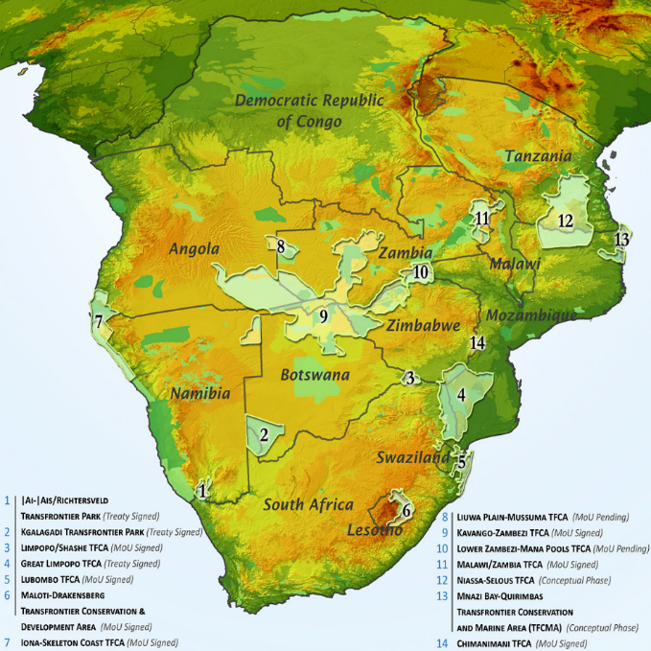
  Wildlife conservation in southern Africa
Eighteen transfrontier conservation areas (TFCAs) under development – although few changes on the ground as yet
Objective: Creation of multiple land-use areas with emphasis on bio-diversity conservation with tourism as the economic driver
includes restitution of wildlife migration routes involving wildlife movement across country borders (mobility of both livestock & wildlife vital in semi-arid environments)
Largest TFCA (KAZA – 9) is size of France, involves parts of 5 countries, home to 1.5 million people and their livestock, ¼ million elephants and some of the world’s most remarkable wetlands
Co-existence of livestock & wildlife in TFCAs is vital for future rural development in southern Africa (Thomson et al., 2013a)
TFCAs (also referred to as ‘Peace Parks’): Undoubtedly the most significant wildlife conservation initiative in the last half century!
However, TFCAs potentially complicate management of SAT serotype FMD!

Slide 6
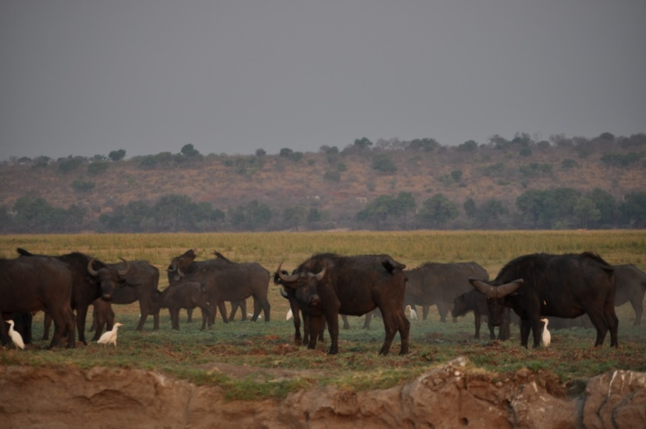
  SAT infections – distinguishing features
Asia 1
Eurasian lineage
O
C
Evidence is that in sub-Saharan Africa SAT serotype FMDVs & buffalo (Syncerus caffer) populations co-evolved over the last ≈ 1000 years (distinct from the Eurasian lineage)
Infection characterised by:
Frequency of mild disease and unapparent infection in both wildlife and livestock (Vosloo & Thomson, 2017)
Usually slow and inefficient cattle-to-cattle transmission (Du Toit, 1932)
Vaccine efficacy compromised by greater antigenic diversity within SAT serotypes; difficult to ‘match’ SAT viruses with available vaccines (Maree et al., 2014)
  field isolates also difficult to adapt as vaccine strains
‘SAT X’
A
SAT 3
SAT lineage
SAT 2
SAT 1
These factors render regional elimination of SATs from southern Africa difficult and complicated (Thomson et al., 2015)

Slide 7
Non-geographic methodologies for TADs risk management
Compartmentalisation (?)
‘Inherent safety’ of commodities
Pathogen inactivation
Commodity-based trade (CBT )
Hazard analysis critical control points (HACCP – mainly applied for FS assurance)
Some of these terms overlap or are apparently contradictory; therefore confusing
}
Apparently covers OIE interpretation of CBT
― No OIE definition
We proposed a wide definition facilitating value chain application (Thomson et al., 2013b)
Shown that HACCP & CBT are conceptually similar but HACCP has advantage of having an implementation mechanism, i.e. CCPs adaptable to value chain application (Thomson et al., 2013b)
CCPs can equally be applied to management of TADs risks (FAO, 2011 & others)
For beef value chains, primary FMD risk mitigator is post-mortem pH change that inactivates FMD viruses (Henderson & Brooksby, 1948)
  – essentially matured (pH <6), deboned beef with lymph nodes removed is a ‘very safe product’ (Paton et al., 2010)!

Slide 8
WTO’s Sanitary & Phyto-sanitary Committee
IPPC
World Organisation for Animal Health (OIE)
Codex Alimentarius Commission (CAC)
Conceptual similarity between HACCP & CBT (Thomson et al., 2013b)
Terrestrial Animal Health Code & AAHC
(animal disease safety)
Codex Alimentarius
(food safety)
Geographic freedom
Compartmentalisation • HACCP
CBT
Risk/hazard management methodologies
Institutional arrangements on which international trade standards for food safety- & animal disease risk are based

Slide 9
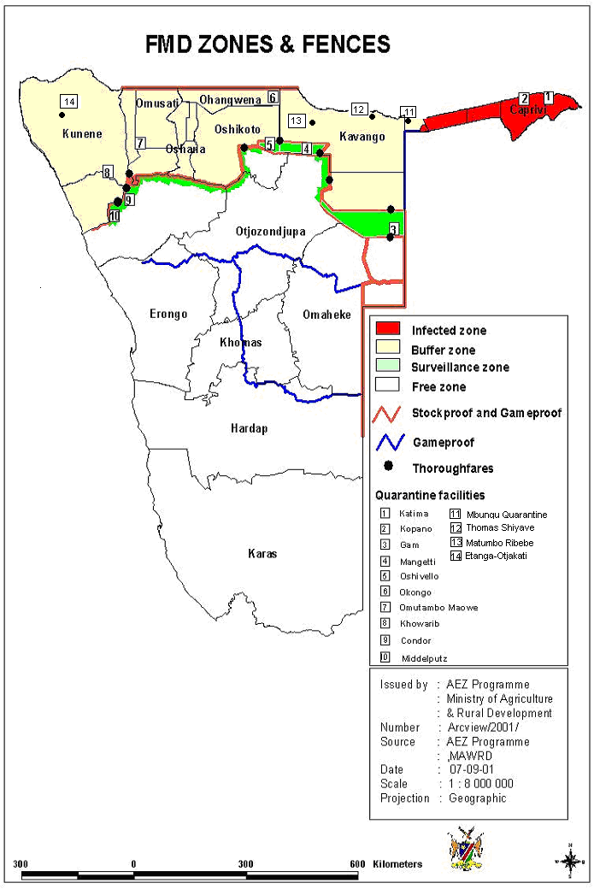
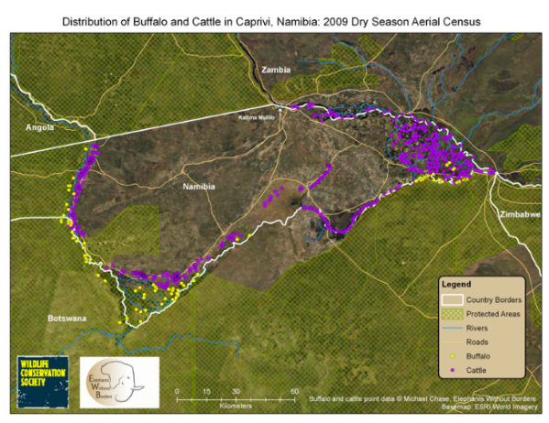
Application: Zambezi Region (ZR) of Namibia
Pilot project (2010-2014) aimed at showing that beef produced in the Zambezi Region can be rendered safe in respect of FMD (achievement of ALOP) ⇨ access to regional and international markets
Geographically-based FMD control systems cannot be applied because buffalo cannot be separated from cattle in this region (ZR is at the centre of the KAZA TFCA)
System adopted was risk management of FS and animal disease (FMD primarily) along the entire value chain using CCPs where possible
Project headed by Meat Board of Namibia, funded by the Millennium Challenge Account – Namibia (MCC USA)

Slide 10
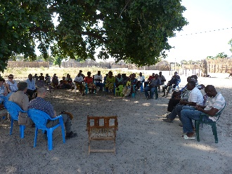
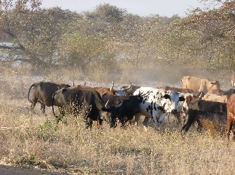
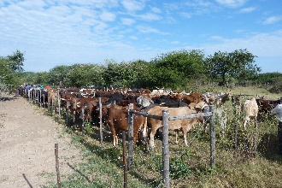
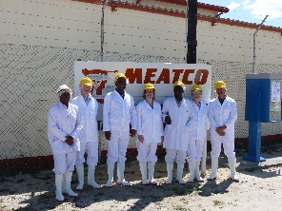
The Zambezi Region (Namibia) beef value chain
Inputs
Suppliers – feed, drugs, finance, MP
Veterinary Services, cattle minders
MeatCo plant, workers, admin & suppliers; Vet Services
MeatCo plant, workers, admin , & suppliers; Vet Services
Drovers, transporters
00
Cutting, packaging, storage & dispatch
ZR cattle producers
Transport to QS
Quarantine
Abattoir
Boxed chilled & frozen cuts of deboned beef for export
Very simple value chain

Slide 11
Integrated FMD & FS risk management in the ZR pilot project
CCPs

Slide 12
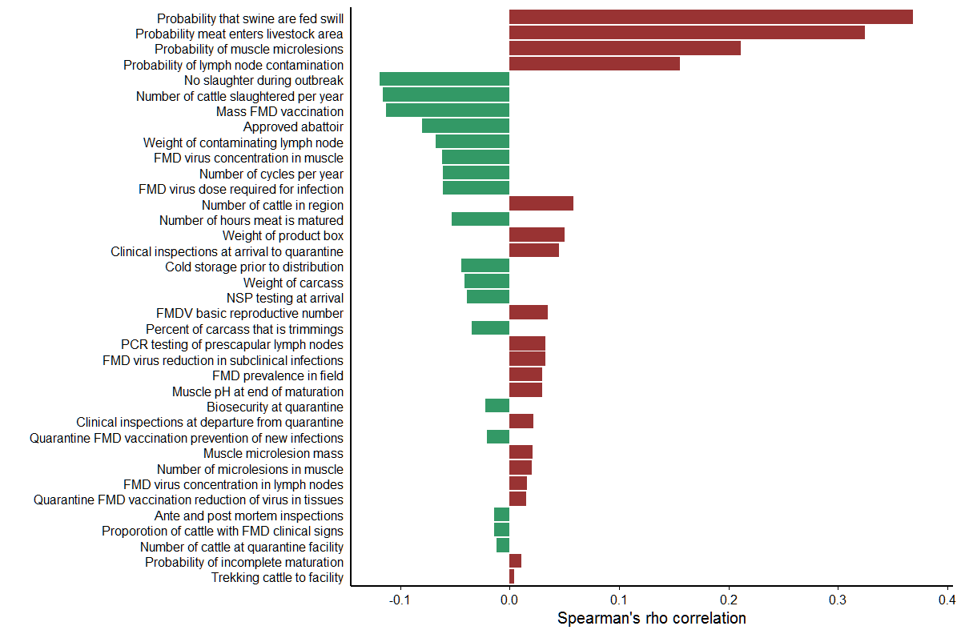
Proof of efficacy
A quantitative stochastic risk assessment that calculated the number of potential FMD outbreaks in a country importing such deboned beef that would occur when simulated over a million year period (Fosgate et al., in preparation)
Average risk varied between beef ‘cuts’ (depending primarily on likelihood of lymph node contamination): <1:10⁶ for 7/19 cuts assessed
Sensitivity analysis conducted on 37 factors that potentially affect the risk of beef produced by this value chain
Surprising findings provided by SA: some of the effects predicted were counter-intuitive
- shows determination of risk needs to be founded on more than ‘expert opinion’
Sensitivity analysis to determine correlation between the predicted risk of FMD outbreaks into an importing country with stochastic elements of the model
For example, ante- & post-mortem inspection at abattoir predicted not to provide significant risk reduction (due to potential sub-clinical infection)

Slide 13
Relevance to Article 8.8.22 of OIE’s TAHC
Article covers international trade in beef derived from cattle & domestic buffalo produced in areas not free of FMD but in which there is an official FMD control policy
Model used to assess the technical foundation of this article considering the two alternatives to clause 1.c (i.e. with or without quarantine) introduced in 2015
When the quarantine option of the current Article adopted, 7/19 beef cuts produced in the ZR represent an average risk-level ≤1: 10⁶
Therefore the approach adopted by the pilot project is (1) acceptably safe for these 7 cuts, (2) accords with a generally accepted safety level and (3) complies with requirements of the relevant international standard
Consequently a sound system exists by which commercial beef production in and around TFCAs in southern Africa and wildlife conservation can be accommodated

Slide 14
Conclusion
This represents progress towards resolution of a southern African conundrum dating back more than 50 years
Further pilot projects initiated or planned …… (circumstances can vary remarkably between locations)
Interestingly, other parts of the world are now interested in this approach ….

Slide 15
The team
Susanne Thalwitzer, Alexander Toto & Paul Strydom
  Meat Board, Namibia
Obed Kaatura & Berry Manda
  MeatCo, Namibia
Mark Atkinson, Steve Osofsky & Shirley Atkinson
  AHEAD Program of Wildlife Conservation Society
Geoff Fosgate
  University of Pretoria
Alec Bishi & Frank Chitate
  DVS, Namibia
Jacques van Rooyen
  University of Pretoria
Alberto Mancuso
  Insituto G Caporale, Teramo, Italy
Mary-Louise Penrith & Gavin Thomson
  TAD Scientific & University of Pretoria
Financial & institutional support
Millennium Challenge Account Namibia (MCC – USA)
Meat Board – Namibia
MeatCo ‒ Namibia
Directorate of Veterinary Services, Namibia
Wildlife Conservation Society
University of Pretoria
FAO Sub-regional Office, Zimbabwe

