Slide 1
ECONOMIC COSTS AND EFFECTS OF ACTIVITIES TO PREVENT FOOT AND MOUTH DISEASE IN DENMARK
S. Denver¹, L. Alban², A. Boklund³, T. Halasa³, H. Houe¹, S. Mortensen*⁴, E. Rattenborg⁵, T.V. Tamstorf², H. Zobbe¹, T. Christensen¹
1 University of Copenhagen.
2 Danish Agriculture & Food Council.
3 Technical University of Denmark.
4 Danish Veterinary and Food Administration.
5 SEGES- Knowledge centre for cattle production.

Slide 2
Materials and methods – determining costs
27 peacetime activities identified
Categorisation in 3 dimensions
  Prevent intro, early detection, limit spread/biosecurity, traceability, education
  Taxpayers, pig industry, cattle industry
  Legal, private standard, individual choice (economic or other reason)
Data from statistic reports, accounting systems, databases and expert opinion
Time cost, investment costs and consumables
Activities have multiple effects – share of cost default 25%

Slide 3
Materials and methods – determining costs
2013 | Cattle sector | Pig sector
Herds | 18,000 ( - 3,500 dairy) | 9,200 ( - 3,100 SPF farms)
Population | 1,6 million cattle | 12 million pigs
New-born | 638,000 calves | 28 million piglets
Slaughtered in Denmark | 489,000 cattle | 18,6 million finishers
Exported | 78,000 (most calves) | 9,2 million weaners
Imported | 459 cattle | 26 pigs
Movements between herds | 687,000 cattle | 795,000 batches of pigs
Trucks domestic transports | 53,300 trucks | 124,000 trucks
Trucks intl. Transports | 2,700 trucks | 22,000 trucks
..
….

Slide 4
Pigs €20 million
Cattle €8 million
State €4 million

Slide 5
Top 5 expenditures in euros

Slide 6
Expenditures by main effect (mill €)

Slide 7
The state: 3.5 mio. €
FMD lab: 2.9 mio. €
Border inspection: 0.2 mio. €
Cont plan / Simex: 0.2 mio. €
OIE, EUFMD and vacc bank: 0.1 mio. €
Models: 0.1 mio. €

Slide 8
Methods – simulation model: DTU-DADS
All epidemics started in a cattle herd in a cattle dense area
1000 epidemics simulated
1000 randomly chosen herds
Notes:
8

Slide 9
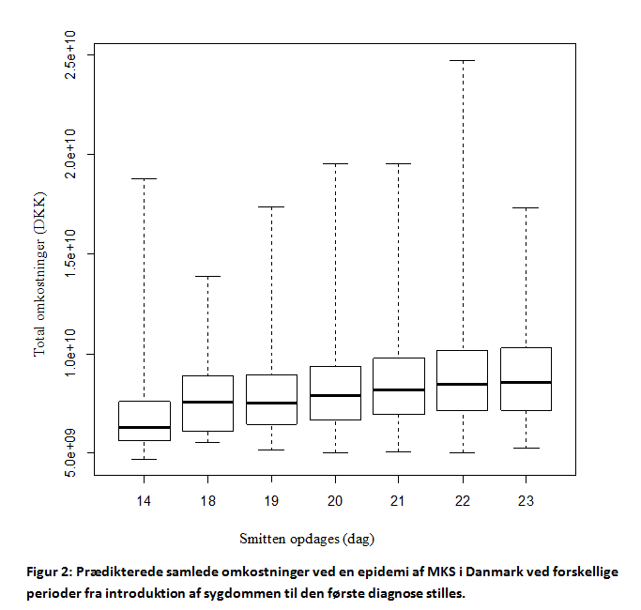
The importance of early detection
HRP from 21 days to 14 days
The duration of epidemics reduced by 50%
The number of outbreak farms reduced by 50%
€ 32 mio. saved per day
From € 1 billion to € 0.7 billion.
More suspects?
Samples taken and diagnostics used in farms?
More PCR’s?
More diagnostic surveillance?

Slide 10
Work load during an outbreak
Outbreak farms (killing capacity: 4800 pigs + 2000 cattle per day)
  Valuation
  Killing of animals
  Hygiene barriers for personel and trucks
  Rendering of animals
  Cleaning and disinfection
Suspect farms
  Clinical visits
  Identify contact farms
    Medium risk: vets and AI technicians 80% follow up
    Low risk: other visitors, trucks 30% follow up
  Take samples
Zone farms (capacity: 450 visits per day)
  Clinical surveillance
  Samples from sheep and goats

Slide 11
Better biosecurity in cattle farms
Effects of ressources for the contingency plan
50% less killing capacity
Reduced capacity to visit farms in zones within 7 days from 450/d to 100/d
Epi visit in 80% contact farms of low risk
Local risk reduction by 25% - effect of distance between farms

Slide 12
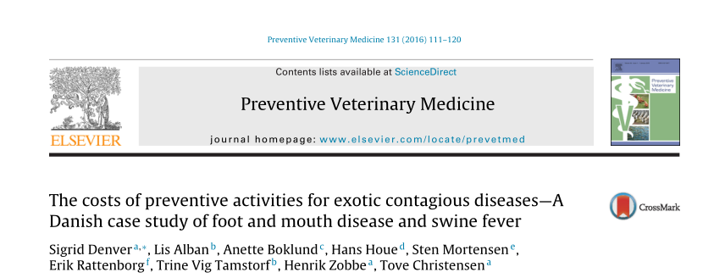
Conclusions
Combining epi-modelling with economic analysis
The costs are allready shared between private and public partners
By public spending cuts: FMD lab at risk
Improved method to prioritizing investments in Animal Health
Providing better data for policy/political discussions
More info: DOI: 10.1016/j.prevetmed.2016.07.010

