Slide 1
Enhanced potency and immunogenicity for cattle vaccinated with FMD A22 vaccine adjuvanted with oil and Poly I:C
Lloyd- Jones K., Mahapatra M, Herbert R, Parekh K, Babu A,
Paton D, Taylor G and Parida S*.
Vaccine Differentiation Group

Slide 2
Current FMD Vaccines and challenges for control
Killed inactivated vaccine
Not quick enough to induce protection
Short lived immunity
Not very stable
Does not give sterile immunity
Vaccinated animals may become infected with or without signs of disease
Notes:
The presence of FMDV specific IgA was previously shown to correlate well with the oro-pharyngeal virus replication in carrier animals.
It is therefore clear that the oro-pharyngeal IgA, along with systemic antibody is not sufficient for the clearance of an established infection.
Therefore an important question need to be addressed is whether a pre-existing IgA could prevent initial viral colonisation in oro-pharynx.
As the route of infection of FMDV is through aerosol, the understanding of mucosal immunity against FMDV is important. However, very little is known about the mucosal immunity against FMDV. Recently our group under the leadership of Satya Parida has been concentrating to study the importance of mucosal immunity against FMDV using two intranasal viral vector vaccines such as the sendai and adeno viral vectors containing FMDV empty capsid.
With this background The hypothesis of this project is whether a viral vector based vaccine containing FMD empty capsid delivered by intranasal route could stimulate local and systemic immune responses to block FMDV infection.

Slide 3
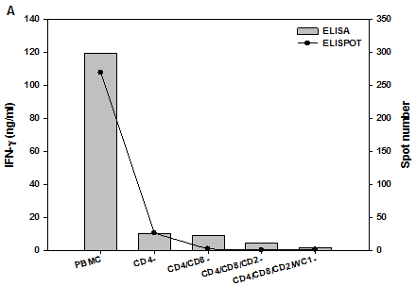
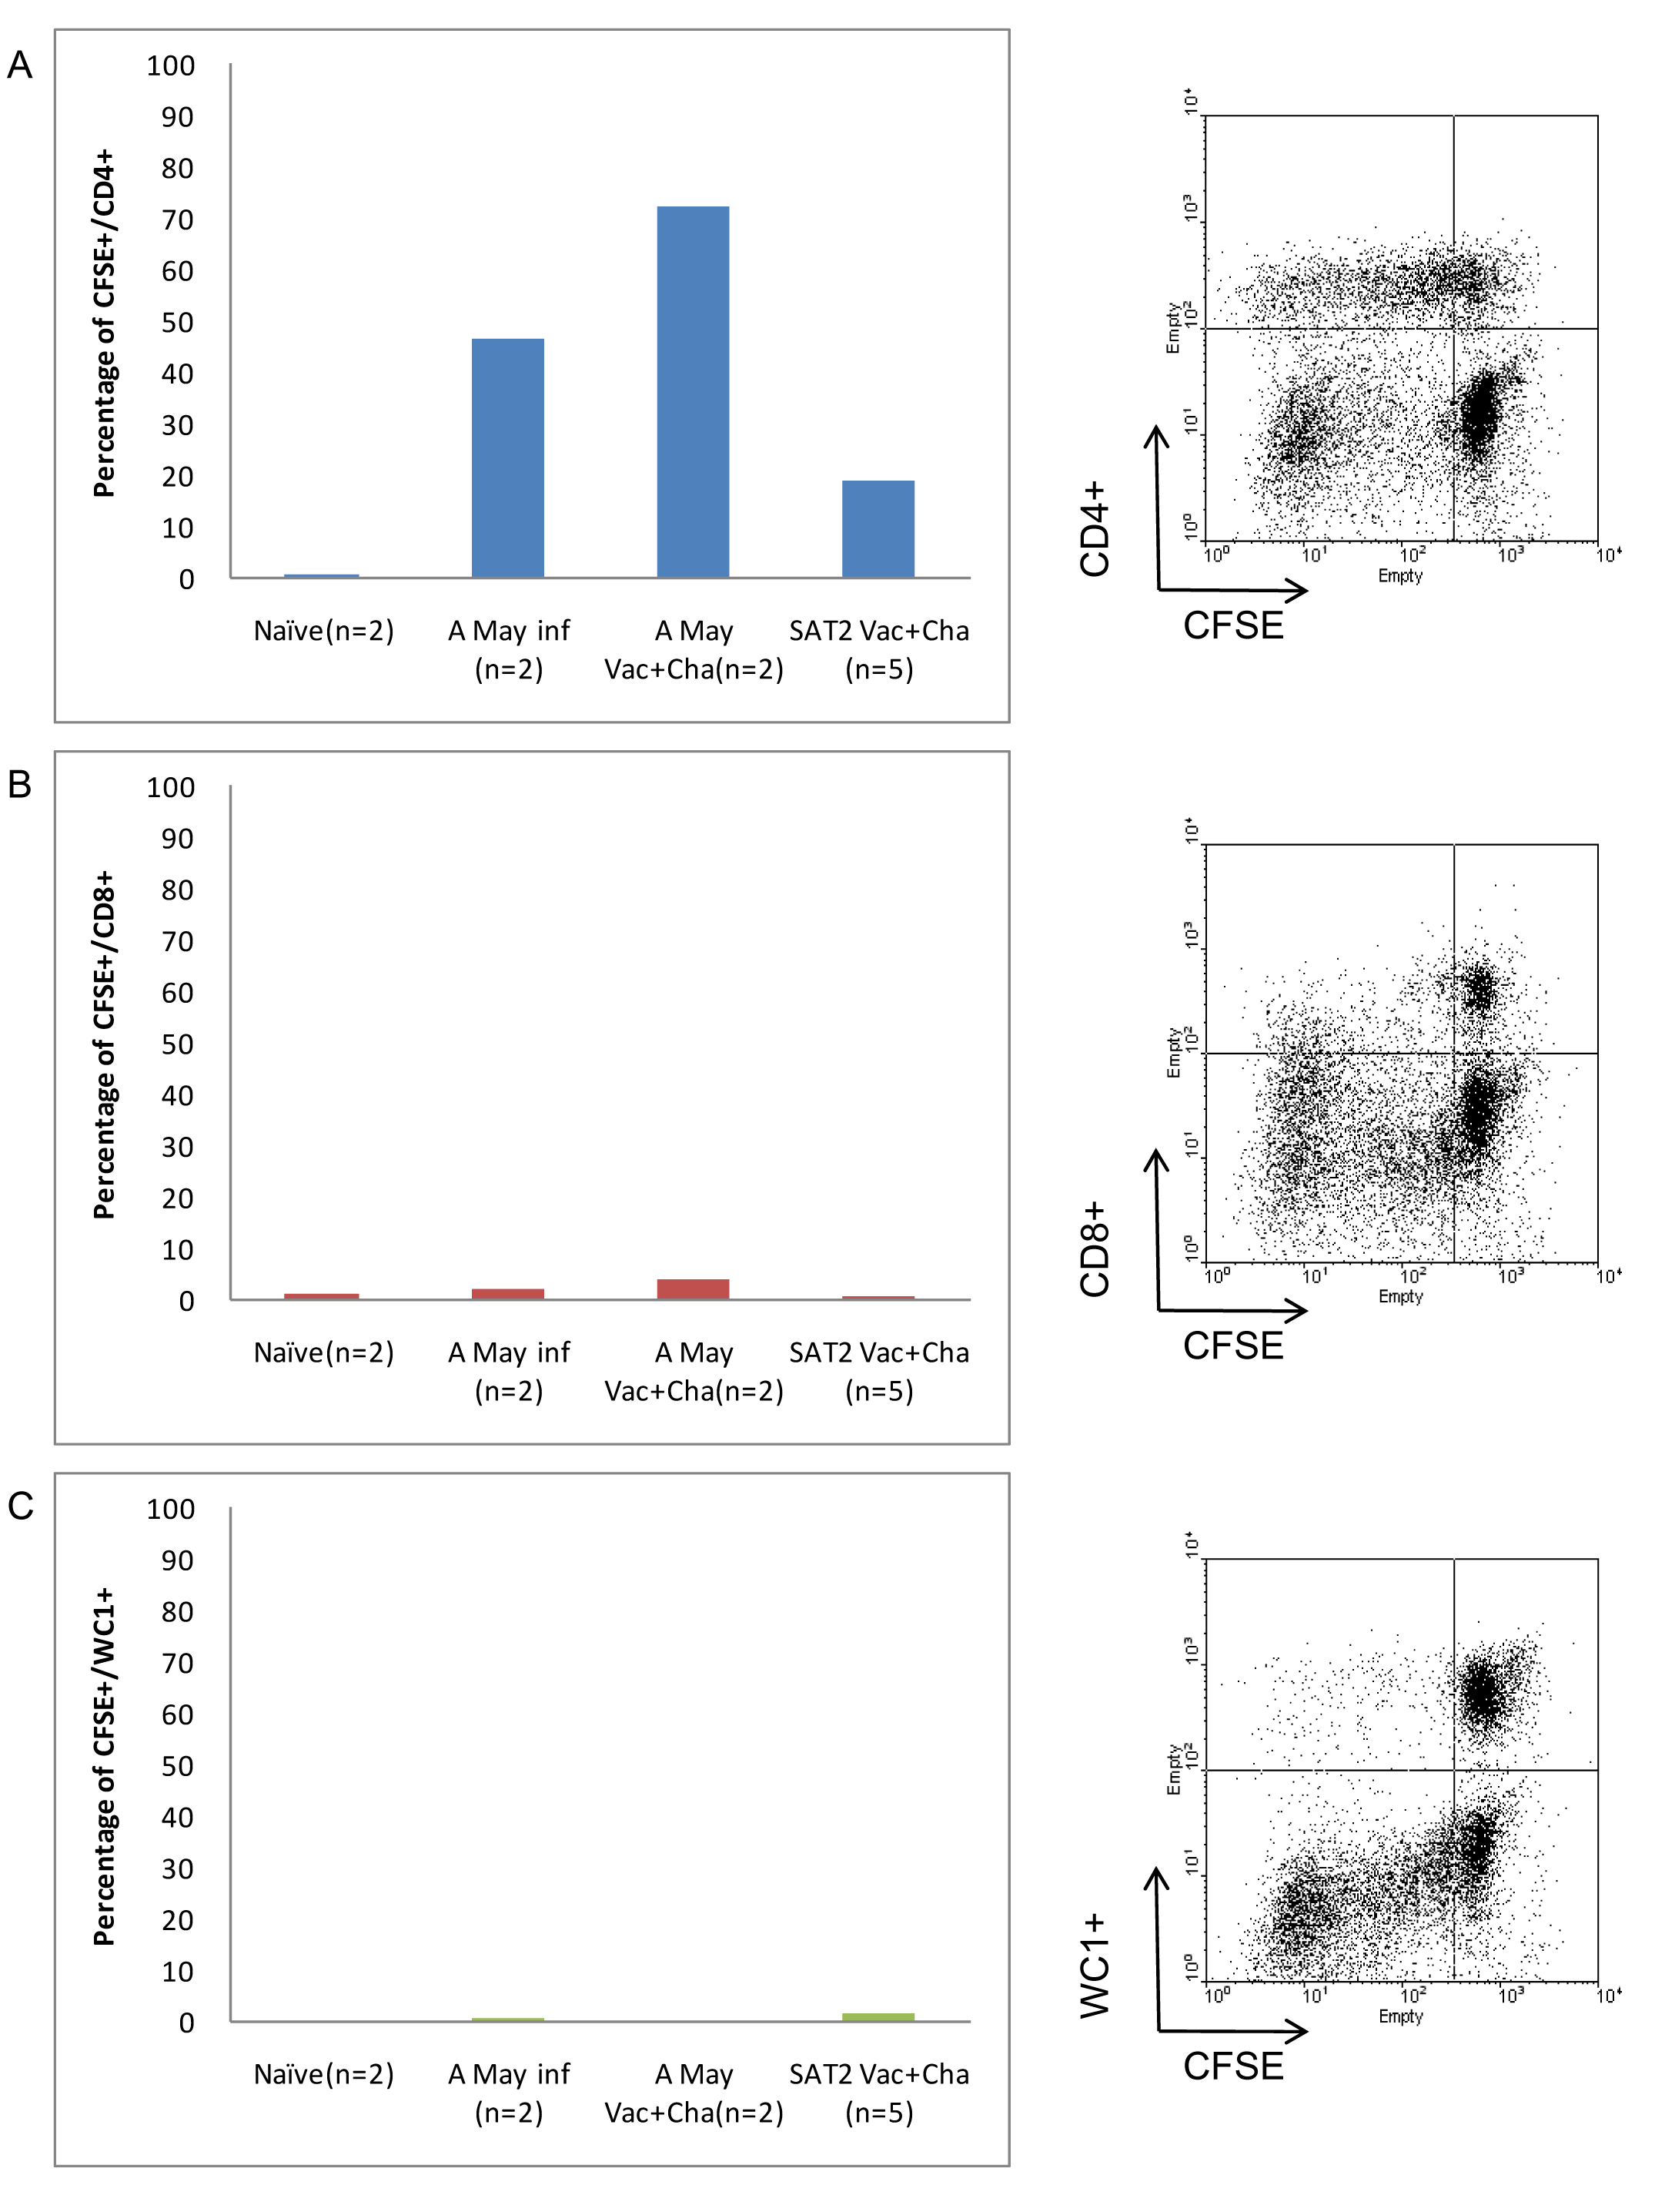
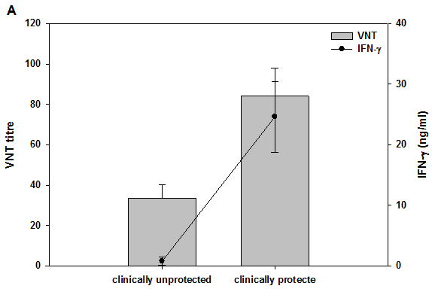
Current FMD vaccines ( A May 97 and SAT2)
Oh et al., 2012 Plos One

Slide 4
Question we need to address
Improvement of existing oil (ISA 206) adjuvanted vaccines by adding new adjuvants - to increase humoral and CMI (IFN-gamma up-regulation by CD4⁺ and CD8⁺ cells)?.

Slide 5






Adjuvant Trial Design
1.
Non-Vaccinate control cattle
2.
A22 Iraq+ ISA-206 control
3.
A22 Iraq+ ISA-206 + AbISCO adjuvant
4.
A22 Iraq+ ISA-206 + poly I:C adjuvant
5.
A22 Iraq+ ISA-206 + R848 adjuvant
6.
A22 Iraq+ ISA-206 + MPLA adjuvant
7.
A22 Iraq+ ISA-206 + R848+ MPLA adjuvant

Slide 6
Adjuvant Trial Timeline
A22 Iraq Vaccination + new generation adjuvant
(sub-optimal dose- 2 micro gram)
A22 Iraq FMDV Challenge
Cull
0
7
14
21
28
0
7
14
Days post vaccination
Days post challenge
Saliva and nostril swabs taken weekly
Blood: heparinised and clotted taken weekly
Rectal temperatures taken daily
Clinical symptoms scored daily

Slide 7
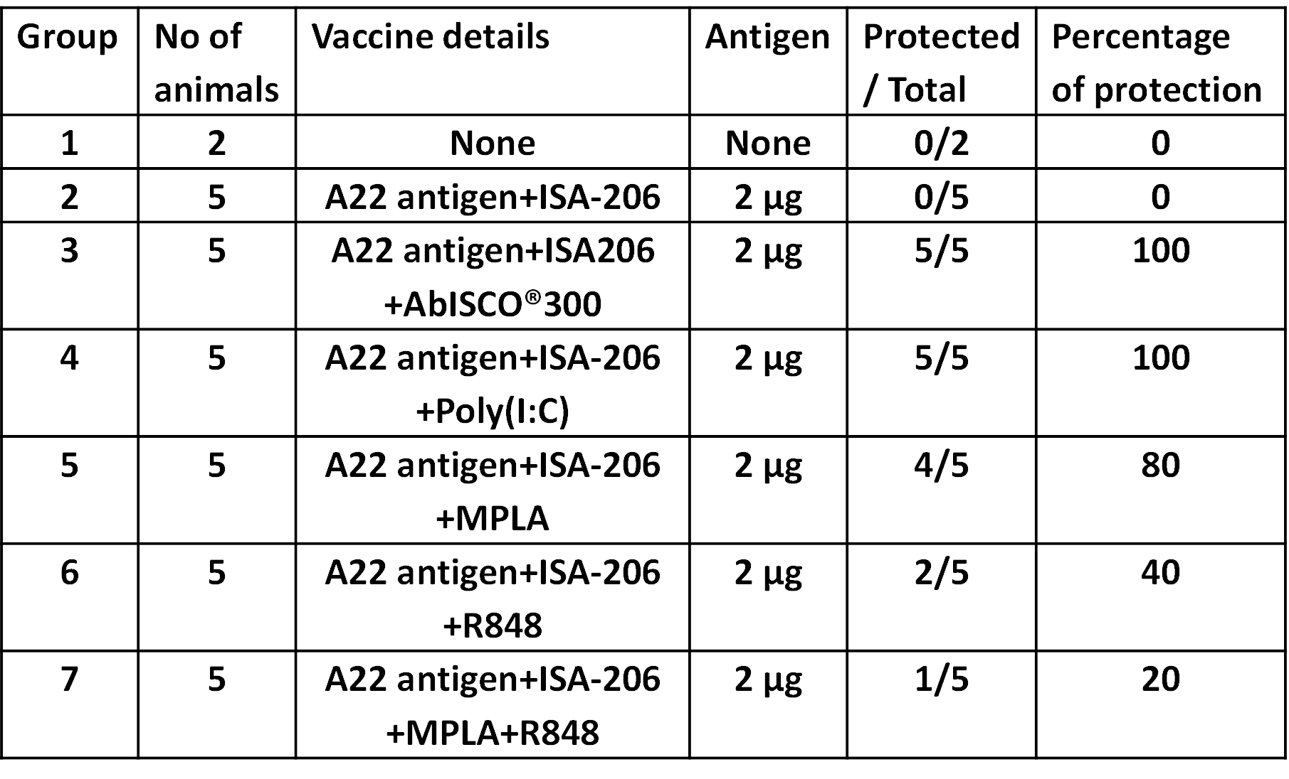
Percentage of clinical protection

Slide 8
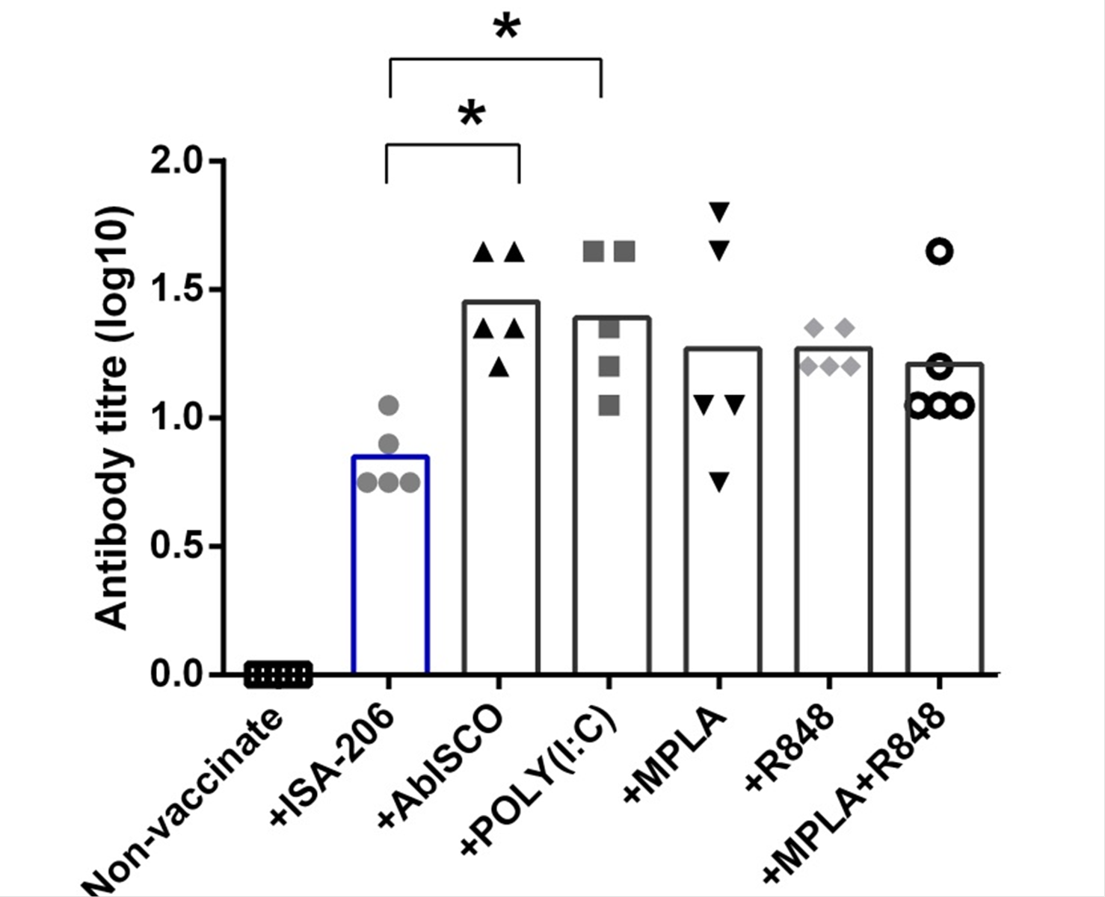
Poly (I:C) and AbISCO had significantly increased neutralizing antibodies compared to the ISA-206
(28 dpv time point)

Slide 9
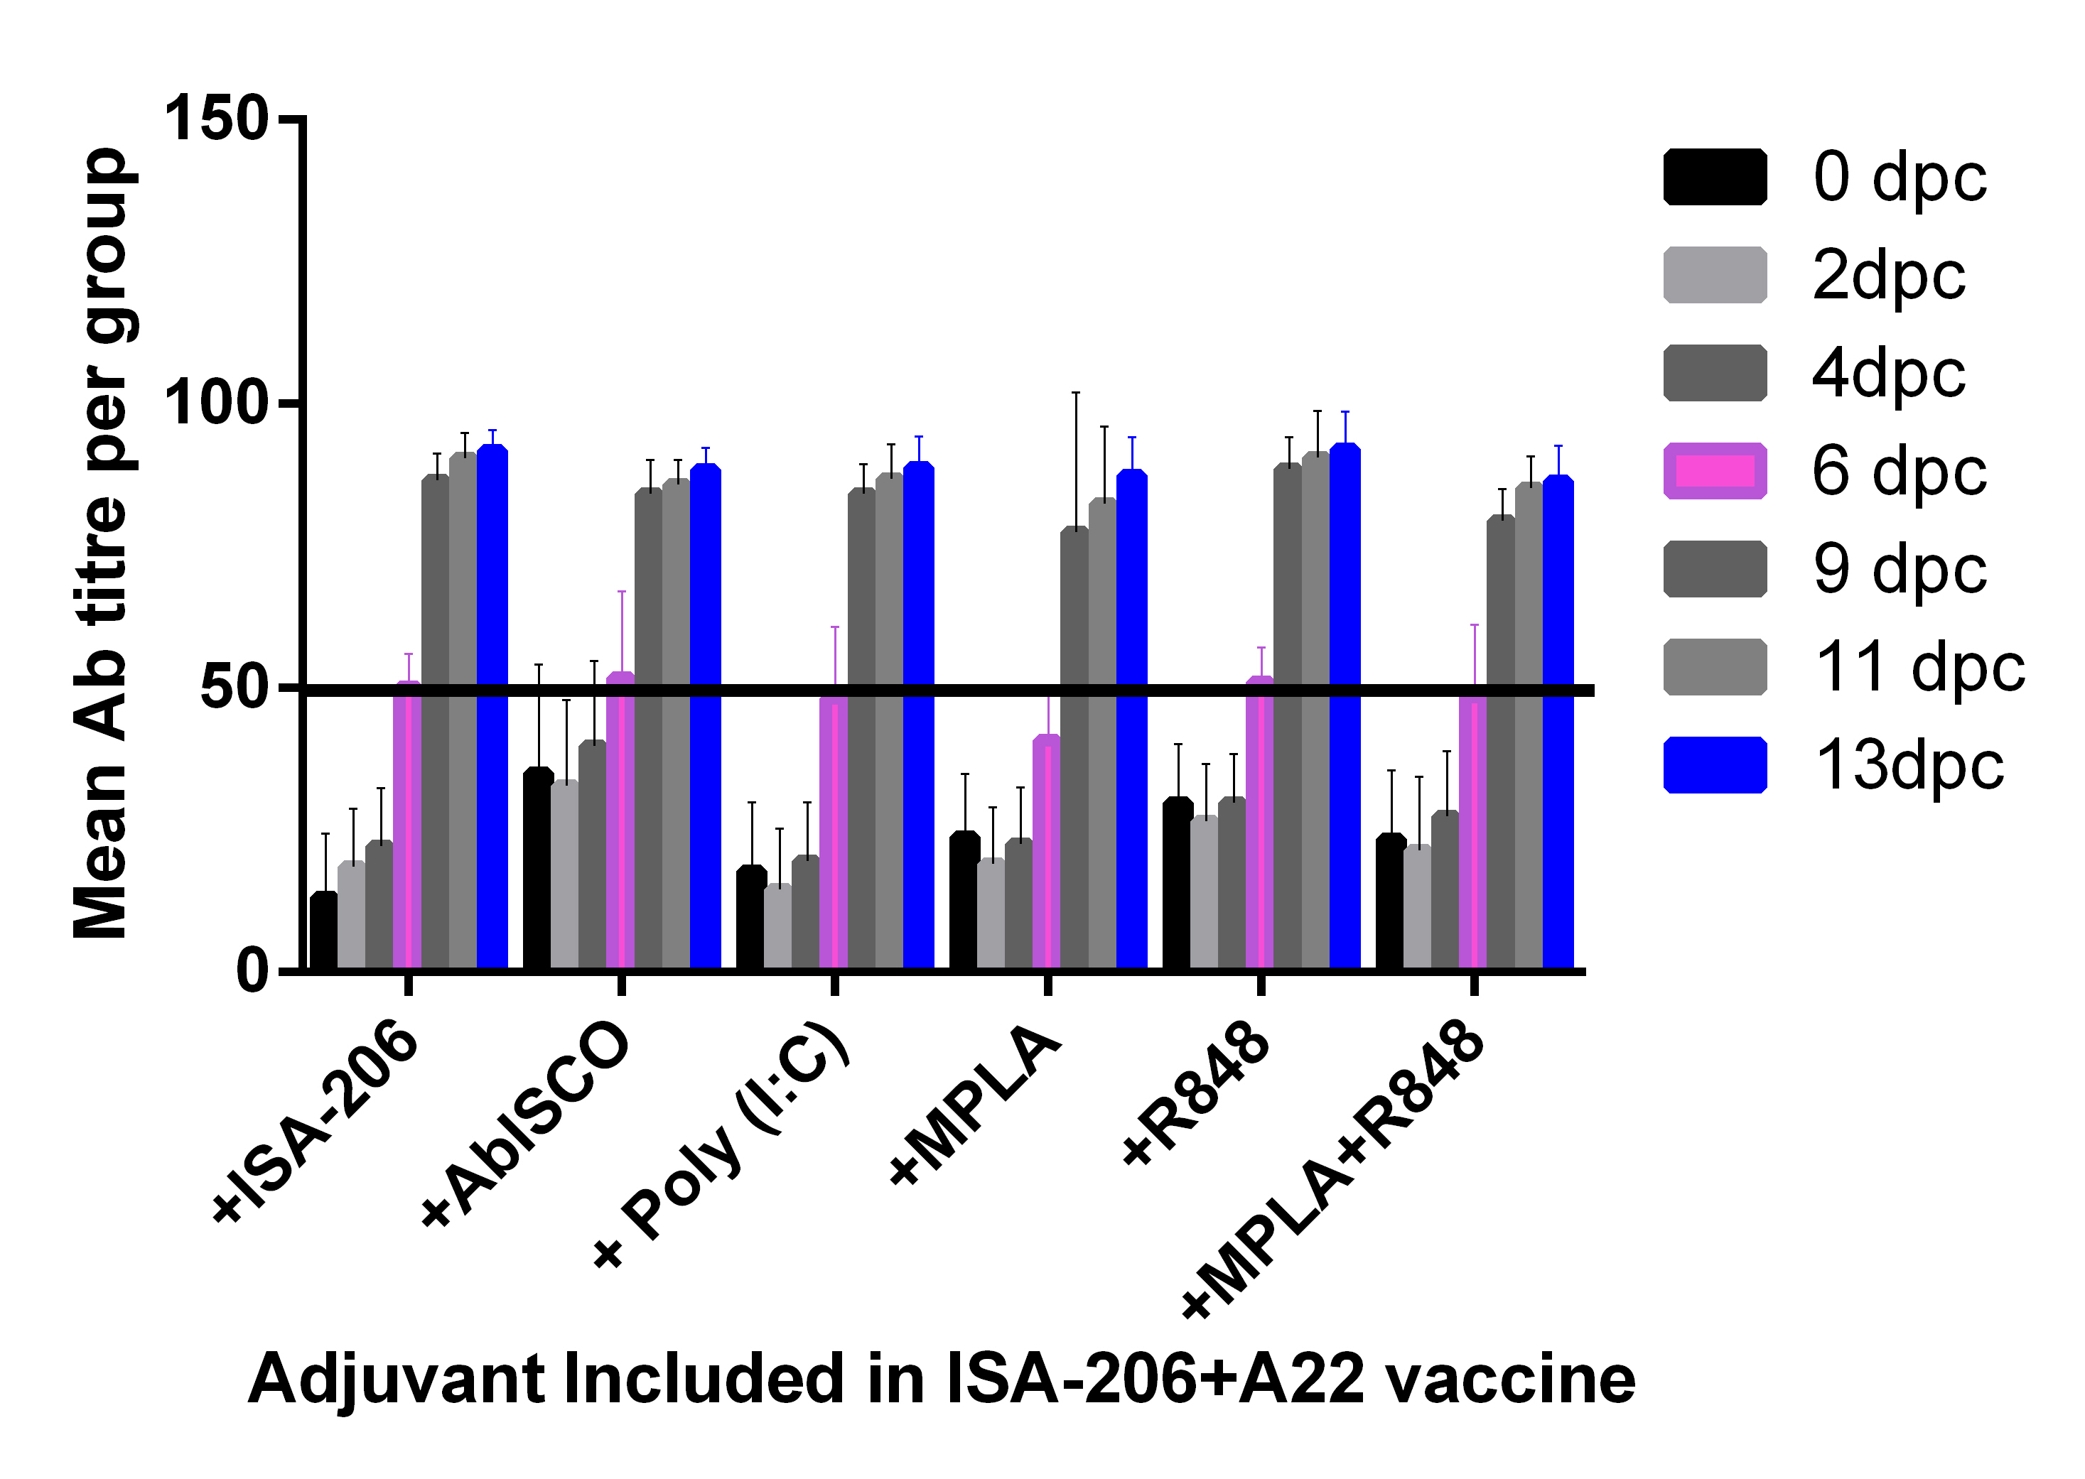
Detection of virus replication by NSP test
Non Structural Protein antibody ELISA

Slide 10
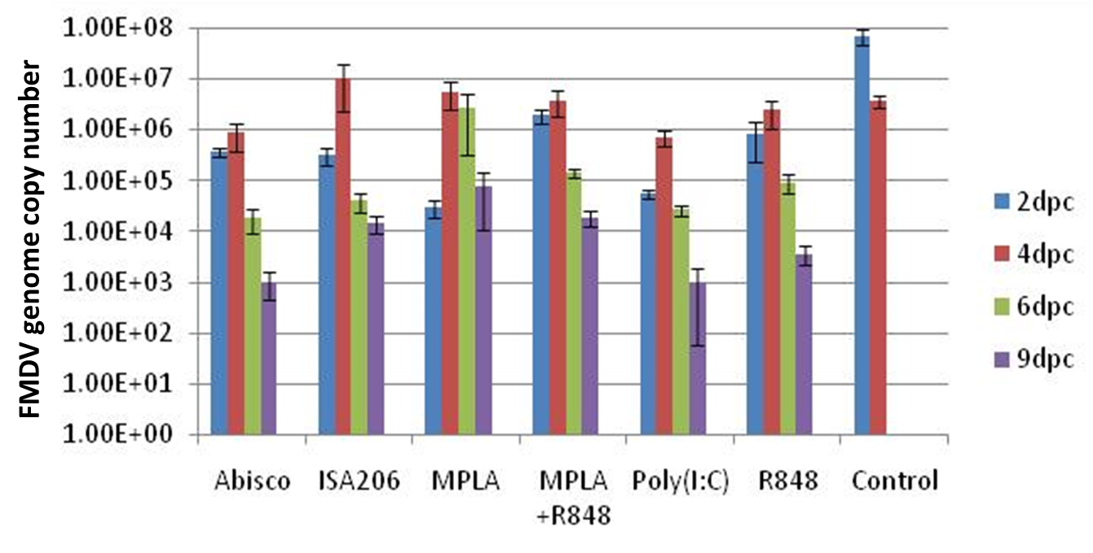
Excretion of virus in nasal swabs qPCR

Slide 11
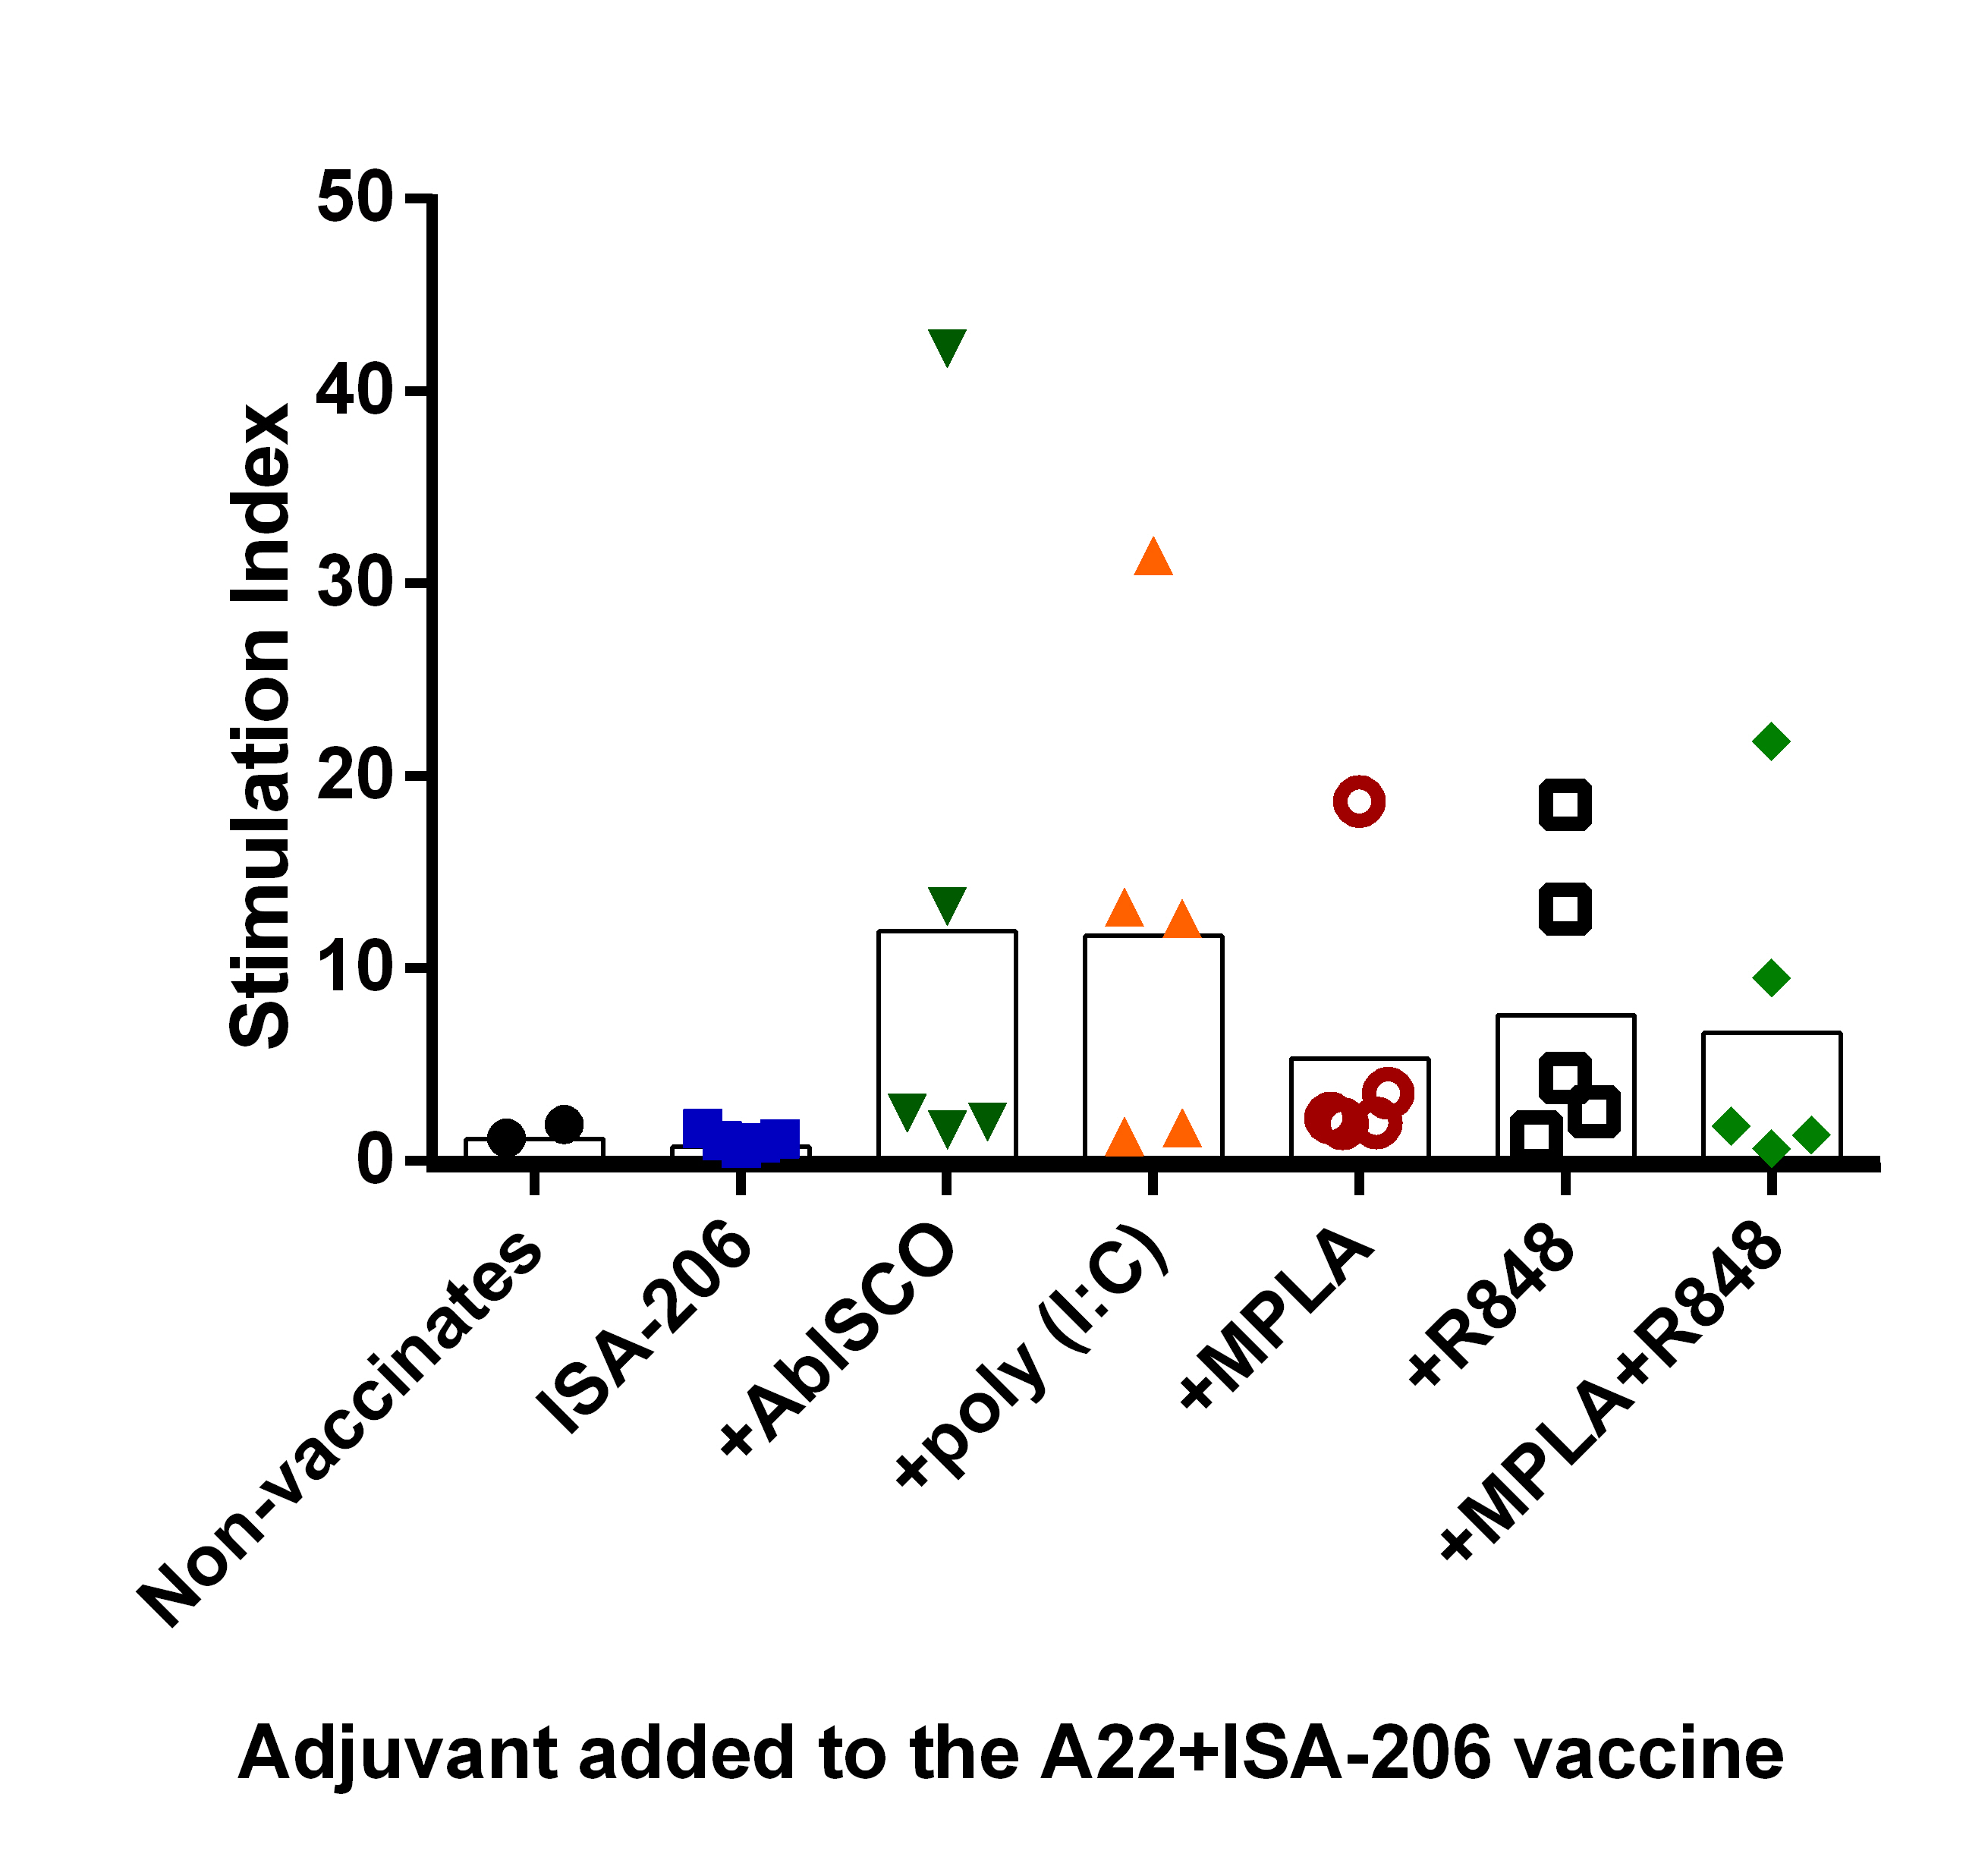
The inclusion of new generation adjuvants enhanced A22 specific proliferation
(28 dpv time point)

Slide 12
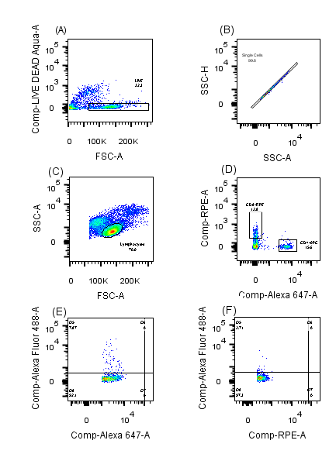
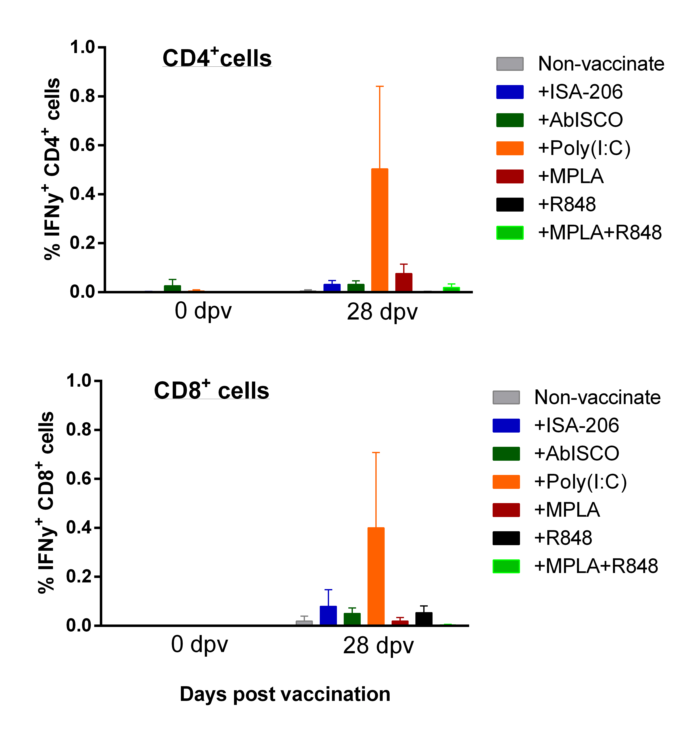
IFN-gamma from CD4⁺ and CD8⁺ PBMC
(G)
(H)
Gating Strategy

Slide 13
Summary
Achieved an increased potency and immunogenicity in Poly (I:C) and AbISCO treated groups with suboptimal antigen dose.
Significantly elevated neutralizing antibodies.
Indication of IFN-gamma up-regulation
by CD4⁺ and CD8⁺ cells in Poly (I:C) group.
On-going work-to measure duration of immunity

Slide 14






Acknowledgements
Collaborators
Madhan Mohan
Nagendra Kumar
V A Srinivasan
Anita Milicic
Sarah Gilbert
Adrian Hill
Richard Reeve
Dan Haydon
IIL

