Slide 1
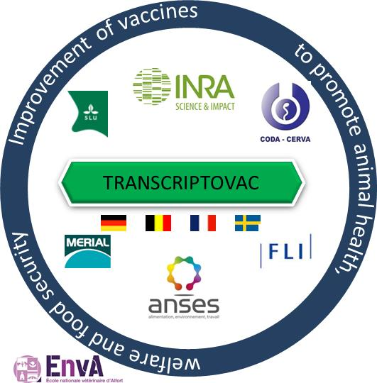
immune responses to foot-and-mouth disease virus in guinea pigs after vaccination with canine adenovirus vector
S.A. Lacour, A. De Vleeschauwer, L. Bakkali-Kassimi, S. Zientara, K. De Clercq, B. Klonjkowski
ERA-NET ANIHWA

Slide 2
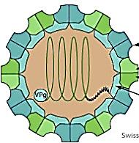
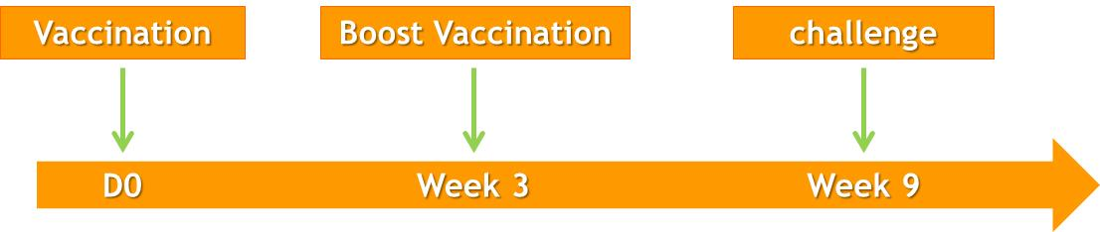

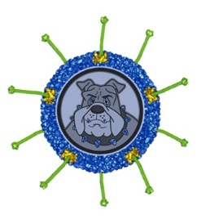
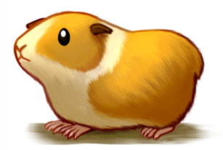
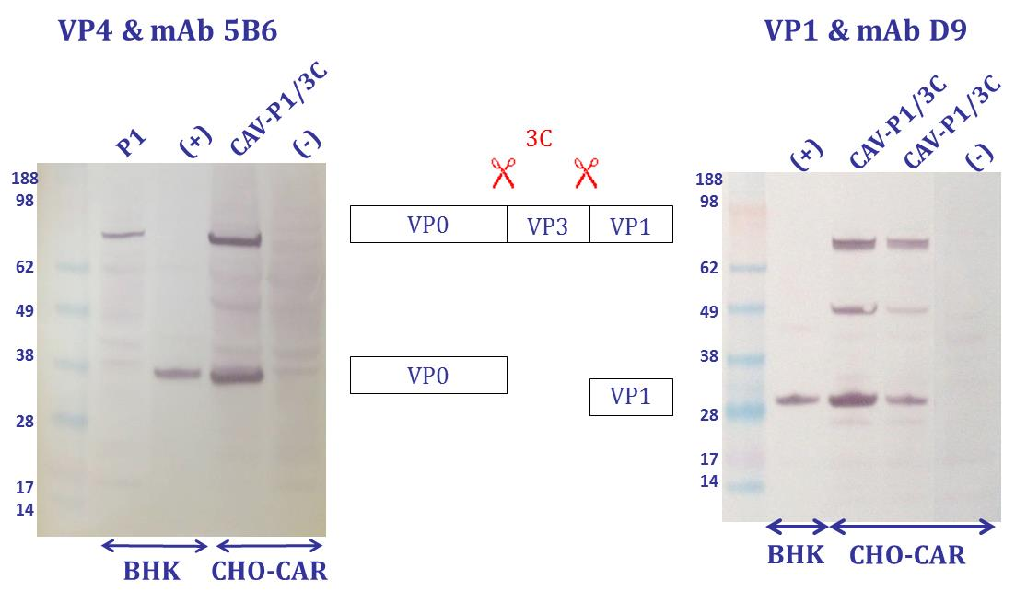
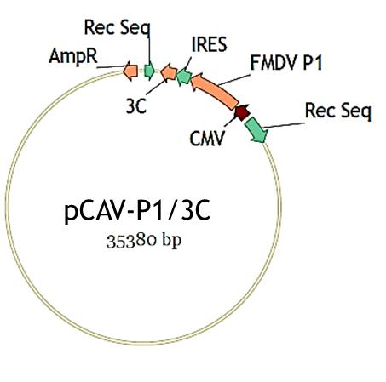

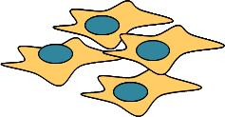
CAV-P1-3C
P1
Human adenovirus
Canine adenovirus
Transfection of DKE1 cells
CAV-P1/3C

Slide 3
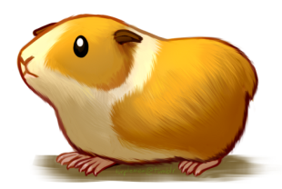
Assessment of protection
Immune response
Clinical symptoms
viremia

Slide 4
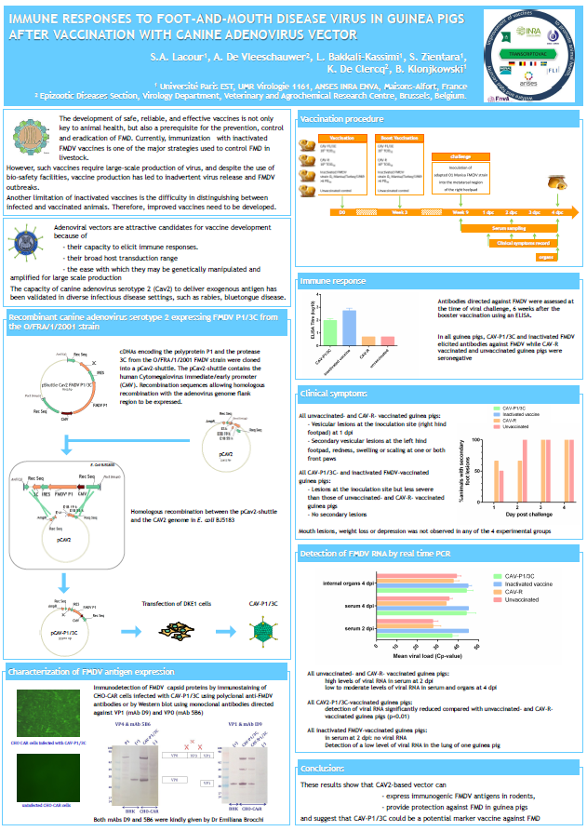
Conclusions
CAV2-based vector can
- express immunogenic FMDV antigens in rodents,
- provide protection against FMD in guinea pigs
- and suggest that CAV-P1/3C could be a potential marker vaccine against FMD

