Slide 1



APPLICATION OF INDIRECT AND AVIDITY ELISAs TO ASSESS ANTI-FMDV ANTIBODIES INDUCED BY VACCINATION IN BUFFALO AND SWINE SERUM SAMPLES
F. Mansilla,; J. Sala, M. Trotta; . Piscitelli; F. Bessone, M. Pérez-Filgueira, S. Caspe, A. Capozzo
Dr. Alejandra V. Capozzo, PhD
HEAD OF THE APPLIED VETERINARY IMMUNOLOGY LAB. INSTITUTE OF VIROLOGY. INTA. BUENOS AIRES

Slide 2

Current situation: FMD free, with or without vaccination.
Vaccines: oil-adjuvanted, tetravalent (O1 Campos - A24 Cruzeiro – A/Arg/2001- C3 Indaial).
Locally produced, purified, high quality.
Vaccines are applied to cattle and buffaloes
Young animals (< 2 years old) are vaccinated twice a year
Animals > 2 years old are vaccinated once a year
Goal: Study antibodies elicited by current vaccines in all susceptible species.
ARGENTINA

Slide 3




We cared more about cattle….
Vaccines are applied to cattle and buffaloes - Pigs are not vaccinated
ARGENTINA 2015
Consumption (per inhabitant)
51,429,848
2nd producer in South America
60 Kg
10 Kg
5,011,446
3rd producer in South America
101,076
3rd producer in South America

Slide 4
Latest outbreak: 2011
O1 serotype
Border belt
All susceptible species are vaccinated
FMDV-free
with vaccination
Animals < 2 years old -twice a year
Animals > 2 years old once a year
Water buffaloes
Bubalus bubalis
Mediterranean breed
FMDV-free without vaccination

Slide 5
Serological surveillance of vaccine efficacy
Pros
Cons
Virus neutralization test
Requires live virus manipulation
Requires cell culture
Time consuming
Difficult to harmonize
Not useful for high-throughput
Dedicated high-containment facilities
VNT
Gold Standard
Can use any field strain
Liquid phase blocking ELISA
Concordance with VNT (bovine serum samples)
High throughput
Easy to harmonize
Uses inactivated virus
LPBE
Requires two antibody preparations: capture and detection antibodies
Not useful for rapid set up assay for new filed variants
VNT and LPBE titers of virus-specific antibodies have been related to protection against infection in cattle (PPG)
75-EPP% Cut-off value
For each vaccine strain

Slide 6
Do ELISAs match VNT when using buffalo serum samples?

Slide 7

Does LPBE match VNT?
LPBE: two different detector Ab
Cut OFF - EPP 75%: LPBE titer 2.11 (Log₁₀Titer , O1 Campos strain)
LPBE
Y
Monoclonal Ab MIX
LPBE-Mab
Y
Y
Y
Detector Ab
Y
Capture Ab
(rabbit)
Guinea-Pig Polyclonal
LPBE-HIS
N=91 samples with different VNT titers
  N=27 Log₁₀ VNT titers < 1.66
  N=64 Log₁₀ VNT titers >1.66
Cut OFF - EPP 75%: VNT titer=1,6 Log₁₀TCID50

Slide 8
Do both LPBE-Mab and LPBE-HIS perform equally when using buffalo samples?
YES
r²=0.87
Pearson´s r= 0.88

Slide 9
Concordance between VNT and LPB-ELISA
Pearson´s r=0,4432 (0.2576 - 0.5972)
EPP 75%=2.1
(Log10 titer)
EPP 75%=1,65
(Log10 titer)

Slide 10
Concordance between VNT and LPB-ELISA
Low specificity

Slide 11
Problem to solve: low specificity
Avidity and subtyping of specific antibodies applied to the indirect assessment of heterologous protection against Foot-and-Mouth Disease Virus in cattle. Lavoria MÁ, Di-Giacomo S, Bucafusco D, Franco-Mahecha OL, Pérez-Filgueira DM, Capozzo AV. Vaccine. 2012
Accuracy of traditional and novel serology tests for predicting cross-protection in foot-and-mouth disease vaccinated cattle. Brito BP, Perez AM, Capozzo AV. Vaccine. 2014
Mainly due to cross-reactive antibodies
Natural antibodies
Avidity ELISA
Binding strength Ag- Ab
Low-avidity binders are removed using UREA
Single dilution
Purified antigen

Slide 12
Indirect and avidity ELISAs
Single dilution test
Purified inactivated antigen
Three steps
Neither detector nor capture Ab needed
IE
Y
Y
Y
Y
Indirect ELISA, purified virus, single dilution
AE
Y
Avidity indirect ELISA: low avidity binders are washed way with Urea, purified virus, single dilution
Y
Y
N=91 samples with different VNT titers
Cut OFF - EPP 70%: VNT titer=1,6 Log₁₀TCID50

Slide 13
Concordance between VNT* and ELISAs
* VNT is the accepted assay for vaccine efficacy testing in the European Pharmacopoeia.
Notes:
0.8

Slide 14
Improving concordance with VNT
VNT titers
LOW VNT titers
<1.4
VNT titers
1.4 – 3.0
HIGH VNT titers
> 3
Avidity ELISA
Classified correctly with tests that measure total antibodies

Slide 15
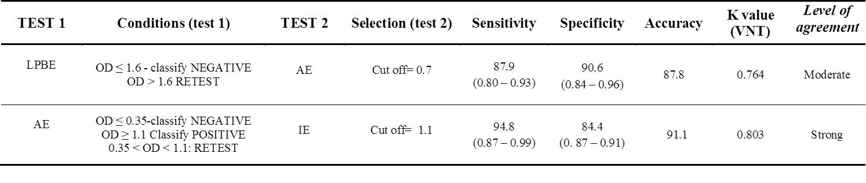
Accuracy of combined indirect assessment
Log ₁₀Titer≤ 1.6 classify NEGATIVE
Log ₁₀Titer≥ 3.5 classify POSITIVE
1.6 < Log ₁₀Titer < 3.5 RETEST
IE
OD ≤ 0.3 classify NEGATIVE
OD ≥ 1.1 classify POSITIVE
0.3 < OD < 1.1 RETEST
AE
88.8
92.6
The best agreement values (κ=80%) were obtained when combining results of both single dilution ELISAs
Additional benefit: high-throughput reproducible assessment that only takes a few hours of work to the result.
Notes:
0.3

Slide 16
Conclusions
The combination of two single-dilution high-throughput ELISA may afford a simpler and faster alternative to the VNT.
Provided a thorough validation is performed, these assays may be useful for monitoring the effectiveness of vaccination campaigns in buffalo populations.
Further analysis ( > 600 samples). Consider changing cut-off values?

Slide 17

Border belt
All susceptible species are vaccinated
Latest outbreak: 2011
O1 serotype
FMDV-free
with vaccination
(cattle and buffaloes)
FMDV-free without vaccination
Swine population (updated Nov. 2015)
PIGS are not vaccinated in Argentina
<10,000
10,000-39,000
40,000-100,000
101,000-500,000

Slide 18


Immune responses to vaccination: experimental design
Piglets (12 weeks old)
Immunized with comercial vaccine
Dose: 2 ml; SC
The same applied in cattle
Control group : immunized with oil adjuvant + PBS.
2ml/dose; SC
n= 12
n= 3
0dpv
10dpv
21dpv
60dpv
Serology against O1 Campos and A 24 Cruzeiro strains
Liquid phase blocking ELISA (LBPE)
Indirect ELISA
Avidity ELISA
Isotype ELISAs

Slide 19
Immune responses to vaccination

Slide 20

Neutralizing Abs
Total abs: LPBE
Total abs: Indirect
ELISA
Avidity ELISA

Slide 21
Do avidity and LPBE match VNT?
Avidity correlates with VNT

Slide 22
Conclusions
Avidity ELISA emerges as a promising low-labor high throughput alternative to VNT
Avidity matches better VNT titers than LPBE and does not require standardized sera, facilitating the assessment of antibodies against new field strains
Indirect ELISA and LPBE provide similar information
Everyone is invited to get the protocol/training and run their samples

Slide 23
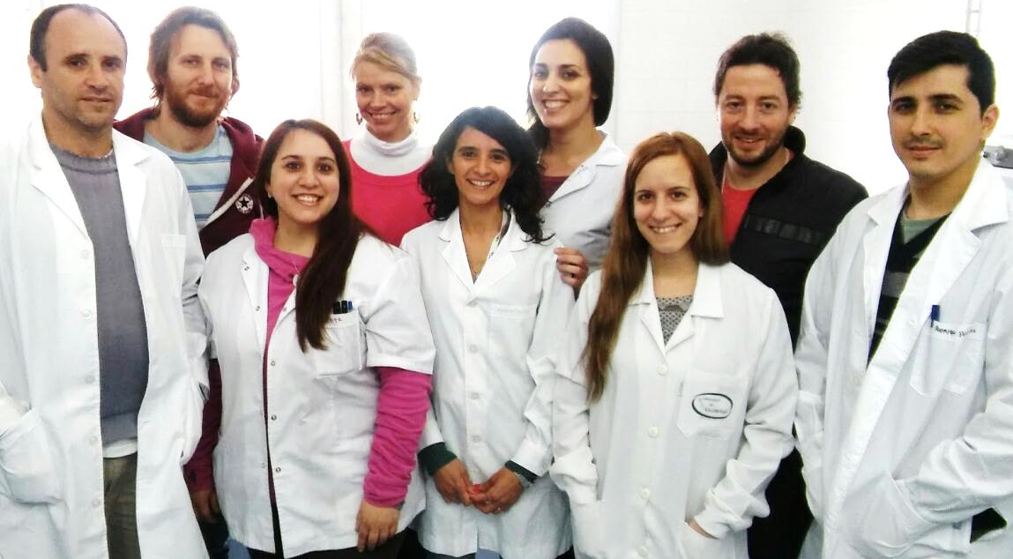
MUCHAS GRACIAS
Capozzo´s Lab
JUAN SALA, DVM
Myrian Trotta
Ms Biotec
FLORENCIA MANSILLA, PhD
APPLIED VETERINARY IMMUNOLOGY LAB. INSTITUTE OF VIROLOGY. INTA.

