Slide 1
Demonstration of early protection
against foot-and-mouth disease virus
seven days post-vaccination
L. Mouton¹ , A. Dekker², M. Bleijenberg², M. Blanchet¹,
B. Van Schaijk¹, J. Coco-Martin³, M. Curet¹, S. Goutebroze¹
¹ Merial S.A.S., Lyon, France
² Wageningen Bioveterinary Research (CVI), Lelystad, The Netherlands
³ Merial B.V., Lelystad, The Netherlands

Slide 2
Introduction
FMD virus can spread very rapidly within a population
Vaccination is mostly the best tool to control the disease
What is the rate of development of protection in cattle ?
Objective of the present study
Assessment of the efficacy of AFTOVAXPUR DOE vaccine
in eliciting protection 7 days post-vaccination
The ideal vaccine profile should be with a short onset of immunity

Slide 3
Study design
Animals
20 cattle, Holstein Friesian and crossbred
Between 6.7 to 9.3 months on D-7
Randomly allocated to 2 groups
In high containment throughout the study
Vaccine
AFTOVAXPUR DOE (double-oil-emulsion)
Commercial vaccine
FMD O Manisa inactivated

Slide 4
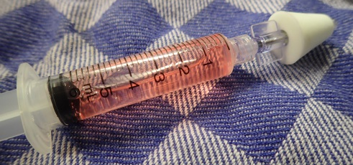
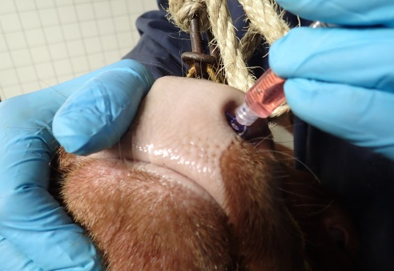
Study design
Group | Number of cattle | FMD O MA vaccination on D-7 (injected dose) | FMD O MA challenge on D0 (injected dose)
G ctr | 10 | N/A (controls) | 10.000 BID50 (10 ml)
G vac | 10 | Aftovaxpur DOE (2 ml) | 10.000 BID50 (10 ml)
Vaccination
G vac
(2 ml, SC)
Challenge
G ctr-G vac
(10.000 BID50,
10 ml, IN)
D-7
VNT
D0
VNT

Slide 5
Study design
Group | Number of cattle | FMD O MA vaccination on D-7 (injected dose) | FMD O MA challenge on D0 (injected dose)
G ctr | 10 | N/A (controls) | 10.000 BID50 (10 ml)
G vac | 10 | Aftovaxpur DOE (2 ml) | 10.000 BID50 (10 ml)
Vaccination
G vac
(2 ml, SC)
Challenge
G ctr-G vac
(10.000 BID50,
10 ml, IN)
Sedation
G ctr-G vac
(FMD signs)
Sedation
G ctr-G vac
(FMD signs)
Necropsy
G ctr-G vac
(FMD signs)
D-7
VNT
D0
VNT
D4
D8
D14
VNT
Rectal temperature
General clinical signs (clinical score)
Virus isolation (mouth swabs, heparinised blood samples)

Slide 6
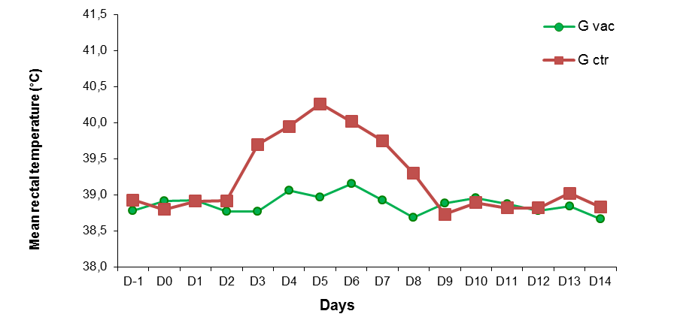
Results : body temperatures
Mean rectal temperature after challenge
A peak of hyperthermia was observed in the unvaccinated control following IN challenge.
No marked increase of mean rectal temperature was observed in the vaccinated group.
Notes:
We also regularly took blood samples for
Antibody assays
Viraemia testing by RT-PCR

Slide 7
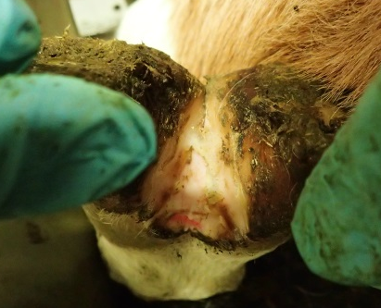
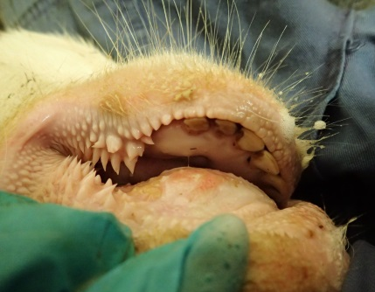
Results : FMD specific lesions
Summary of the FMD lesions observed over the 14 days period
Group | Lesions site | Number of cattle with FMD lesion (10 cattle per group)
 |  | D-1 | D4 | D8 | D14
G ctr (unvaccinated controls) | Foot only | 0 | 0 | 0 | 0
 | Head only | 0 | 3 | 0 | 0
 | Foot and head | 0 | 3 | 10 | 10
G vac (vaccinated D-7) | Foot only | 0 | 0 | 0 | 0
 | Head only | 0 | 0 | 1 | 1
 | Foot and head | 0 | 0 | 0 | 0
Foot
Tongue
Mouth & lips
Notes:
We also regularly took blood samples for
Antibody assays
Viraemia testing by RT-PCR

Slide 8
Results : FMD specific lesions
Protection against foot lesions
Group | Protected animals against foot lesions | Prevented fraction | p-value (one sided Fisher’s exact test)
G ctr (unvaccinated controls) | 0/10 | 1.0 | < 0.001
G vac (vaccinated D-7) | 10/10
None of the cattle in the vaccinated group presented foot lesions over the study period.
All control animals (G ctr) showed lesions on all four feet.
Notes:
We also regularly took blood samples for
Antibody assays
Viraemia testing by RT-PCR

Slide 9
Results : global clinical score
Scoring system (GCS)
GCS = Temperature Score + Clinical Sign Score + FMD Lesion Score
Where:
Temperature Score: +1 for each day with temperature ≥ 39.6°C
Clinical Sign Score: +1 for each clinical sign (appetite, mucosa, posture) observed on each day
FMD Lesion Score: +1 point per affected site when lesions on a foot claw and +1 point when head lesion at each inspection timepoint
Summary of clinical scores
Group | Total Clinical Scores
 | Rectal Temperature mean ± sd | General Clinical Signs mean ± sd | FMD Lesions mean ± sd | GCS* mean ± sd
G ctr (unvaccinated controls) | 3.6 ± 0.8 | 10.8 ± 2.3 | 21.7 ± 4.6 | 36.1 ± 5.6
G vac (vaccinated D-7) | 0.2 ± 0.4 | 0.2 ± 0.6 | 0.2 ± 0.6 | 0.6 ± 1.6
* P < 0,001
The distribution of GCS was highly significantly different
between the vaccinated and the control group
Notes:
We also regularly took blood samples for
Antibody assays
Viraemia testing by RT-PCR

Slide 10
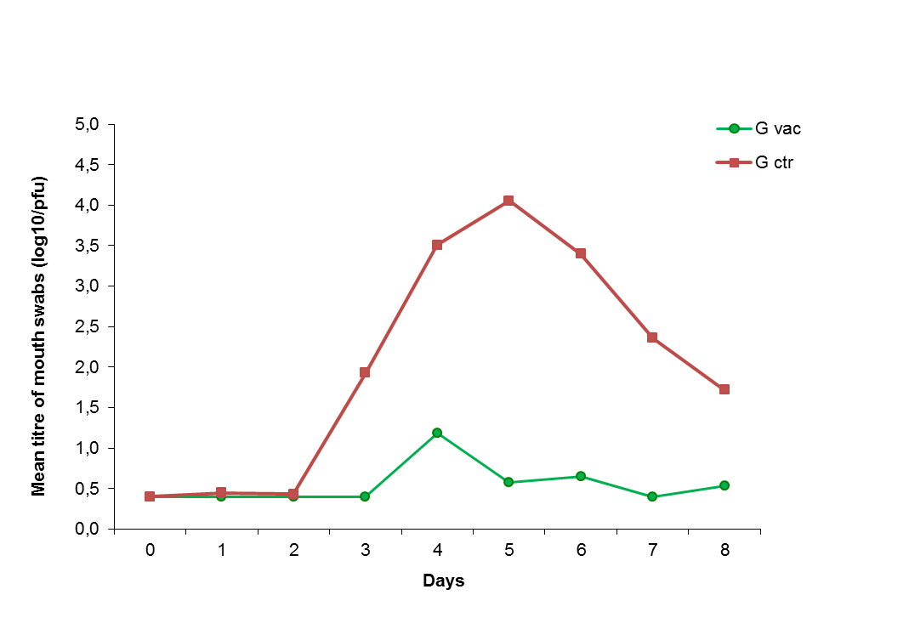
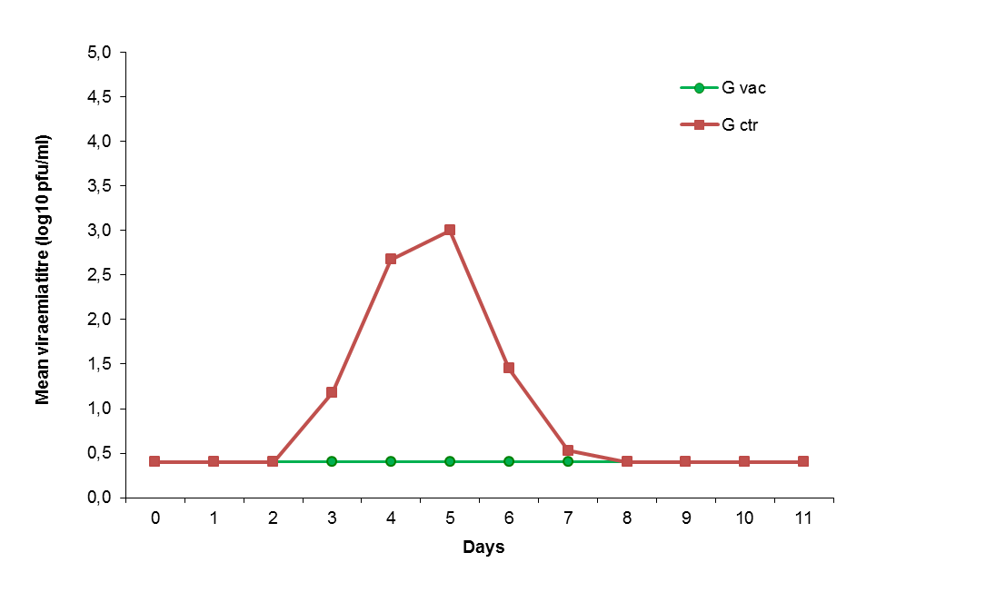
Results : virological testing
Viraemia
Virus isolation in mouth swabs
Group | Number positive animals | AUC* mean ± sd (log10 pfu/ml) | Duration* mean ± sd (days) | Max Titre* mean ± sd (log10 pfu/ml)
G ctr | 10/10 | 3.6 ± 0.9 | 2.5 ± 0.7 | 3.4 ± 0.9
G vac | 0/10 | 1.4 ± 0.0 | 0.0 | 0.4 ± 0.0
Group | Number positive animals | AUC* mean ± sd (log10 pfu/ml) | Duration* mean ± sd (days) | Max Titre* mean ± sd (log10 pfu/ml)
G ctr | 10/10 | 5.2 ± 0.4 | 5.3 ± 0.8 | 5.1 ± 0.5
G vac | 7/10 | 1.8 ± 0.6 | 0.9 ± 1.2 | 1.3 ± 1.0
* P < 0,001
* P < 0,001

Slide 11
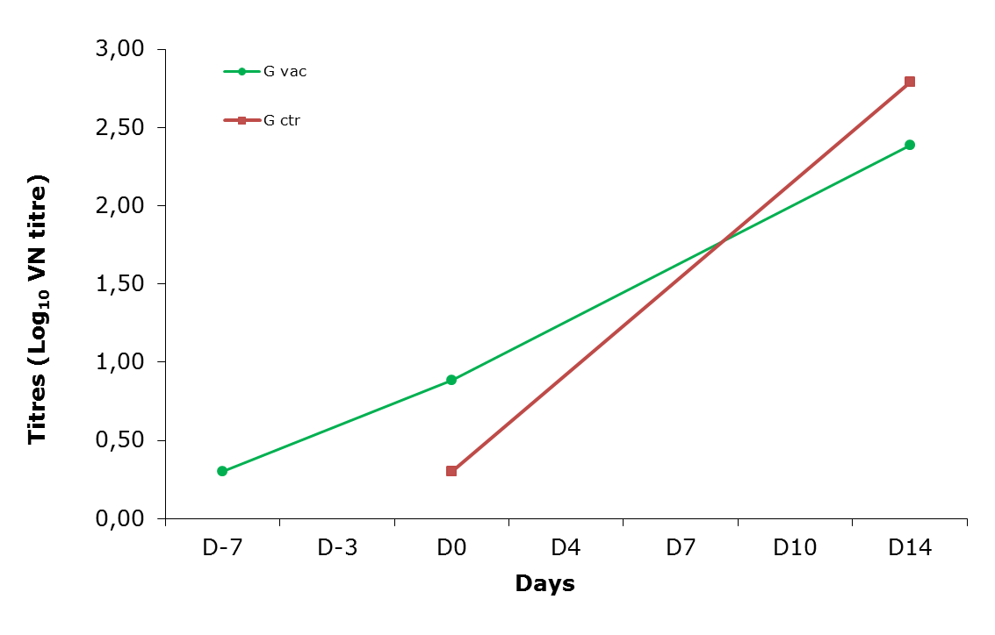
Results : FMD serology (VNT)
Mean FMD O Manisa neutralizing antibody titres
Challenge
Neutralizing antibody response was detected in most animals as early as 7 dpv.
All animals in both groups have seroconverted against O MA 14dpc.
Notes:
We also regularly took blood samples for
Antibody assays
Viraemia testing by RT-PCR

Slide 12
Conclusion
The positive effect of the FMD O MA inactivated vaccine
after challenge at 7 days post-vaccination was:
Complete reduction of the number of foot lesions and significant reduction of the severity of clinical signs
Complete protection against of viraemia and significant reduction of viral excretion
Early onset of serological response against O Manisa
.
Notes:
We also regularly took blood samples for
Antibody assays
Viraemia testing by RT-PCR

Slide 13
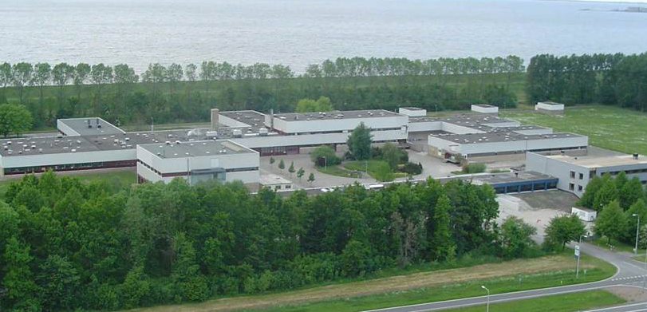
Acknowledgements
Technical Staff from Wageningen Bioveterinary Research (CVI)
and
MERIAL R&D Lelystad Laboratories

