Slide 1
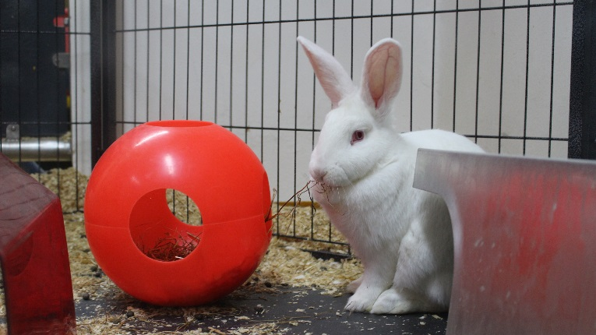

SELECTION OF AN ADJUVANT TO RAISE POLYCLONAL ANTIBODIES TO FOOT-AND-MOUTH DISEASE VIRUS IN RABBITS AND GUINEA-PIGS
Alison Morris | Beatriz Sanz-Bernardo | Alison Burman | Anna Ludi
The Pirbright Institute, Ash Road, Pirbright, Woking, GU24 0NF UK. Tel: +44 (0)1483 234455.
Email: beatriz.sanz-bernardo@pirbright.ac.uk www.pirbright.ac.uk

Slide 2
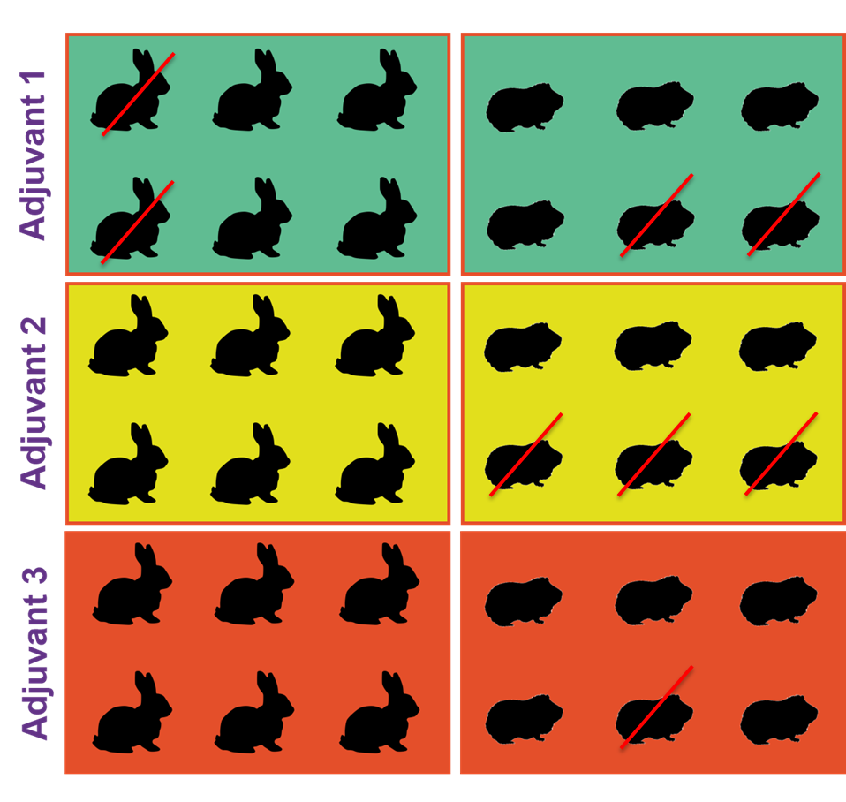
Aims and Experimental Design
Alternative to Freund’s adjuvant for the production of polyclonal antibodies.
  Good antibody titers but painful adverse effects.
3 adjuvant candidates (water-in-oil-emulsions):
  Adjuvant 1 (TitreMax-Gold).
  Adjuvant 2 (Montanide ISA50_V2).
  Adjuvant 3 (Stimune).
Immunization protocol:
  Prime inoculation followed by a boost on day 28.
  Serum: day 0, day 22 and day 42 (end of experiment) → indirect ELISA.

Slide 3
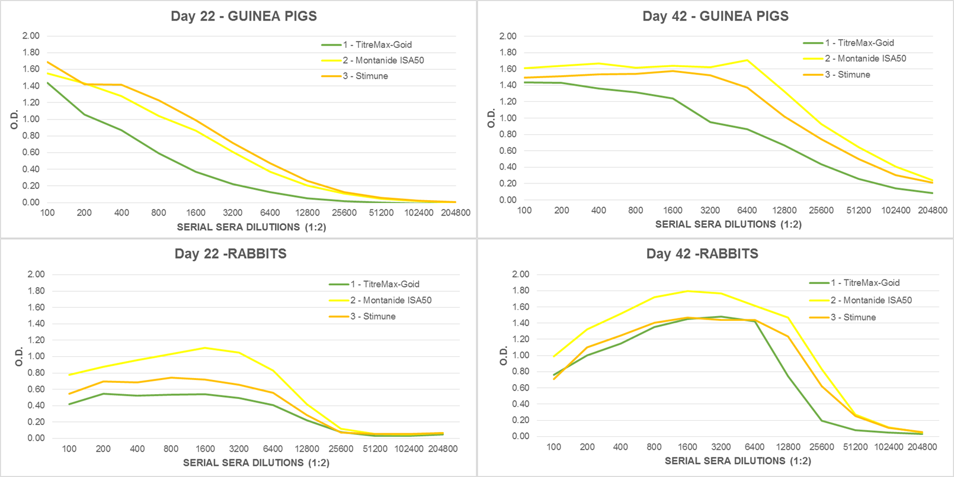
Testing antisera to the homologous antigen
Successful antibody production in all adjuvants.
  Montanide > Stimune > TitreMax-Gold.
    TitreMax-Gold (boost of soluble antigen without adjuvant).
Further work to be done:
  Specificity ELISA.

Slide 4
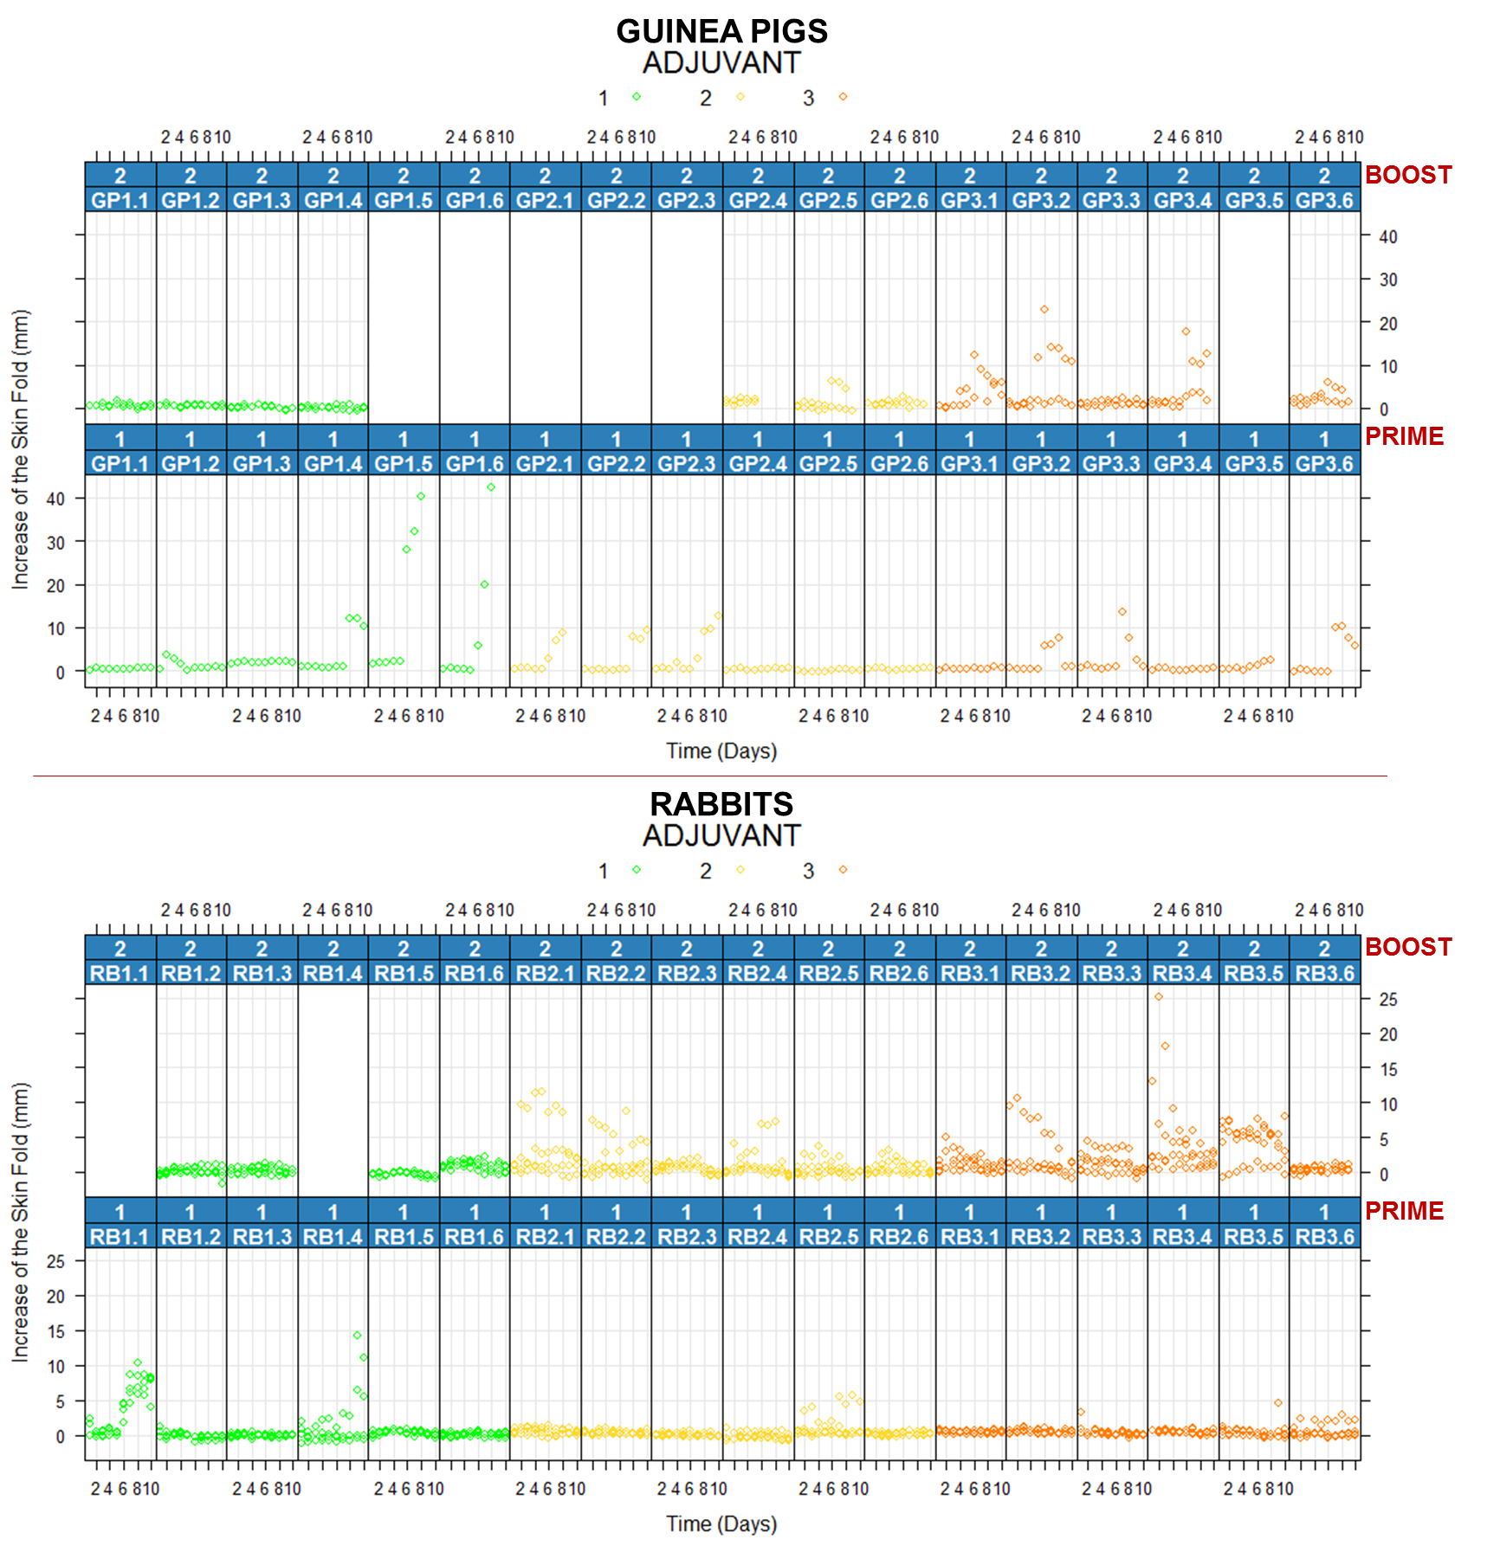
Adverse reactions
To the prime injection:
  Significant skin inflammation
  in GP with TitreMax-Gold.
To the boost:
  No reactions were observed in Group 1 – GP and rabbits - (boosted with antigen in PBS).
  An increase inflammation during the boost (compared to prime injection) in rabbits of Groups 2 and 3.
  In GP the adverse effects were better characterized by the pain response, which was greater in Groups 2 and 3.
Adjuvant | Species | Number of animals | Reason for Euthanasia
TitreMax-Gold | GP | 2 | Severe inflammation and pain of the injection site. Severe lesions upon necropsy.
 | Rabbit | 2 | Severe inflammation of the injection site. Severe lesions upon necropsy.
Montanide ISA50 | GP | 3 | Moderate inflammation and pain on the injection site. Moderete lesions upon necropsy.
Stimune | GP | 1 | Pain on the injection site no associated with lesions produced by the inoculum.
Work in progress to refine the immunization protocol

