Slide 1




Foot-and-Mouth Disease in Turkey: Livestock Movements and Mathematical Modelling
Peter Dawson, Matt Keeling and Mike Tildesley

Slide 2
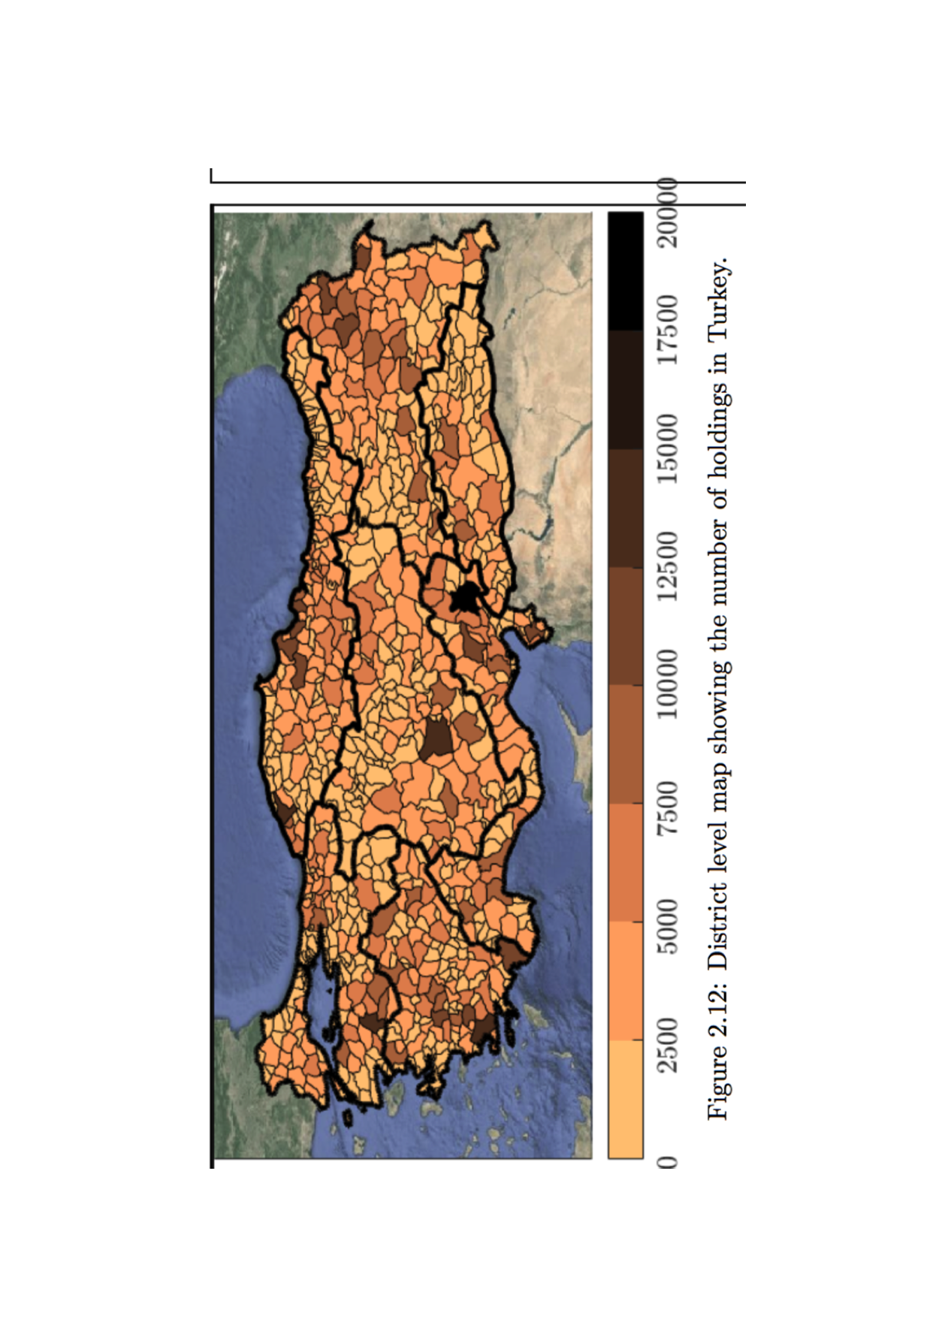
FMD in Turkey
Approximately 3 million cattle holdings in Turkey

Slide 3
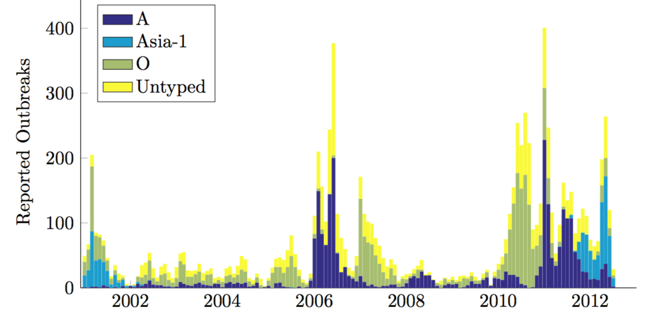
FMD in Turkey
Approximately 3 million cattle holdings in Turkey
9282 outbreaks on holdings from 2001 to 2012.

Slide 4
FMD in Turkey
Approximately 3 million cattle holdings in Turkey
9282 outbreaks on holdings from 2001 to 2012.
Ongoing outbreaks of type O and type A.

Slide 5
FMD in Turkey
Approximately 3 million cattle holdings in Turkey
9282 outbreaks on holdings from 2001 to 2012.
Ongoing outbreaks of type O and type A.
Asia 1 had “died out” by 2002 but re-emerged in 2012.

Slide 6
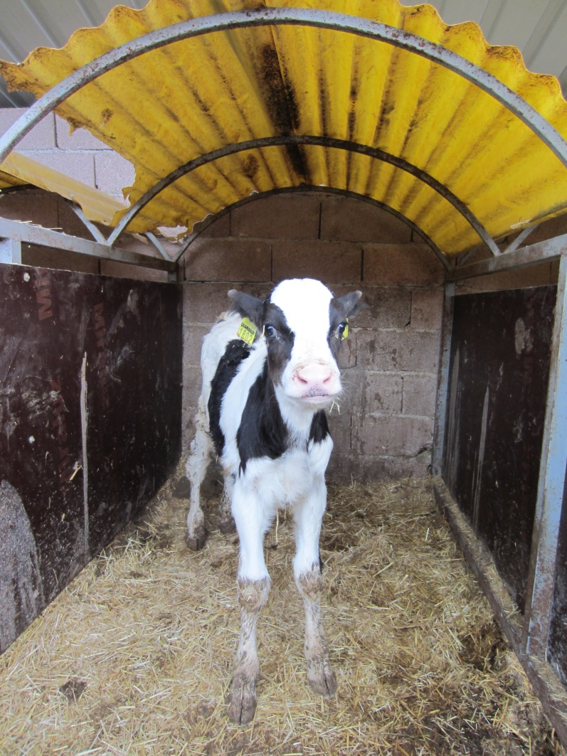
Livestock Movements
All cattle in Turkey are tagged.
Data available
  Movements
  Births
  Deaths

Slide 7
Livestock Movements
All cattle in Turkey are tagged.
Data available
  Movements
  Births
  Deaths
# | From | To | Date
1 | birth | 1842444 | 14/5/2007
2 | 1842444 | 1813237 | 27/9/2007
3 | 1813237 | 1842444 | 27/9/2007
4 | 1842444 | 1813237 | 14/5/2008
5 | 1813237 | 1829052 | 31/5/2008
6 | 1829052 | death | 31/5/2008

Slide 8
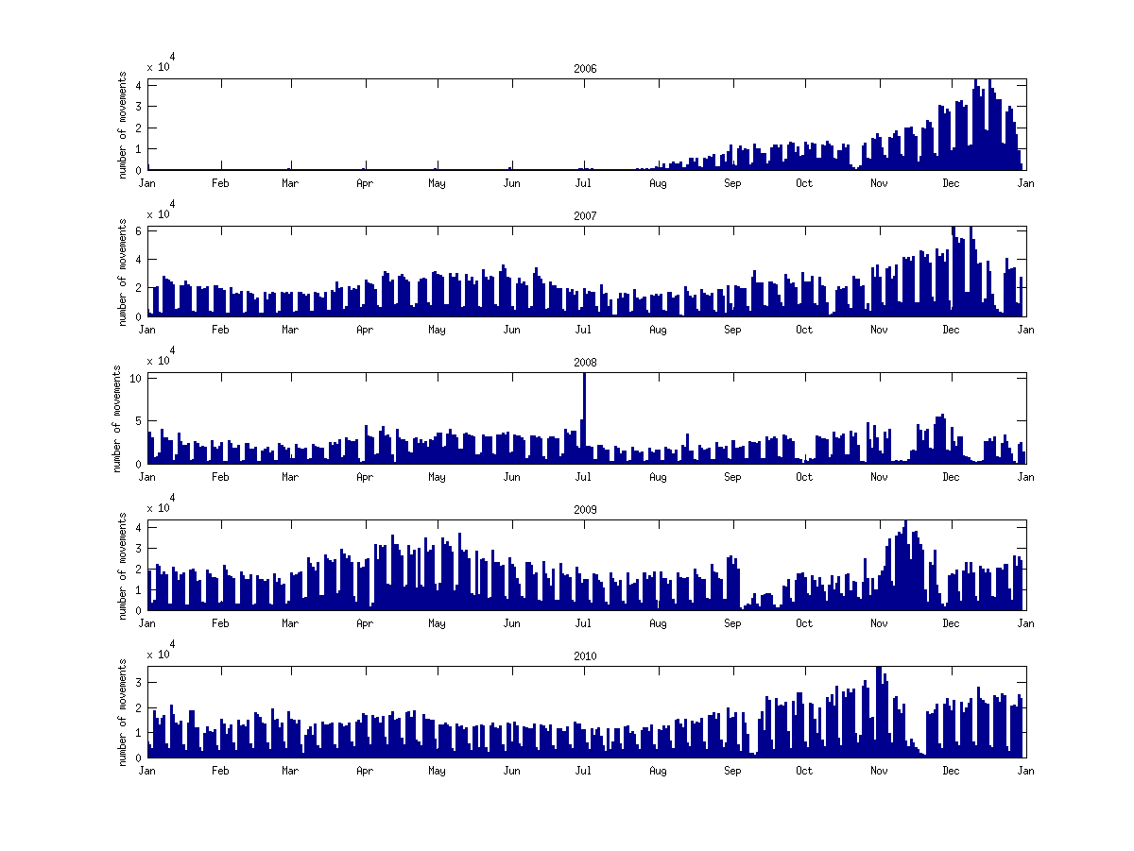
Seasonal variation
Movements show strong seasonal variation

Slide 9
Seasonal variation
Movements show strong seasonal variation
Peak around the Kurban festival (Nov in 2009 and 2010), when large batches move to urban areas in preparation for slaughter.

Slide 10
Seasonal variation
Movements show strong seasonal variation
Peak around the Kurban festival (Nov in 2009 and 2010), when large batches move to urban areas in preparation for slaughter.

Slide 11
Seasonal variation
Can clearly see weekly variation (very few movements on weekends).

Slide 12
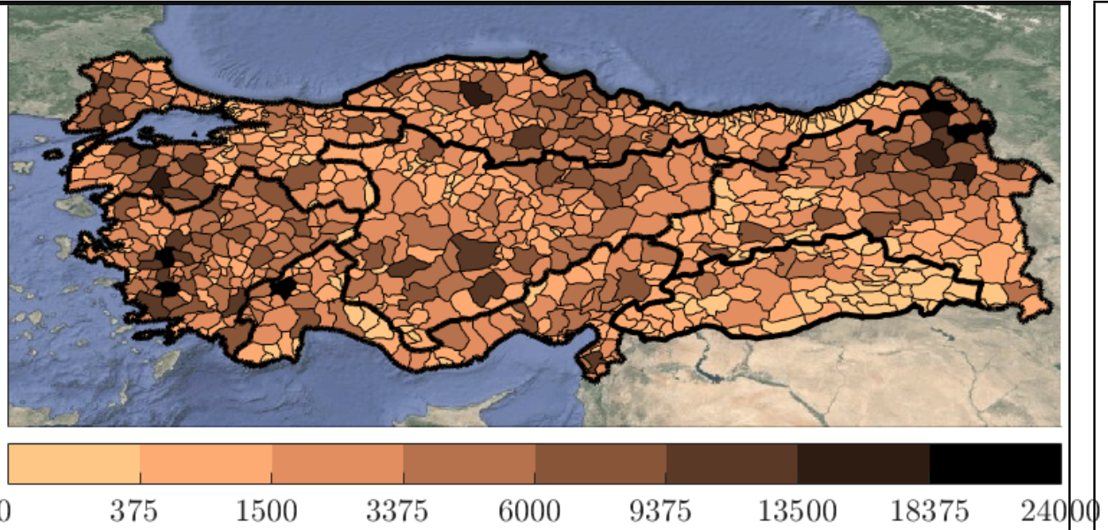
Spatial pattern of movements
Colour shows movements originating in each district.

Slide 13
Spatial pattern of movements
Colour shows movements originating in each district.
High number of out movements in Eastern Anatolia and Aegean Regions.

Slide 14
Spatial pattern of movements
Colour shows movements originating in each district.
High number of out movements in Eastern Anatolia and Aegean Regions.
Very few movements from South-Eastern Anatolia.

Slide 15
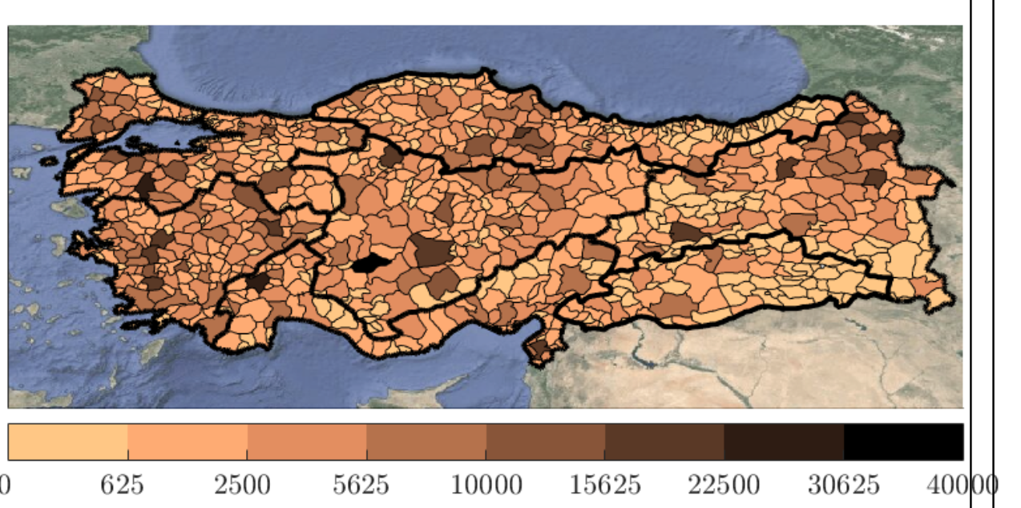
Spatial pattern of movements
Colour shows movements originating in each district.
High number of out movements in Eastern Anatolia and Aegean Regions.
Very few movements from South-Eastern Anatolia.
Similar trends are found when looking at movements into districts.

Slide 16
So how do we establish risk of transmission of a disease such as Foot-and-Mouth Disease in a movement network?

Slide 17
Community structure in Turkey
Can we find “communities” of farms that are at increased risk of being connected to one another?

Slide 18
Community structure in Turkey
Can we find “communities” of farms that are at increased risk of being connected to one another?

Slide 19
Community structure in Turkey
Can we find “communities” of farms that are at increased risk of being connected to one another?

Slide 20
Community structure in Turkey
Can we find “communities” of farms that are at increased risk of being connected to one another?

Slide 21
Community structure in Turkey
Can we find “communities” of farms that are at increased risk of being connected to one another?
Stronger communities

Slide 22
Community structure in Turkey
Can we find “communities” of farms that are at increased risk of being connected to one another?
Stronger communities

Slide 23
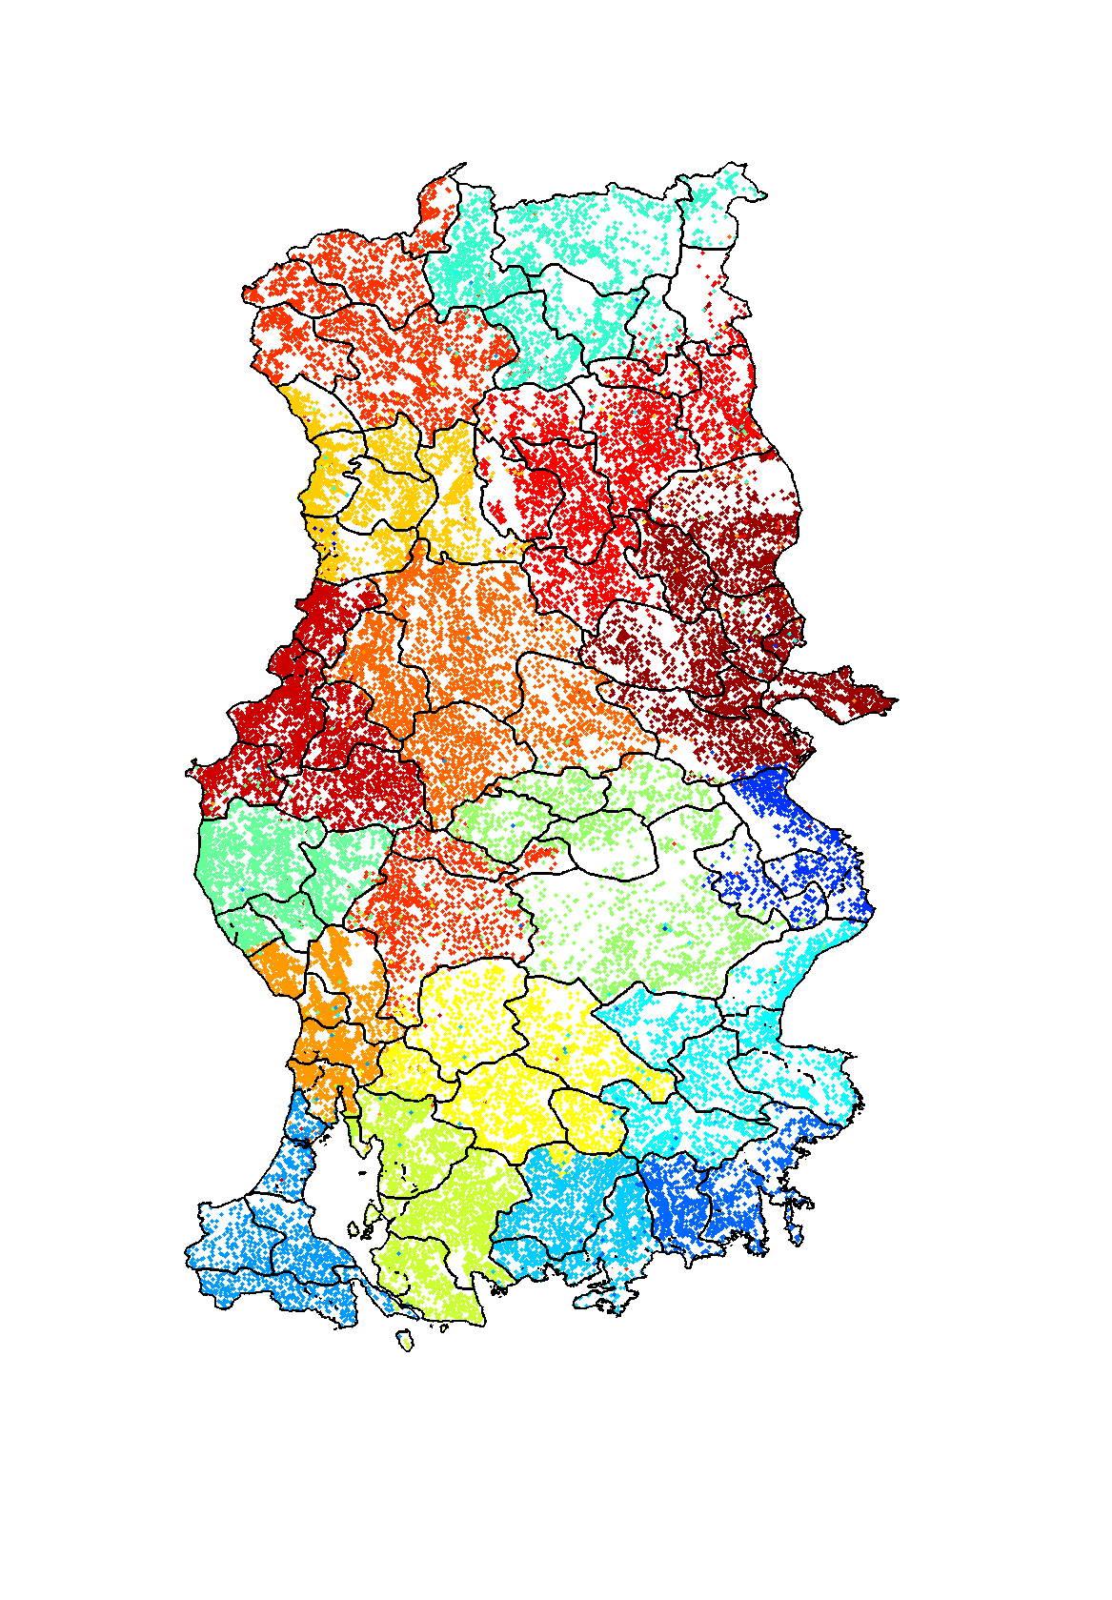
Community Structure in Turkey
Examining the Turkish cattle network we get the following:
Each colour corresponds to a different “community” of farms.
Strong spatial dependence, implying communities are most likely to form with nearby farms.
We can draw polygons around groups of same coloured epi-units to form community regions.

Slide 24
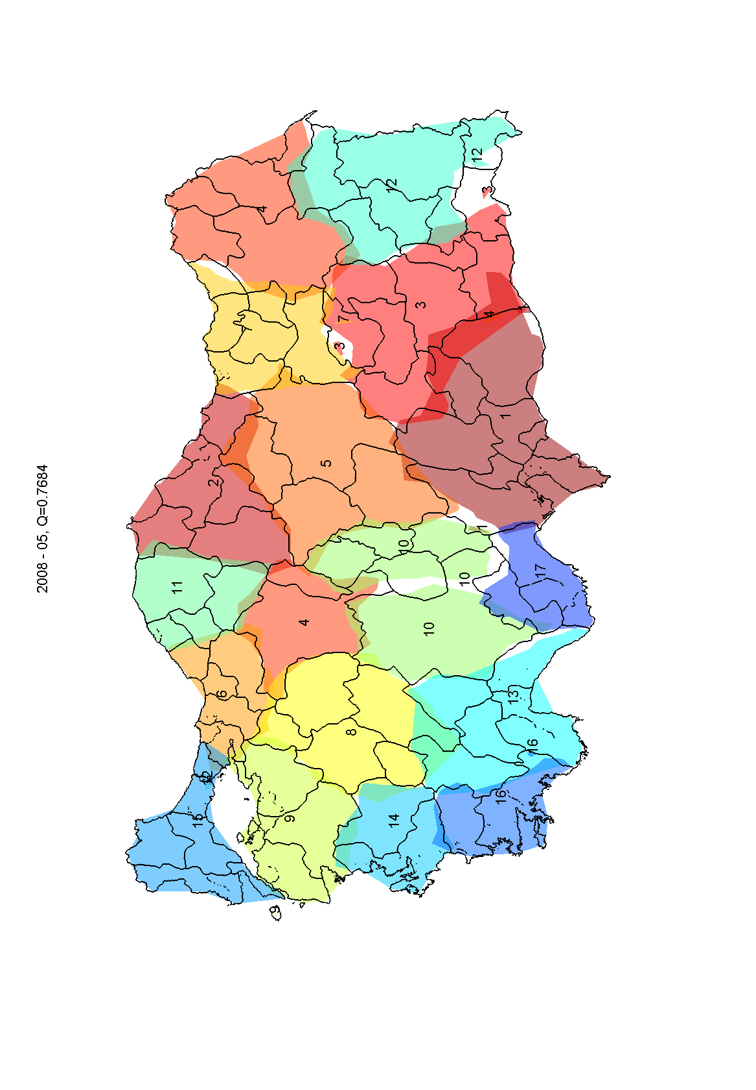
The provinces of Ankara and Erzurum are placed in the same community
Communities 1 and 3 overlap here

Slide 25
The provinces of Ankara and Erzurum are placed in the same community
Communities 1 and 3 overlap here
Community detection could help target FMD surveillance and provide a basis for movement control
Active surveillance could be targeted at high risk regions to reduce the future impact of the disease.

Slide 26
Model

Slide 27
Transmission within epi-units
S
E
I
R
Every animal is given a status
  Susceptible
  Exposed
  Infectious
  Recovered

Slide 28
Model Fitting within epi-units

Slide 29
Model Fitting within epi-units
Outbreaks

Slide 30
Model Fitting within epi-units
Outbreaks

Slide 31
Model Fitting within epi-units
Outbreaks
Model Prediction of within epi-unit infections

Slide 32

Transmission between farms

Slide 33
Transmission between farms

Slide 34
Transmission between farms

Slide 35
Transmission between farms

Slide 36

Transmission between farms

Slide 37
Transmission between farms

Slide 38
Transmission between farms

Slide 39
Transmission between farms

Slide 40
Model
Disease data
Movements
Local Spread
Births and deaths
Strain data
Sheep data
Existing control and vaccination
?????

Slide 41
Impact of Movement Restrictions
The model is now used to simulate the impact of movement restrictions upon disease spread.
We investigate four scenarios:
No movement control
Local movement ban (within 20km)
District level movement ban
Nationwide movement ban

Slide 42
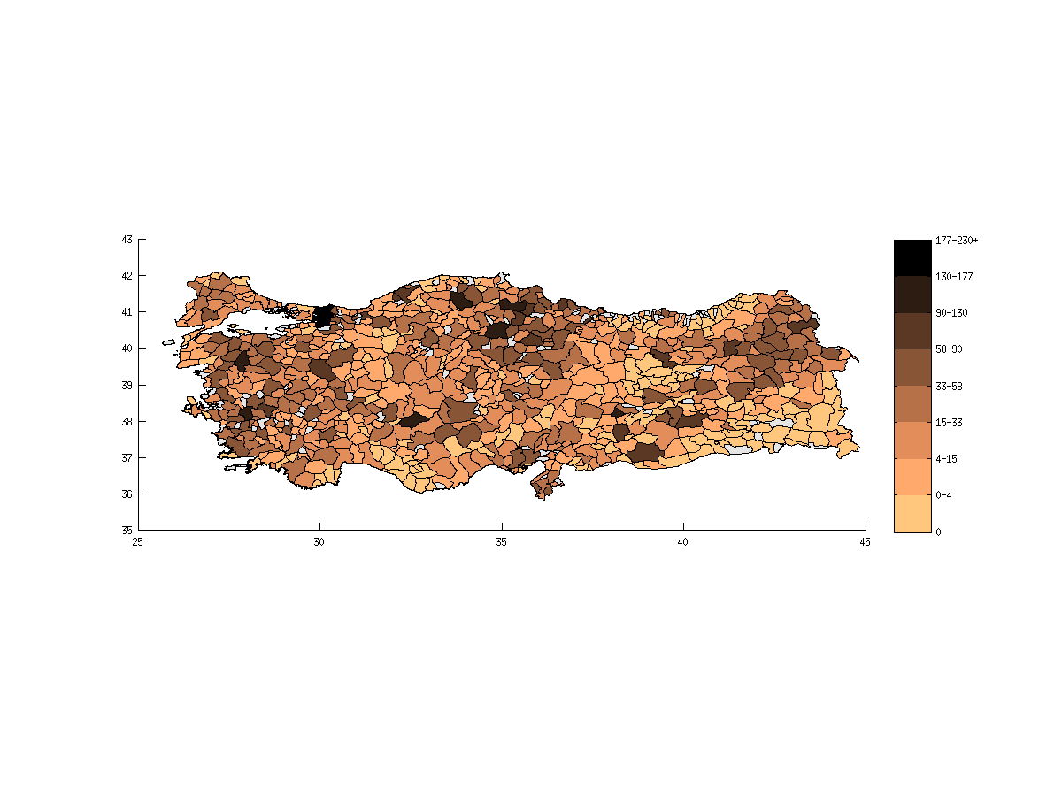
No movement control
Colour scale shows number of farms infected in each district.

Slide 43
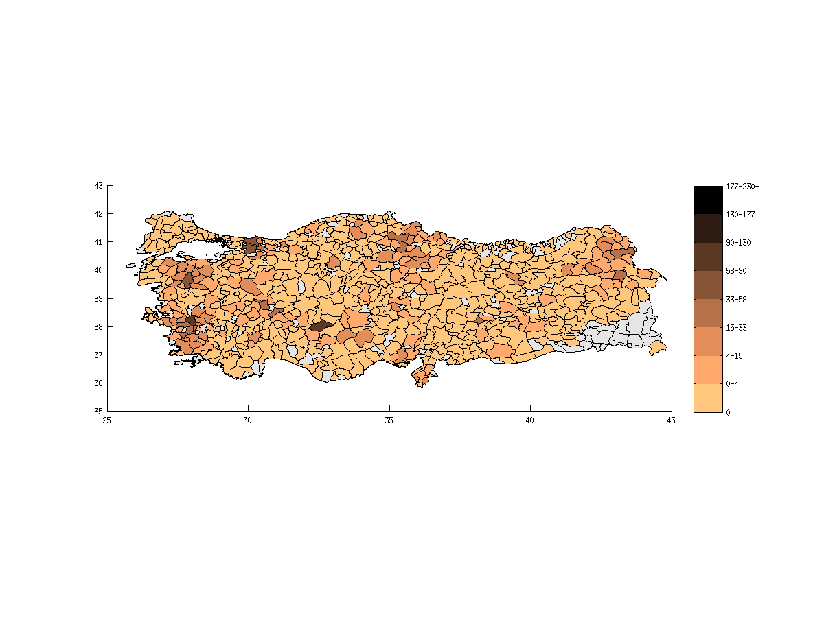
Local movement ban

Slide 44

District level movement ban
District level movement ban

Slide 45
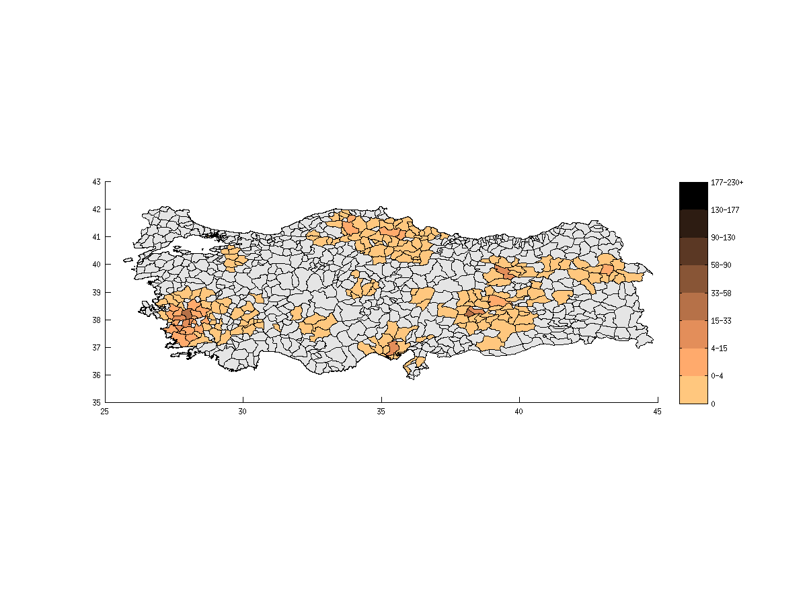
Nationwide movement ban
The model predicts that districts coloured grey will have no reported outbreaks during 2010.
District level and nationwide movement bans prove very effective at controlling the spread of disease.

Slide 46
Conclusions and Further Work
Strong community structure in the farm network – may guide future FMD-surveillance to improve reporting.

Slide 47
Conclusions and Further Work
Strong community structure in the farm network – may guide future FMD-surveillance to improve reporting.
Model predicts that movement control can have a significant impact upon FMD spread at the national scale.

Slide 48
Conclusions and Further Work
Strong community structure in the farm network – may guide future FMD-surveillance to improve reporting.
Model predicts that movement control can have a significant impact upon FMD spread at the national scale.
Model currently being adapted to investigate the role of interventions (e.g. vaccination, culling).

Slide 49



Acknowledgements
Peter Dawson (Warwick)
Matt Keeling (Warwick)
Keith Sumption, Melissa McLaws and EuFMD
Naci Bulut (SAP Institute, Turkey)
Nahit Yazicioglu (Ministry of Food, Agriculture and Livestock, Turkey)
Theo Knight Jones (Pirbright)

