Slide 1
The U.S. Animal Movement Model (USAMM) - A Bayesian approach to modeling a partially observed continental scale livestock movement network
Peter Brommesson, Linköping University

Slide 2
Introduction
Computer simulations of spread of diseases can:
Localize hotspots
Evaluate control strategies
Inform policy regarding preventive actions
Transport data
EU legislations require (computerized) records of cattle transports
USA , Interstate Certificate of Veterinary Inspection (ICVI)

Slide 3
Introduction ctd.
Data
10% ICVI
~19,000 transports
Transport network
Nodes = US. Counties (3108)
Edges = Cattle transports
Parameterized kernel model
Generate new complete networks

Slide 4
Model basics
Data
USAMMv1
(Lindström et al. 2013)
USAMMv2
10% ICVI
Number of farms
Historical inflow
100% Transports
State spec. kernels
Number of trp per state
100% Transports
Estimates per quarter
Attraction estimated
Covariates
10% Super nodes

Slide 5
Model basics
Data
USAMMv1
(Lindström et al. 2013)
USAMMv2
10% ICVI
Number of farms
Historical inflow
100% Transports
State spec. kernels
Number of trp per state
100% Transports
Estimates per quarter
Attraction estimated
Covariates
10% Super nodes

Slide 6
Model basics ctd.
Estimate parameter distribution in a Hierarchical Bayesian framework (MCMC simulations)
Generating from parameter dist. Uncertainty in predictions is accounted for (Bayesian vs ML)

Slide 7
Distance dependence
Different kernel shapes
Kernel value
Displacement Kernel =
(Brommesson et al. 2016)
Distance

Slide 8
Intrastate estimation
Intrastate estimation
Intrastate trp estimation =
#interstate trp + kernel

Slide 9
Base model (USAMMv1)
Data
USAMMv1
(Lindström et al. 2013)
USAMMv2
10% ICVI
Number of farms
Historical inflow
100% Transports
State spec. kernels
Number of trp per state
100% Transports
Estimates per quarter
Attraction estimated
Covariates
10% Super nodes

Slide 10
USAMMv1 results
Overall structure
Betweenness
Density
Betweenness
(Lindström et al. 2013)
Notes:
.

Slide 11
USAMMv1 disadvantages
Underestimates #counties with many transports
No seasonality included
Lacks information on infrastructure

Slide 12
Extended model (USAMMv2)
Data
USAMMv1
(Lindström et al. 2013)
USAMMv2
10% ICVI
Number of farms
Historical inflow
100% Transports
State spec. kernels
Number of trp per state
100% Transports
Estimates per quarter
Attraction estimated
Covariates
10% Super nodes

Slide 13
Extended model (USAMMv2) ctd.
Data
USAMMv1
(Lindström et al. 2013)
USAMMv2
10% ICVI
Number of farms
Historical inflow
100% Transports
State spec. kernels
Number of trp per state
100% Transports
Estimates per quarter
Attraction estimated
Covariates
10% Super nodes

Slide 14
Extended model (USAMMv2) ctd.
Data
USAMMv1
(Lindström et al. 2013)
USAMMv2
10% ICVI
Number of farms
Historical inflow
100% Transports
State spec. kernels
Number of trp per state
100% Transports
Estimates per quarter
Attraction estimated
Covariates
10% Super nodes

Slide 15
Extended model (USAMMv2) ctd.
Data
USAMMv1
(Lindström et al. 2013)
USAMMv2
10% ICVI
Number of farms
Historical inflow
100% Transports
State spec. kernels
Number of trp per state
100% Transports
Estimates per quarter
Attraction estimated
Covariates
10% Super nodes

Slide 16
Three USAMMv2 models
USAMMv1 + Attraction (no covariates)
USAMMv1 + Attraction + additional covariates (covariates only)
USAMMv1 + Attraction + covariates + super nodes ( covariates and super nodes)

Slide 17
Max degree
No covariates
Covariates only
Covariates + Super Nodes
In - degree
Out - degree

Slide 18
Degree distribution
No covariates
Covariates only
Covariates + Super Nodes
In - degree
Density
Out - degree
Density
Degree
Degree
Degree

Slide 19
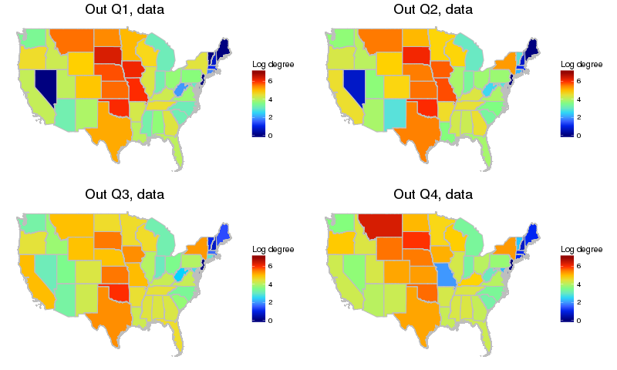
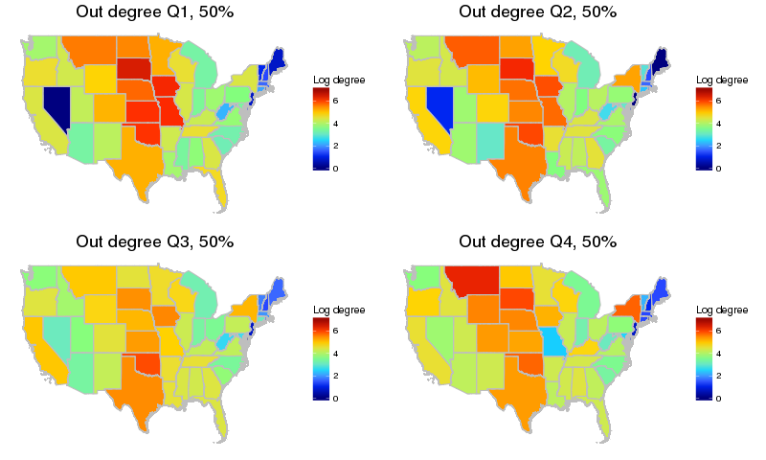
Out-degree
1000 generated networks, median degree
Data
Generated
Q1
Q2
Q1
Q2
Q3
Q4
Q3
Q4

Slide 20
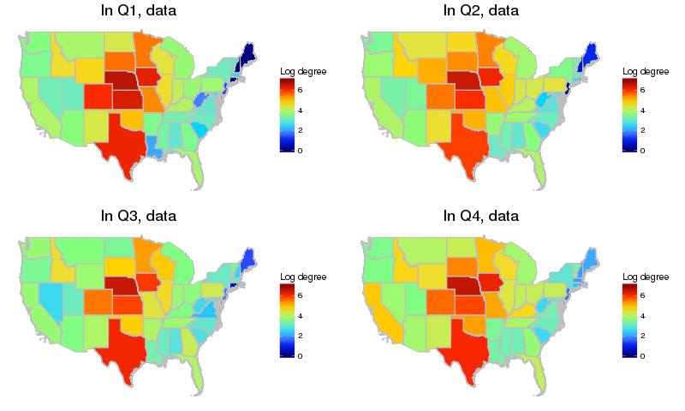
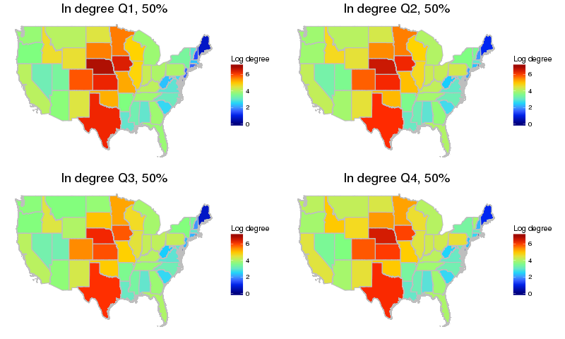
In-degree
1000 generated networks, median degree
Data
Generated
Q1
Q2
Q1
Q2
Q3
Q4
Q3
Q4

Slide 21
Visualization
https://usamm-gen-net.shinyapps.io/usamm-gen-net/

Slide 22
Summary
Better prediction of max degrees
Better prediction of degree distribution, especially highly connected nodes
Capture the total state and quarter specific in/out degree
Seasonal effects less than we anticipated

Slide 23
Acknowledgements
Department of Physics, Chemistry and Biology, Linköping University
T. Lindström
S. Sellman
U. Wennergren
Department of Ecology and Evolutionary Biology, University of California
M. Buhnerkempe
Department of Biology, Colorado State University
L. Beck-Johnson
E. Gorsich
C. Hallman
K. Tsao
C.T Webb
Mathematics Institute, University of Warwick
M.J. Tildesley
USDA APHIS Veterinary Services, Center for Epidemiology and Animal Health
R. S. Miller
K. Portacci
D. Grear
Funding
Foreign Animal Disease Modeling Program, Science and Technology Directorate, U.S. Department of Homeland Security (Contract HSHQDC-13-C-B0028)
European research area: animal health and welfare (ANIHWA; https://www.anihwa.eu) Contract No. ANR-13-ANWA-0007-03 (LIVEepi)

