Slide 1
Real-time updating in emergency response to foot-and-mouth disease outbreaks
Will Probert
Research Fellow, Tildesley Lab
School of Life Sciences, Mathematics Institute
University of Warwick, UK

Slide 2
Acknowledgements
Mike Tildesley Warwick
Chris Jewell Lancaster
Marleen Werkman CVI, Netherlands
Matt Ferrari Penn State
Kat Shea Penn State
Matt Keeling Warwick
Mike Runge USGS
Chris Fonnesbeck Vanderbilt
Satoshi Sekiguchi Miyazaki
Yoshitaka Goto Miyazaki
Ecology and Evolution of Infectious Disease NSF/NIH/BBSRC 1 R01 GM105247-01
Notes:
This is very much a collaborative piece of work between the UK, US, and Japan.
The parameter estimation work was done by Chris Jewell at Lancaster, and the simulation results were run by Michael Tildesley at Warwick University.

Slide 3
In disease control problems, a relationship exists between:
• That is, more informed decisions are made with more information
• Yet, in emergencies we cannot wait for info to accrue; we must act
Information
accrual
Capitalizing upon information by
taking action
Notes:
The idea at the heart of this work … is acknowledging that in emergency outbreak response …
That is, as information accrues we become more informed and therefore are more likely to choose a better action, yet the longer we wait the larger the potential opportunity cost from not acting upon said information.
In the event of an infectious disease outbreak, such as foot-and-mouth disease, decision makers are faced with significant uncertainty yet they have the real problem in that they still have to make decisions. Decisions are hampered by uncertainty.
So we don’t have the luxury to wait around and learn about the disease process, for instance. We must act upon the information at hand.
So we wanted to look at …

Slide 4
  How does information accrual using near real-time updating impact control recommendations when
  using epidemiological models?
Notes:
So what does that mean in regards to how epidemiological models may be used to inform decision making?

Slide 5
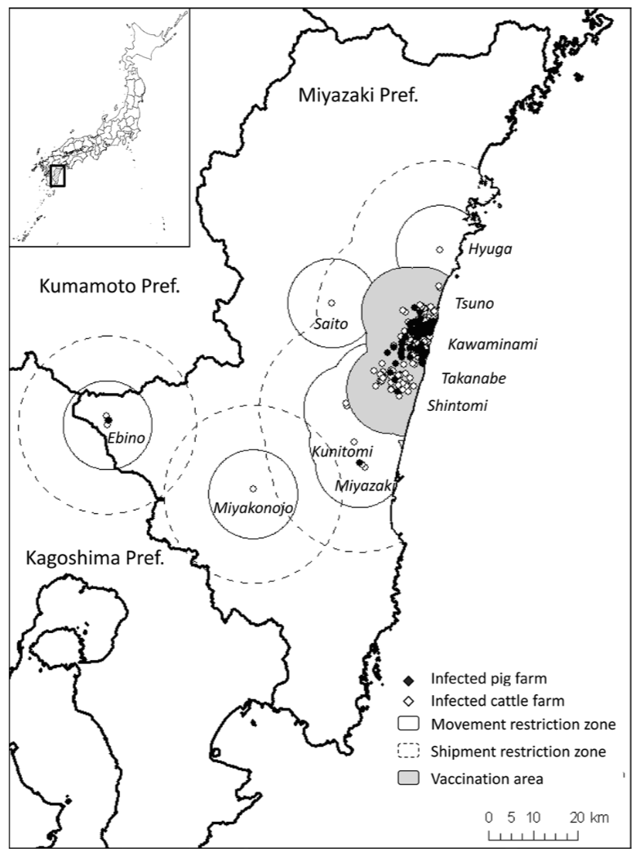
UK 2001; Miyazaki 2010
Contrasting outbreaks
Severity
• >2000 infected premises over 230,000 km²
(across UK)
• 292 infected premises over 8,000 km²
(just Miyazaki prefecture)
Distribution at time of confirmation
• Multiple foci of infection
• Single focus of infection
Control actions applied
• Culling only
• Vaccination due to limits on carcass disposal
Miyazaki prefecture (Muroga et al., 2001)
Notes:
I won’t go into detail, just to say that these two outbreaks were different in many respects so make a provide two case studies that contrast with each other.

Slide 6
Cases
Culled
Infected
26 Feb
2001
24 Dec
2001
Data
Predictive
model
Total culls
Control A
Control B
Control C
26 Feb
2001
Notes:
And the way we tackled this ideas was by looking at fitting data and making forward projections at various times throughout historical outbreaks to see how these changed as information accrued.
So consider this outline …
Our approach to looking at this problem was to essentially re-enacted what policy recommendations would be for several weeks throughout the outbreaks, given the data at hand and compared those recommendations with what would be recommended if we’d had all the data.
The UK outbreak started in February 2001 — and the grey indicates the number of infected farms and the red indicates the number of farms culled over time
So we could take observed outbreak data at a given date, use it to parameterize a predictive model, and run future projections of different interventions to get a ranking of alternatives.
A ranking is not a perfect measure, but it does reflect that at the end of the day, a policy decision regarding control must be made (so one of the control actions needs to be adopted), so a ranking is implicit. It’s best we be explicit about this.

Slide 7
Cases
Culled
Infected
26 Feb
2001
24 Dec
2001
Data
Projections are conditional on:
Predictive
model
• parameter estimates
• state of the outbreak
Control A
Control B
Control C
Notes:
The projections we get are conditional upon parameter estimates and the state of the outbreak at that point in time.

Slide 8
Cases
Culled
Infected
26 Feb
2001
Confirmed Infected
Susceptible
Data
Predictive
model
Control A
Control B
Control C
Notes:
What I mean by the ‘state’ of the outbreak the distribution of confirmed and susceptible premises.
Just to be clear, we’re talking about a herd-level stochastic model here.

Slide 9
Cases
26 Feb
2001
Confirmed Infected
12.5
*
*
62.1
Susceptible
Data
Undetected infection
I =
We’re also estimating
the infection times of
undetected infections
Control A
Control B
Control C
Notes:
We’re not only estimating transmission parameters but we’re also estimating …
But we’re not only acting upon confirmed infected cases, we can do better than that using methodology that Chris has outlined – we can estimate undetected infections also.
We can think of these as estimating a vector of infection times. So we’re not assuming there’s a fixed time between infection and confirmation.

Slide 10
Cases
Culled
Infected
26 Feb
2001
24 Dec
2001
Data
Projections are conditional on:
Predictive
model
• parameter estimates
• state of the outbreak
• known infecteds
• inferred infecteds
Control A
Control B
Control C

Slide 11
Cases
Culled
Infected
5 Mar
2001
24 Dec
2001
Data
Total culls
Predictive
model
Control A
Control B
Control C
26 Feb
2001
5 Mar
2001
Notes:
We then do this for a week later on the 5th March

Slide 12
Cases
Culled
Infected
5 Mar
2001
24 Dec
2001
Data
Total culls
Predictive
model
Control A
Control B
Control C
26 Feb
2001
5 Mar
2001
12 Mar
2001
Notes:
We then do this for a week later on the 5th March

Slide 13
Cases
Forward projections based
upon ‘accrued’ information
Culled
Infected
24 Dec
2001
Total culls
Control A
Control B
Control C
26 Feb
2001
5 Mar
2001
3 Sep
2001
Notes:
Until we have done this for the duration of the outbreak.
So we can get an idea of what the recommended control actions would be at each week throughout the 2001 outbreak.

Slide 14
For each week:
Update parameters with new data
McMC estimation methods (Jewell et al. (2009) Interface)
Species-specific, herd-level, infection model
Joint distribution of transmission parameters and undetected IPs
Conditional on true outbreak until that week
Generate forward projections
Under several control strategies
Based upon confirmed IPs and undetected IPs
Keeling et al. (2001) Science; Tildesley et al. (2008) Proc B.
Notes:
16 parameter species-specific herd-level infection model
Mention the cloud of points.
Conditional on true outbreak in question – so we were not looking at an uncontrolled outbreak at any point.
We have a cloud of points – an empirical distribution of parameter estimates and we’re drawing randomly from these to seed the forward simulations.

Slide 15
Cases
Forward projections based
upon ‘complete’ information
Culled
Infected
24 Dec
2001
Data
Predictive
model
Total culls
Control A
Control B
Control C
26 Feb
2001
5 Mar
2001
Notes:
So the distribution of parameters don’t change and only the underlying state of the system changes.
And we can get an idea of what our control recommendations would be given we had all the data … allowing us to isolate this effect of information accrual.
We’re going to call these forward projections those based upon ‘complete’ knowledge.

Slide 16
UK
Notes:
As a sort of proxy for R0, and as a way to summarise the parameters, we looked at measure of the risk of onward transmission.
I haven’t shown all time steps, just the first 5 and then the final week.
Just to show that uncertainty decreases through time, as does the risk of onward transmission.

Slide 17
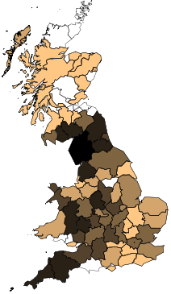
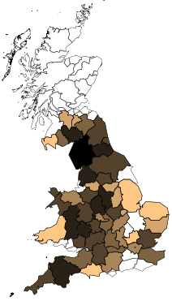
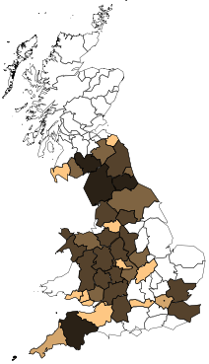
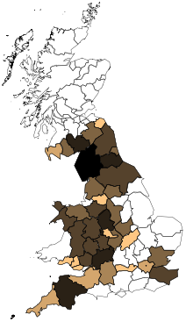
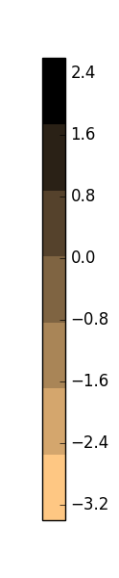
Expected no.
undetect IPs
(log10)
UK
Accrued
Complete
Accrued
Complete
Week 2
Week 3
None
Notes:
We can also summarise the uncertainty associated with the spatial distribution of undetected infected premises.
In the UK there are so many farms so here it’s summarised using the expected number of undetected infections …
Here is the expected number of undetected infections per county at weeks 2 and 3, both when we’re estimating it using only the data available (accrued; left) and all the data (complete; right).
Our understanding of where undetected infections are improves through time.

Slide 18
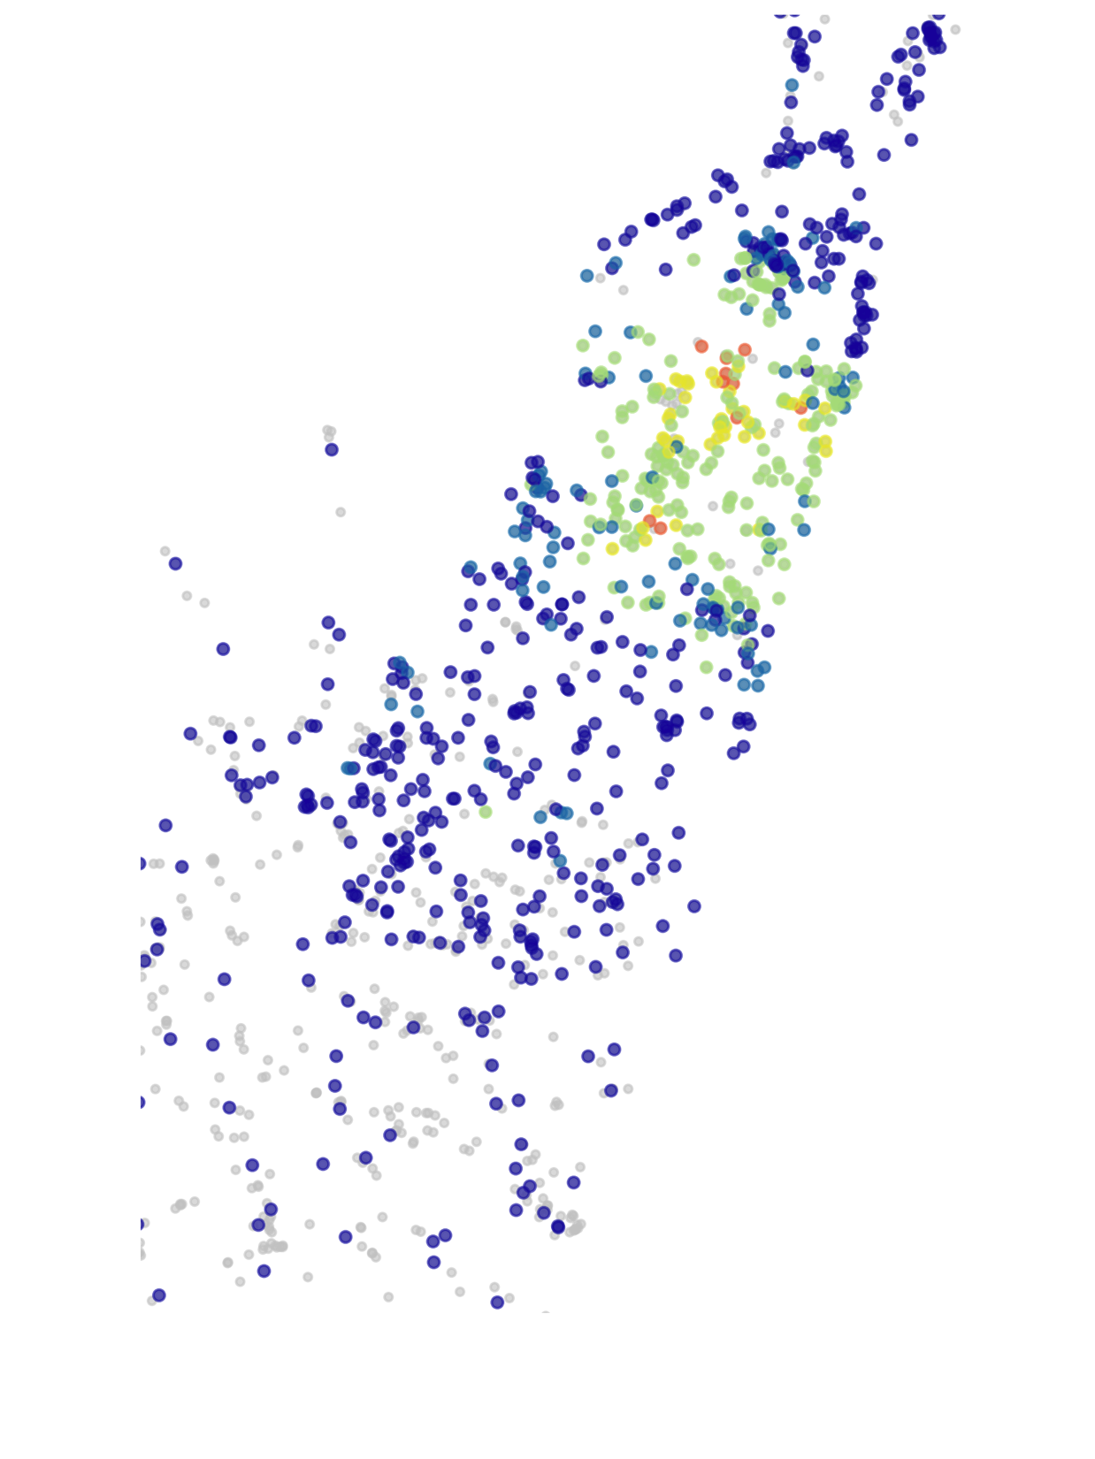
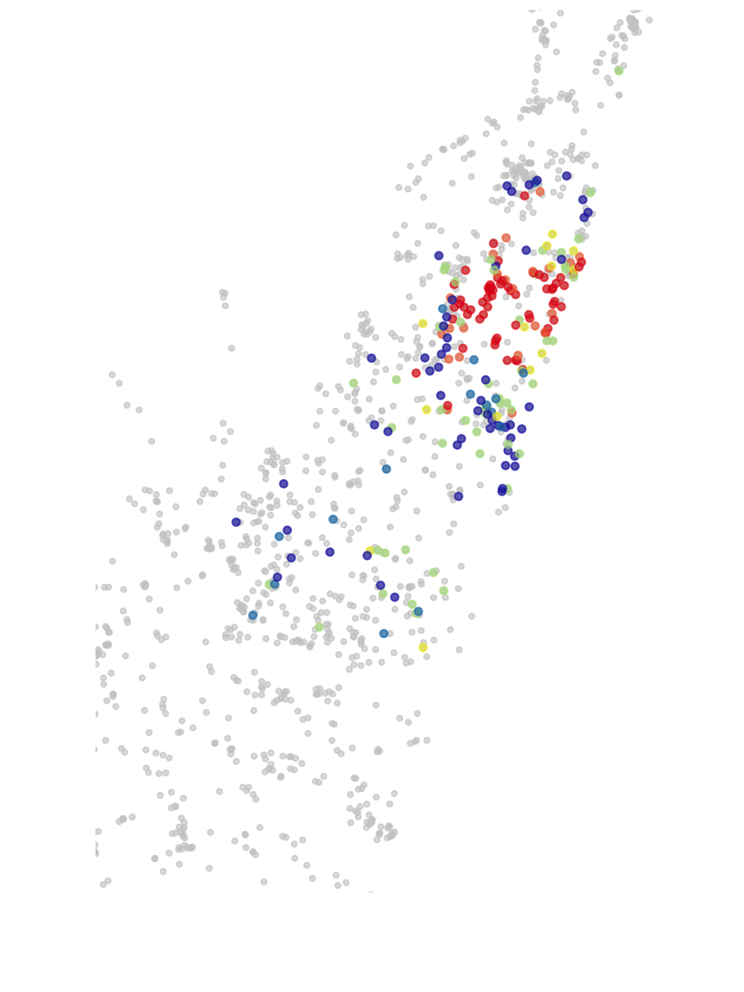
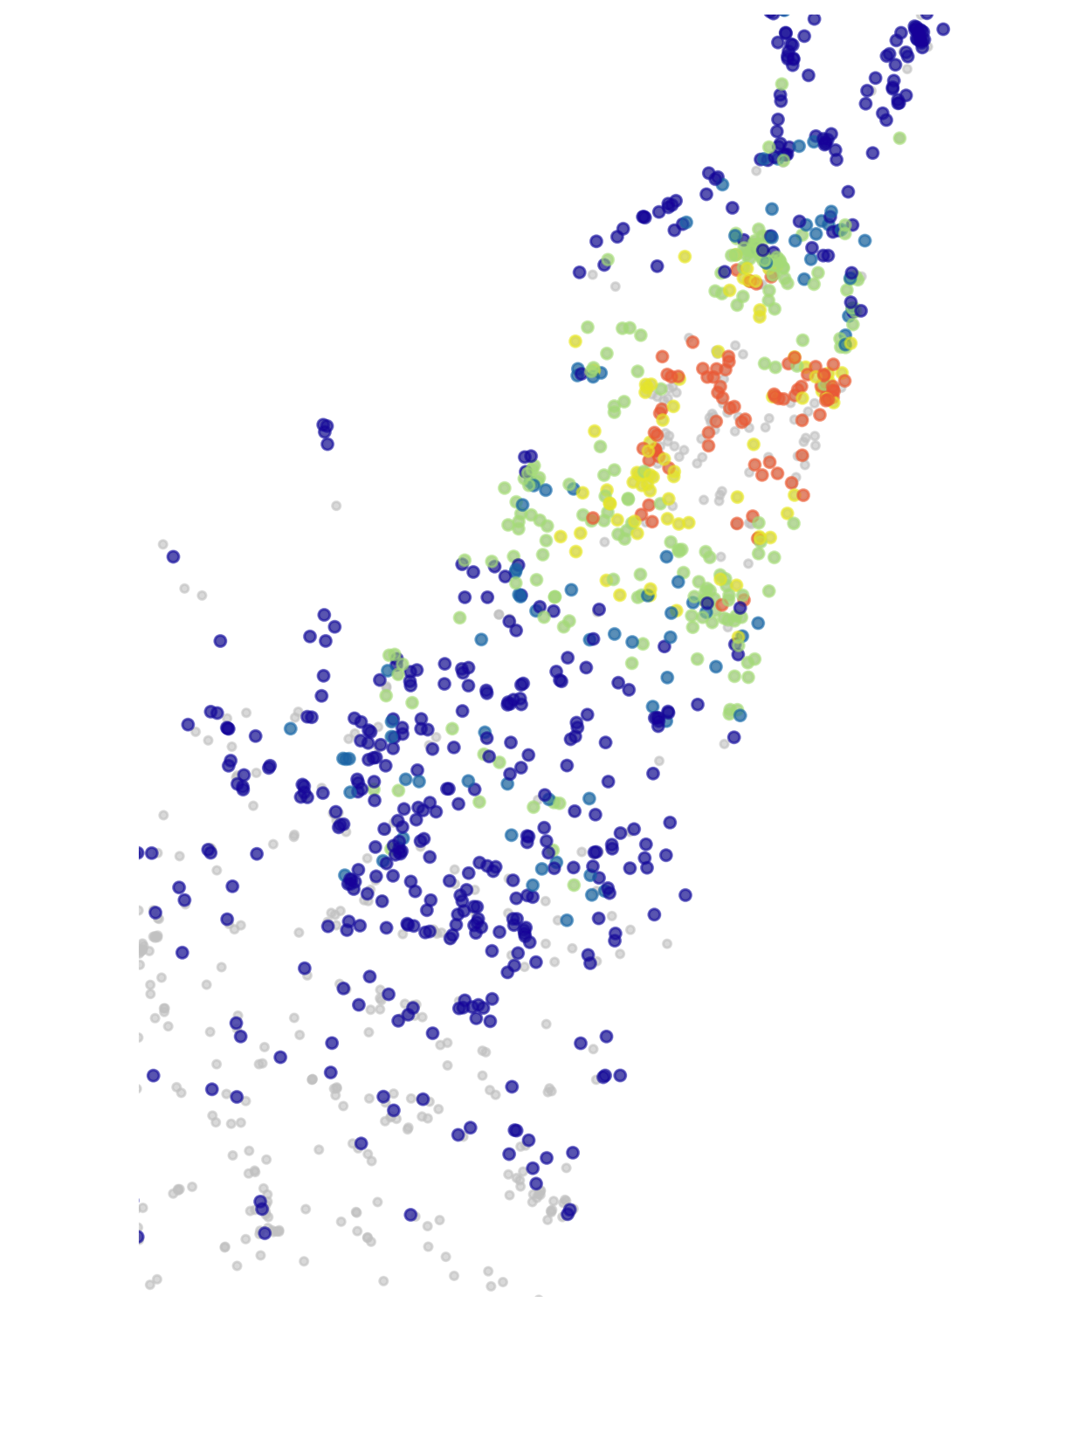
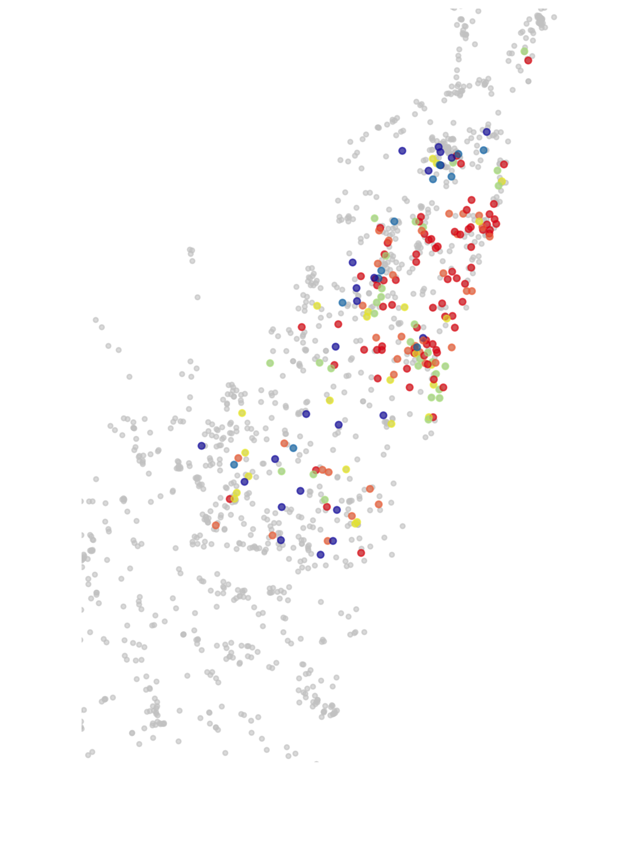
Japan
Accrued
Complete
Accrued
Complete
Week 2
Week 3
Pr(undetected IP)
Notes:
And for Japan.
Shown here are the actual probability of being an undetected infection since there are fewer premises
So similarly we have a decrease in uncertainty through time, in both parameter estimates and our understanding of where infected premises are.
But how do these changes translate into recommendations of control actions?

Slide 19
Projections of outbreak size (total culls)
Rankings of control actions
Proportion of simulations in which control was optimal
Time
Notes:
Our results for the forward simulations look like this … I’m going to show you set of plots that have three panels.
Top panel – distribution in outcomes from that point onward under a range of control actions. 2000 simulations
Middle panel – is the ranking of those control actions according to the median of the top panel
Bottom panel – the bottom panel is the proportion of times each control action was optimal from those runs. You can think of it as how much the top panels overlap
The bottom axis is time.

Slide 20
Culling of infected premises (IP)
Projections of outbreak
size (total culls)
Culling of IP and dangerous
contacts (DC)
Culling of IP, DC and
contiguous premises
Rankings of
control actions
Proportion of simulations
in which control was optimal
Notes:
Control actions are …

Slide 21
Culling of infected premises (IP)
Projections of outbreak
size (total culls)
Culling of IP and dangerous
contacts (DC)
Culling of IP, DC and
contiguous premises
Ring culling at 3km
Rankings of
control actions
Ring culling at 10km
Proportion of simulations
in which control was optimal

Slide 22
Culling of infected premises (IP)
Projections of outbreak
size (total culls)
Culling of IP and dangerous
contacts (DC)
Culling of IP, DC and
contiguous premises
Ring culling at 3km
Rankings of
control actions
Ring culling at 10km
Ring vaccination at 3km
Proportion of simulations
in which control was optimal
Ring vaccination at 10km

Slide 23
UK
Projections of
outbreak
size
Rankings of
control actions
Proportion of
simulations in
which control
was optimal
Notes:
As information accrues …
We can see our projections start off large, and decrease as time move on.
Not only do our projections change but the rankings of relative controls change through time.
Our projections change AND the rankings of recommended control action change.
But how do these compare with what we’d predict at each week if we had all the data?

Slide 24
UK
Compared with projections based upon all data
(‘complete’ information)

Slide 25
UK
Early-on, projections over-estimate outbreak severity
Notes:
Projections are doubley-poor at the start because: 1) we don't know where the occult infections are and, 2) because we have bad estimates of the parameters.

Slide 26
However, relative rankings
are resolved after 5 weeks
UK
Notes:
Rankings of controls are identical after 5 weeks of data.

Slide 27
Week 3 sees a large change in
rankings of optimal control
UK
Notes:
Rankings of controls are identical after 5 weeks of data.
And the relative performance becomes much more in-line with those had we had all the data.

Slide 28
UK
Accrued
Complete
Accrued
Complete
Week 2
Week 3
Notes:
What’s driving this change in control our understanding of where infected premises are located.
So it’s this change in the spatial distribution of our understanding of where infected premises are that’s driving changes in control actions.

Slide 29
Japan
Notes:
When we look at simulation results from Japan we don’t see such a dramatic change in control recommendations.

Slide 30
Japan
Notes:
We do see flare-ups as second foci of infection occur, but these are not enough to change the recommended control action.
As the outbreak was largely confined to a single point of infection and the resource constraints were never challenged.

Slide 31
Summary
• Early rankings of control actions may be robust despite poor early projections
• focus on relative performance of actions; not absolute size of projections
• reassuring our use of models in the early stages of an outbreak
• Optimal action strongly influenced by spatial distribution of IPs
• Important to re-evaluate performance of actions as state changes
• Estimation of both infection parameters and undetected IPs is intertwined
• Control needs to adapt to the specific realisation of the outbreak at hand
• Reinforcement learning methods can offer solutions
Notes:
1) This is …
• reassuring our use of models in the early stages of an outbreak
2)
We saw that changes to control recommendations occurred even when using static (final) parameter distribution
• near real-time updating is possible and this illustrates the necessity
3)
Methods from the artificial intelligence literature, such as reinforcement learning, can offer solutions to generating control strategies that adapt to a changing outbreak
• this is something that we’ve been working on, so please come and chat afterwards if this is of interest.

Slide 32
Thank you
Will Probert
Research Fellow
University of Warwick,
Coventry, UK
Email: w.probert@warwick.ac.uk
Web: www.probert.co.nz
Acknowledgements
Mike Tildesley Warwick
Chris Jewell Lancaster
Marleen Werkman CVI, Netherlands
Matt Ferrari Penn State
Kat Shea Penn State
Matt Keeling Warwick
Mike Runge USGS
Chris Fonnesbeck Vanderbilt
Satoshi Sekiguchi Miyazaki
Yoshitaka Goto Miyazaki
Ecology and Evolution of Infectious Disease NSF/NIH/BBSRC 1 R01 GM105247-01

