Slide 1
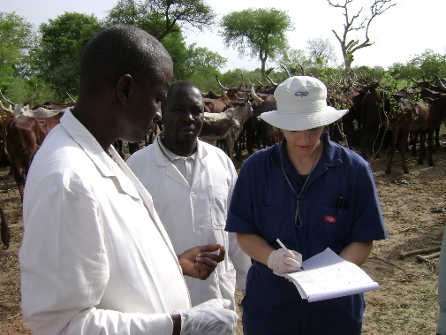
H.A.E.B.O.S. a Hybrid Agent- and Equation-based Behavioral Outbreak Simulator
AJ Yoak¹, RB Garabed¹, AH Delgado²
1 The Ohio State University, Department of Veterinary Preventive Medicine
2 Center for Epidemiology and Animal Health, US Department of Agriculture

Slide 2
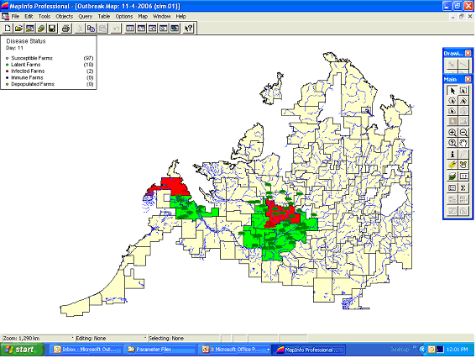
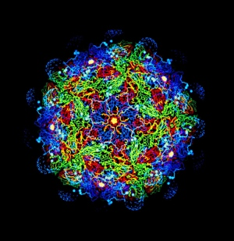
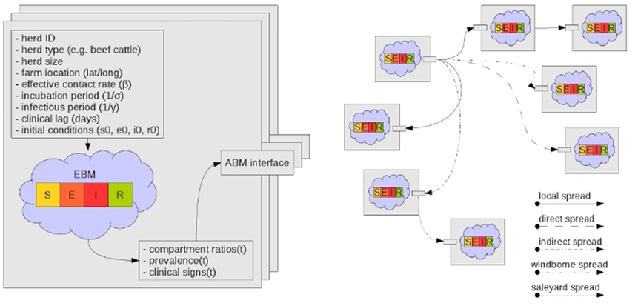
Modeling Foot and Mouth
AuSpread
A long history of FMD Models
AusSpread
ADDIS
DADS/DTU DADS
Interspread (+)
NAADSM
Labute Model
Bradhurst et al 2015

Slide 3
Modeling With Agent-Based Models
“Agent” or “Individual”-based models apply a list of simple (or complex) commands to a group of agents acting independently
Here we are using NetLogo v5.3.1

Slide 4
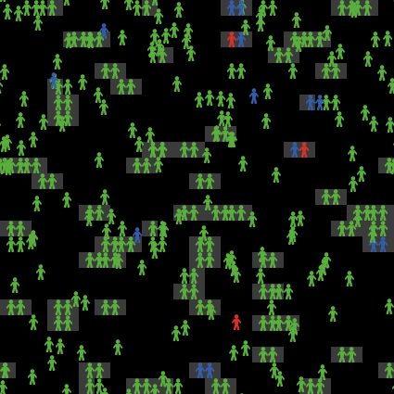
Modeling With Agent-Based Models
From simple rules, complex interactions and patterns can emerge

Slide 5
Modeling With Agent-Based Models
These types of models allow easier understanding of:
Spatial patterns
Heterogeneities in actions/responses
Contact and network structures
Especially important in highly stochastic systems
Rahmandad & Sterman 2004

Slide 6
Farmer Compliance Influences Disease Outbreak Demographics
Here we focus on two specific farmer compliance behaviors
Likelihood to report disease
Likelihood to follow movement restrictions
Large, long outbreaks are reached more often with more non-compliant farms

Slide 7
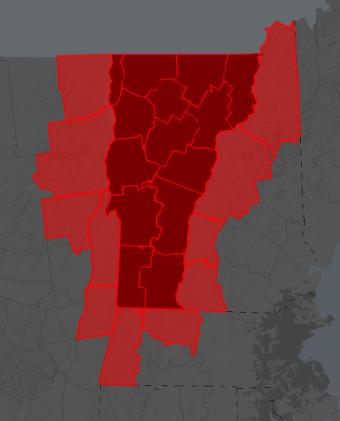
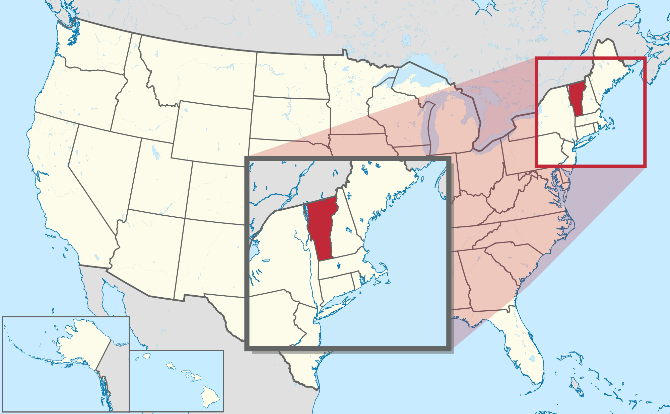
Study Location
We focus this initial study in Vermont, USA and the proximate counties in the surrounding states
Why?
From FLAPS

Slide 8
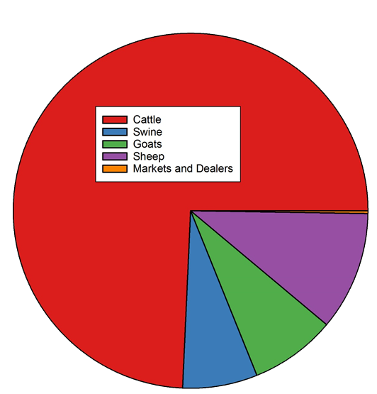
Study Location
Includes 11,401 farms
This area is predominated by cattle operations
Cattle farms are mostly beef but there are dairy farms

Slide 9
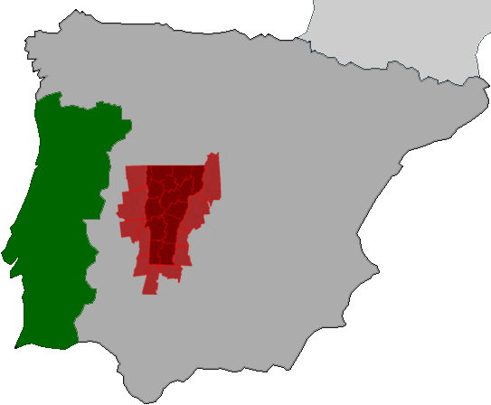
Study Location
Model’s total area is 56,029 km²
~60% of Portugal’s landmass

Slide 10
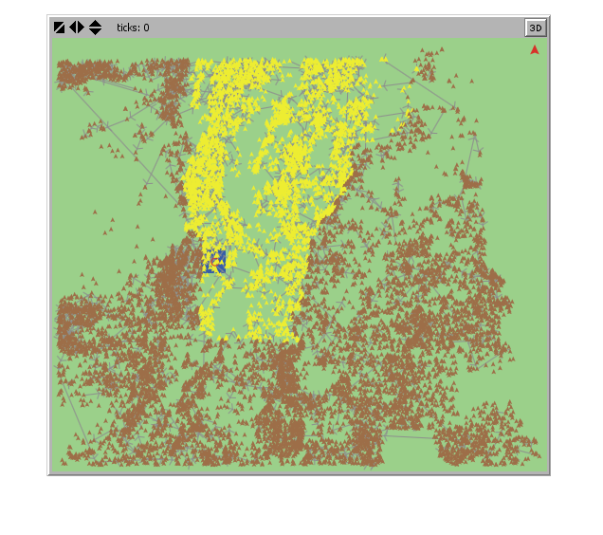
Data Sources
Input data was produced by FLAPS (farm location and animal population simulator, Burdett et al. 2015)
Generalized data created from summaries of real-world farm locations creates pseudo-real farms
Based on the Census of Agriculture done by the National Agricultural Statistics Service
HAEBOS model

Slide 11
An Introduction
HAEBOS is a hybrid model, meaning it operates using both traditional equation-based compartmental models and agent-based models
An ‘agent’ is the farm
It has unique traits such as:
Location
Species and Number of animals present
Commodity Type
Compliance Behavior
Etc.

Slide 12
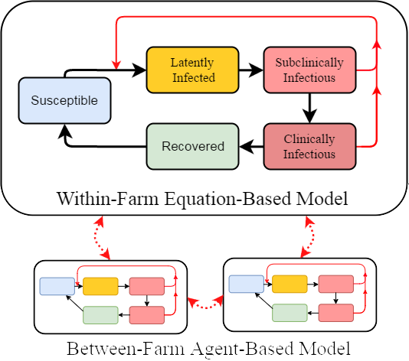
An Introduction
Within each farm, the number of animals in each disease class is determined by an unique SEI_{s}I_{c}R model
Spread of disease between farms is driven by stochastic agent-based actions

Slide 13
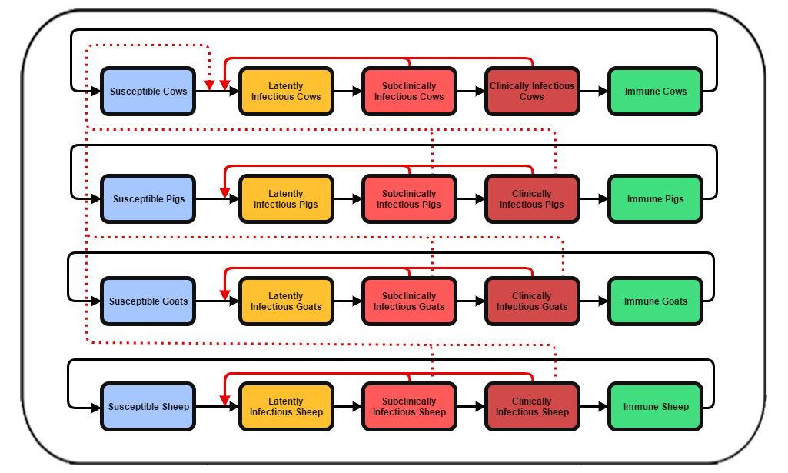
Within-Farm Equation-Based Model
Four compartmental models run simultaneously in each infected farm
The between species force of infection (dotted-line) is lowered by 90%

Slide 14
Between-Farm Agent-Based Model
We model FMD spread through five possible spread mechanisms:
Local Area Spread
Direct Transfer of infected livestock
Indirect Spread because of shared resources
Airborne Spread
Milk Tanker Spread

Slide 15
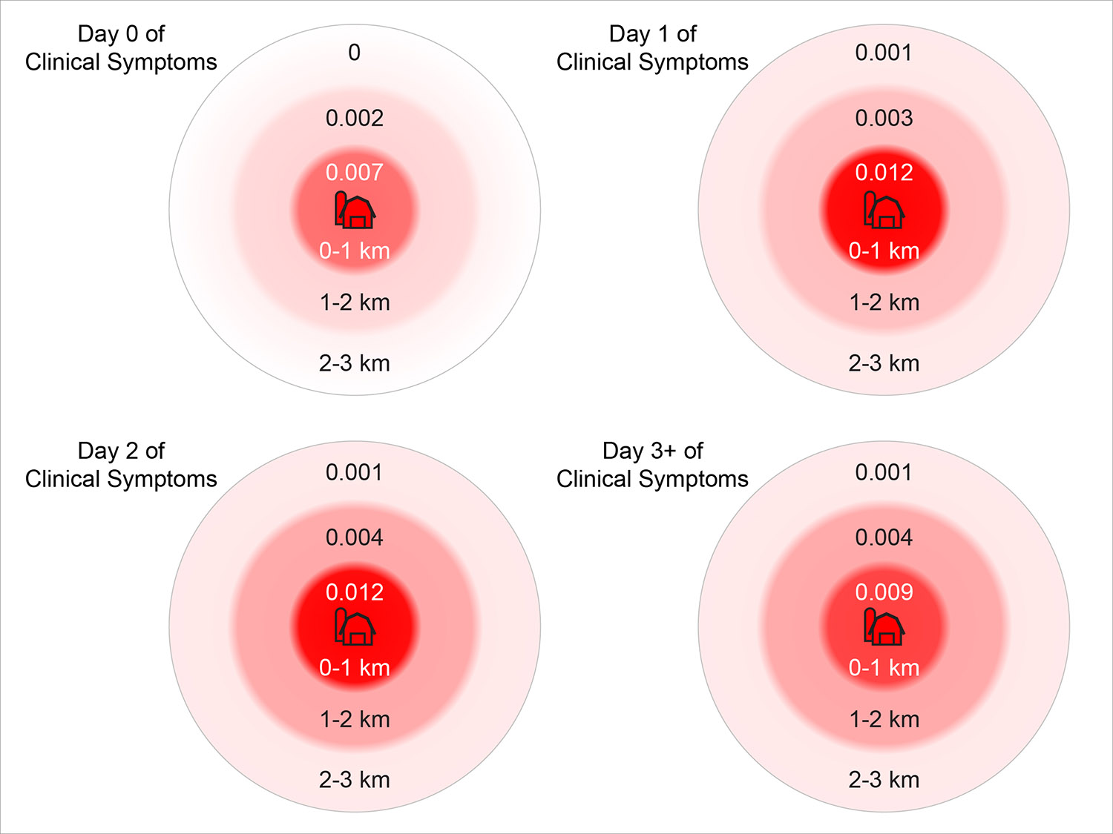
Between Farms: Local Area Spread
Local Area Spread which is influenced by:
Distance from source farm
Time since infection began on source farm
Based on Sanson, Stevenson, and Moles-Benfell’s 2006 figures

Slide 16
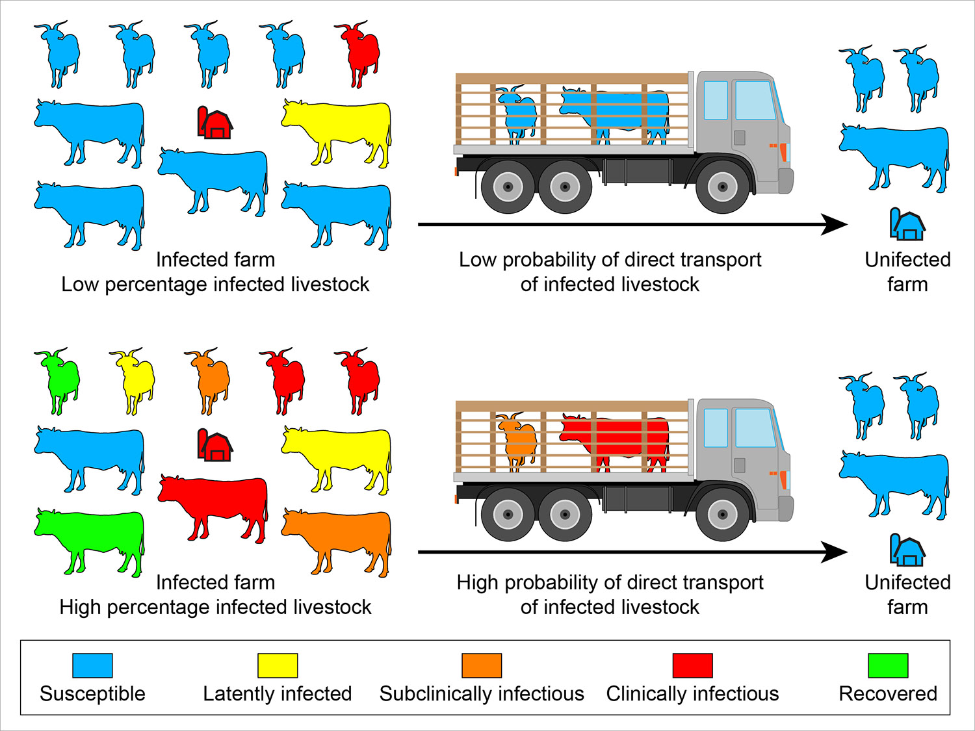
Between Farms: Direct Transfer
Direct Transfer of infected livestock
Using real-time prevalence created by the within-herd model
Shipments are built by roulette wheel selection

Slide 17
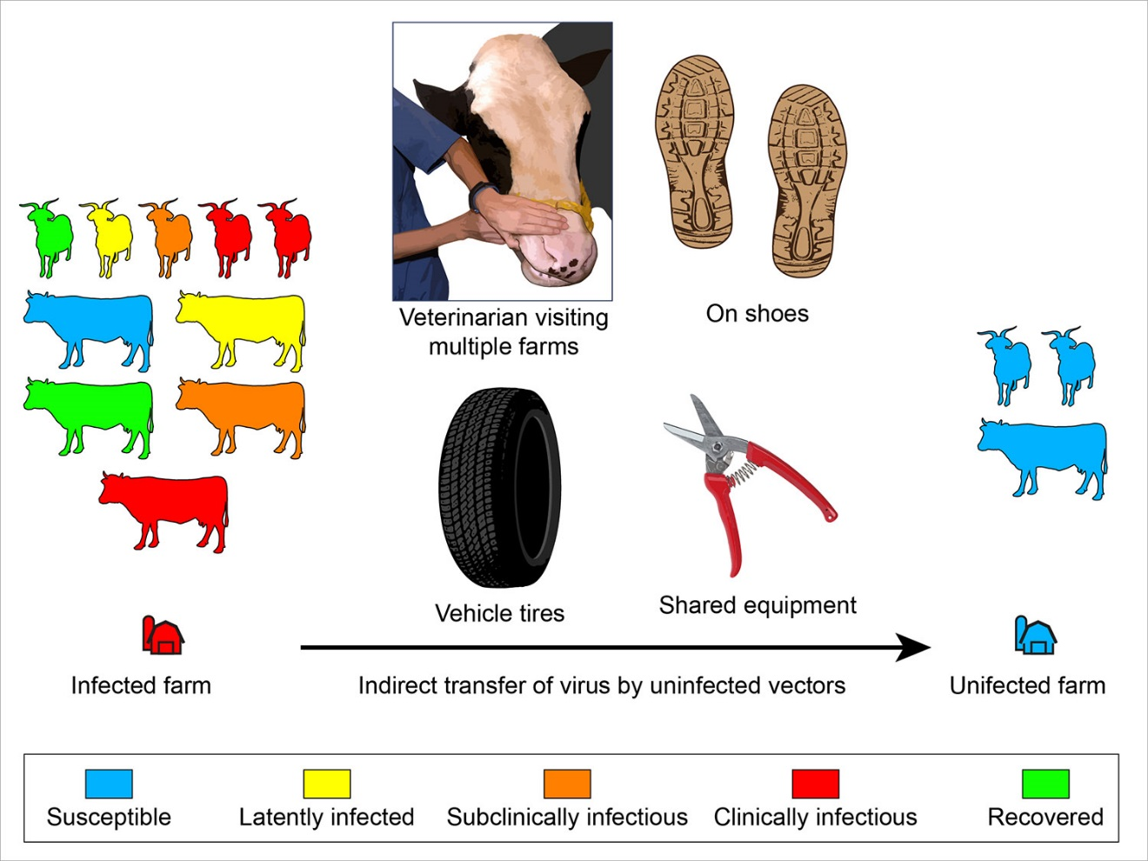
Between Farms: Indirect Spread
Indirect Spread represents:
Shared farm workers, veterinarians, or equipment
Common Feed trucks
Uses CEAH estimates from NAHMS and other national surveys

Slide 18
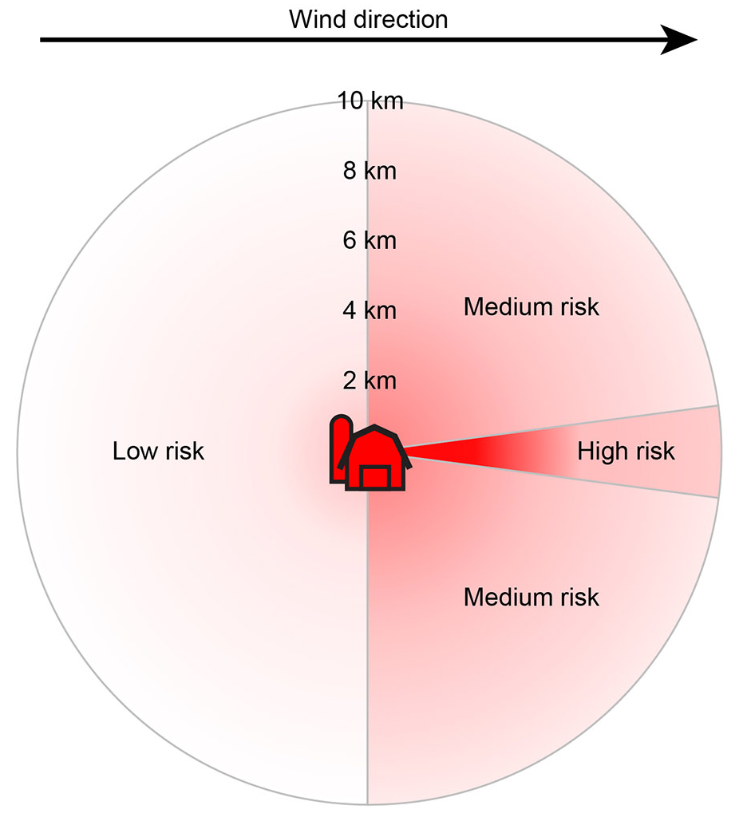
Between Farms: Airborne Spread
Airborne Spread which is influenced by:
Wind direction
Distance
Species of source farm
Species of target farm
We use Interspread+ parameters

Slide 19
Between Farms: Airborne Spread
Wind Direction data was compiled from ASOS meteorological stations in Vermont.
Collected using the reim R package
Monthly data was summed to weight direction
Example Wind Direction counts showing speed as color

Slide 20
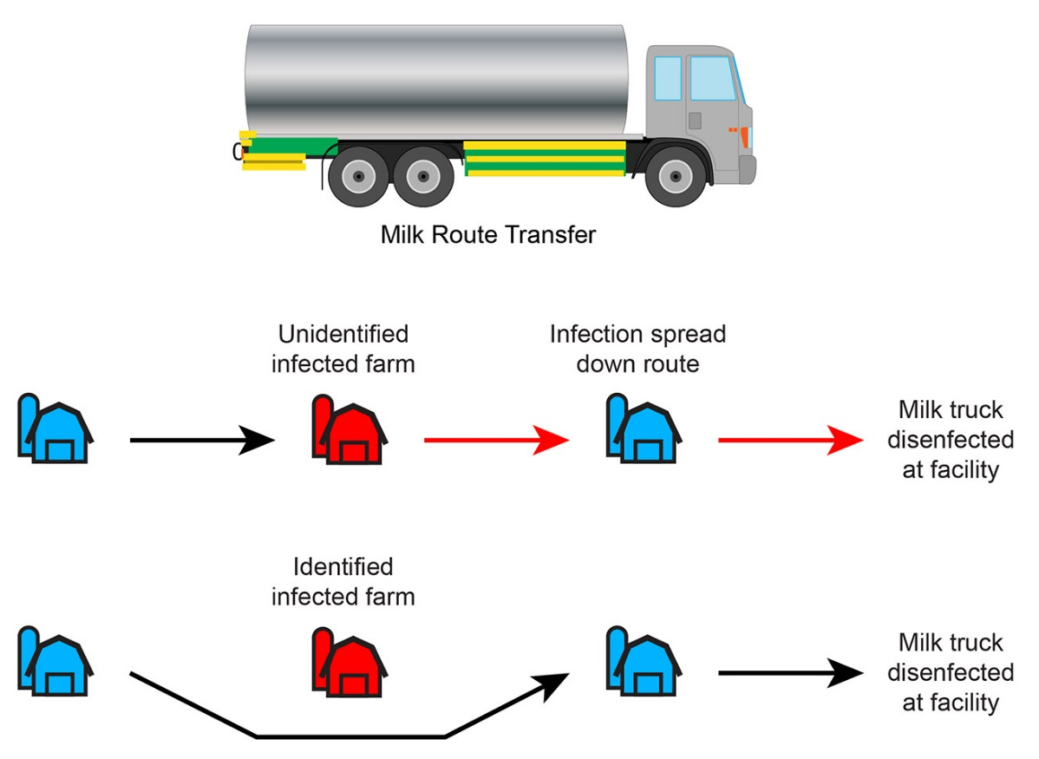
Between Farms: Milk Tanker Spread
Milk Tanker Spread
Moved by tankers on a realistic network from Vermont data (collected by J Smith and analyzed by H Kim)
Infected farms can be removed from network upon discovery of disease
Parameters from USDA risk assessment

Slide 21
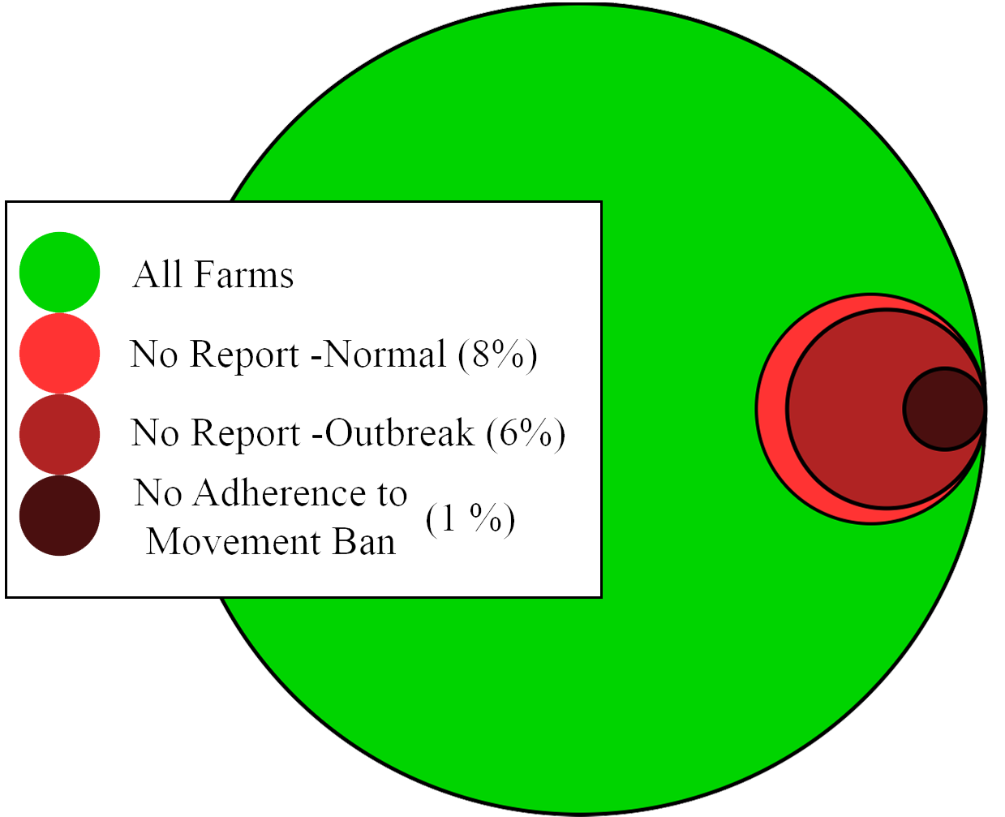
Farmer Compliance Behavior
There’s concern that non-compliance with reporting and movement restrictions would severely worsen the outbreak
This is built in to the ABM by altering farmer compliance rates
Estimates taken from Delgado et al. 2014
Baseline Degree of Compliance

Slide 22
Detection
A farmer is assumed to survey 15 animals each day sufficiently enough to detect disease.
Discovery is influenced by
Farm size
Real-time prevalence of clinical animals
$$\left.Detection Probability=15 ×(Current Clinically Infected Prevalence\right)$$

Slide 23
Outbreak Control
Once reported, depopulation teams build up slowly in the system
Depopulation permanently removes farm from model
No vaccination currently

Slide 24
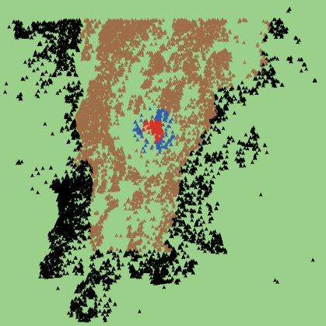
Outbreak Control
Areas around known infected farms have :
a 10 km Movement Ban Zone
a 20 km Surveillance Zone
These zones
Increase detection rates
Decrease spread (except airborne and local area spread)
Known Infected Farm

Slide 25
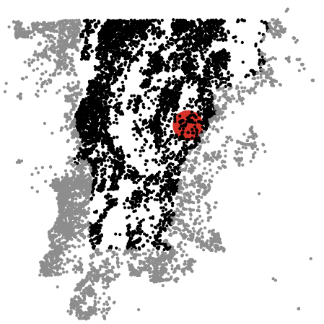
Study Experiments
We can vary the initial infected farm’s:
Location
Commodity Type
Compliance Behavior
As well as the population’s degree of compliance behavior

Slide 26
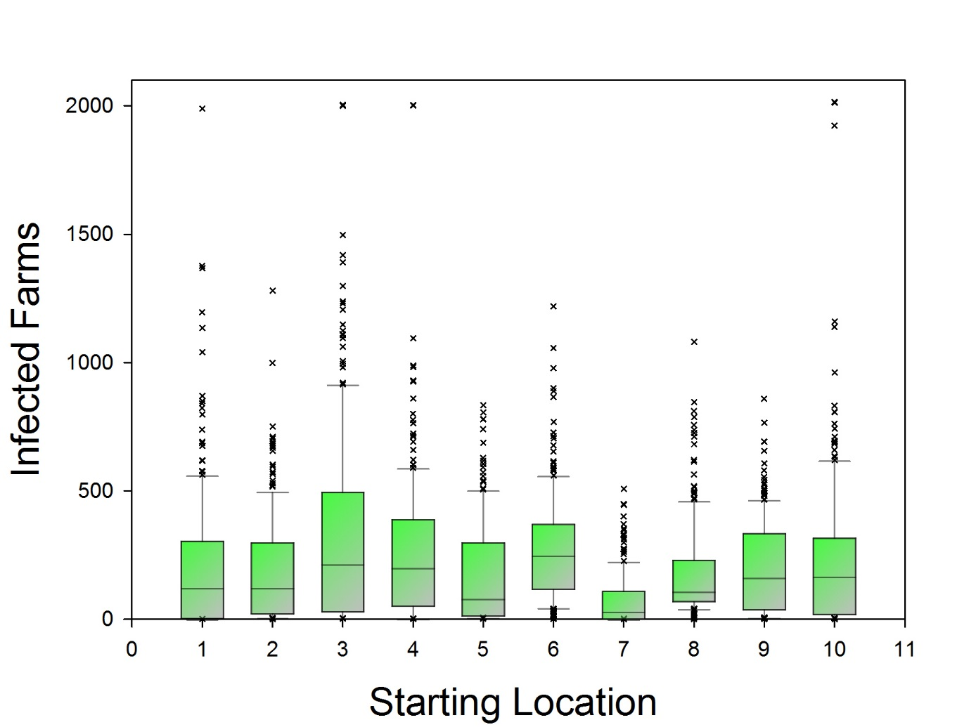
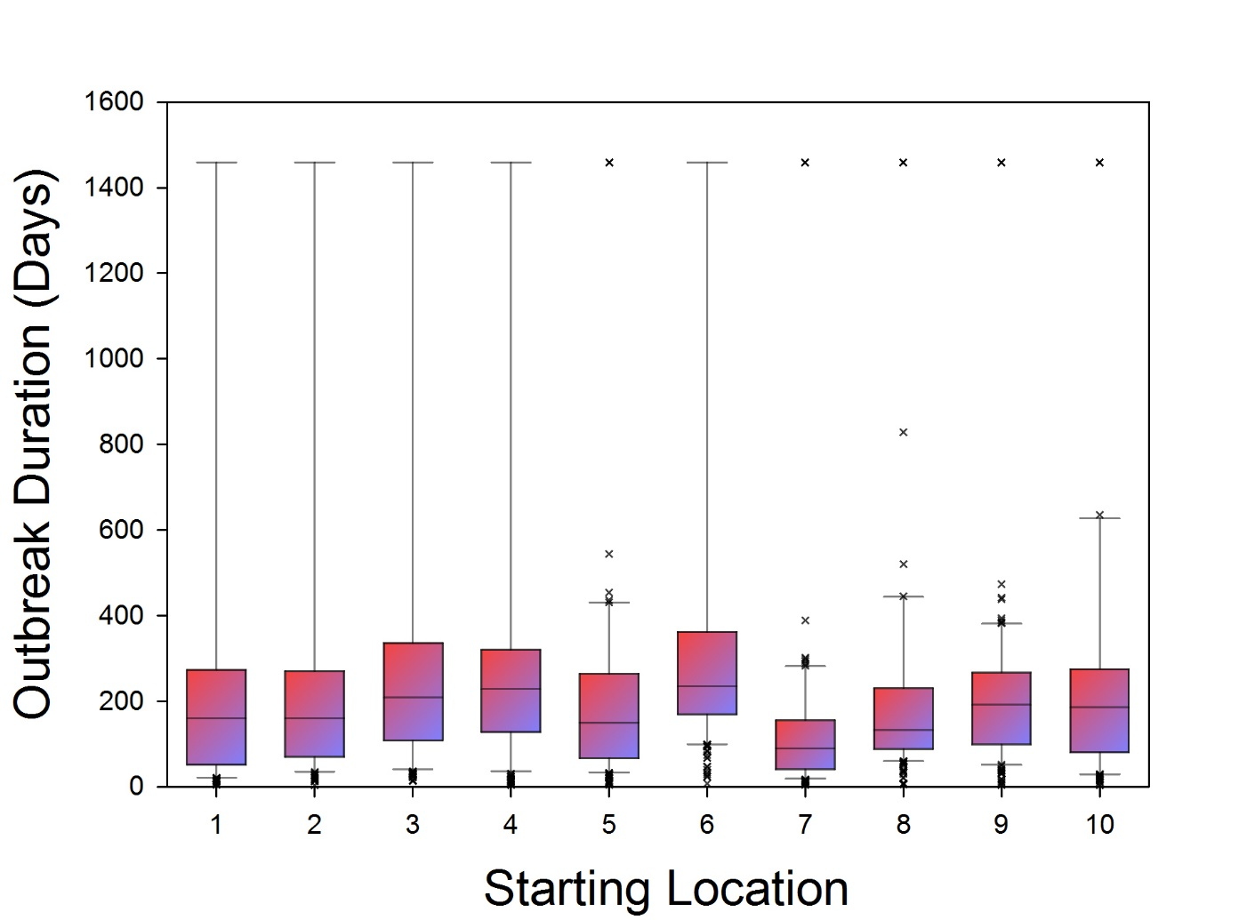
Results – Starting Location

Slide 27
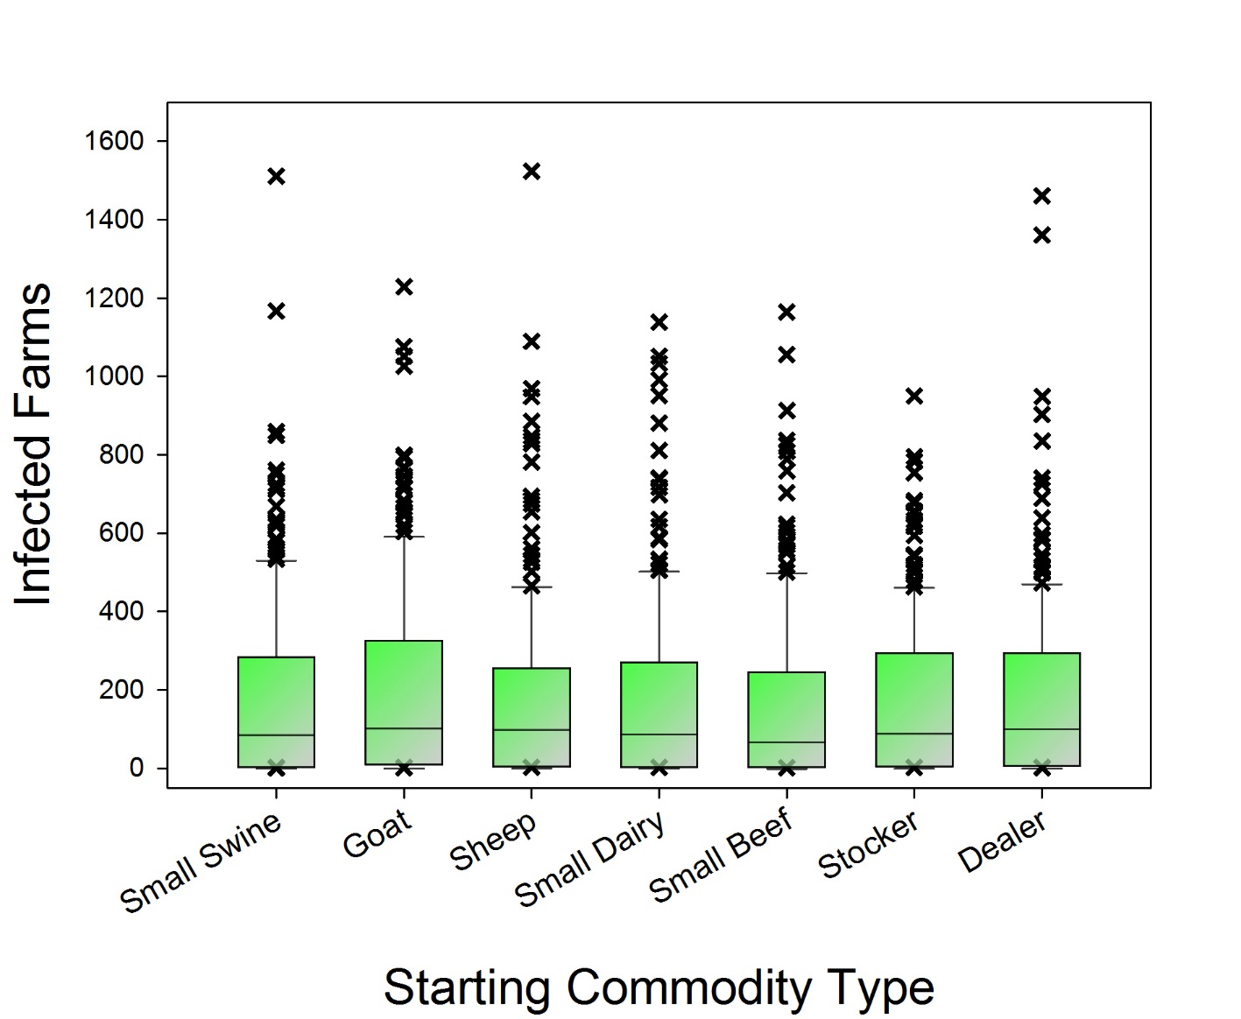
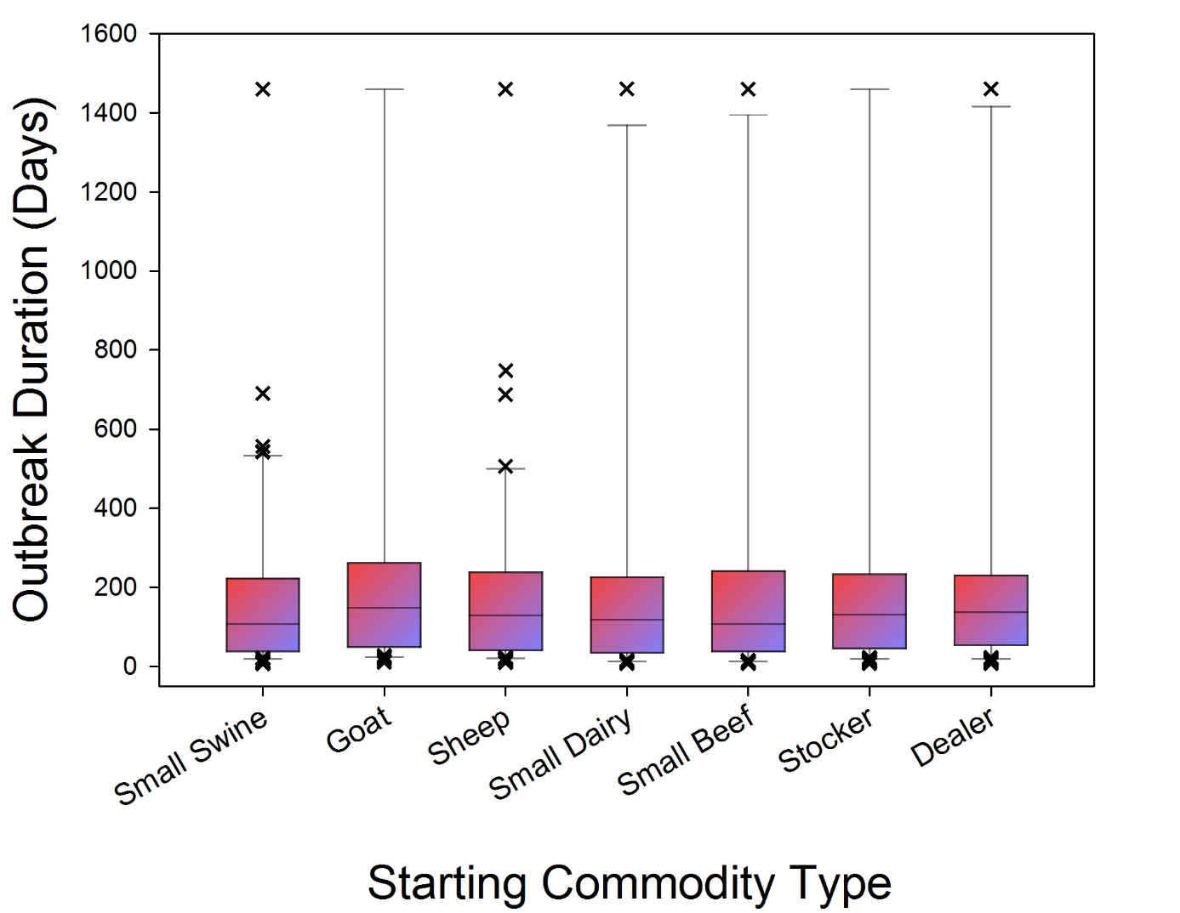
Results – Starting Commodity Type

Slide 28
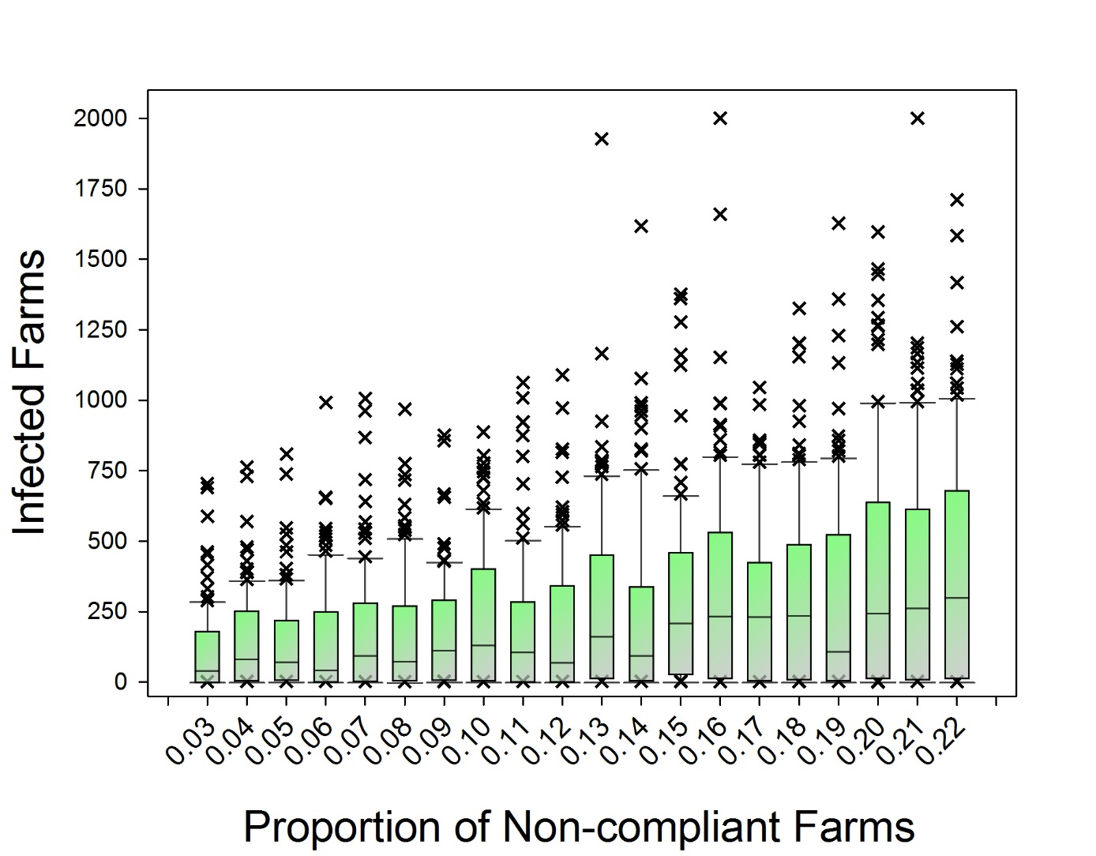
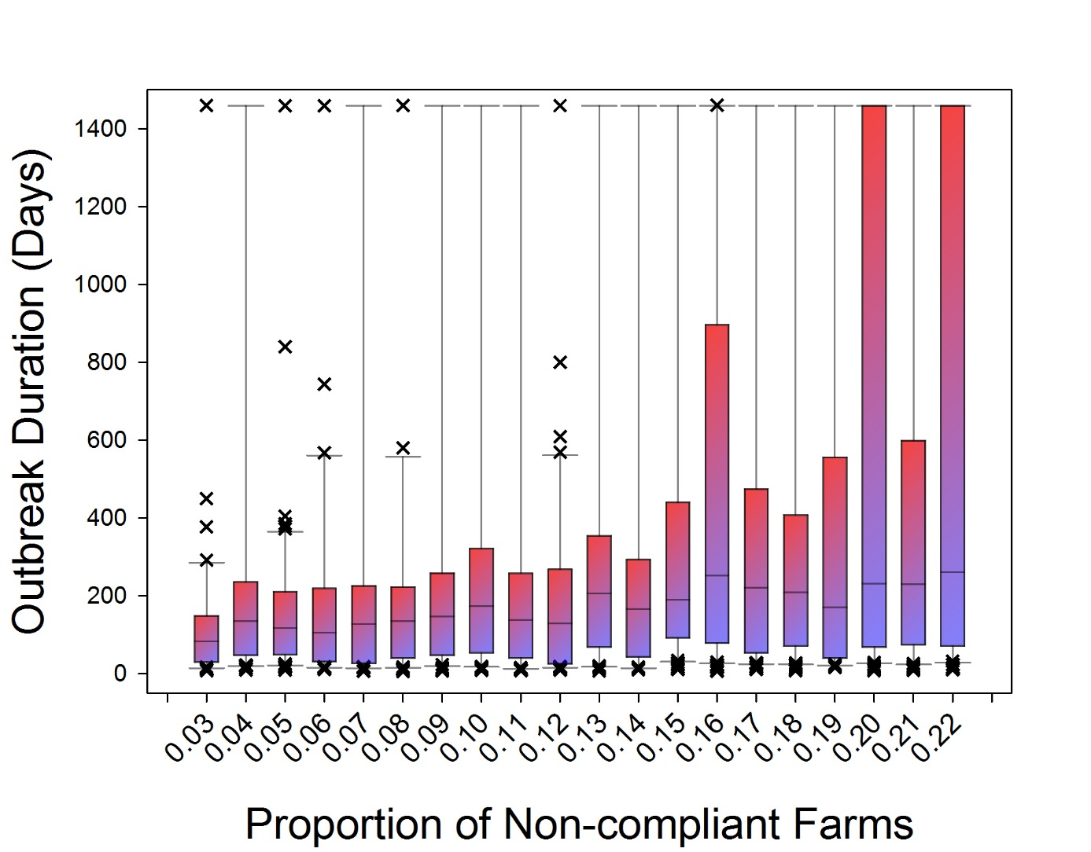
Results – Overall Degree of Compliance

Slide 29
Results

Slide 30
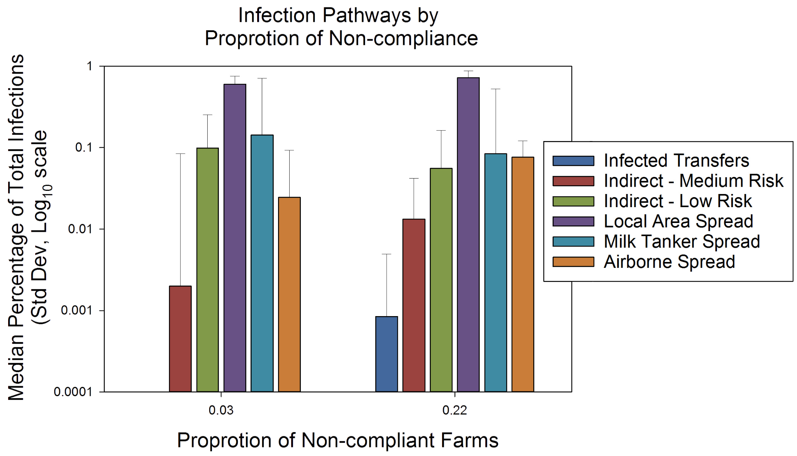
Discussion
The Route of Transmission appears mostly* unaffected by the degree of non-compliance
Local Area Spread accounts for ~80% of infections

Slide 31
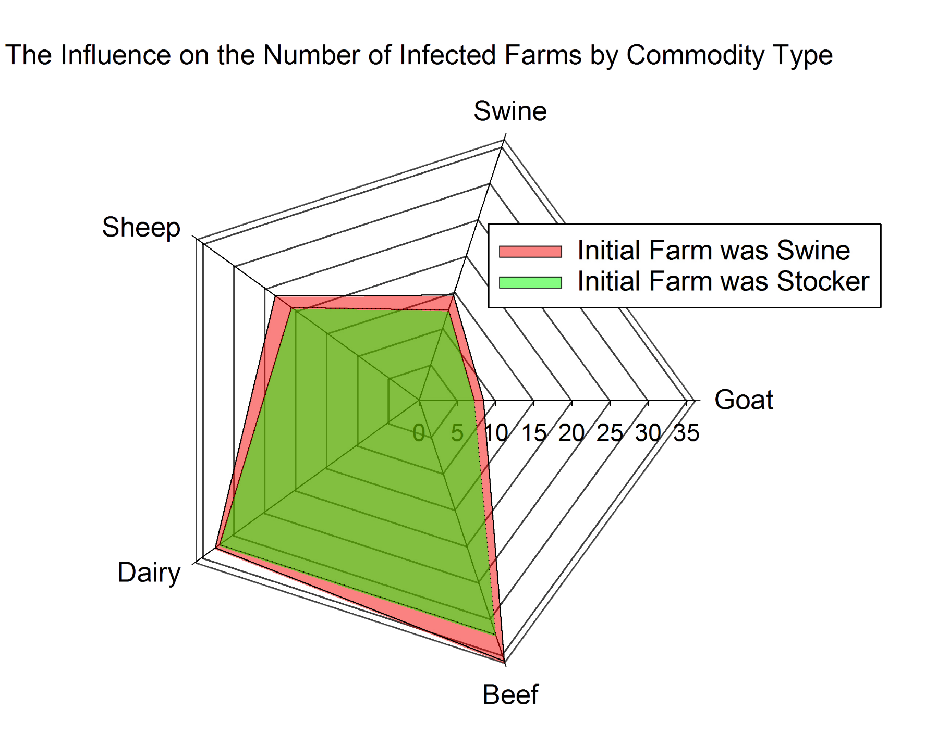
Discussion
The commodity type of the initially infected farm has minimal influence on final outbreak demographics
This may show a possible need to reassess Local Area Spread parameters?

Slide 32
Future Work
Further analysis of compliance on outbreak trajectories
Addition of farm data from Canada
Adding tracing and vaccination capabilities
Adaptation of model to other diseases and populations

Slide 33
Cited
Rahmandad and Sterman, 2004. Heterogeneity and Network Structure in the Dynamics of Diffusion: Comparing Agent-Based and Differential Equation Models. MIT Sloan Working paper 4512-04
Bradhurst, R.A., Roche, S.E., East, I.J., Kwan, P. and Garner, M.G., 2015. A hybrid modeling approach to simulating foot-and-mouth disease outbreaks in Australian livestock. Frontiers in Environmental Science, 3, p.17.
Sanson, R.L., Stevenson, M.A., Mackereth, G.F. and Moles-Benfell, N., 2006, August. The development of an InterSpread Plus parameter set to simulate the spread of FMD in New Zealand. In International Symposia on Veterinary Epidemiology and Economics (ISVEE) proceedings (p. 682).
Delgado, A.H., Norby, B., Scott, H.M., Dean, W., McIntosh, W.A. and Bush, E., 2014. Distribution of cow–calf producers’ beliefs about reporting cattle with clinical signs of foot-and-mouth disease to a veterinarian before or during a hypothetical outbreak. Preventive veterinary medicine, 117(3), pp.505-517.
Burdett, C.L., Kraus, B.R., Garza, S.J., Miller, R.S. and Bjork, K.E., 2015. Simulating the distribution of individual livestock farms and their populations in the United States: An example using domestic swine (Sus scrofa domesticus) farms. PloS one, 10(11), p.e0140338.
USDA 2013. Risk assessment for the transmission of foot-and-mouth disease via the transport of raw milk into, within, and outside of a control area during an outbreak. Collaborative agreement between USDA:APHIS:VS and University of Minnesota Center for Animal Health and Food Safety. Fort Collins, CO. May 2013. 126 pgs. http// fadprep.lmi.org
NAHMS Survey Documents
Interspread Plus Movement Parameter document

Slide 34
Acknowledgements
Missy Schoenbaum and Columb Rigney at USDA-APHIS
Julie Smith, University of Vermont
The Ohio State University
Matt Oremland at Mathematical Biosciences Institute
Hyeyoung Kim and the Disease Ecology and Computer Modeling Laboratory
Funded by USDA

