Slide 1
Comparison of two commercial NSP antibody tests (PrioCHECK® and IDvet®FMDV NS ELISAs) to detect infection in vaccinated animals (DIVA)
A.Tewari, K.G. Parekh, A. Di Nardo and Parida S*.
Vaccine Differentiation Group

Slide 2
Number of Bovine samples used in NSP tests with infection status
Group | Infection Route |  | No of Animals |  | No of Samples
Non-carrier
Unvaccinated infected recovered |  |  | 30 |  | 47
Contact |  |  | 20 |  | 31
Needle |  |  | 10 |  | 16
Vaccinated infected recovered |  |  | 185 |  | 261
Contact |  |  | 80 |  | 130
Needle |  |  | 75 |  | 131
Carrier
Unvaccinated |  |  | 12 |  | 22
Contact |  |  | 8 |  | 16
Needle |  |  | 4 |  | 6
Vaccinated |  |  | 68 |  | 154
Contact |  |  | 32 |  | 74
Needle |  |  | 36 |  | 80
Naïve sera - |  |  | 991 |  | 911
Known field clinically infected - |  |  | 159 |  | 159

Slide 3
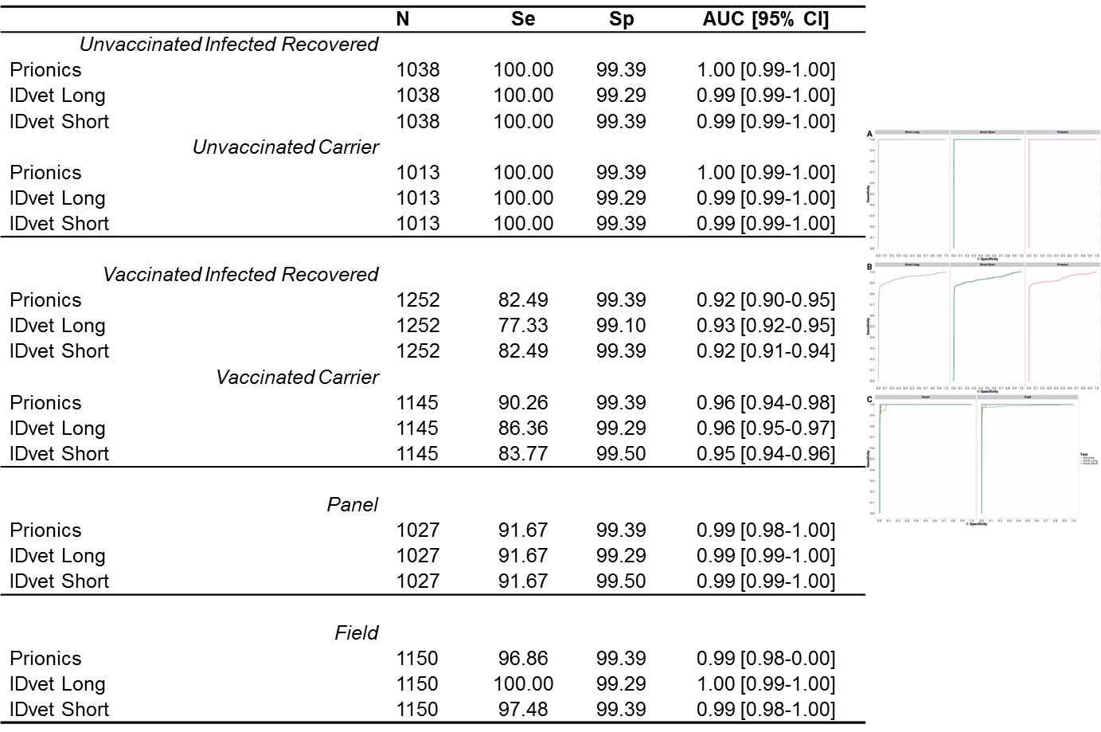
Sensitivity and specificity calculation by ROC

Slide 4
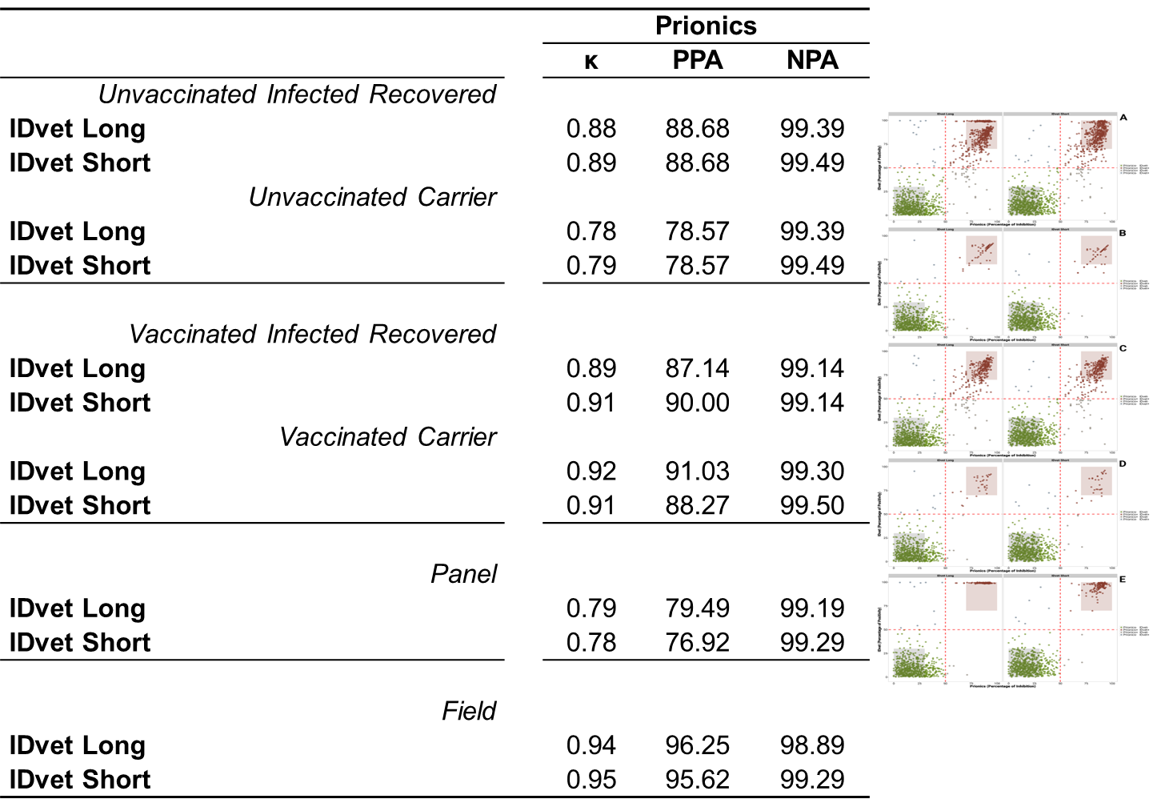
Agreement between the tests

Slide 5
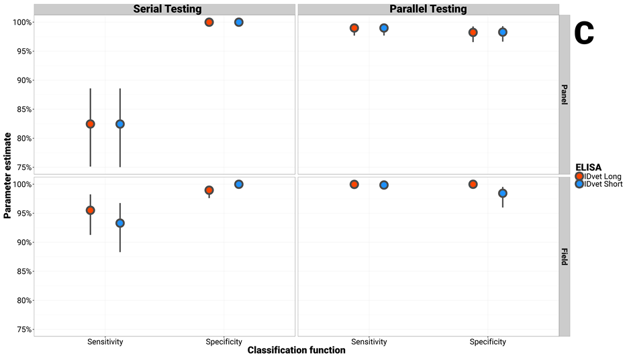
Serial and Parallel testing regime

