Slide 1
DEVELOPMENT OF A REFERENCE FOOT-AND-MOUTH DISEASE VIRUS ANTIGEN PANEL FOR THE CONSISTENT VALIDATION OF DIAGNOSTIC ASSAYS
Alison Morris, Valérie Mioulet, Britta Wood, Lissie Henry, Ashley Gray,
Barsha Thapa, Jemma Wadsworth, Nick J. Knowles and Donald P. King
FMD Reference Laboratory

Slide 2
Introduction
Foot-and-mouth disease virus (FMDV) is highly diverse, consisting of seven immunologically distinct serotypes
Numerous topotypes and lineages.
The importance of laboratory-based diagnostics is critical.
The aim of this project is to prepare a reference panel suitable for the ongoing validation of existing and novel FMDV diagnostic assays.

Slide 3
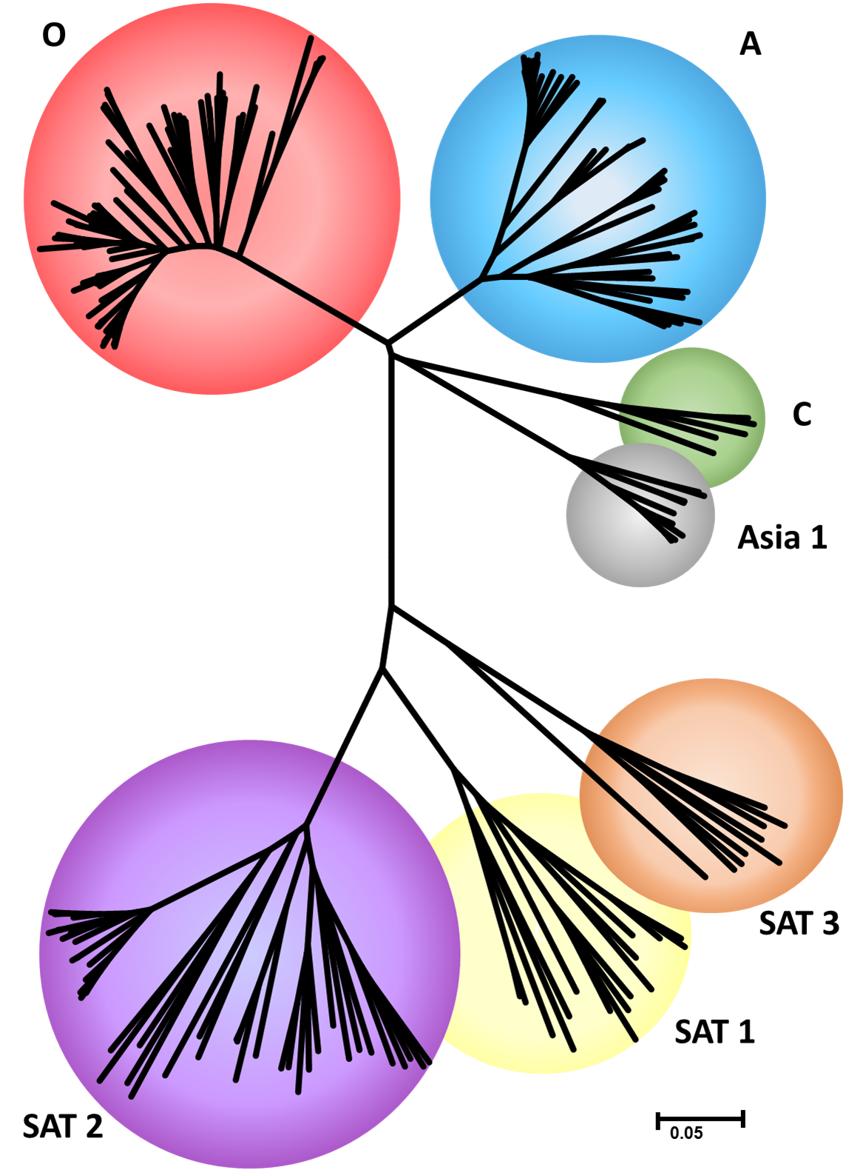
Selection of the panel
Isolates selected representing
Global diversity of FMDV
Covering all seven serotypes
Large range of topotypes and linages
Currently the panel consists of 196 isolates (Figure 1).
Used to assess the performance of different antigen detection ELISAs. Data presented: B. Thapa et al., Eu-FMD 2016.
Figure 1- Phylogenetic tree of the seven FMDV serotypes that are represented in the reference panel.

Slide 4
Ongoing development
Dynamic panel that will be representative of circulating strains
Inclusion of other vesicular diseases:
Swine Vesicular Disease,
Vesicular Stomatitis,
Vesicular Exanthema,
Seneca Valley virus
Assessing performance of new diagnostic assays:
Antigen detection, for example bovine Integrin ELISA
Molecular diagnostics
Provide a reference panel that will be available commercially
Inactivated-reducing the biosafety restrictions
Selection of the larger panel (~30 isolates)

Slide 5
Acknowledgements
This project was supported by the UK Department for Environment, Food and Rural Affairs (Research Project SE1128).
The authors would like to thank collaborating FMD Reference Laboratories and other reference laboratories for submitting samples to WRLFMD.
Many thanks for your time, are there any questions?
FMD Reference Laboratory

