Slide 1
Application of a theory-based approach for evaluating knowledge in FAO
Natalia Acosta
Evaluation Officer

Slide 2
BACKGROUND ON THE EVALUATION
Section 1

Slide 3
FAO: A complex knowledge production and management structure
Specialized UN agency
Knowledge Organization: many units collecting, analyzing and producing information (core mandate)
Technical departments: Fishery, Forestry, Nutrition, Plant Protection, Animal Health, Land and Water, Statistics, etc.
Cross-cutting themes: Capacity Development, Gender, Governance
Decentralized offices (+90)
12th EES Biennial Conference 2016

Slide 4
The Knowledge Evaluation
Objective: assess effectiveness and quality (from users perspective) of knowledge
Conducted: 2014 -2015 / Period covered: 2011-2014
Focused on the tangible aspect of knowledge and its use – not so much on the production and dissemination process
No framework to evaluate knowledge
Carried out by a team of 13 experts and 4 OED staff
12th EES Biennial Conference 2016

Slide 5
THE METHODOLOGY
Section 2

Slide 6
Designing the Methodology
Scoping Phase
Inception Phase
Main Evaluation phase
Desk research & informal external consultations to frame evaluation questions
Initial discussions with FAO staff to identify/map type of knowledge and dimensions of complexity (Step 1. mapping complexity dimensions)
4 units of analysis / 4 components
Development of generic Theory of Change for FAO knowledge products and services
12th EES Biennial Conference 2016
Notes:
Theory-based approach: the “use of an explicit theory of change to draw conclusions about whether and how an intervention contributed to observed results
Theory of change (TOC): diagram “that explains how activities are understood to produce a series of results that contribute to achieving the final intended impacts”
Dimensions of complexity: intersections between four components:
Contextual factors and nature of the system
Characteristics of the intervention
Institutions and stakeholders and how they interact
Nature of causality and processes of change

Slide 7
Evaluation Questions
Are FAO’s products consistent with the Organization’s goals, needs or mandates?
Are FAO’s products adequate?
How well does FAO ensure the technical excellence and quality of its products?
How efficiently has FAO used its human and financial resources in the production and dissemination of its products?
Are there synergies, duplications or gaps in the products produced and disseminated by FAO?
Have FAO’s products reached the intended users and uses?
What outcomes have FAO’s products achieved, or contributed to achieving?

Slide 8
Inputs
Processes
Outputs
Audiences
Immediate Outcome
Intermediate Outcome
Human Resources
Knowledge workers
(FAO staff)
Technical experts
Advisory committees
Audience members
Institutional Resources
Literature
Information technology
Infrastructure
Financial resources
Policies and procedures
Audience needs and priorities identified
Information collected, synthesized & organized
Technical consensus developed
Information uptake and application strategies developed
Dissemination strategies developed
Databases developed & populated
Networking approaches developed
Knowledge products
Norms & Standards
Technical reports & policy briefs
Manuals & guidelines
Training guides
Good practices
Knowledge services
Distance learning
Training programs
Databases
Web sites & portals
Tools & support for knowledge sharing (Networking, capitalization of experiences)
Policy & advocacy
Donors
Policy-makers
Civil society
User satisfaction
Content, presentation & delivery facilitate understanding, adoption & adaptation
Product or service
Quality products & services perceived as relevant, credible, authoritative & trustworthy
Environment informed
Evidence-based information contributes to policy and increased resources for food and agriculture
Scale-up of proven approaches supported
Programs & practice enhanced
Adoption of evidence-based practice
Enhanced quality of policy/technical advice
Improved quality of service delivery
Training & education enhanced
Evidence-based information informs & updates training & educational programs
Research enhanced
Speed of research to practice increased
Programs & practice
Managers Knowledge workers
Technical experts
Reach
Training & education
Trainers/ Educators
Trainees
Research
Knowledge workers
Researchers
Long-term Outcomes
Eradication of hunger, food insecurity and malnutrition
Elimination of poverty

Slide 9
Implementing the Methodology
Scoping Phase
Inception Phase
Main Evaluation phase
+ 600 publications, 70 databases, 120 networks, 70 learning resources
Component 1 Inventory & survey of knowledge products and services staff
Component 2 Meta-evaluation (+50 reports)
Step 2. Units of analysis
Type of products
Publications
Databases
Networks
Learning Resources
12th EES Biennial Conference 2016

Slide 10
Implementing the Methodology
Scoping Phase
Inception Phase
Main Evaluation phase
Component 3 Sectoral assessments (10 case studies)
Component 4
Survey FAO Member Countries and clients
Approach
Contribution analysis based on reconstructed TOC
Tools
User surveys (online)
Cybermetric studies (big data)
Key informant interviews
Publications
Databases
Networks
SWOT analysis
Secondary data (meta-evaluation)
Learning Resources
12th EES Biennial Conference 2016

Slide 11
OECD-FAO Agricultural Outlook
Inputs
Processes
Outputs
Audiences
Immediate Outcome
Intermediate Outcome
Human Resources
Technical experts (FAO staff, OECD staff, etc.)
Governance bodies and advisory committees (OECD & FAO Secretariats, OECD Group on Commodity Markets, Working Party on APM, FAO EST, ESS, ESA, FI, etc.)
National government agencies
International commodity associations (cotton, fish, dairy, sugar, etc.
Private sector (consultancies, etc.)
Audience members (OECD MC & FAO MS, MoA, etc.)
Institutional Resources
Policies and procedures (OECD-FAO partnership agreement, country questionnaires, etc.)
Models, databases, software and information technology (COSIMO, Aglink, TROLL, GAMS, etc.)
Literature
Infrastructure
Financial resources
Consultations conducted to identify needs and priorities of OECD MC & Key Partners and FAO MS
Topics submitted to Committee for final deliberation/approval
Data from OECD MC collected through questionnaire and processed by FAO from FAOSTAT
Consultations with industry groups organized
Information reviewed, checked, organized
Models updated and projections developed
Technical reviews conducted (baseline projections and key findings)
Outlook produced, reviewed and declassified (APM)
Dissemination strategies developed and implemented (senior management launch, press release, website, conferences and events, etc.)
Knowledge products
OECD-FAO Agricultural Outlook
Separate outlets, working papers, Highlights (2013)
Database of latest national commodity market developments, including domestic agricultural support & trade policy regimes
Database User Guide, manuals & guidelines (general description of the model, detailed model documentation, full set of equations and model parameters, results of tests carried out in the process of model validation)
Technical reports
Knowledge services
Databases (EN, FR)
Web sites & portals
Tools & support for knowledge sharing (capacity development, visiting experts, networks)
Policy & advocacy
Policy-makers
International organisations
Resource Partners
Civil Society
User satisfaction
Content, presentation & delivery facilitate understanding, adoption & adaptation
Product or service
The Outlook and related products & services are perceived as relevant, credible & useful
Environment informed
Informing policy debates and resource planning
Informing debates on, and negotiations of, agricultural trade-related agreements
National and international institutions used the Outlook to develop projections (in a cost-effective manner)
Programmes & practices enhanced
Private sector informed
Education & research enhanced
Programmes & practice
Technical experts
Reach
Private sector
Specialized commodity groups
Analysts & technical experts
Industry associations
Academia & Research
Education (methods)
Researchers (outputs)
Long-term Outcomes
Eradication of hunger, food, insecurity and malnutrition
Elimination of poverty
Sustainable management of natural resources

Slide 12
Cybermetric Analysis
Estimated references and citations for SOFA and the World Development Report
Publication | Reference estimates |  | Academic citations
 | Links | Web sites | Google scholar | Scopus
FAO State of Food and Agriculture 2010-11 Gender | 786 | 353 | 4 | 20
World Bank 2012 World Development Report Gender | 938 | 427 | 19 | 134
12th EES Biennial Conference 2016
Notes:
Links: individual webpages with links to the report
Websites: number of different web sites hosting these links

Slide 13
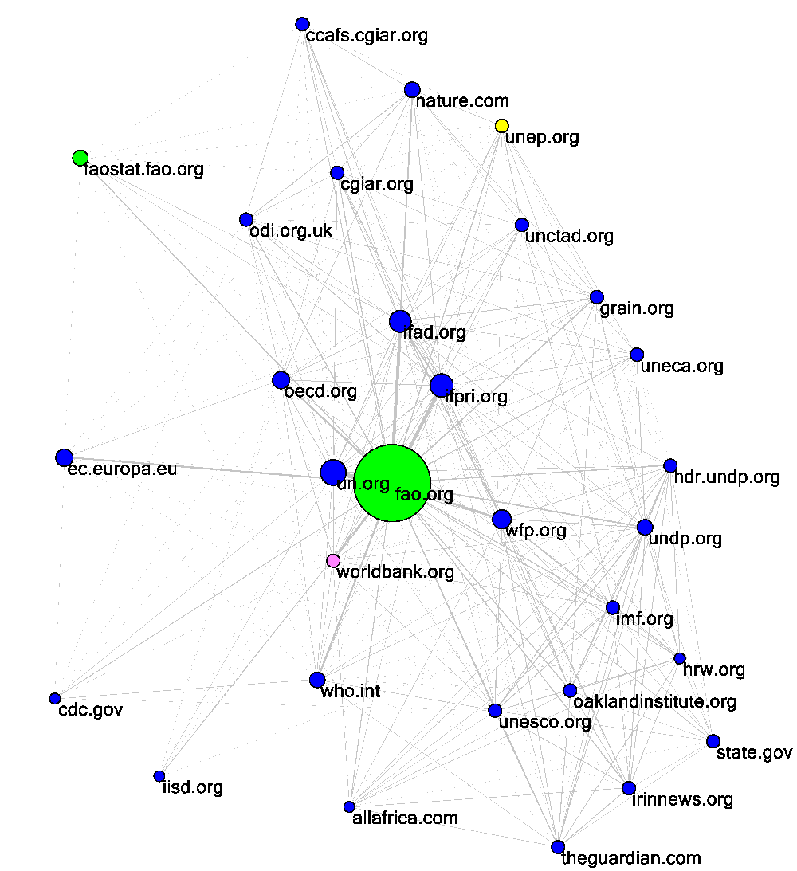
Web community of the FAO publication “State of Food and Agriculture” publication
Notes:
Note: Colours other than blue indicate different parts of a single Organization that appear in more than one web community figure (e.g., all FAO websites are light green in all web communities). Organizations that are close together tend to be linked to by the same websites. A line between two websites A and B indicates that at least one Organization citing SOFA links to both A and B (so A and B have something in common, relative to SOFA).
The nodes represent websites that are frequently linked to by pages that mention SOFA
First step: gather the URLs of all non-UN web pages that mention SOFA (there were 814).
Second step: download all these 814 webpages and extract their hyperlinks and build the network from the websites with the most links in the second stage
The sizes of the nodes reflect the level of influence of the websites within this network.
When interpreting the network maps, line width indicates the number of other websites that link to both. A wider line means there are a higher number of links from one website to another, while a narrower line indicates fewer links. For example, the relatively thick line between cgar.org and fao.org reflects the fact that many sites within this network simultaneously link to both fao.org and cgar.org. In contrast the lack of a line between worldwatch.org and bbc.co.uk indicates that no organisations within this network link to both sites. To simplify the network, generic, spam and technical websites were removed.
Specific sites removed: pandastats.net, ipaddress.com, statcounter.com, extremetracking.com, siteadvisor.com, quantcast.com, domaintools.com, whois, browsehappy.com, mywot.com, tinyurl.com, validator.w3.org, geek-tools.org, whatisonip.com, histats.com, addthis.com, ipaddressnetwork.com, avgthreatlabs.com, error, alexa.com, siteanalytics, siteexplorer, creativecommons.org, addtoany.com, templatix.com, jigsaw.w3.org, bit.ly, feedburner, preventionweb, printfriendly, omniture, eepurl. Big sites removed: google, bing, yahoo, facebook, youtube, twitter, linkedin, digg, del.icio.us, archive.org, technorati.com, flickr.com, doi.org, reddit,
stumbleupon, myspace, pinterest, instagram, tumblr, dmoz, blogger, wordpress, disqus, amazon, apple, delicious, vimeo
The raw data is the set of pages mentioning each website. We download these pages and extract their hyperlinks and pick out the most linked-to organisations and draw the graph with them. A line on the graph is drawn between two websites if at least one of the downloaded pages contains a link to both of these websites. This is a strange process, sorry! We have found that this process gives much better results than anything simpler, such as a basic hyperlink network. Extra explanations have been added to the start of section 7.

Slide 14
Data Analysis and Reporting
Reassembling into a whole (2 levels)
Sectoral assessments: Common checklist and matrix to synthesize information from case studies and identify common findings by evaluation question
Final evaluation report: Attempt to draw generic findings that respond to key evaluation questions (relevance, use and efficiency of FAO’s knowledge products and services)

Slide 15
CONCLUSIONS
Section 3

Slide 16
Benefits of the methodology
Modular design useful to collect evaluative data from a complex programme in a step-by-step process
Increased learning within FAO on the use of a TOC for programme management
New tools such as cybermetric studies useful to validate and complement findings collected with traditional tools
Required a collaborative and participatory process

Slide 17
Challenges
Difficulties in reassembling results and drawing general conclusions > used anecdotal evidence
Difficulties in identifying relationships and synergies between the units of analysis
Quantifying and analysing the breadth of qualitative data collected from different stakeholders (user surveys)
12th EES Biennial Conference 2016

Slide 18
Thank you
Visit our website
www.fao.org/evaluation/en/

