Slide 1
Food and Agriculture Organization of the United Nations
Office of Evaluation
October 2015
Evaluating Contributions to Developing-Country Climate Change Adaptation and Mitigation Readiness:
Methodological Lessons from an FAO Evaluation
Eoghan Molloy
IDEAS Global Assembly, Bangkok, Thursday 29th October 2015

Slide 2

Overview of FAO’s Climate Change Evaluation
Global in scope
FAO Climate Change activities 2008-2014
Across all sectors
Identifying FAO’s comparative advantage in Climate Change Adaptation and Mitigation (CCAM)
Cross-Cutting focus on FAO’s Country-level contributions to CCAM
Notes:
This presentation focuses on the last two points in this slide:
Identifying FAO’s comparative advantage in Climate Change Adaptation and Mitigation (CCAM)
Cross-Cutting focus on FAO’s Country-level contributions to CCAM
Download the full evaluation report here:
http://www.fao.org/fileadmin/user_upload/oed/docs/Climate%20Change%20Evaluation-FINAL%20REPORT.pdf

Slide 3
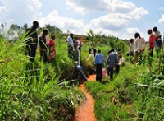


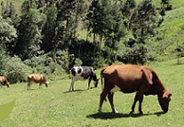
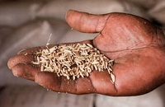
Assessing FAO’s country-level contributions to CCAM
No FAO Climate change strategy, or corporate-wide climate change programme
Project-based approach to Climate Change Adaptation and mitigation
No overall baseline
  Need to develop a theory of change
Notes:
Explaining the need to develop a theory of change for FAO’s contributions to Climate change adaptation and mitigation (CCAM).
Although FAO’s approach to CCAM has mostly been project-based, there are some notable exceptions such as the EPIC programme: http://www.fao.org/climatechange/epic/home/en/
And the MICCA programme: http://www.fao.org/climatechange/micca/en/

Slide 4
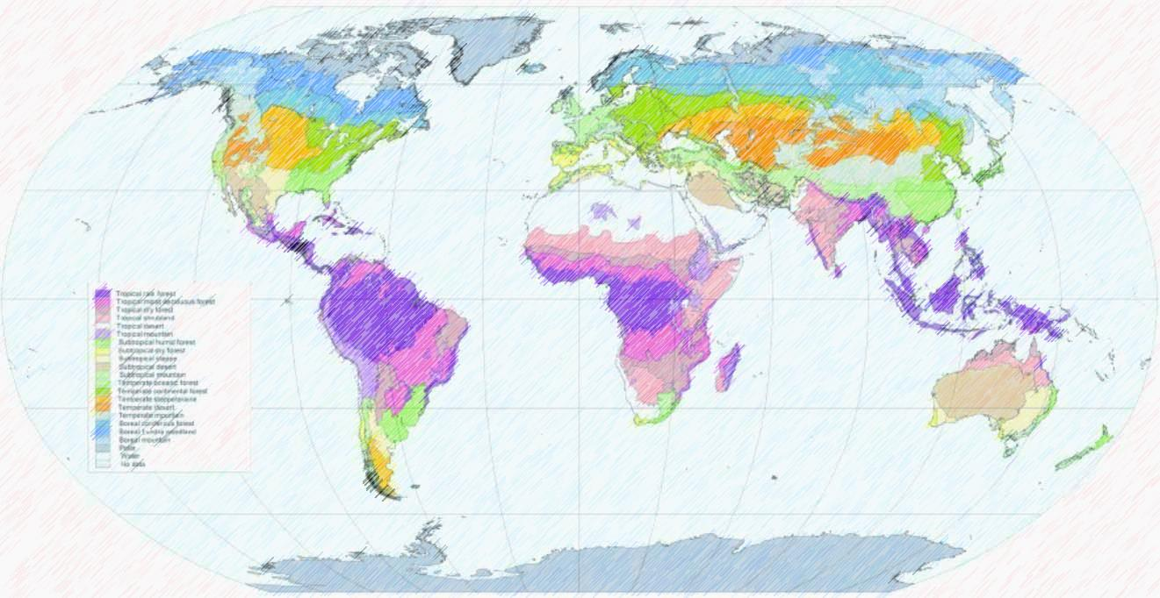
Country-level Contribution Maps
  Difficulty in developing theory of Change at global level
  Different country contexts
  Unpredictable and differing impacts of Climate Change across different countries, contexts
  Many factors affecting ‘readiness’ of country systems
Notes:
Developing a unifying theory of change proved difficult due to the complexity of the evaluation.

Slide 5


Country-level Contribution Maps
Contribution typology based on review of literature
(*references at end of presentation)
  FAO Publications
  Scholarly articles
  See Handout for Detailed Contribution map
Notes:
Ultimately, it proved too complex to develop an actual one-size-fits-all theory of change for FAO’s country-level activities. It was also unfeasible to develop multiple cascading theories of change for all the focus countries of the eveluation.
The ‘Contribution maps’ represent a usable and pragmatic compromise. They serve as a typology of CCAM country level activities, and were used in the evaluation as a reference point against which FAO’s activities could be identified and mapped across the 11 focus countries.

Slide 6
4 main Areas of Activity for climate-Change Readiness
  Policy, governance and strategy
  Climate Finance
  Coordination for implementing technologies and practices
  Knowledge and Data
Notes:
The handout contains more detail on these contribution areas.

Slide 7
  Policy, governance and strategy
Strong awareness of climate change
Coordination among departments/ministries
CC has been mainstreamed in sector policies
Quality NAPA, NAP and NAMA
Notes:
The handout contains more detail on these contribution areas.

Slide 8
4 main Areas of Activity climate-Change Readiness
  Policy, governance and strategy
  Climate Finance
  Coordination for implementing technologies and practices
  Knowledge and Data
Notes:
The handout contains more detail on these contribution areas.

Slide 9
Climate Finance
Adequate funding for climate change programs
collaboration and partnership with the private sector.
Funds from payments for environmental services schemes (.e.g. REDD+)
Notes:
The handout contains more detail on these contribution areas.

Slide 10
Knowledge and Data
Mapping and monitoring of natural resources,
Quality models, tools and data for climate-impact risk assessment
Vulnerability mapping
Notes:
The handout contains more detail on these contribution areas.

Slide 11
  Coordination for implementation
Producer organizations
Marginalized groups (e.g. women, youth, ethnic minorities) are included in programs
Communication of climate change-related weather data to vulnerable communities
Notes:
The handout contains more detail on these contribution areas.

Slide 12
4 main Areas of Activity climate-Change Readiness
  Policy, governance and strategy
  Climate Finance
  Coordination for implementing technologies and practices
  Knowledge and Data
Notes:
The handout contains more detail on these contribution areas.

Slide 13

Data collection – practical application
FAO’s activities assessed against the Contribution Maps
Country visits and project site visits
Evaluation team members report on FAO’s contributions
Team members also provide an explanatory narrative for each contribution

Slide 14
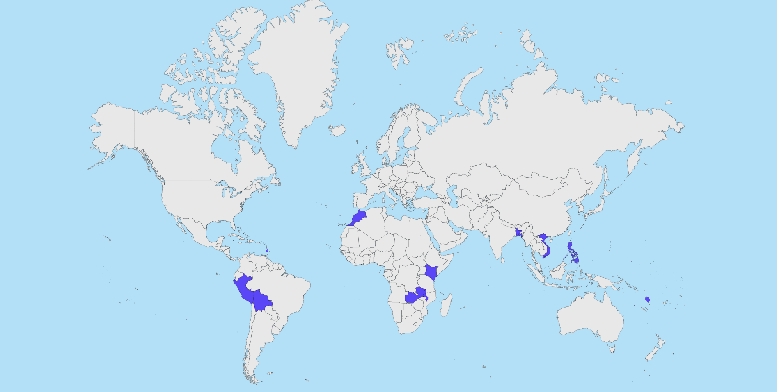
Countries Visited
MOROCCO
BANGLADESH
SAINT LUCIA
KENYA
PHILIPPINES
VIETNAM
PERU
VANUATU
MALAWI
BOLIVIA
ZAMBIA
Notes:
Criteria for country selection:
CC vulnerability (ND GAIN Index);
Development ranking;
Number of FAO national projects or activities
National Adaptation Plans (NAPs)
Suggestions from FAO staff
Sector coverage
Geographic coverage (incl. SIDS)
Past or planned OED evaluation missions in the countries.

Slide 15
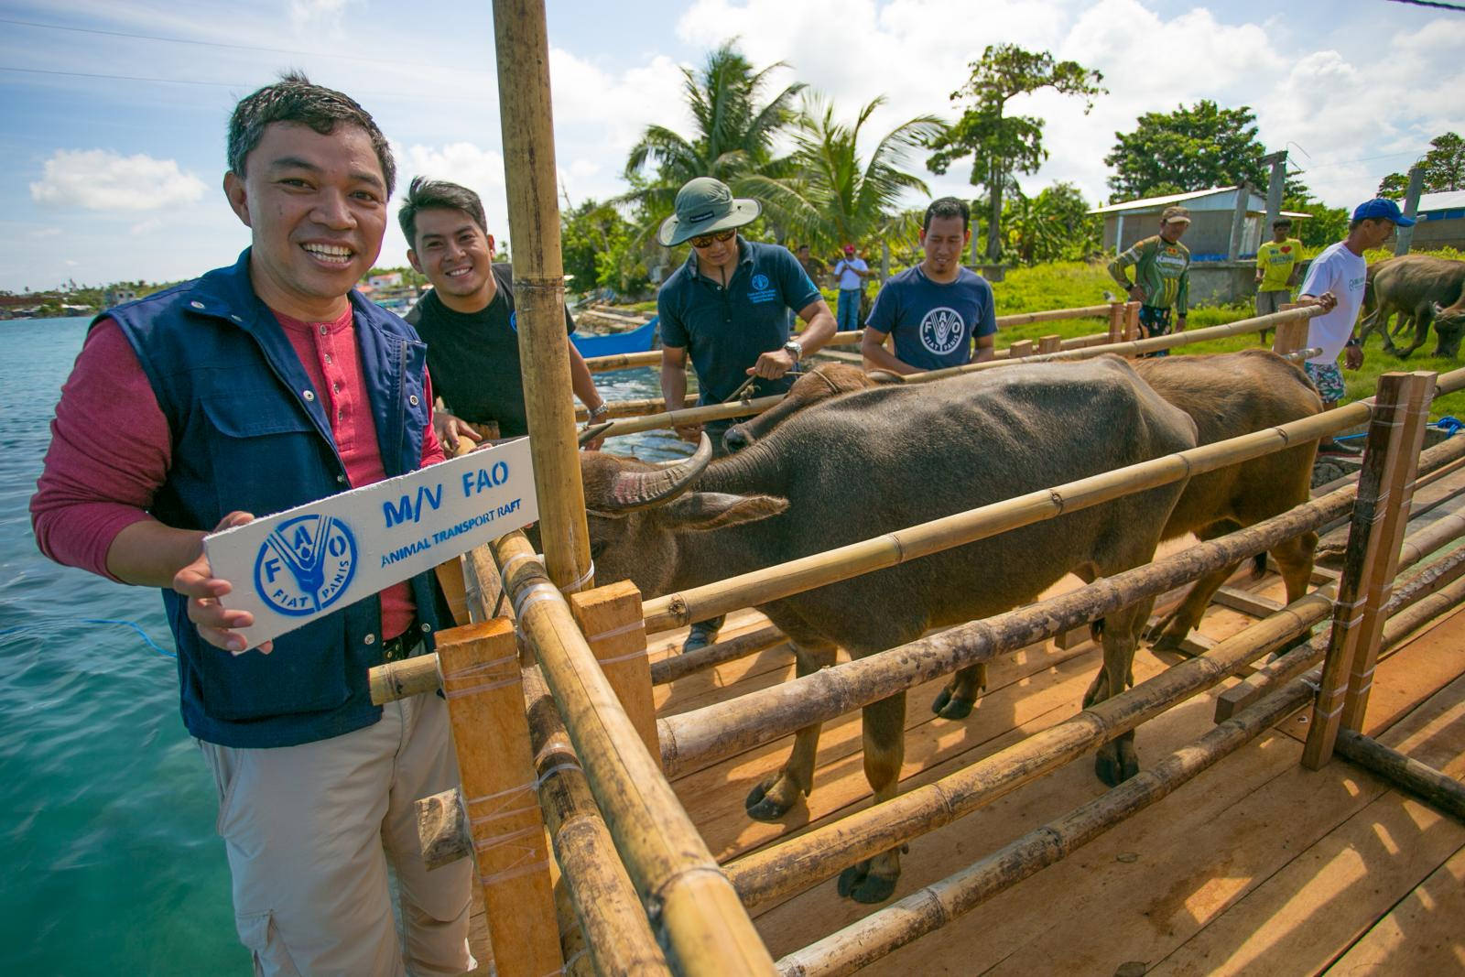
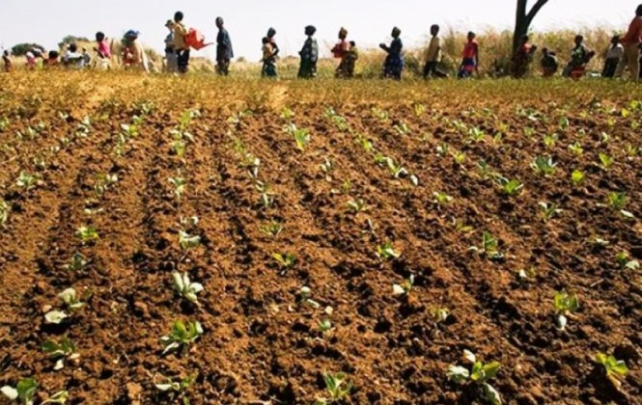

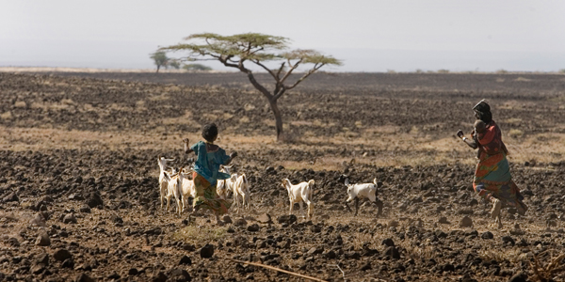
Reporting and Findings

Slide 16
Consolidation of Evidence
Composite map developed from all team member submissions across 11 countries
Patterns emerged:
  Areas where FAO has consistent focus
  Elements on which FAO not focusing

Slide 17
FAO’s Strengths
Contribution area | Countries/sectors
Coordination among relevant ministries/departments | Bolivia (A, D); Peru (A); Philippines (A); Bangladesh (D,F);
CC mainstreaming in emergency response programs | Malawi (A); Peru (A,D); St. Lucia (A); Philippines (A); Bangladesh (D); Bolivia (D); Philippines (A,D)
models, tools and data for climate-impact risk assessment | Kenya (A,D); Malawi (A); Peru (A); Vietnam (f); Zambia (A); Bangladesh (D,f); Morocco (A,W,F); Philippines (A); Vietnam (f); Vanuatu (f)
Notes:
FAO Strengths:
developing national policy, strategy and governance on CC and DRR
building on the CC knowledge and monitoring systems of countries
One of FAO’s greatest comparative advantages lies in its expertise-based alignment of the strategies of different ministries and departments involved in CCAM and DRR in agriculture.
The Map corroborated this finding and shows that FAO is in fact focusing on this activity in many countries.

Slide 18
Areas for improvement
Contribution Area | Countries/Sectors
collaboration and partnership with the private sector | Kenya (A); Zambia (A)
linking farmers to private sector and markets | Kenya (A,L)
Notes:
Partnerships on CCAM were not a strongpoint for FAO, and few examples were found. I have highlighted private sector partnerships here, but there were also few examples of partnerships on CCAM – with notable exceptions in Malawi and Kenya where string engagement with NGO’s was observed.

Slide 19
Added value of the contribution map
Helps in identifying FAO’s main focus areas in its activities
Helpful in devising interview questions
Supports the conclusions of the evaluation
  Valuable exercise for validating findings (particularly for comparative advantage)
Notes:
The contribution map helped to verify if FAO was actually targeting its comparative advantages in its country-level activities. From our surveys and interviews, it was apparent that FAO had a comparative advantage in aligning the strategies of different ministries and departments involved in CCAM and DRR in agriculture.
The Map corroborated this finding and shows that FAO is in fact focusing on this activity in many countries.

Slide 20
Some shortcomings
Use of the map evolved throughout the evaluation
  Map was not a Theory of Change in the traditional sense
Difficult to apply the tool at global level
Not intended to be a checklist
Not a qualitative or substantive measure of FAO’s contribution
Notes:
Difficult to apply the tool at global level
Not a qualitative or substantive measure of FAO’s contribution (some areas may be more relevant than others in different contexts)

Slide 21
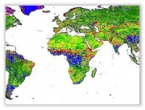
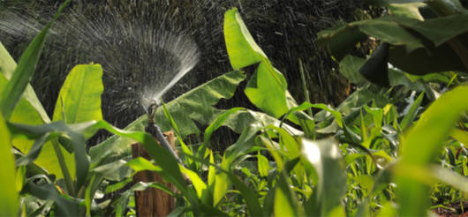
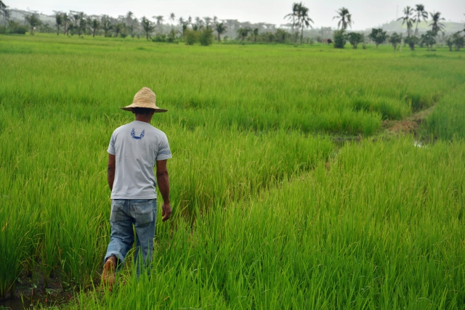
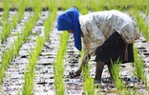
Usefulness for future evaluations?
Can be adapted for different contexts
    country-specific conditions
Useful for applying ‘external lens’ to the evaluation
Useful for building composite coherent narrative
Useful for triangulating findings of evaluation country reports

Slide 22

Usefulness for future evaluations?
Highlights the complexity of evaluating Climate change adaptation and mitigation contributions from a global perspective
Notes:
If anything, this case serves as a practical example of the difficulties in developing complex, cascading theories of change for the macro and micro levels. The evaluation team realized this difficulty early on, and decided to adapt the methodology by developing these contribution maps. While the maps were perhaps overly simplistic when compared to the initial ambitions of the evaluation team, they nonetheless were very useful in mapping FAO’s activities across the focus countries and across he relevant sectors.

Slide 23
References
Agrawal, A. Kononen, M. & Perrin, N. 2009, The Role of Local Institutions in Adaptation to Climate Change. Social Development Papers: Social Dimensions of Climate Change, Paper No. 118/June 2009. http://siteresources.worldbank.org/EXTSOCIALDEVELOPMENT/Resources/244362-1164107274725/sdp118.pdf
Bours, D., McGinn, C., & Pringle, P. 2014. Guidance Note 2: Selecting indicators for climate change adaptation programming. SEA Change, UKCIP http://www.ukcip.org.uk/wordpress/wp-content/PDFs/MandE-Guidance-Note2.pdf
Cabell, J. F., & M. Oelofse. 2012. An indicator framework for assessing agroecosystem resilience. Ecology and Society 17(1): 18. http://dx.doi.org/10.5751/ES-04666-170118
Cannell, M, Cruz, R., Galinski, W., & W.P. Cramer. 2009. Climate Change Impacts on Forests, in IPCC Second Assessment Report, Watson, R., Zinyowera,M.C. and R. Moss, (Eds.). https://www.ipcc-wg2.gov/publications/SAR/SAR_Chapter%201.pdf
De Silva, S.S. & Soto, D. 2009. Climate change and aquaculture: potential impacts, adaptation and mitigation. In K. Cochrane, C. De Young, D. Soto and T. Bahri (eds), Climate change implications for fisheries and aquaculture: overview of current scientific knowledge, FAO Fisheries and Aquaculture Technical Paper. No. 530. Rome, FAO. pp. 151-212 http://www.fao.org/docrep/012/i0994e/i0994e04.pdf
FAO. 2007. Building adaptive capacity to climate change, Policies to sustain livelihoods and fisheries, New Directions in Fisheries – A Series of Policy Briefs on Development Issues, No. 08 http://www.fao.org/docrep/010/a1115e/a1115e00.pdf
FAO. 2008. Report of the FAO Expert Workshop on Climate Change Implications for Fisheries and Aquaculture, Rome, Italy, 7-9 April 2008, Fisheries Report No. 870 http://www.fao.org/docrep/011/i0203e/i0203e00.pdf

Slide 24
References Contd.
FAO. 2009. FAO Adapt: Framework Programme on Climate Change Adaptation, FAO http://www.fao.org/climatechange/27594-03ecd7bd225b93086e7dca3944de64307.pdf
FAO. 2010. Managing Forests for Climate Change - FAO, working with countries to tackle climate change through sustainable forest management, http://www.fao.org/docrep/013/i1960e/i1960e00.pdf
FAO. 2011. Climate Change for Forest Policy-Makers
FAO. 2011a. Climate change, water and food security, FAO Water Reports No. 36. http://www.fao.org/docrep/014/i2096e/i2096e.pdf
FAO. 2013. Climate-Smart Agriculture Sourcebook, FAO, http://www.fao.org/docrep/018/i3325e/i3325e.pdf
FAO, RECOFTC. 2009. Forests and natural disaster risk reduction in Asia and the Pacific.
Glantz, M. H, Gommes, R. & Ramasay, S. 2009. Coping with a changing climate: Considerations for adaptation and mitigation in agriculture, Environment and Natural Resources Management Series, Monitoring and Assessment – FAO, 2009, No. 15 http://www.fao.org/docrep/012/i1315e/i1315e.pdf
Horrocks, L., Pringle, P., Le Cornu, E. & Winne, S. 2012. Review of international experience in adaptation indicators. Available from: www.seachangecop.org/node/2660
McDonald, G.T. & M.B. Lane. 2004. Converging global indicators for sustainable forest management, Forest Policy and Economics 6, 63-70 http://www.sciencedirect.com/science/article/pii/S1389934102001016
UNESCAP (2012), Climate change adaptation for water management in a green growth economy, Working Paper Series http://www.unescap.org/sites/default/files/Climate-Change-Adaptation.pdf
Wilk, J. & Wittgren, H.B. (eds). 2009. Adapting water management to climate change, Swedish Water House Policy Brief No. 7, SIWI. http://www.siwi.org/documents/Resources/Policy_Briefs/SWHWaterClimate.pdf

Slide 25

Thank you
For the full Evaluation Report:
FAO Office of Evaluation website:
www.fao.org/evaluation
Email:
eoghan.molloy@fao.org
ashwin.bhouraskar@fao.org
Notes:
Download the full evaluation report here:
http://www.fao.org/fileadmin/user_upload/oed/docs/Climate%20Change%20Evaluation-FINAL%20REPORT.pdf

