Slide 1
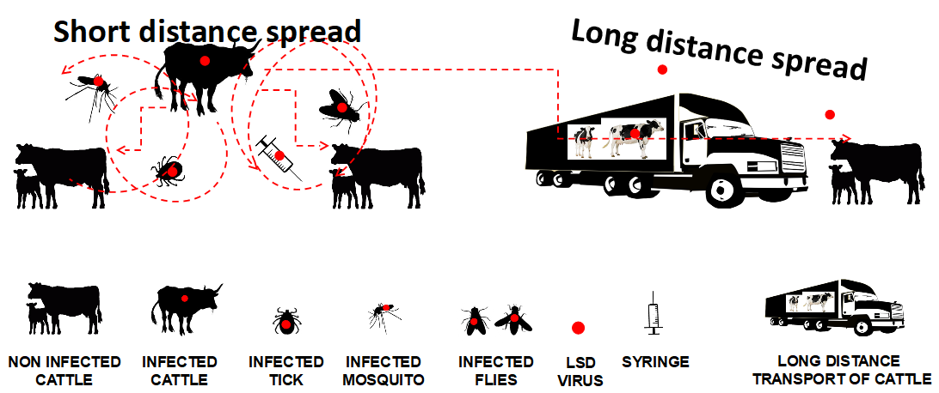
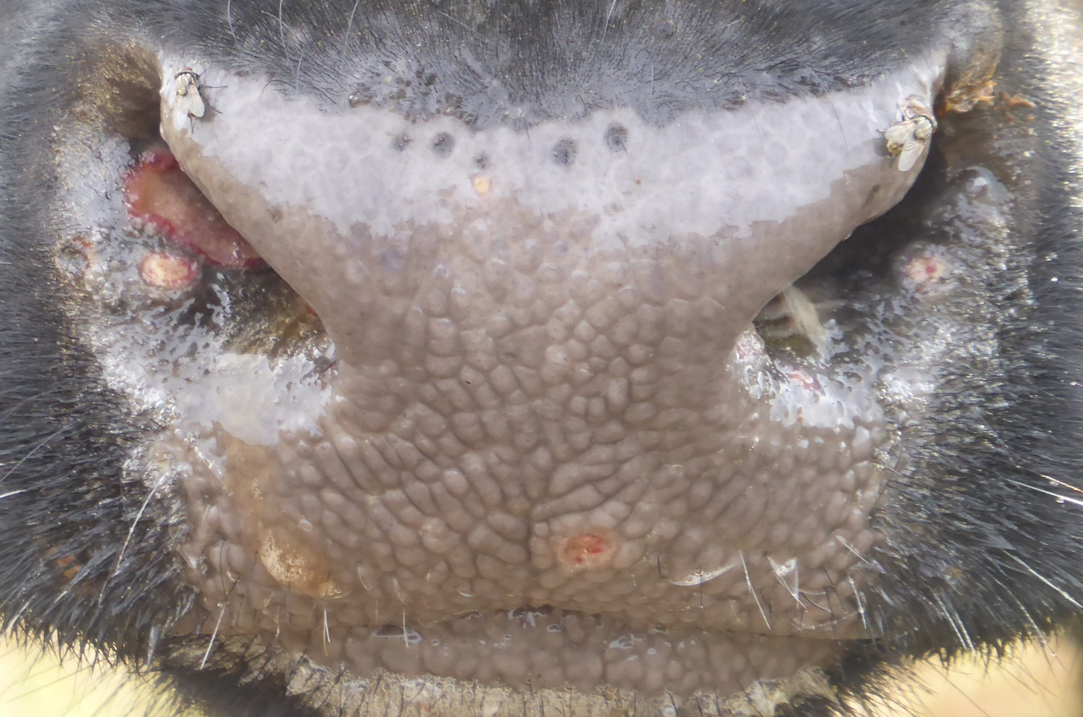
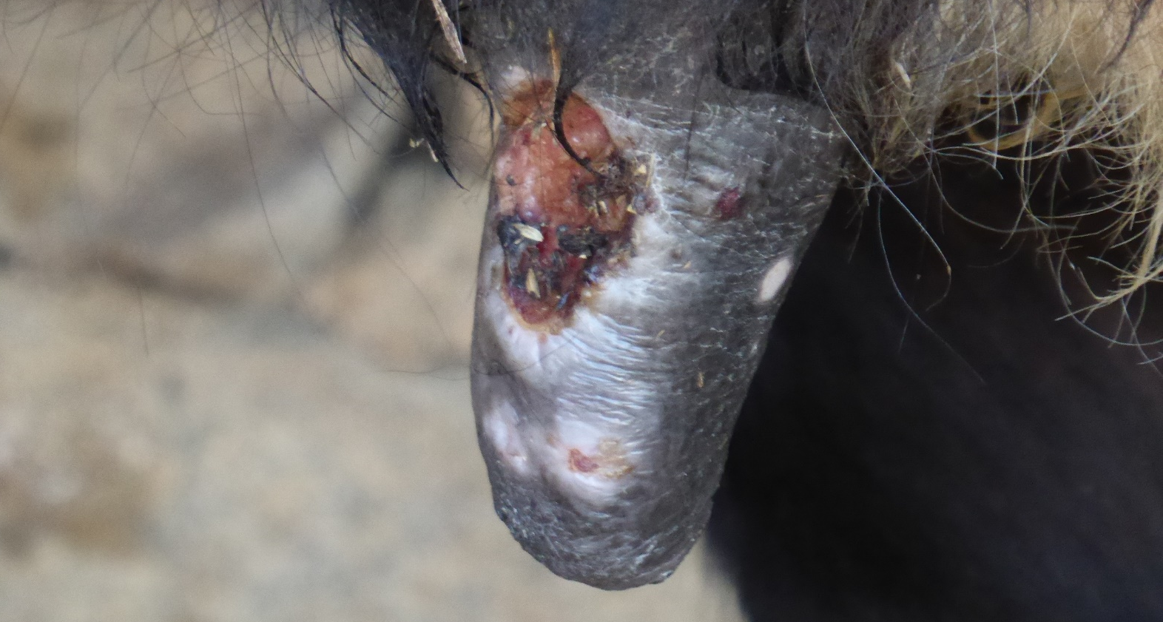
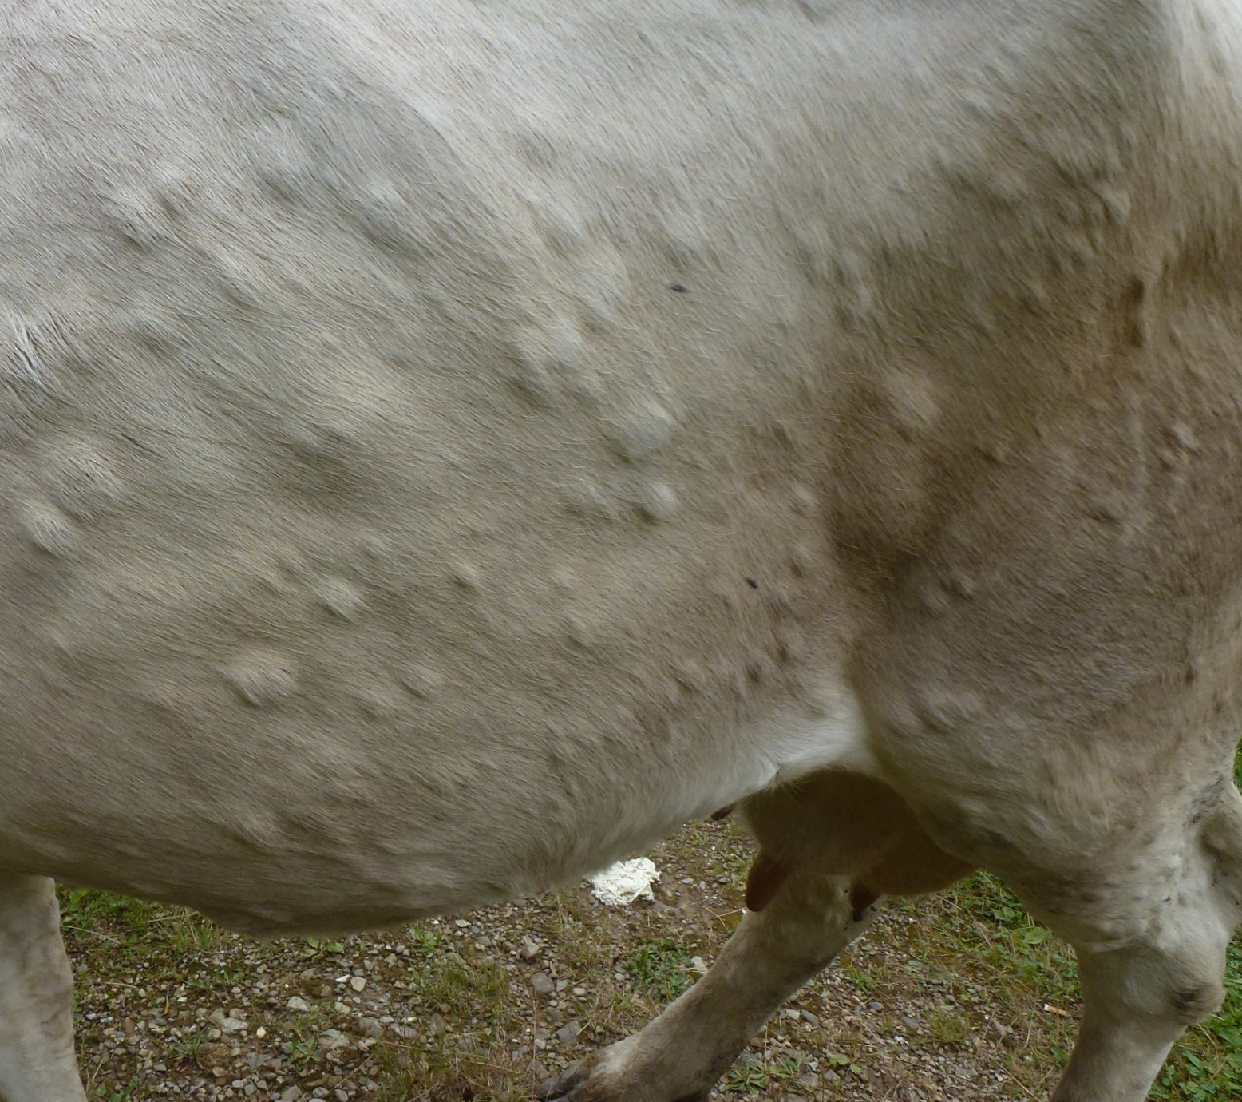
LUMPY SKIN DISEASE
Lumpy skin disease (LSD)
How your animals can get infected?
Monitor your cattle and notify suspected cases
Affects only cattle and water buffalo.
Does not affect humans.
Seasonal outbreaks during the warmer months, when insects are most active and abundant.
Causes important production losses due to sharp drop in milk production, fertility problems, abortions, damaged skins and hides, decreased weight gain, and sometimes death.
Additional losses caused by cattle movement restrictions and trade.
Mostly by biting insects like mosquitoes or stable flies and ticks.
Through bringing in infected cattle from affected regions.
Also possible via shared drinking troughs or feeding sites, milk, semen (natural breeding and artificial insemination), veterinary treatments (if needles are not changed between animals) and direct contact.
During outbreaks or in areas at-risk, cattle should be monitored daily.
Notify any suspicion immediately to your local veterinarian or the official Veterinary Services (telephone [ENTER TELEPHONE NUMBER]), who will initiate actions to prevent further spread of the disease.
When LSD is suspected, cattle movement should be stopped immediately.
Schematic illustration of the spread of LSDV
How does LSD look like?
How you can protect your farm?
Infected animals show:
High fever, loss of appetite and drop in milk production.
Firm round skin lesions (nodules/lumps) of 1-5 cm (usually first noticed in the head and neck). In long-haired cattle, they are not easily noticed unless the skin is palpated or moistened.
Number of nodules varies from a few (mild cases) to many covering the entire body (severe cases).
Nodules may disappear with time, but usually the centre of the lesions sloughs off (scabs), leaving deep ulcers that attract insects.
Ulcers in the muzzle, lips and inside the mouth and nose.
Eye and nasal secretions and excessive salivation.
Swollen lymph nodes.
Be aware that some infected animals may not show any clinical signs!
Through vaccination - Effective vaccines provide full protection within three weeks.
Cattle should be vaccinated before the herd is infected.
Minor adverse reactions may follow vaccination:
Swelling at the vaccination site, which is not harmful and disappears within 1-2 weeks.
Short-lived fever associated to a slight decrease in milk production.
Some vaccines can rarely cause small nodules in the body or udder that disappear shortly.
Buy stock only from trusted sources. New animals should be examined prior to movement and on arrival, and should be kept in quarantine (i.e. separated from the herd) for 28 days. During an outbreak in the area, don’t introduce new animals into your herd.
Regular application of a good insect repellent by dipping, spraying or using spot-on products.
Keep the farm free of breeding sites for insects, such as standing water and dung.
Farm visitors should be restricted to essential services. All visitor vehicles, equipment and boots should be cleaned before entering the property or shoe covers should be used.
©BFSA/TSVIATKO ALEXANDROV
Ulcerative lesions in the muzzle
©BFSA/TSVIATKO ALEXANDROV
©BFSA/TSVIATKO ALEXANDROV
Ulcerative lesion in the teat
Treatment
A-C-D ©BFSA/TSVIATKO ALEXANDROV, B ©EEVA TUPPURAINEN
No effective treatment against LSD.
For additional information on the below aspects please refer to the FAO Manual on LSD for Veterinarians: http://www.fao.org/3/a-i7330e.pdf
[CHECK NEXT LINK IF YOU NEED THE MANUAL IN A DIFFERENT LANGUAGE: http://www.fao.org/publications/card/en/c/1fcf63b0-80e9-4f8e-825f-10ea6e998479/]
Severely affected cow with skin lesions covering the entire body, and enlarged lymph node
Skin lesions with scabs, ulcers and scars
Contact information:
[ENTER HERE THE CONTACT INFORMATION OF THE VETERINARY SERVICES, E.G. NAME, ADDRESS, TELEPHONE, EMAIL, ETC]
Address:
Tel .: +
e-mail:
Web:

