Slide 1



The FIRMS partnership
What it can offer: the FIRMS system, the data sharing services, the multi-scale networking dimension
http://firms.fao.org
Final workshop TCP/RAF/3512 “Strengthening routine fisheries data collection in West Africa: Benin, Cote d’Ivoire, Ghana, Liberia, Nigeria, Togo and Fishery Committee of the West Central Gulf of Guinea (FCWC)
Monrovia, Liberia 23-24 November 2017

Slide 2
Outline
About the FIRMS partnership
Target audience
Data coverage
Marine Resource & Fishery inventories and fact sheets
FIRMS 10 years after - Directions for fulfilling the next 10 years ambition
  Minimum data requirements
  Traffic light approach
  FIRMS Stocks & Fisheries Map Viewer
  Global Record for Stocks and Fisheries
  FIRMS & the Sustainable Development Goals (SDGs)
Key messages
Assessment of Fishery reporting status in the CECAF area
FIRMS Actions for TCP Output 4 Activity 4.1
Expected Workshop Outcomes

Slide 3














About the Partnership
14 intergovernmental organizations / 19 RFBs
subscribed the Partnership Arrangement providing for international cooperation in the development and maintenance of FIRMS
Provide access to a wide range of high-quality information on the global monitoring and management of fishery marine resources.
In 2015 we celebrated “10 years of FIRMS”

Slide 4
FIRMS target audience and value proposition
RFBs:
  to increase visibility beyond their area of competence
  to provide a dissemination capacity when no other dissemination mechanism exists
  to foster information exchange in context where data sharing is a sensitive issue or would require long learning curve
  to be functional to needs of Fishery Management Plans
  regional dashboard of indicators for the State of environment
National agencies of governments dealing with fisheries reporting
Analysts and instruments (e.g. SDG14) working on global monitoring of state of fishery resources
NGOs promoting sustainable fisheries and promoting progress in fisheries management (FIPs), including through traceability of fish products
Stakeholders (e.g. fishermen associations) and General public, to whom fishery data should be made available in more immediate and easy ways

Slide 5
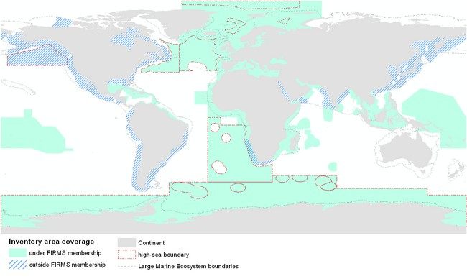
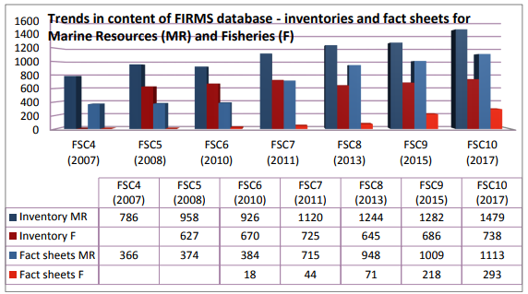
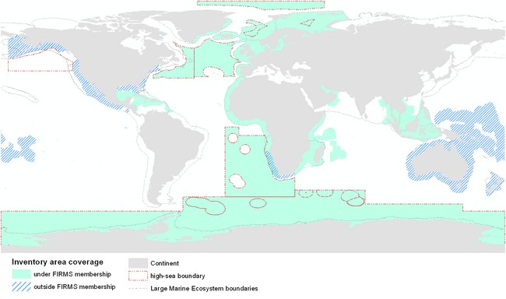
FIRMS Data coverage
FIRMS is reporting on Marine Resources and Fisheries
Published inventory of 1479 stocks and 738 fisheries
Published status reports for about 600 stocks and 250 fisheries
Identified records with no published status:
  ~ 900 stocks
  ~ 500 fisheries
FIRMS Marine Resources data coverage (tuna resources not included)
FIRMS Fisheries data coverage
Notes:
Source: page 4 and page 8 of FSC10 meeting doc http://www.fao.org/fi/static-media/MeetingDocuments/FIRMS/FIRMS_FSC10/2ae.pdf

Slide 6
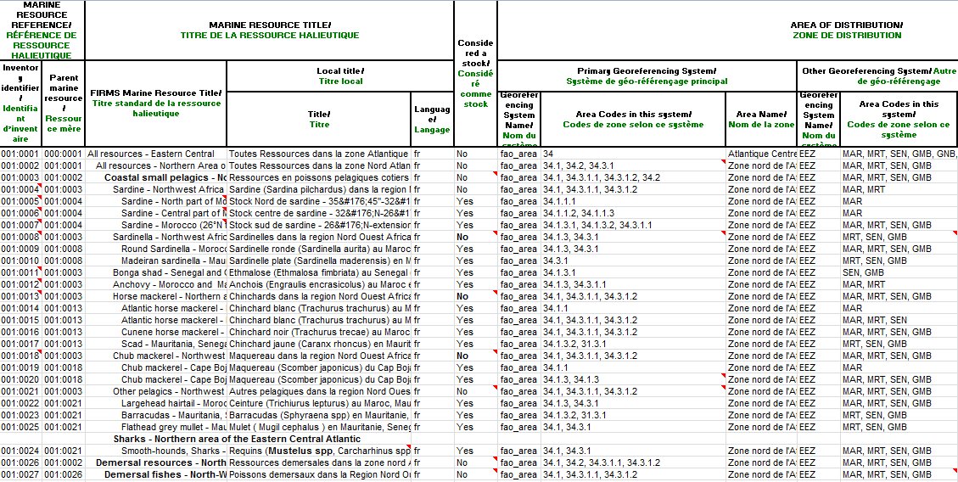
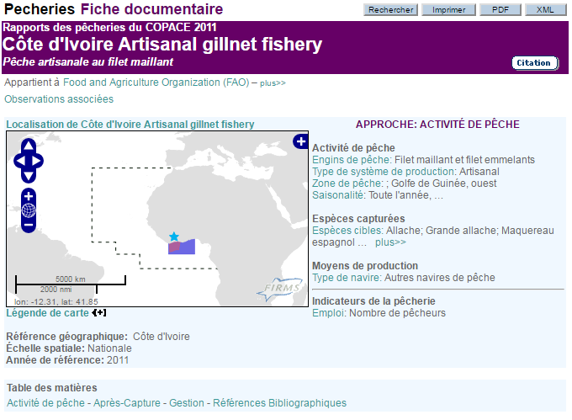
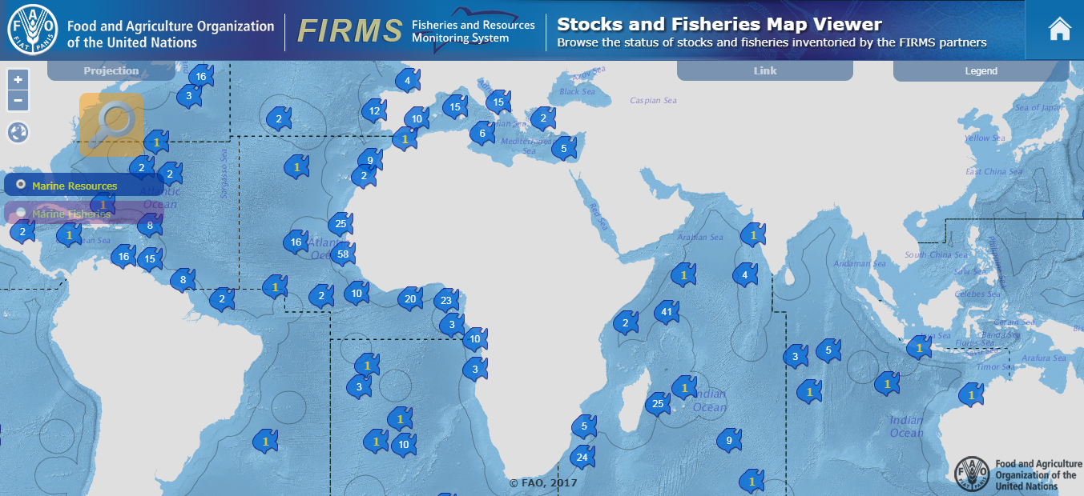
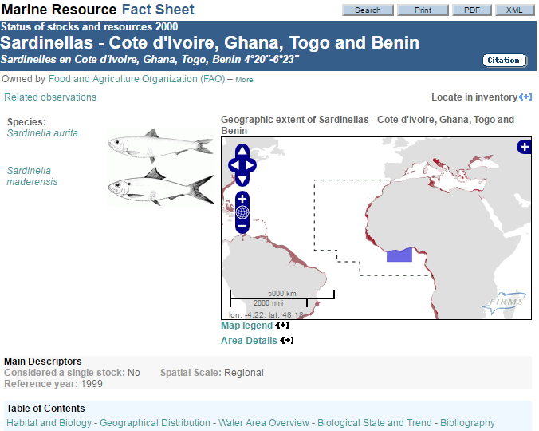
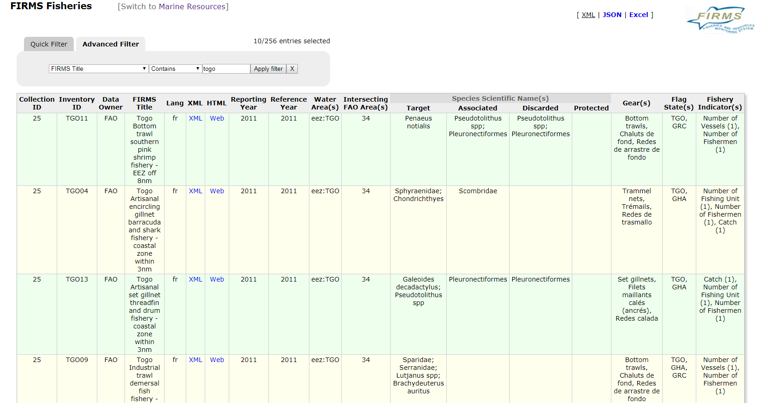
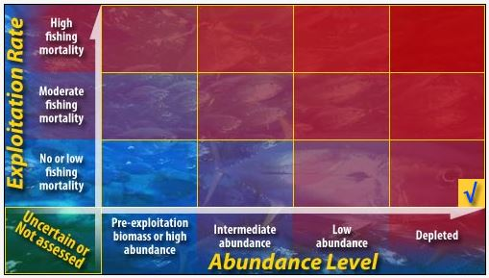
FIRMS Products
Marine Resource & Fishery Inventories (Excel)
Standards and guidelines
Fact Sheets
Search interfaces
Map viewer
Web services

Slide 7
FIRMS Marine Resource & Fishery inventories
Inventories constitute the backbone of the FIRMS knowledge base. Inventories provide the complete picture from which to assess current level of knowledge
Marine Resources and Fisheries are inventoried for reporting purpose
To capture status and trends of Marine Resources and Fisheries
The inventory is implemented using an Excel format for initial data input
Once harmonized according FIRMS standards and validated by data owners, information is stored into the FIRMS database and published as fact sheets
Through their data inputs in FIRMS, partners contribute to the global inventory of marine resources and fisheries.
“You manage what you can measure”

Slide 8
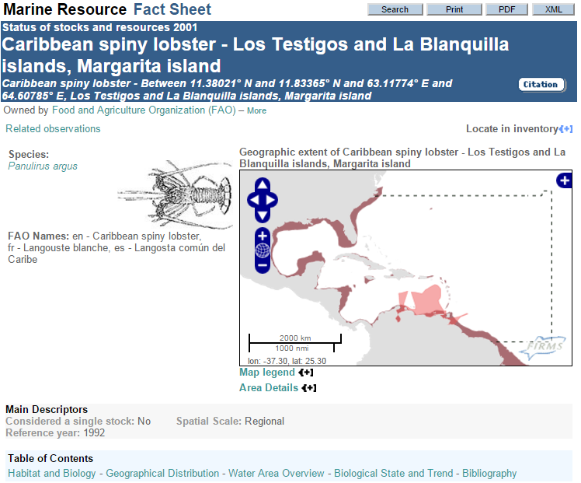
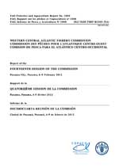
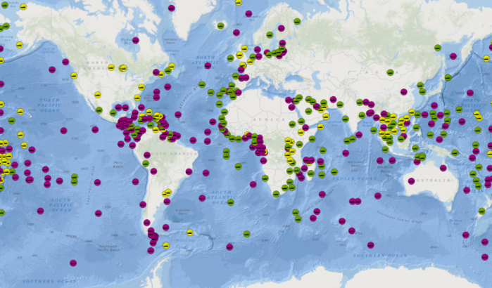
FIRMS Marine Resource & Fishery inventories
One input many outputs: fact sheets, maps, publications, etc.

Slide 9
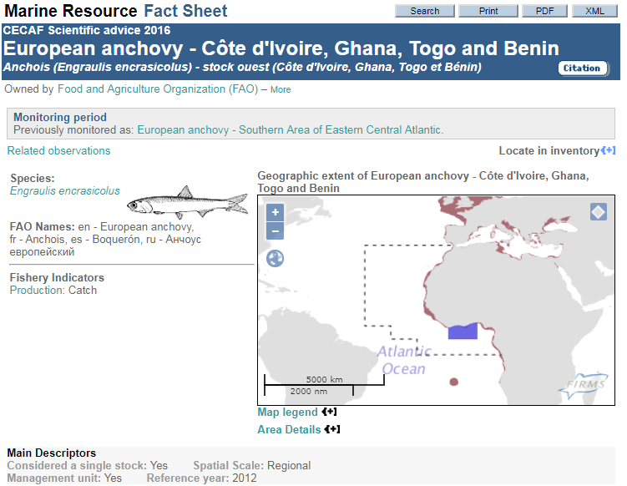
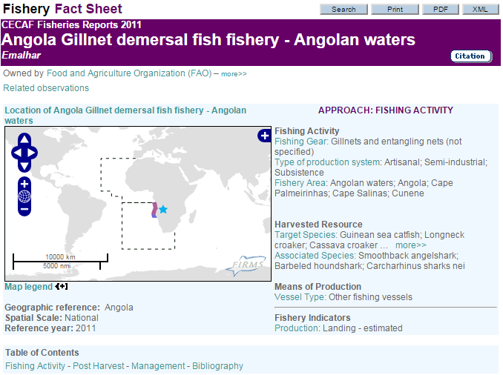
FIRMS Marine Resource & Fishery fact sheets
Examples of fact sheets
  CCSBT - Southern Bluefin tuna
  IATTC - Swordfish - Northeastern Pacific
  NAFO - Atlantic Cod - Flemish Cap
  CECAF - Angola : Gillnet demersal fish fishery - Angolan waters
  SEAFO - South East Atlantic SEAFO High seas fisheries
“Data tell, stories sell”

Slide 10
FIRMS 10 years after
Directions for fulfilling the next 10 years ambition
Minimum data requirements to facilitate reporting to FIRMS
FIRMS maps viewer, and other on-line services
Dashboard of stock status indicators for the region – traffic light approach
Global Record for Stocks and Fisheries: towards
  supporting a live SDG 14.4.1 indicator “Proportion of fish stocks within biologically sustainable levels”
  use of FIRMS stocks and fisheries references for traceability purpose (also contribute to support 14.6.1 “Progress by countries in the degree of implementation of international instruments aiming to combat illegal, unreported and unregulated fishing”)
Cost-effective solutions for enhancing benefits and returns on investments

Slide 11
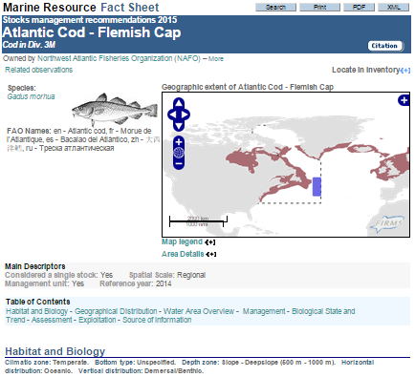
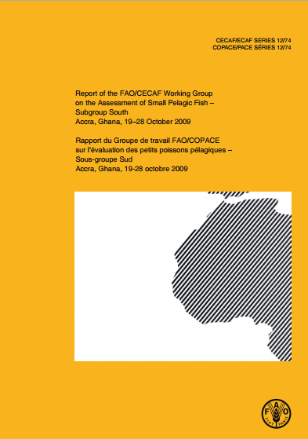
Minimum data requirements
Towards mechanisms ensuring reporting timeliness
Mainstream the FIRMS reporting flow with Partner’s established reporting procedures

Slide 12
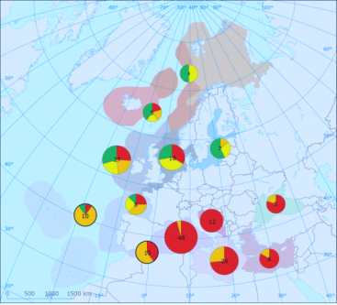
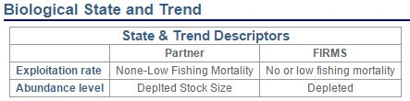

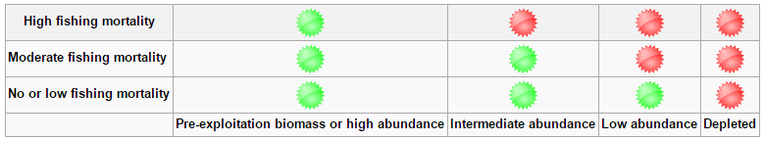
Traffic light approach
Traffic light approach

Slide 13
FIRMS Stocks & Fisheries Map Viewer
Interactive mapping application to browse the status of stocks and fisheries inventoried by the FIRMS partners

Slide 14



Global Record for Stocks and Fisheries
Fisheries and Resources Monitoring System (FIRMS)
RAM Legacy Stock Assessment Database
FishSource
Comprehensive and shared global reference set of
stocks and fisheries records
(a component of the BlueBRIDGE project – EU Horizon 2020)

Slide 15
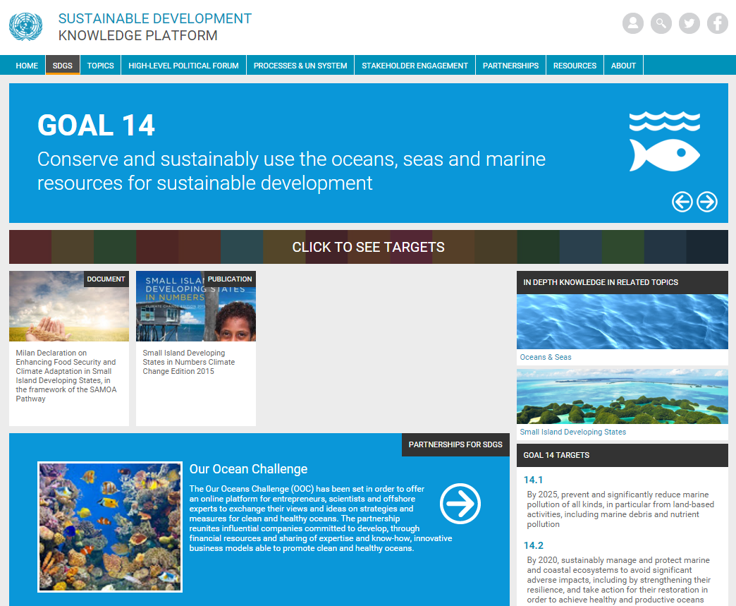
FIRMS & the Sustainable Development Goals
FIRMS, as a global reporting tool on fisheries and resources status & trends, is expected to be instrumental to the SDG 14
“Conserve and sustainably use the oceans, seas and marine resources for sustainable development”
“In particular can provide the RFBs’ backbone to support a live monitoring of Indicator 14.4.1 “Proportion of fish stocks within biologically sustainable levels”, for which FAO/FI is responsible
14.4
By 2020, effectively regulate harvesting and end overfishing, illegal, unreported and unregulated fishing and destructive fishing practices and implement science-based management plans, in order to restore fish stocks in the shortest time feasible, at least to levels that can produce maximum sustainable yield as determined by their biological characteristics.
Notes:
https://sustainabledevelopment.un.org/sdg14
support to Stock status monitoring

Slide 16
Key messages
FIRMS is a partnership of intergovernmental fisheries organizations with competence for resource assessment and conservation.
Provides decision-and others with high-quality, authoritative information on global marine fisheries resources.
Enables decisions makers with information to develop informed fisheries and marine resource policies in accordance with the Code of Conduct for Responsible Fisheries.
Information Dissemination: presented in synthesized “Fact Sheets” and “State of Resources Summaries”.
Transparency and ownership: Fact Sheets sourced with a partner’s relevant links, providing transparent traceability, and when validated by the partner, they may also include related references and observations from other sources.

Slide 17
Key messages
FIRMS as a mature framework for global reporting tool on fisheries and resources status & trends
FIRMS as a shared reporting & web-dissemination system
  as well as a data collation & sharing mechanism
FIRMS contribute to evidence-based decision making

Slide 18
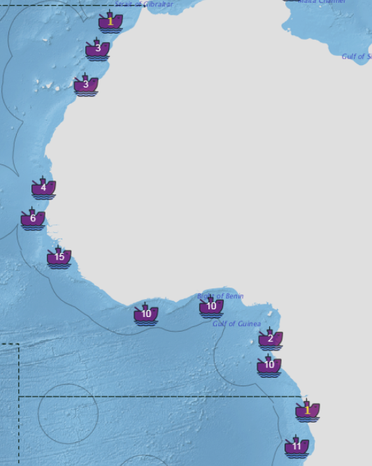

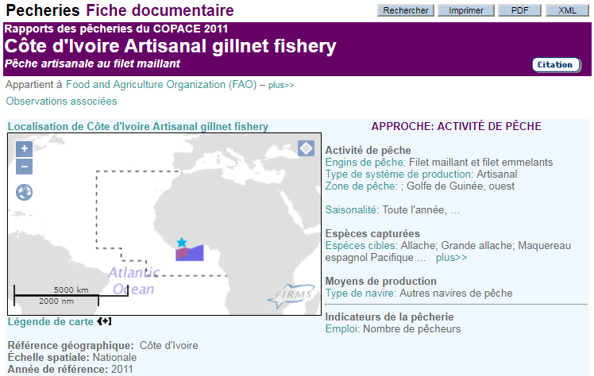
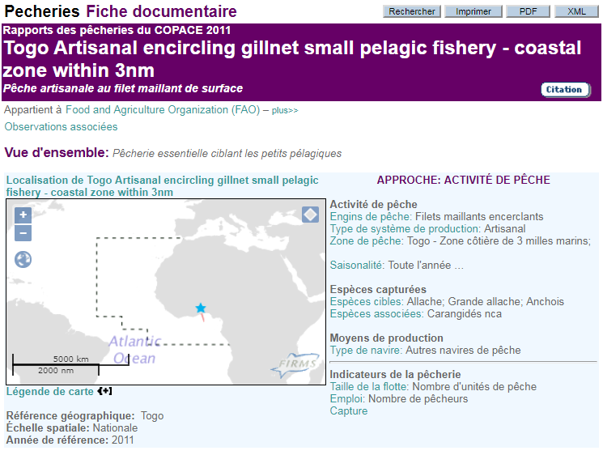
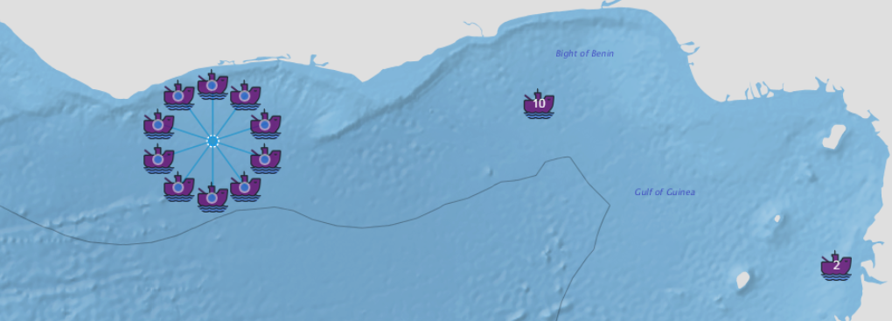
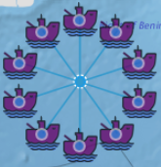
Assessment of Fishery reporting status in the CECAF area
80 reports published as Fishery fact sheets for CECAF area
  20 Fact sheets, with reporting year = 2011, were produced by Côte d‘Ivoire (10) and Togo (10).
Notes:
80 fisheries: Angola, Côte d`Ivoire, Gabon, Guinée, Senegal, Spain, and Togo

Slide 19
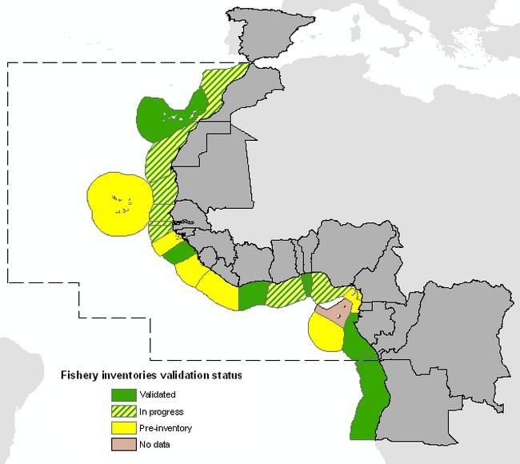
FIRMS Actions for TCP Output 4 Activity 4.1
- Update Fishery inventories of FCWC Member countries -
In consultation with national officers:
Collate new information to update FIRMS inventories for Cote d’Ivoire and Togo
Finalize inventory for Benin
Complete draft inventories for Ghana, Liberia and Nigeria
Publish Fishery fact sheets based on the new inventories
*Collaboration and data provision from national
officers is critical for the success of the activity
FIRMS activities in the CECAF area

Slide 20
Expected Workshop Outcomes
Identifying the benefits of playing a role within the CECAF-FIRMS collaboration for FCWC sub-regional organisation and its Member Countries.
Update Fishery inventories of FCWC Member countries.
Raise awareness on a related matter regarding how FAO and FIRMS can support Member Countries’ contribution to SDG Indicator 14.4.1 “Proportion of fish stocks within biologically sustainable levels”, and more generally Target 14.4 on Sustainable Fisheries (e.g. support to FMPs and dissemination of relevant information).

Slide 21
شكر
謝謝
Merci
Thank You
Благодарю
¡Muchas Gracias!

Slide 22
Past FIRMS regional workshop reports
Report of the WECAFC-FIRMS Data workshop, Christ Church, Barbados, 19-21 January 2016 http://www.fao.org/3/a-i5789e.pdf
Report of the WECAFC-FIRMS Workshop on Marine Resources and Fisheries Inventories – Corpus Christi. USA, 1-2 November 2013 http://www.fao.org/3/a-i3661e.pdf
Report of the RECOFI - FIRMS Workshop on Resources and Fisheries Inventories, Cairo, Egypt, 12-14 July 2011 http://www.fao.org/docrep/015/i2353e/i2353e00.pdf
Report of the CECAF-FIRMS Workshop on resources and fisheries inventories, Accra, Ghana, 7-9 December 2009 http://www.fao.org/3/a-i5022b.pdf

