Slide 1



FCWC within the CECAF-FIRMS collaboration
Distributed roles and anticipated benefits
http://firms.fao.org
Final workshop TCP/RAF/3512 “Strengthening routine fisheries data collection in West Africa: Benin, Cote d’Ivoire, Ghana, Liberia, Nigeria, Togo and Fishery Committee of the West Central Gulf of Guinea (FCWC)
Monrovia, Liberia 23-24 November 2017

Slide 2
FIRMS target audience and value proposition
RFBs:
  to increase visibility beyond their area of competence
  to provide a dissemination capacity when no other dissemination mechanism exists
  to foster information exchange in context where data sharing is a sensitive issue or would require long learning curve
  to be functional to needs of Fishery Management Plans
  regional dashboard of indicators for the State of environment
National agencies of governments dealing with fisheries reporting
Analysts and instruments (e.g. SDG14) working on global monitoring of state of fishery resources
NGOs promoting sustainable fisheries and promoting progress in fisheries management (FIPs), including through traceability of fish products
Stakeholders (e.g. fishermen associations) and General public, to whom fishery data should be made available in more immediate and easy ways

Slide 3
A possible scenario for FCWC collaborating within the FIRMS-CECAF context (1)
Considering:
TCP/RAF/3512 Output 4: Collaboration between FCWC and its member countries with FIRMS is improved
The FCWC countries have several shared fish stocks and willing to contribute to sustainable management and exploitation of fishery resources for food and nutrition security
FCWC, as a sub-regional organization, has a close collaboration with CECAF and its Member countries
We suggest that:
Interactions among the three organizations would be an added value for the CECAF-FIRMS collaboration
A formalization of data exchange mechanism with FCWC and Member countries would be also welcome

Slide 4
A possible scenario for FCWC collaborating within the FIRMS-CECAF context (2)
Responsibilities: - CECAF is responsible for the content of the marine resources inventory while countries are responsible for the content of the fisheries inventory.
    - CECAF through its SSC has the corporate responsibility for the overall consistency of the fisheries inventory, overview of strategic and policy aspects.
    - FCWC is focal point for the West Central Gulf of Guinea sub-region and coordinate/facilitate the countries submission of Fishery information.
Governance: The Chairperson of the SSC is the CECAF-FIRMS focal point for the CECAF region.
    - a FCWC focal point be nominated for FIRMS
    - a CECAF-FIRMS task force be created to coordinate inputs, review needs, address issues, ensure capacities are built: composed of CECAF and FIRMS-Secretariats and two above focal points, others (e.g. COREP, SRFC) could join afterwards
Maintenance: - Marine Resource reports are produced upon published CECAF Working Group Reports.
    - Fishery reports are updated by Countries on a routine basis.
    - Data calls are launched for regular updates
Notes:
Responsibilities and maintenance of workflow with respect to some aspects of CECAFs contribution to FIRMS were discussed and laid out at the sixth session of the SSC in Accra, Ghana, in 2011 (see page p.9 of the report of this meeting). ftp://ftp.fao.org/FI/DOCUMENT/cecaf/cecaf21/CECAF_XXI_2016_Summary.pdf

Slide 5
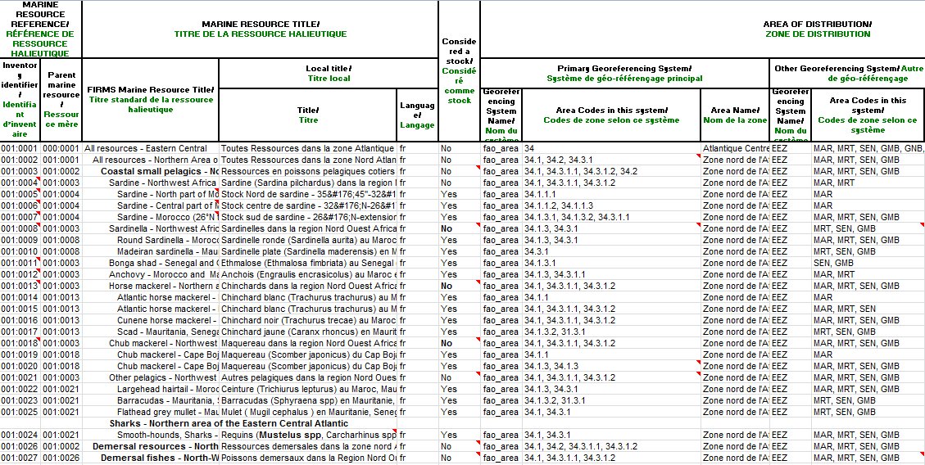
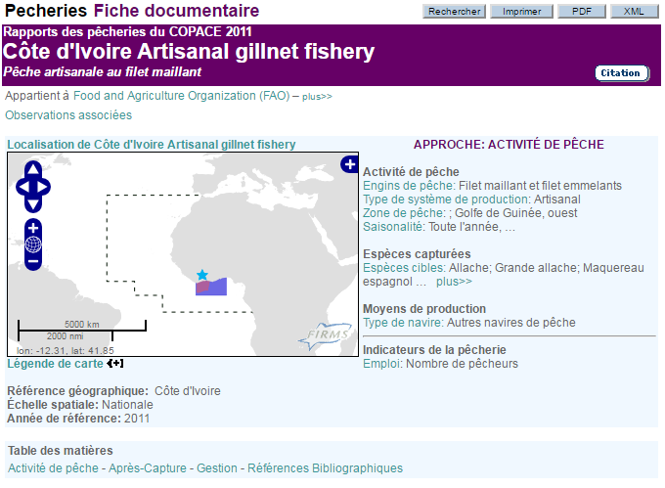
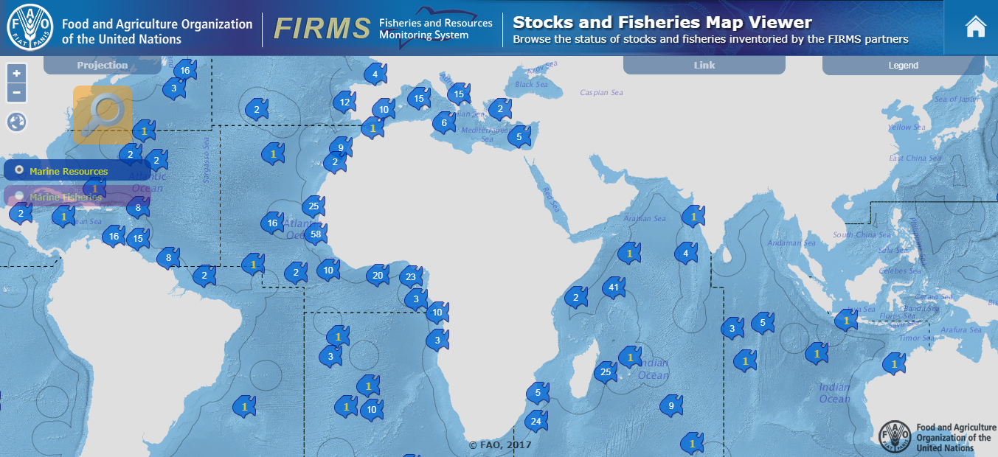
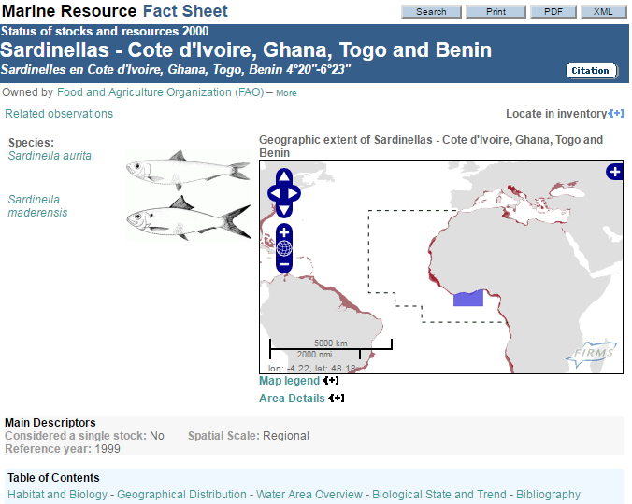
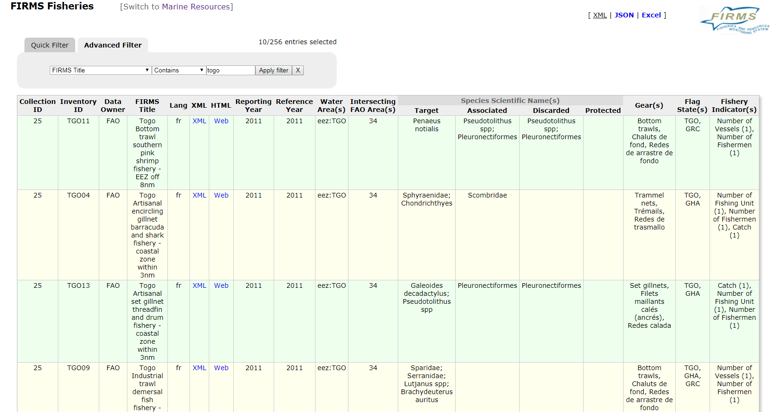
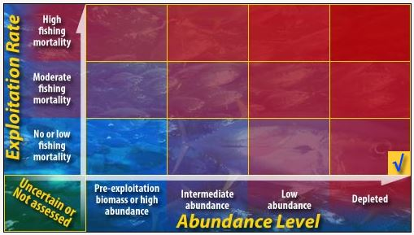
FIRMS Products
Marine Resource & Fishery Inventories (Excel)
Standards and guidelines
Fact Sheets
Search interfaces
Map viewer
Web services

Slide 6
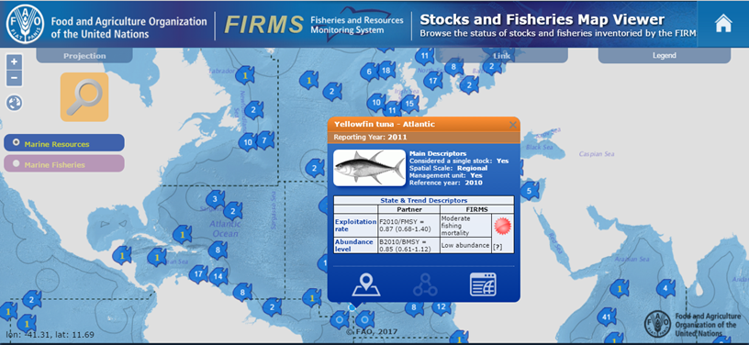
FIRMS Stocks & Fisheries Map Viewer
Interactive mapping application to browse the status of stocks and fisheries inventoried by the FIRMS partners

Slide 7
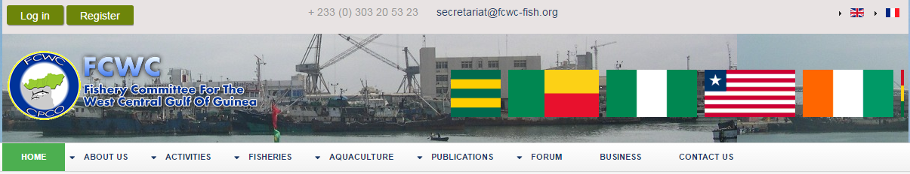
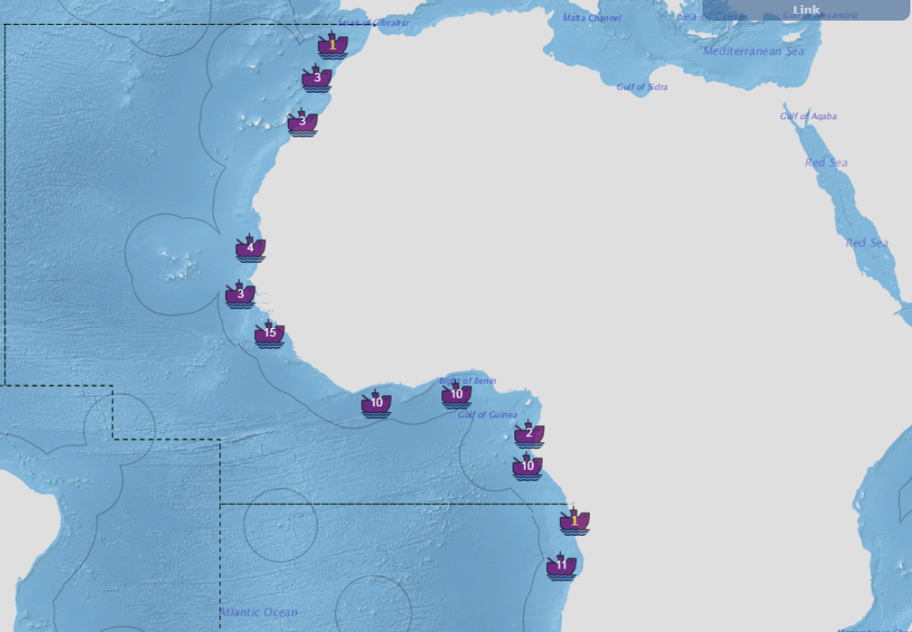
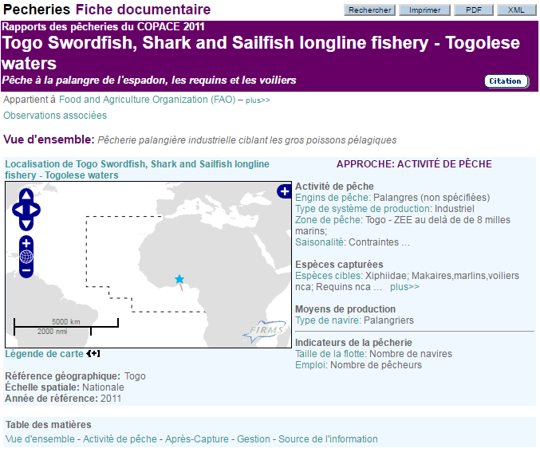
Reutilizing FIRMS web products
Embedding capacities are available for FIRMS partners and data providers.
  Fact sheets and applications can be displayed within other websites.

Slide 8
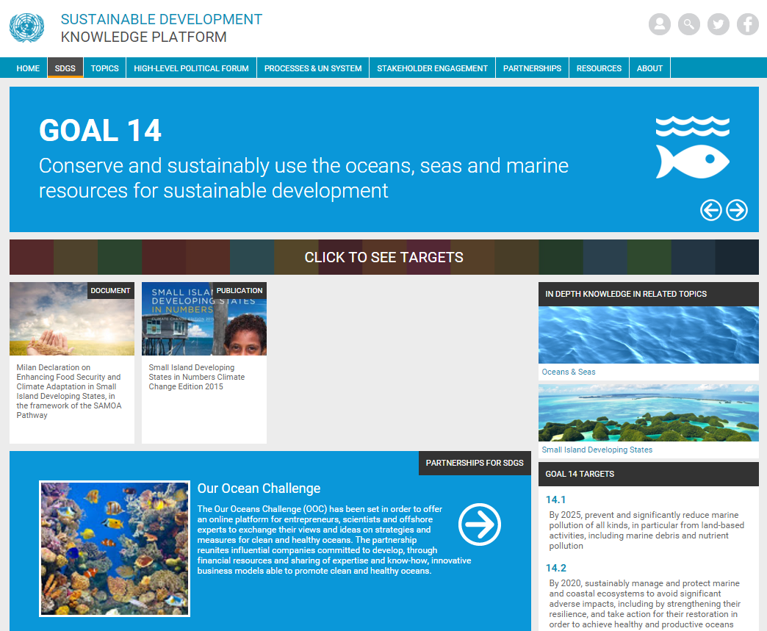
FIRMS & the Sustainable Development Goals
FIRMS, as a global reporting tool on fisheries and resources status & trends, is expected to be instrumental to the SDG 14
“Conserve and sustainably use the oceans, seas and marine resources for sustainable development”
“In particular can provide the RFBs’ backbone to support a live monitoring of Indicator 14.4.1 “Proportion of fish stocks within biologically sustainable levels”, for which FAO/FI is responsible
14.4
By 2020, effectively regulate harvesting and end overfishing, illegal, unreported and unregulated fishing and destructive fishing practices and implement science-based management plans, in order to restore fish stocks in the shortest time feasible, at least to levels that can produce maximum sustainable yield as determined by their biological characteristics.
Notes:
https://sustainabledevelopment.un.org/sdg14
support to Stock status monitoring

Slide 9
Capacity building
FIRMS partnership can catalyse other funds opportunities for capacity building
  E.g. DG-MARE (EU) supported two projects under the WECAFC-FIRMS collaboration and enabled the connection with EU-DEVCO (FIT4CC project formulation is in progress, Fisheries Information Technology Innovations For Resource Management And Climate Change Adaptation In The Caribbean)
Dedicated training(s) for SDGs
Notes:
improve the data and information exchange between countries, sub-regional and regional organizations such as WECAFC, and eventually feeding FAO’s global monitoring system. To this objective, a proactive and participatory network under the FIRMS partnership can result as catalyst for funding opportunities for capacity building.

Slide 10
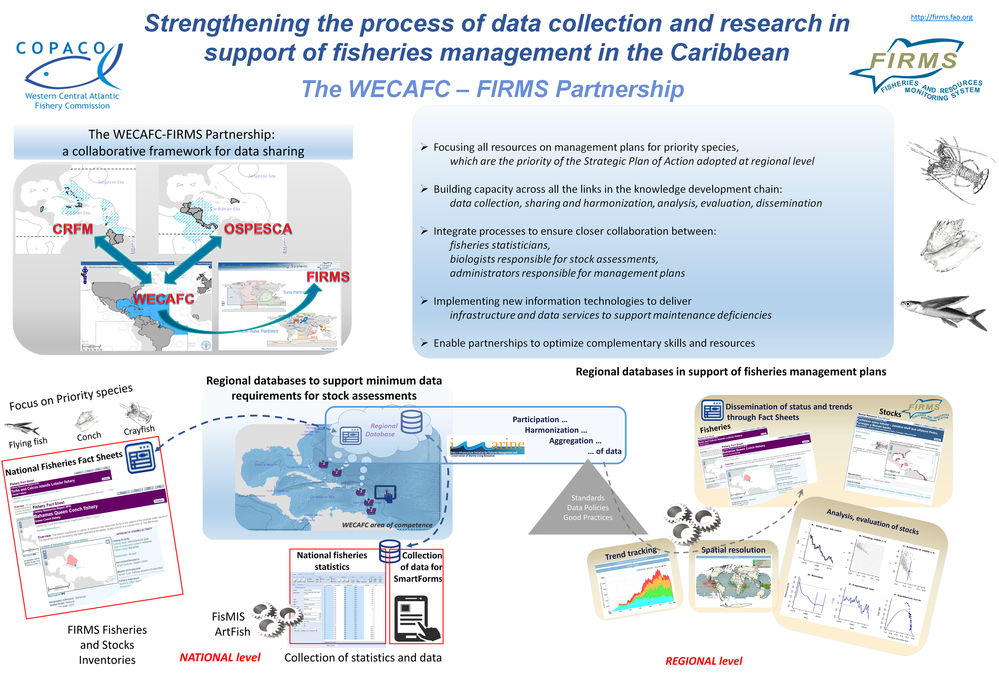
FIRMS instrumental to regional process - The WECAFC example

Slide 11
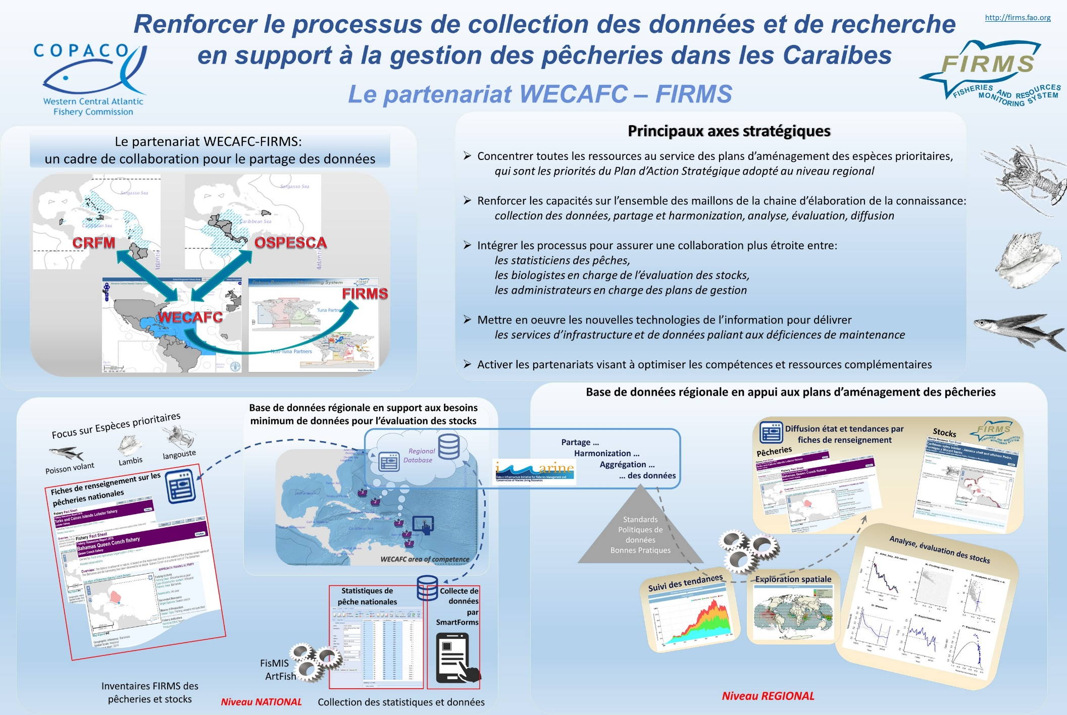
Instrument du FIRMS pour le processus régional - L'exemple de la COPACO

Slide 12
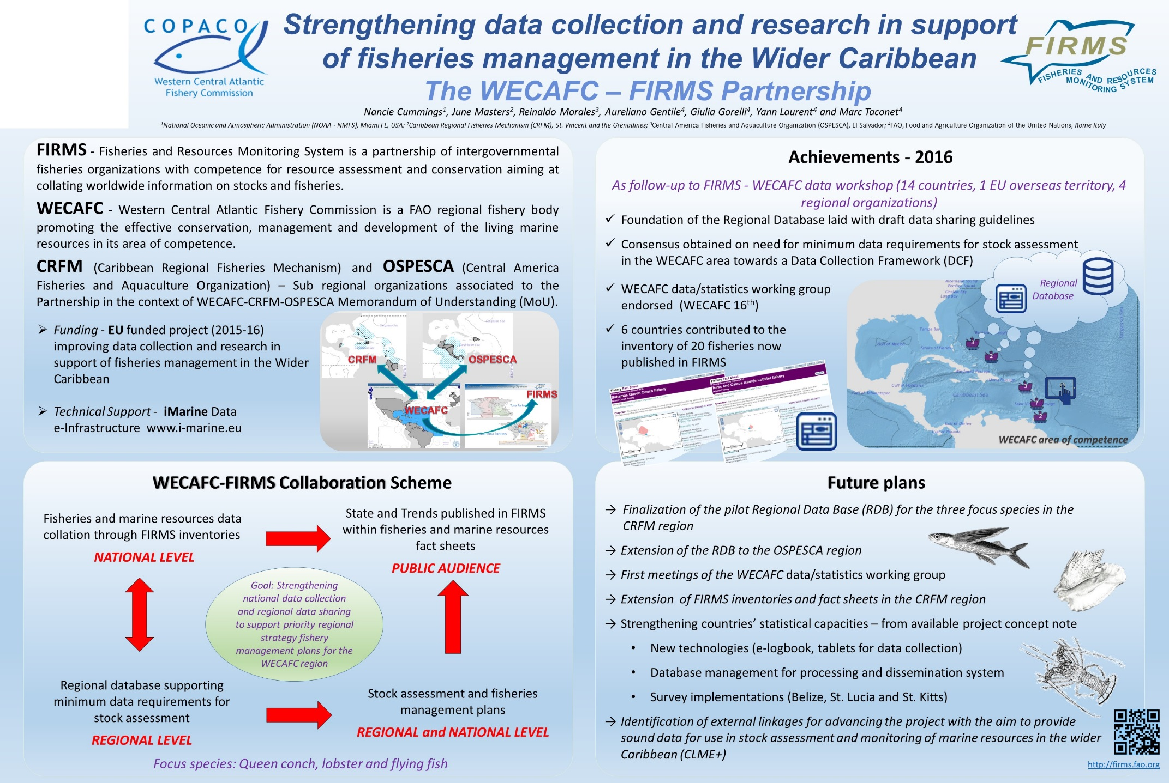
FIRMS instrumental to regional process - The WECAFC example

Slide 13
Overall benefits
Potential return on investment for stakeholder participating in the FIRMS framework:
Visibility at global level
  Including recognition of web traffic to FCWC and Member countries
Clear involvement and contribution to political agenda (SDG 14.4.1)
Availability of FIRMS data services in support to stocks status monitoring and fisheries management
(e.g. map viewer, analytical tools, data dissemination capacity)

Slide 14
Extended benefits
FIRMS Partnership instrumental to improving basic data on fisheries
  Inventories / fact sheets providing minimum data for monitoring and management
  Utilizing FIRMS standards and concepts to add informative value to data
  Providing mechanism for basic dissemination on Status and Trends (S&T)
FIRMS Partnership beneficial to regional fisheries needs
  Supporting the need for access to high quality information for management
  Foundation information layers (inventories, fact sheets) that:
    act as catalyst to develop regional data base when not pre-existing (case WECAFC)
    provide easily accessible and comprehensive information on S&T (including mix of quantitative/qualitative information)
  Developing multi layered collaboration initiatives
    Strategic and cost effective

Slide 15
Key messages
FIRMS as a mature framework for global reporting tool on fisheries and resources status & trends
FIRMS as a shared reporting & web-dissemination system
  as well as a data collation & sharing mechanism
FIRMS contribute to evidence-based decision making

Slide 16
Actions asked to the Committee
Provide feedback on the suggested collaboration scenario;
Provide feedback on current inventory and fact sheets, and on how workflow and timeliness of uploading new information to FIRMS can be improved;
Provide feedback on the usefulness of the FIRMS products to FCWC and FCWC members.

Slide 17
شكر
謝謝
Merci
Thank You
Благодарю
¡Muchas Gracias!

