Slide 1



FIRMS supporting the data collation and dissemination of fishery indicators
Marc Taconet, Stefania Savoré and Aureliano Gentile
Fisheries Officers, Statistics and Information Branch,
Fisheries and Aquaculture Department
Food and Agriculture Organization of the UN, Rome, Italy,

Slide 2
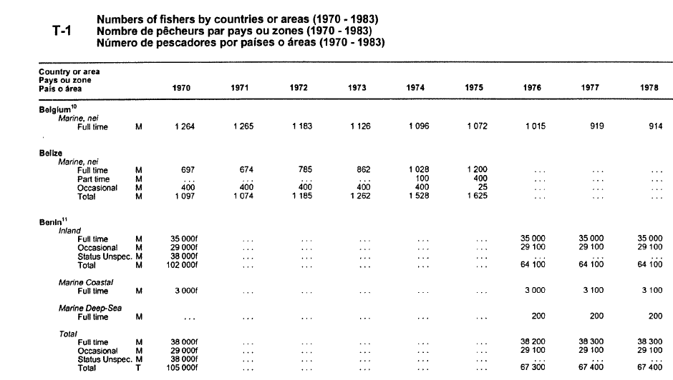
FAO and the collection of socio-economic data
Employment
  Number of commercial and subsistence fishers and fish farmers from 1970.
  Annual via questionnaire.
  Separation of the number of workers according to the time devoted to fishing as an occupation (full-time, part-time, occasional).
  Number of people engaging in inland or marine waters, and commercial aquaculture.
  Disaggregation of employment data by gender.

Slide 3
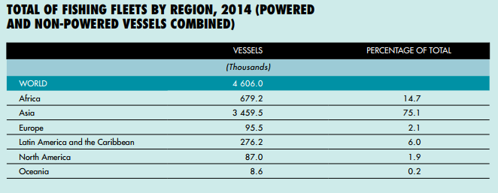
FAO and the collection of socio-economic data
Fishing fleets
  National annual statistics.
  Number and total tonnage of fish catching used in commercial, subsistence and artisanal fisheries are collected by size of vessel measured in gross register tons (GRT) or gross tons (GT)
  Data collected for 10 types of vessels defined in the International Standard Statistical Classification of Fishery Vessels (ISSCFV, currently under revision)
  Collection methods:
    directly from each country through a questionnaire and explanatory notes.
    national publications, international fishery magazines, FAO fishery country profiles, national fleet registers and Lloyd's Maritime Information Services database.
    The problems in obtaining the information prevent release of timely statistics.
Notes:
Gather any comment on needs that should be taken into account in such revision, also propose FCWC as reviewer of the proposed revision.

Slide 4
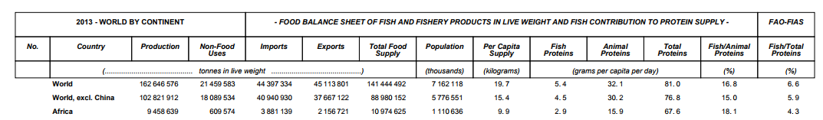
FAO and the collection of socio-economic data
Apparent consumption of fish and fishery product
  Annual statistics
  Supply/utilisation accounts (SUAs) for eight groups of primary fishery commodities and nine groups of processed products.
  Data on per caput fish food supplies are expressed in terms of quantity and, in terms of caloric value and protein and fat content.
  Information disseminated through FAOSTAT (http://www.fao.org/fishery/statistics/global-consumption/en) and FishStatJ (http://www.fao.org/fishery/statistics/software/fishstatj/en)
Notes:
The FBS disseminated through FishStatJ is relatively recent and it's important to bring to their attention that this can be used now.

Slide 5
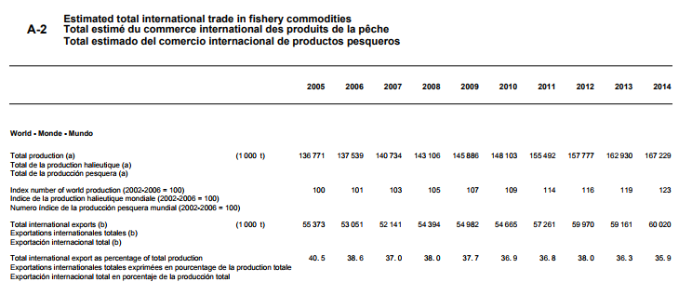
FAO and the collection of socio-economic data
Fishery Commodities and Trade
  Annual production of fishery commodities.
  Imports and exports (including re-exports) of fishery commodities by country.
  Commodities in terms of volume and value.
  Summary statistics for apparent consumption of fish and fishery products.
  The disposition of world production and the value of production by capture fisheries and aquaculture, by major groups of species.
  The direction of trade for selected country groups.
  Information disseminated through FAOSTAT(http://www.fao.org/fishery/statistics/global-consumption/en) and FishStatJ (http://www.fao.org/fishery/statistics/software/fishstatj/en)

Slide 6
Relevant socio-economic publications
The following FAO publications provide fisheries data, including socio-economics information:
FAO Yearbook of Fishery and Aquaculture Statistics: a compilation of statistical data on capture fisheries and aquaculture production, employment, commodities production and trade, apparent fish consumption and fishing fleets.
The State of World Fisheries and Aquaculture (SOFIA): the flagship publication of the FAO Fisheries and Aquaculture Department. This premier advocacy document is published every two years to provide policy-makers, civil society and those whose livelihoods depend on the sector a comprehensive, objective and global view of capture fisheries and aquaculture, including associated policy issues.

Slide 7
FIRMS Indicators in support to socio-economic databases
The FIRMS Inventory includes data models for many fishery indicators. This is expected to encourage collation of a wide variety of data, including socio-economic information provided by countries and in support of better management practices.
Class | Type | Measure
Exploitation | Catch | Catch
Socioeconomic | Effort | Gross Value Added
 | Nominal Effort | Number of Ports
 | Economic Performance | Landed Volume
 | Employment | Landed Value
 | Fishing Capacity | Landed Average Price
 | Fleet Size | Landed Global Value
 | Production | International Market Global Value
 | Participation | Fleet Tonnage
 | Utilization | Fleet Power
 |  | Number Vessels
 |  | Number Fishermen
 |  | Number Fishing Unit
 |  | Trawling Hours
 |  | Per Capita Consumption
 |  | Domestic Human Consumption
 |  | Shared in Animal Protein
The provision of these indicators could support outlooks like SOFIA particularly where collation of data is not yet produced or made publically available. FIRMS fact sheets offer an easily accessible opportunity to make this data available, combining quantitative and qualitative information.
Notes:
Class x Type x Measure are combined to provide full context and meaning for an indicator, e.g. in the fishery fact sheets you are asking contributions for: Exploitation x Participation x Number of fishermen, different from a socio-economic frame survey that would handle Socioeconomic x Employment x Number Fishermen.
Different combinations are possible within FIRMS with the available of these indicators.

Slide 8

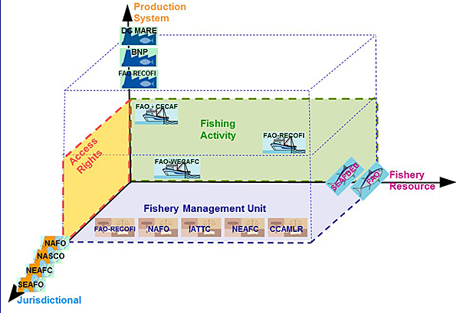
The FIRMS thematic approach
Different thematic approaches are envisaged, according to the disciplinary viewpoint prevailing in the identification of fishery units when a fisheries inventory is compiled:

Slide 9

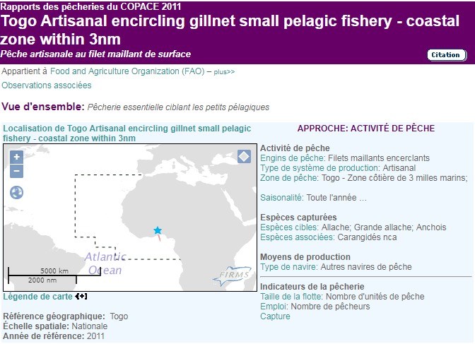
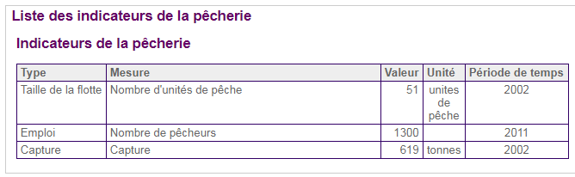
Fishing Activity
Main fishery descriptors:
Gear type
Fishery area
Seasonality
Production descriptors
Flag state
Target and/or other species (associated, protected, discarded spp.)
Notes:
Make clear that Reference Year is associated to any indicator value.

Slide 10

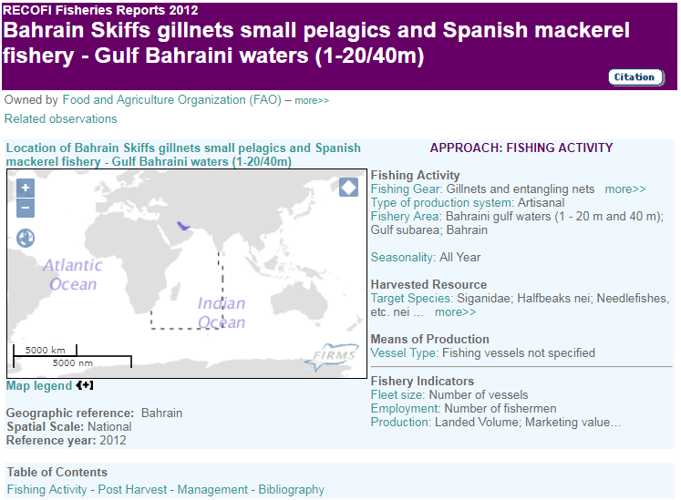
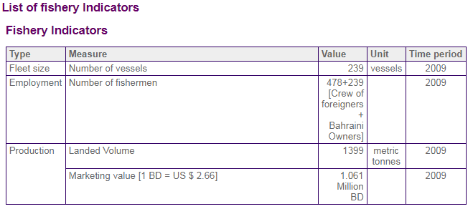
Management Approach
Main fishery descriptors:
Jurisdiction descriptors
Captured species
Target and/or other species (associated, protected, discarded spp.)
Fishery area

Slide 11

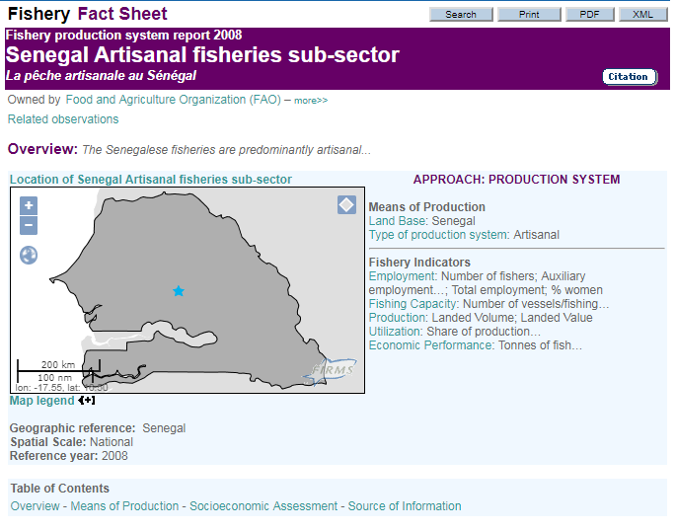
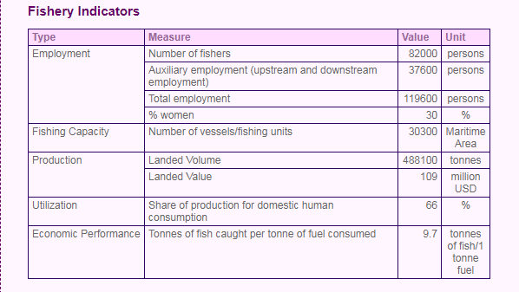
Production Approach
Main fishery descriptors:
Land base
Type of production system
Vessel type
Flag state
Fleet segment
Fishers community
Fishery area

Slide 12

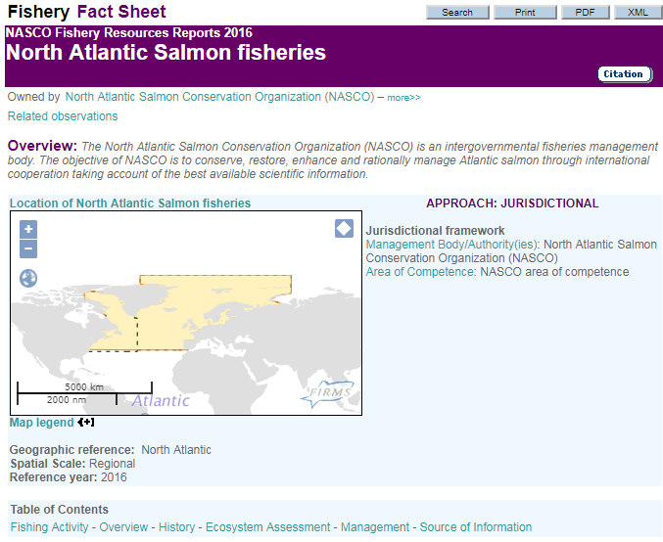
Jurisdictional Approach
Main fishery descriptors:
Management body
Area of competence
Jurisdiction area (geographical)
Enforcement authority

Slide 13

Access Rights
Main fishery descriptors:
Jurisdiction descriptors
Production descriptors
Fishing agreement

Slide 14
شكر
謝謝
Merci
Thank You
Благодарю
¡Muchas Gracias!
Notes:
FAO – Capacity Development/Technical Assistance

