Slide 1




The FIRMS partnership in support of stock status monitoring for SDG indicator 14.4.1
Marc Taconet, Stefania Savoré and Aureliano Gentile
Fisheries Officers, Statistics and Information Branch,
Fisheries and Aquaculture Department
Food and Agriculture Organization of the UN, Rome, Italy,
TCP/RAF/3512 “Strengthening routine fisheries data collection in West Africa: Benin, Cote d’Ivoire, Ghana, Liberia, Nigeria, Togo and Fishery Committee of the West Central Gulf of Guinea (FCWC)
Monrovia, Liberia 23-24 November 2017

Slide 2
Outline
Sustainable Development Goal 14, Target 14.4 and Indicator 14.4.1
FAO SOFIA
Reporting under SDG 14: Objectives and Challenges
FIRMS in support to SDG 14.4.1
FIRMS and the Global Record of Stock and Fisheries
In summary

Slide 3
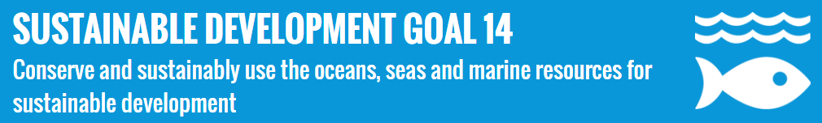
The increasingly adverse impacts of climate change (including ocean acidification), overfishing and marine pollution are jeopardizing recent gains in protecting portions of the world’s oceans.
14.1. By 2025, reduce pollution
14.2. By 2020, protect ecosystems
14.3. Minimize the impact of ocean acidification
14.4 By 2020, rebuild fisheries / restore fish stocks
14.5. By 2020, conservation through MPAs
14.6. By 2020, prohibit certain fisheries subsidies
14.7. By 2030, increase economic benefits
Notes:
On September 25th 2015, countries adopted a set of goals to end poverty, protect the planet and ensure prosperity for all as part of a new sustainable development agenda. Each goal has specific targets to be achieved over the next 15 years.

Slide 4

Sustainable Development Goal Target 14.4
“By 2020, effectively regulate harvesting and end overfishing, illegal, unreported and unregulated fishing and destructive fishing practices and implement science-based management plans, in order to restore fish stocks in the shortest time feasible, at least to levels that can produce maximum sustainable yield as determined by their biological characteristics”
Indicator 14.4.1
Proportion of fish stocks within biologically sustainable levels

Slide 5
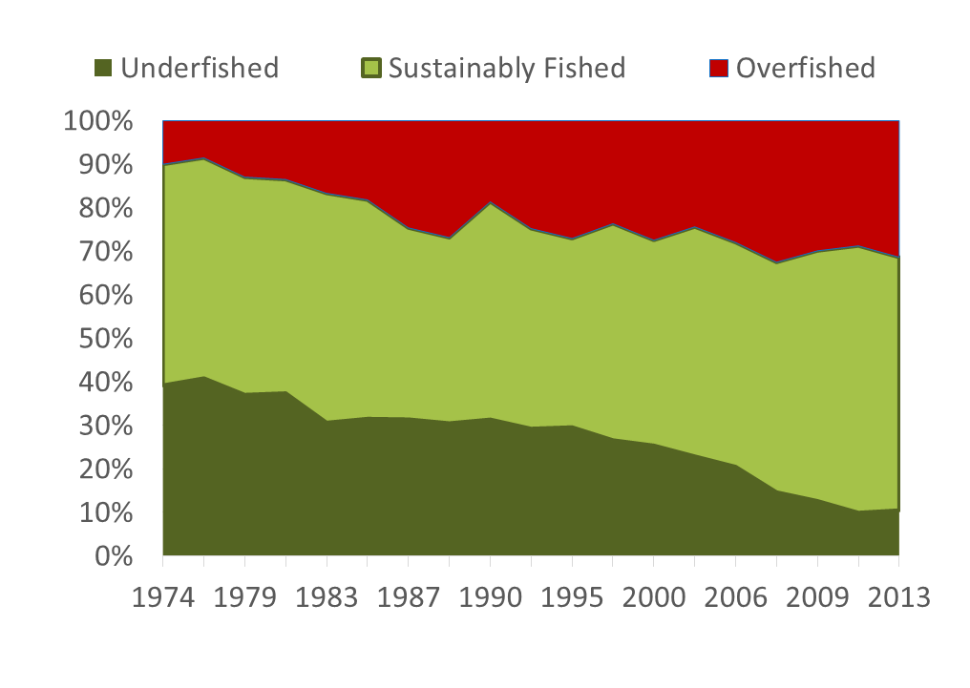

FAO State of the World Fisheries and Aquaculture (SOFIA) - Global Trends in World Marine Fish Stock since 1974
  FAO regularly reports as part of its biennial SOFIA publication the state of fish stocks at global level
This SDG indicator measures the sustainability of the world's marine capture fisheries by their abundance
Results show approximately 30% overfished in 2013, and 70% is sustainably harvested.
The decreasing trend is worrying.

Slide 6
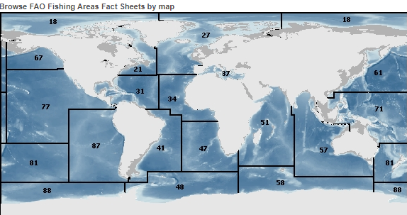
SOFIA’s indicator is the result of a methodology based on:
Status of shared or straddling stocks assessed under RFMO/RFBs mandates
Status of national stocks assessed under national mandates
and in absence of stock assessment
Analysis of Species catch trends by FAO area (FAO catch statistics)
Achieved by:
Defining Stock units at a granularity of [FAO Major Fishing Areas X Species]
Calculating the “proportion” is based on stock numbers (without weighting either by its production volume or stock abundance, every fish stock is considered of the same importance)

Slide 7
Reporting on stock status within country EEZs under SDG 14.4.1
Objectives
Challenges
Assess the status of stocks under the national jurisdiction.
Build a globally consistent monitoring framework
      FAO guidelines and standards for the selection of species and identification of national stock units by countries, resulting into national inventories of relevant fish stocks;
      a monitoring system ensuring transparency and access to published assessment results of individual stocks;
      a standard compilation of the proportion of sustainable fish stocks in time/space consistent ways.
Catch effort data of insufficient quality
  Catch often not available by species, effort often not available by fleet segment;
  Assessment/Distribution areas often not precise enough;
  When available, time series are often short or difficult to reconstitute consistently in long term.
Difficulties in selecting species and stock units that do not overlap with those monitored under RFB mandates.
Need to accept transparency rules.
Inconsistent availability of monitoring systems.

Slide 8
The Fisheries and Resources Monitoring System (FIRMS)
Can provide a key monitoring instrument to help FAO fulfil its SDG 14.4.1 custodianship role and support Member Countries in reaching their reporting goals.
Indicator 14.4.1
Proportion of fish stocks within biologically sustainable levels

Slide 9
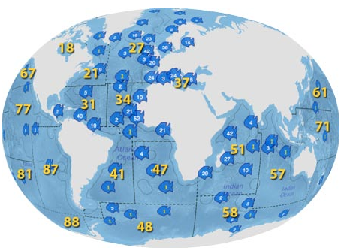
FIRMS is an information sharing partnership to facilitate the monitoring of stocks status among:
14 International organizations
19 Regional Fisheries Bodies (RFBs)
Such inventory of stocks following agreed SDG14.1.1 guidelines would enable a systematic, transparent, traceable and consistent aggregation of stock status on national, regional and global levels.
The role of FIRMS RFB Partners will be key in ensuring consistency of this inventory across national and regional scales.

Slide 10
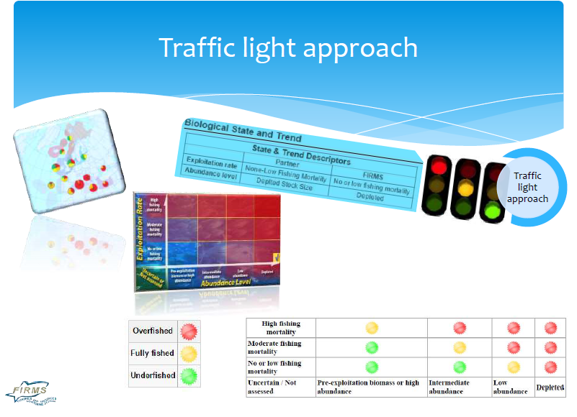
The FIRMS Mandate (Article 1.1 of the FIRMS Partnership Arrangement )
To promote development and extension of fisheries status and trends reporting to all fisheries resources
The FIRMS database currently covers:
shared stocks under RFBs mandates
national stocks / assessment units
status of national fisheries
FIRMS has set Information Standards:
  To facilitate transparency and comparability among single stock status reports and provide a unique reference framework for implementation of SDG14.4.1
Under RFBs monitoring capacity

Slide 11
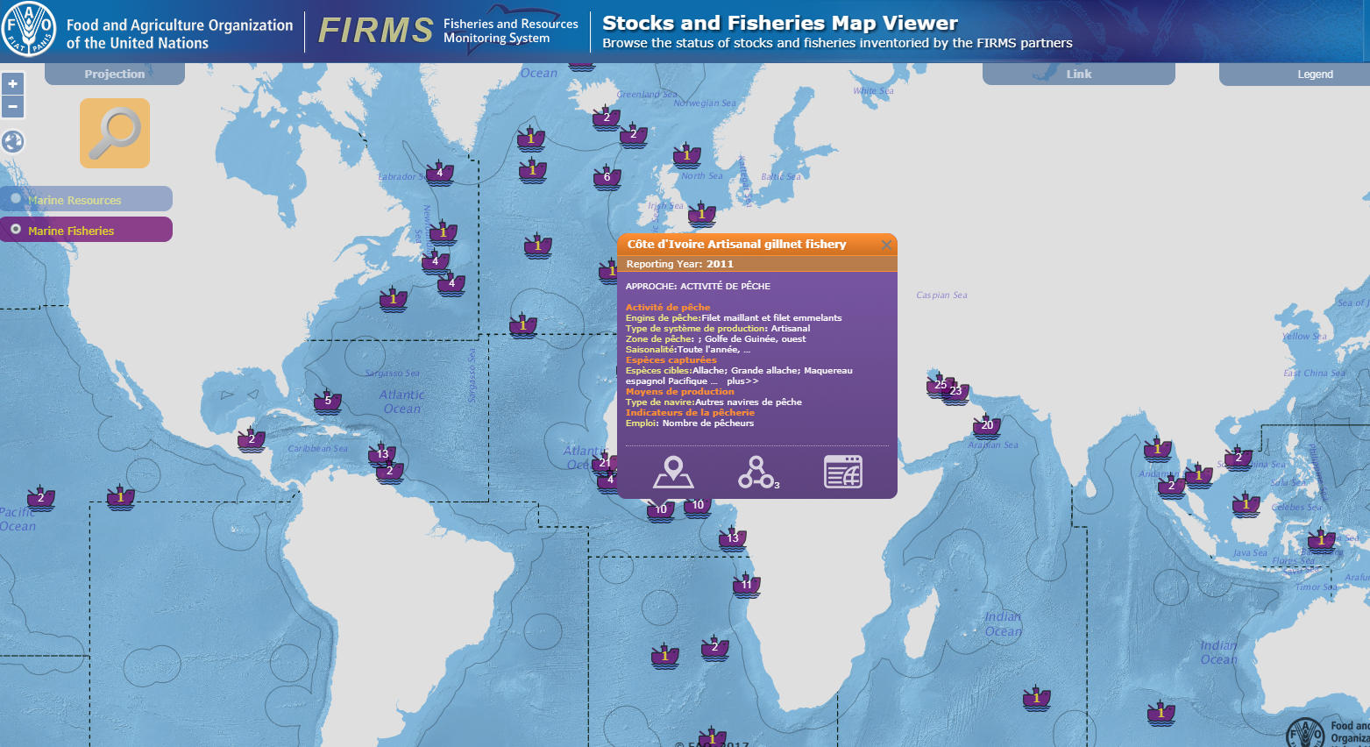
Monitoring is based on inventories of stocks and fisheries
Each stock inventoried includes information on the identification of single marine resources/stocks plus the indicators of Stock State and total catch (or landings)

Slide 12
How will FIRMS help countries fulfil their SDG14.4.1 ownership
  Through FIRMS, FAO offers facility for Unique Global Stock Identifiers;
  Publishing of such Unique Identifiers constitutes a validation mechanism by FAO;
  These unique global identifiers are then used as references for countries:
      To publish the Status of individual stocks on national web-sites, and/or in case of low capacity
      To publish the Status of individual stocks through FIRMS
  To facilitate reporting of the indicator, a tool will assist in computing the percentage and provide an indicator report for final validation by the country.

Slide 13
Stocks with limited data
As part of the Weight of Evidence approach, the two first steps to reach a conclusion on stock status are:
Description of all attributes of species and fishery
  Species:
    Management unit
    Productivity (based on biological parameters etc.
  Fishery
    Target species, associated/bycatch species
    Gear
    Etc.
Lines of evidence
Indicators in point 1 are covered under the FIRMS Fishery inventories, therefore providing an additional practical way to support SDG14.4.1.

Slide 14
The Global Record of Stocks and Fisheries (GRSF)
  The GRSF is developed under the European Union funded project BlueBRIDGE.
  The GRSF aims at providing an innovative environment supporting the collaborative production and maintenance of a comprehensive and transparent inventory of stocks and fisheries records that will boost regional and global stocks and fisheries status and trend monitoring as well as responsible consumer practices.
  Fisheries and Resource Monitoring System (FIRMS), the RAM Legacy Stock Assessment Database and FishSource (program of the Sustainable Fisheries Partnership) are the three database sources.
  By collating these sources, the reporting coverage of any of these single entities is increased.
  The GRSF database collects information on biological and fishing activity aspects, respectively identified as “stocks” and “fisheries”.

Slide 15
  Why is the GRSF so unique?
  First of all, a global record of stocks and fisheries does not yet exist.
  The current effort aims at creating a critical mass of information with widespread coverage and this should position it as key instrument of global fish stocks status monitoring and traceability.
  GRSF provides a collaborative environment will allows data providers including countries (beyond the initial three database sources) to contribute to GRSF incrementally by exposing their data with minimum effort.
  Users get access to a huge amount of quality data collected in a cost-effective way with distributed effort among authoritative sources.
  Special attention is given to provenance and ownership metadata to make the GRSF a valuable source of information for the seafood industry.

Slide 16
In summary
Under SDG 14.4.1, Countries will report on stock status within their EEZs.
A monitoring framework for SDG14.4.1 can be set up by:
  building upon an enhanced FIRMS data dissemination framework for use by countries to enable/facilitate their dissemination of individual stock status;
  ensuring consistency among stocks disseminated at national level and stocks disseminated at regional level through FIRMS.
Key involvement of FIRMS Partners
  ensure the consistency of national versus regional stocks;
  foster improved data collection and sharing;
  offer a framework for training in stock assessment.
Such mechanism would enable to strengthen SOFIA’s global indicator on the state of stocks by building more systematically on both regional and national level stocks.

Slide 17
شكر
謝謝
Merci
Thank You
Благодарю
¡Muchas Gracias!
Notes:
FAO – Capacity Development/Technical Assistance

