Slide 1

OUR FISHERY AND AQUACULTURE KNOWLEDGE BASE
A COMMUNITY APPROACH TO COLLECTIVE KNOWLEDGE
By Aureliano Gentile
Statistics and Information Branch
FAO Fisheries and Aquaculture Department
Sixth Meeting of Regional Fishery Body Secretariats Network - (RSN-6)
Italy, Rome, 9 July 2016 - 15 July 2016

Slide 2

OUR FISHERY AND AQUACULTURE KNOWLEDGE BASE
Working Definition
The Fishery and Aquaculture knowledge base is a public* pool of information available as a coherent package of knowledge for easy access by the fisheries and aquaculture community.
*Or as required access-restricted
Species
Area
Geartype
Aquaculture
VME
Stock
Fishery
Species
Area
Geartype
Aquaculture
VME
Stock
Fishery
Aquatic Species
Capture
Stock
Fishery
Aquaculture
VME
Measures

Slide 3

OUR FISHERY AND AQUACULTURE KNOWLEDGE BASE
Supporting the Sustainable Development Goals
The Fishery and Aquaculture knowledge base can support the Sustainable Development Goals
SDG 14. Conserve and sustainably use the oceans, seas and marine resources for sustainable development

Slide 4
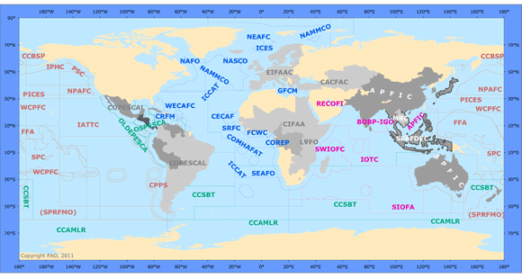
OUR FISHERY AND AQUACULTURE KNOWLEDGE BASE
RFB involvement
The ever growing amount of information which has been collected, collated and disseminated in the last twenty years constitutes our joint Fishery and Aquaculture knowledge base with the hope to serve more and more interested communities.
A considerable amount of information originates from Regional Fishery Bodies under different agreements of provision.

Slide 5
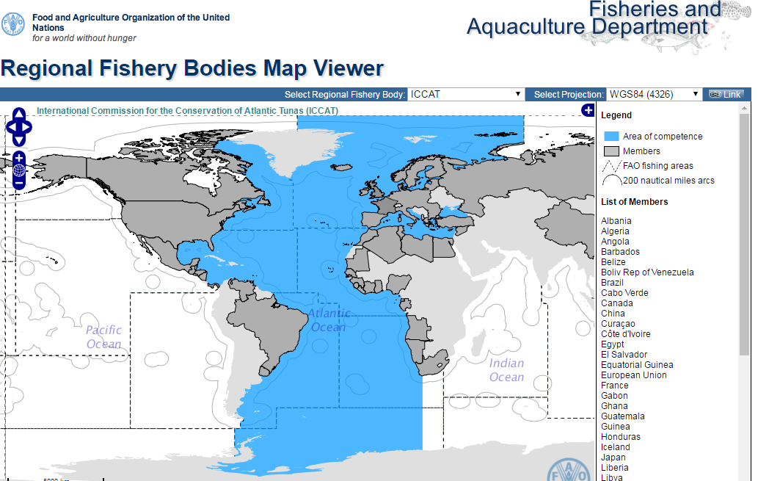
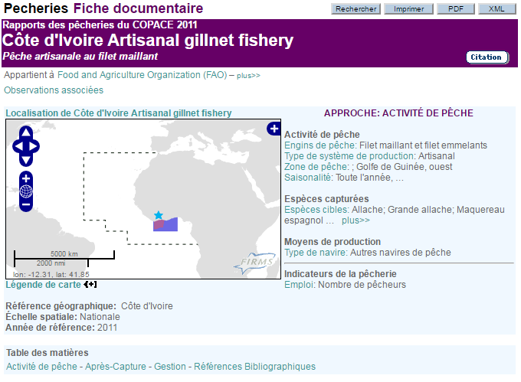
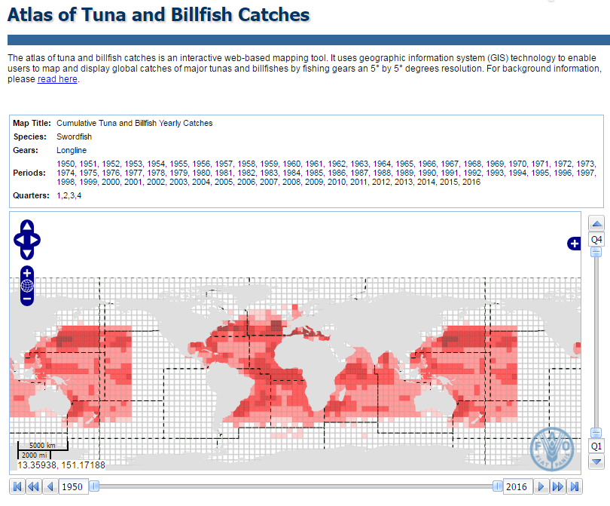
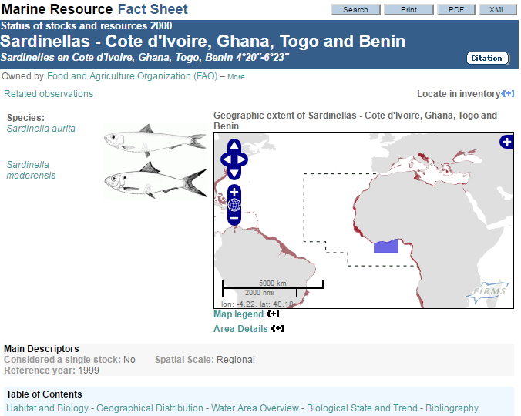
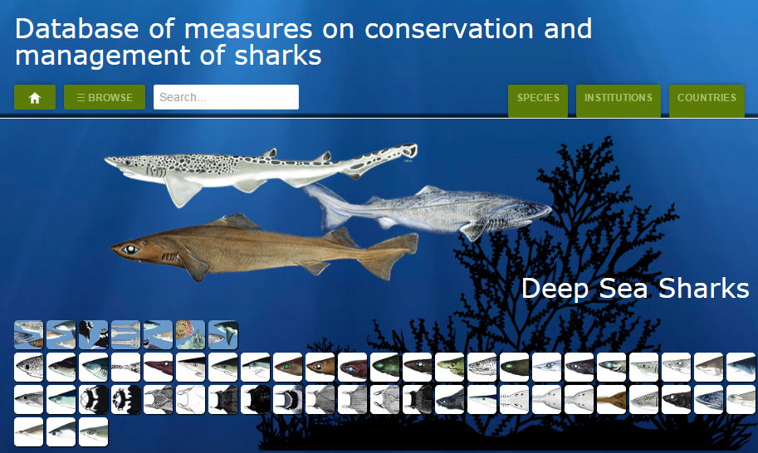
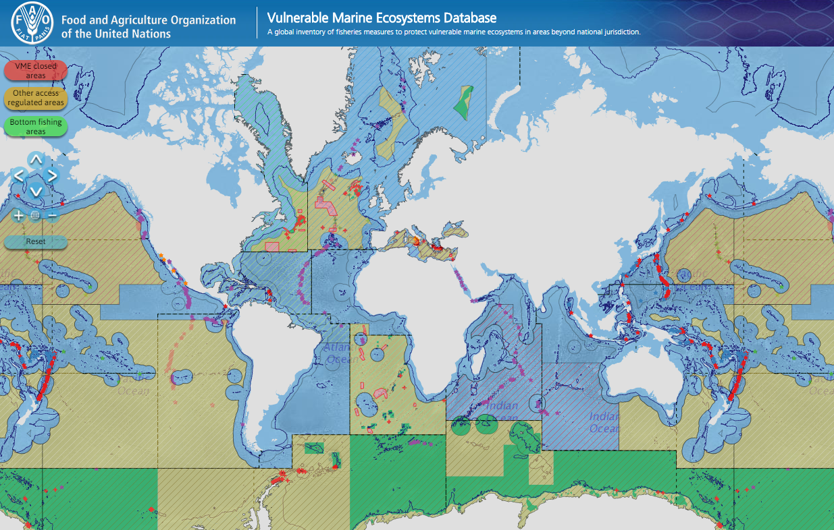

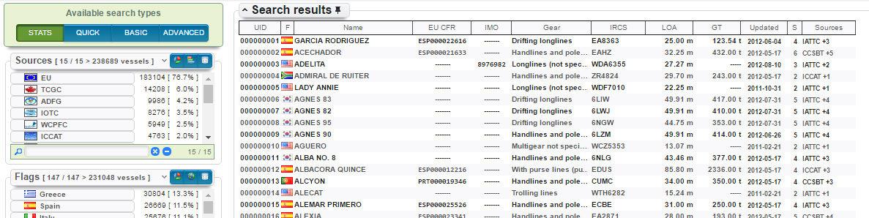
OUR FISHERY AND AQUACULTURE KNOWLEDGE BASE
RFB involvement
Some examples of collective knowledge of global relevance

Slide 6
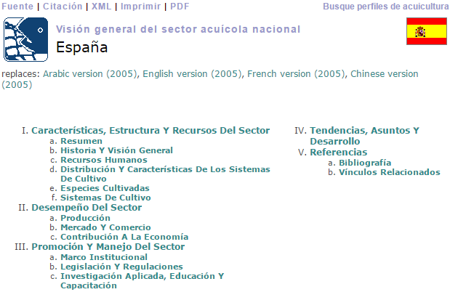
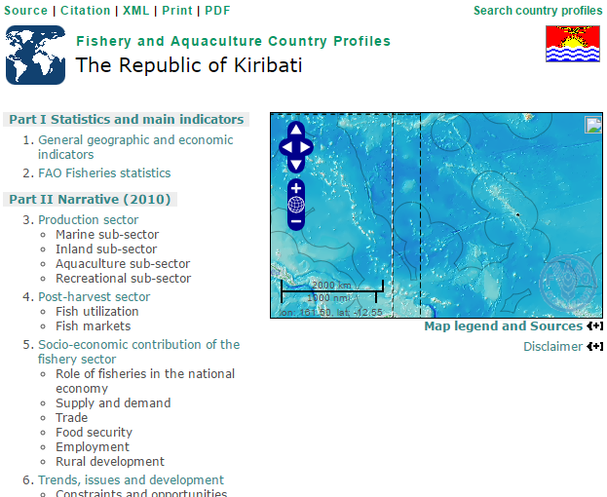
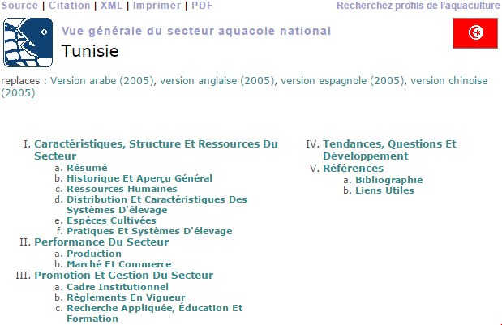
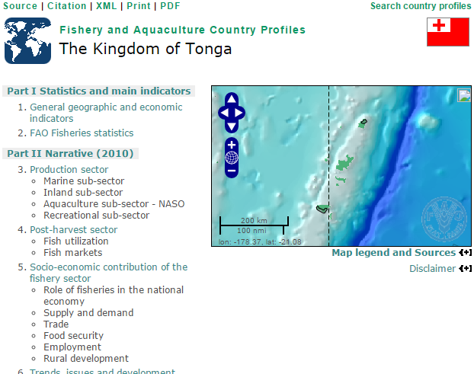
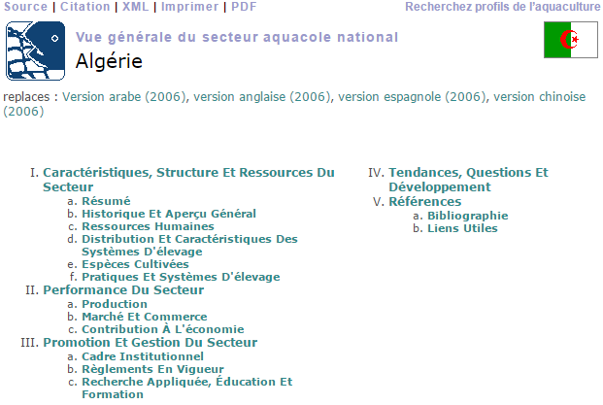
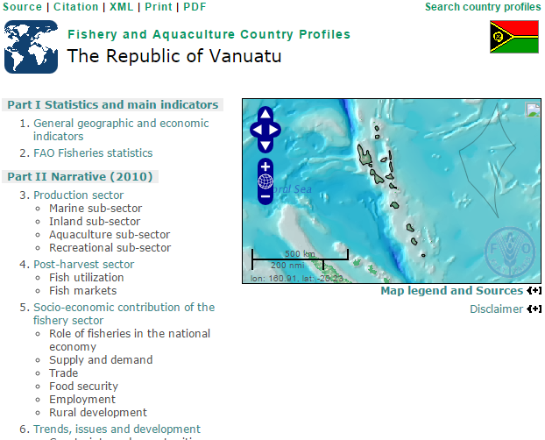
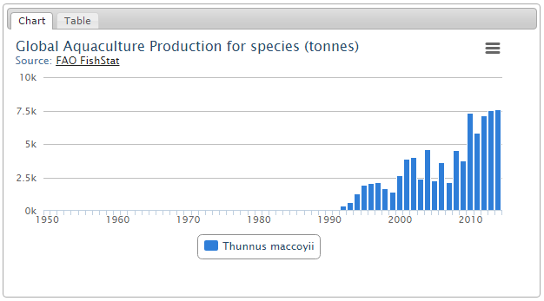
OUR FISHERY AND AQUACULTURE KNOWLEDGE BASE
RFB involvement
Some examples of collective knowledge of global relevance

Slide 7
OUR FISHERY AND AQUACULTURE KNOWLEDGE BASE
RFB involvement
RFB acronym | RFB fact sheets and map viewer | Coordinating Working Party on Fishery Statistics (CWP) / Statlant questionnaires | Stocks & Fisheries - FIRMS Partnership | Vulnerable Marine Ecosystems database | Database of measures on conservation and management of sharks | FACP & NASOs | Global Record of Fishing Vessels | Consolidated List of Authorized Vessels (CLAV) | Atlas of Tuna and Billfish Catches | Global Tuna Nominal Catches
ACAP | X
ACFR | X
APFIC | X
BOBP-IGO | X
CACFISH | X
CCAMLR | X | X | X | X | X |  | X
CCBSP | X
CCSBT | X | X | X |  | X |  | X | X | X | X
CECAF | X | X | X
CIFAA | X |  |  |  |  | X
COFREMAR | X
COMHAFAT-ATLAFCO | X
COPESCAALC | X
COREP | X
CPPS | X
CRFM | X |  | X
CTMFM | X |  |  |  |  |  | X
EIFAAC | X
FCWC | X
FFA | X |  |  |  |  |  | X
GFCM | X | X | X | X | X | X
IATTC | X | X | X |  | X |  | X | X | X | X
ICCAT | X | X | X |  | X |  | X | X | X | X
ICES | X | X | X
IOTC | X | X | X |  | X |  | X | X | X | X
IPHC | X
IWC | X | X
JOINTFISH | X
LTA | X
LVFO | X
MRC | X
NACA | X | X
NAFO | X | X | X | X | X
NAMMCO | X
NASCO | X | X | X
NEAFC | X | X | X | X | X
NPAFC | X
NPFC | X |  |  | X
OLDEPESCA | X
OSPESCA | X | X
PERSGA | X
PICES | X
PSC | X
RECOFI | X |  | X |  | X
SEAFDEC | X | X | X |  |  | X
SEAFO | X | X | X | X | X
SIOFA | X
SPC | X | X |  |  |  | X |  |  | X
SPRFMO | X |  |  | X |  |  | X
SRFC | X
SWIOFC | X |  | X
WCPFC | X | X |  |  | X |  | X | X | X | X
WECAFC | X |  | X
Examples of shared information and related RFBs’ involvement under different types of data provision arrangements
More than twenty RFBs and other institutions are contributing in different ways to the Fishery and Aquaculture knowledge base

Slide 8
OUR FISHERY AND AQUACULTURE KNOWLEDGE BASE
Benefits
This amount of shared information is part of the Fishery and Aquaculture knowledge base offered to the community in a form of collective knowledge.
Benefits for information gathering and mutual exchange, with FAO disseminating third party information :
Overall, Partners’ return on investment include credibility, reliability, neutrality, as well as high visibility.
Data owners and data providers can also benefit from global data services in fisheries exposed under a common data sharing policy.

Slide 9
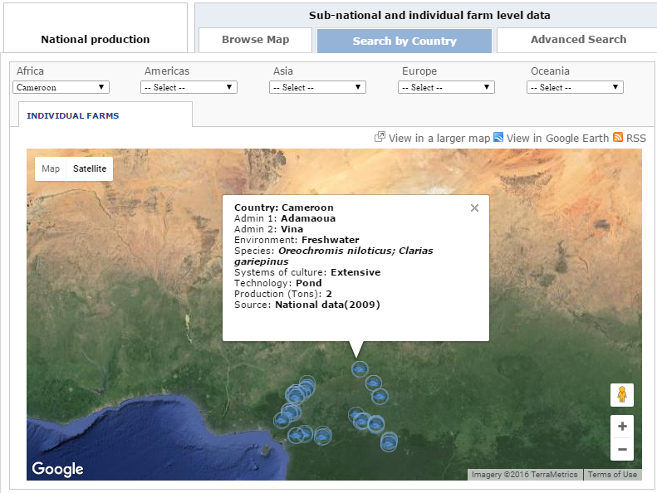
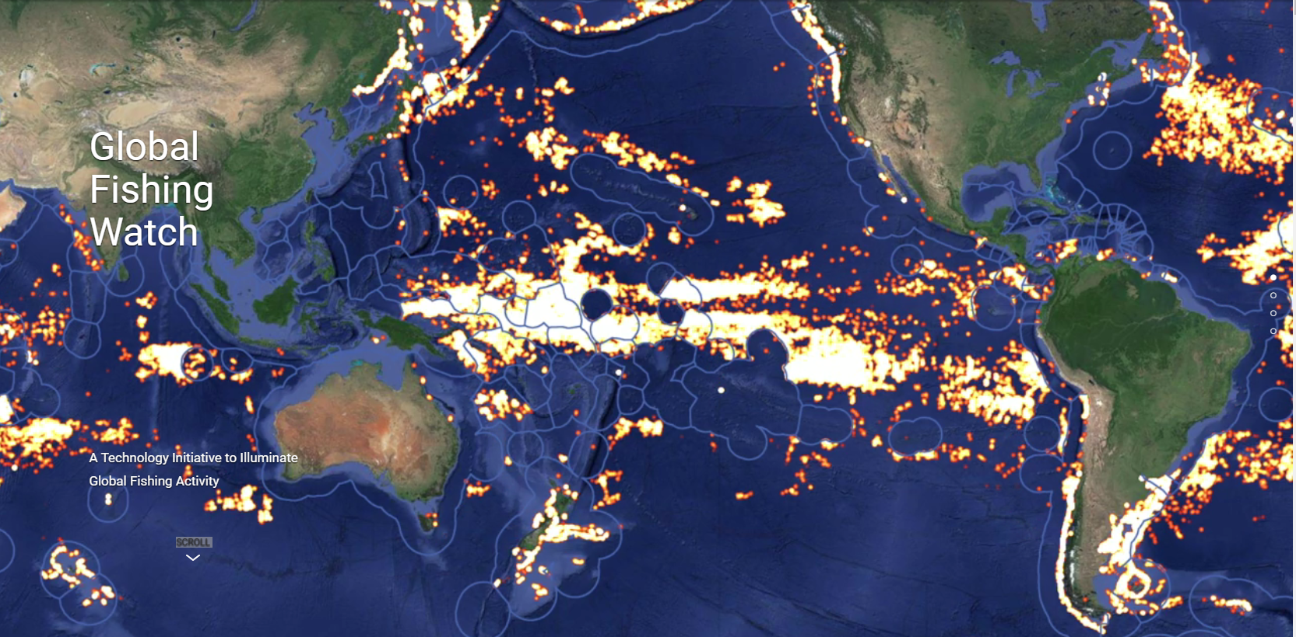



OUR FISHERY AND AQUACULTURE KNOWLEDGE BASE
Building on global data services
Beyond assets already achieved, FAO-FI now develops partnerships for innovative IT solutions, with delivery of Global Data services (e.g. VME Database, Tuna Atlas, Regional Data Bases, Remote Sensing assisted Aquaculture inventories, Global Fishing Watch)
Notes:
Blue Growth is a responsible and sustainable approach to reconcile Economic growth & Food security & Conservation of aquatic resources
Blue Growth requires timely cross-disciplinary data in order to support decision-making towards social, economic and environmental sustainability
(Timely cross-disciplinary information is crucial for sustainable growth and better decision-making)

Slide 10
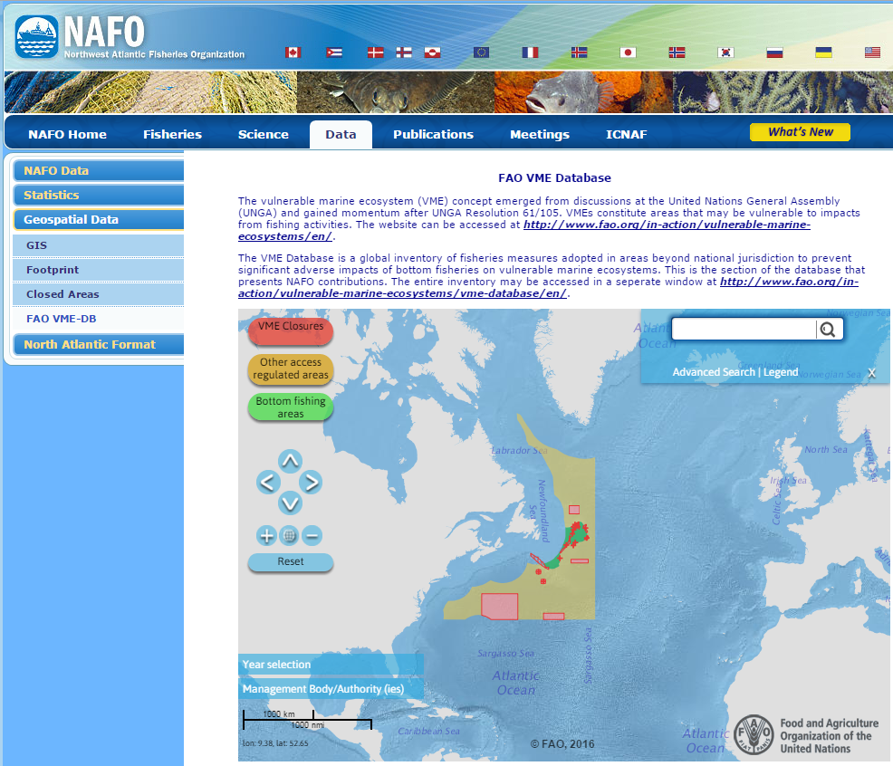
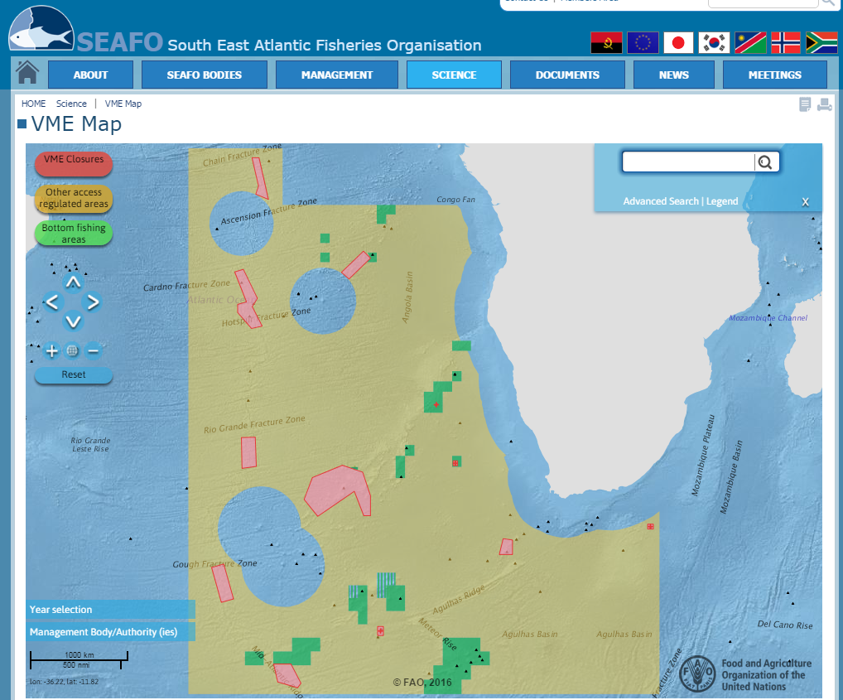
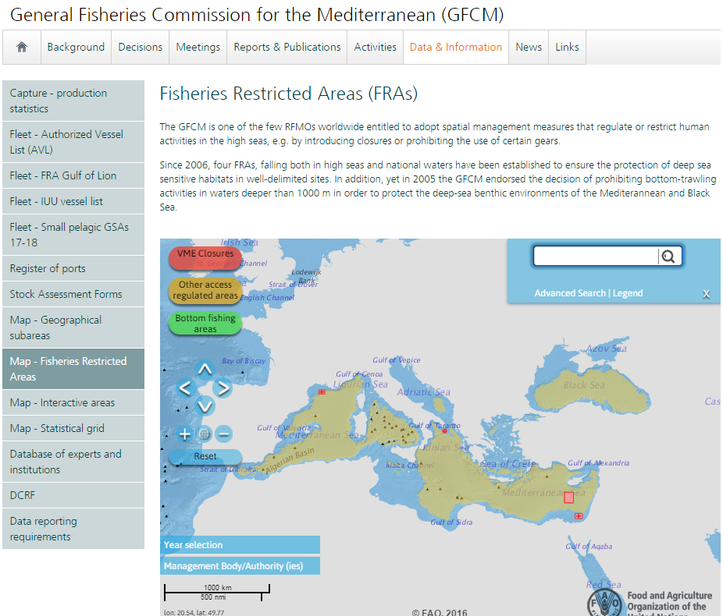
OUR FISHERY AND AQUACULTURE KNOWLEDGE BASE
Building on global data services
The VME Database, a success story of return on investment

Slide 11

OUR FISHERY AND AQUACULTURE KNOWLEDGE BASE
How to strengthen authoritativeness and usage
Timeliness: Reporting and publishing as soon as updates are available; here the rapidity and efficiency of the information flows make the difference; timely information drive users in selecting their preferred content providers.
The FAO-FI department is committed to produce databases of information and update them as frequently as possible.
To foster timely updates, there is a need for imagining business models building on joint efforts.
Ensuring the effective reutilization of information and data can attract global donors interested in contributing to the collective knowledge on fisheries and aquaculture and to its impact.
Notes:
Timeliness is a key factor for managing information and contributes to make an authoritative source of information.

Slide 12
OUR FISHERY AND AQUACULTURE KNOWLEDGE BASE
RSN is invited to…
The RSN is invited to comment focusing on the recognition of the statements enunciated. Any indication on further forms of return on investment is also welcome.
The RSN is invited to confirm the overall will to contribute to the collective knowledge on fisheries and aquaculture, and to indicate any will to commit to timeliness in the provision of information contributions wherever these have been agreed. Indication of constraints preventing timeliness will enable collaborative thinking and suggestions to resolve timeliness issues.
The RSN might suggest actions to move forward. I.e. to involve those RFBs so far not yet directly involved in contributions, to investigate other areas of intervention where shared information could make the difference, etc.
  UNFSA fund could be used to support the reporting. E.g. for supporting consultancies within FAO that will liaise and assist RFBs who cannot afford to provide timely reports

Slide 13
شكر
謝謝
Merci
Thank You
Благодарю
¡Muchas Gracias!

