Slide 1


RFBs and biodiversity including Biological Diversity Beyond Areas of National Jurisdiction (BBNJ), and ongoing cooperation between FAO, UNEP and CBD
Regional Fisheries Secretariat’s Network
9 July 2016, Rome, Italy
Notes:
Merete Tandstad
FAO Fishery resources Officer, Marine and Inland Fisheries Branch (FIAF)

Slide 2

Outline
1) Deep-sea fisheries in the high seas and UNGA
2) Biodiversity beyond national jurisdiction
3) Cooperation between FAO, UNEP and CBD
4) Other relevant processes (SDGs, CITES)

Slide 3

Broadened perspectives of fisheries management
Ecosystem Approach to Fisheries (EAF)
Fishery
Ecological
Wellbeing
Human
Wellbeing
Ability to Achieve
Retained
Community
Governance
Non Retained
National
Impact of
Environment
Habitat impacts
e.g. Benthic Biota
Trophic Changes
General
Ecosystem
Notes:
Fisheries management today includes considerations of a wide variety of issues:, and
Sound fisheries management promotes sustainability across a range of dimensions: from resource characteristics, biodiversity and ecological considerations, environmental influences and constraints (including climate relates variability and change), fleets capacity and technological considerations, socio-economic dimensions at different levels (including trade), institutional settings and functions
All while ensuring stakeholder participation and addressing different time scales, and using best available information and considering the precautionary approach
CODE OF CONDUCT
CCRF – 1995 – the code provides voluntary principles and standards applicable to the conservation, management, and development of all fisheries. It also covers the capture, processing, and trade of fish and fishery products, fishing operations, aquaculture, fisheries research, and the integration of fisheries into coastal area management.
The ecosystem approach to fisheries as promoted by FAO provides a framework to reconcile the different objectives in fisheries management..exemplified in this illustration, used as one of the tools in the EAF planning process.

Slide 4
Deep-sea Fisheries in the High Seas
& UNGA

Slide 5

2006 UNGA Res 61/105
Calls upon regional fisheries management organizations or arrangements with the competence to regulate bottom fisheries to adopt and implement measures, in accordance with the precautionary approach, ecosystem approaches and international law, for their respective regulatory areas as a matter of priority, but not later than 31 December 2008
(a) assessment of bottom fishing activities, ensure appropriate management measures to prevent SAIs
(b) identify VMEs and determine if SAI & long-term sustainability of fish stocks
(c) closures and other measures
(d) encounters with VMEs, and reporting of the encounter so that appropriate measures can be adopted
This resolution triggered the process of development for the International Guidelines for the Management of Deep-sea Fisheries in the High Seas
UPTAKE AND IMPLEMENTATION BY RFMOs
Notes:
For the past decade, the issue of protecting biodiversity in the deep sea in areas beyond national jurisdiction has been extensively debated by the United Nations General Assembly (UNGA) and in other international fora, FAO and at regional level
Starting in the mid 2000’s, the UNGA adopted a series of resolutions, beginning with UN Resolution 59/25 in 2004, which called on high seas fishing nations and regional fisheries management organizations (RFMOs) to take urgent action to protect vulnerable marine ecosystems (VMEs) from destructive fishing practices, including bottom trawl fishing,
The discussions on VMEs and SAIs gained momentum after UNGA Resolution 61/105 in In December 2006.
UNGA Resolution 61/105 set a deadline for compliance of 31 December 2008 in regions where an RFMO/A already existed and a year earlier where negotiations to establish an RFMO/A under way.
The resolution triggered many activities at different levels (as can be seen on the next slide): including the development for the International Guidelines on the management of Deep-sea Fisheries in the High seas. Also many RFMO/As and their member States adopted interim measures to meet the deadlines of the UNGA.
-------------------------------------------------------------
For Information text of resolution:
(a) To assess, on the basis of the best available scientific information, whether individual bottom fishing activities would have significant adverse impacts on vulnerable marine ecosystems, and to ensure that if it is assessed that these activities would have significant adverse impacts, they are managed to prevent such impacts, or not authorized to proceed;
(b) To identify vulnerable marine ecosystems and determine whether bottom fishing activities would cause significant adverse impacts to such ecosystems and the long-term sustainability of deep sea fish stocks, inter alia, by improving
scientific research and data collection and sharing, and through new and exploratory fisheries;
(c) In respect of areas where vulnerable marine ecosystems, including seamounts, hydrothermal vents and cold water corals, are known to occur or are likely to occur based on the best available scientific information, to close such areas to bottom fishing and ensure that such activities do not proceed unless conservation and management measures have been established to prevent significant adverse impacts on vulnerable marine ecosystems;
(d) To require members of the regional fisheries management organizations or arrangements to require vessels flying their flag to cease bottom fishing activities in areas where, in the course of fishing operations, vulnerable marine ecosystems are encountered, and to report the encounter so that appropriate measures can be adopted in respect of the relevant site;

Slide 6
2004
2006
2008
2009
2011
2012
2014
2015
2016
2010
2013
UNGA 59/25
UNGA 64/72
UNGA 66/68
UNGA 68/71
UNGA 70/75
UNGA 61/105
UNGA 69/109
UNGA WS
61/105 & 64/72
UNGA WS
64/72 & 66/68
FAO
DSF GUIDE-LINES
Busan
VME DB Launch
DSF PREP
FAO DSF Programme
IMPLEMENTATION OF GUIDANCE BY DEEP SEA RFMOs
Notes:
This slides provide an overview of he different resolutions that have passed since the initial resolution in 2004, where the Vulnerable marine ecosystem concept was introduced.
At the UNGA level, resolutions have since then been, and will continue to be, reconsidered and revised. A review workshop was organised in 2011 to look at progress of the implementation of the resolutions and a new review workshop is planned for 2016
it also illustrates the activities that these resolutions have spurred at the different levels:
Importantly at a technical level the discussions spurred the development of the International Guidelines on the Management of deep-sea fisheries in the high seas, which was developed through a consultative process and which was agreed by COFI in 2008.
Deep-sea guidelines
Request: by COFI to assist States and RFMO/As in sustainably managing deep-sea fisheries and in implementing the UN General Assembly Resolution 61/105, concerning responsible fisheries in the marine ecosystem
Result: the FAO International Guidelines for the Management of Deep-sea Fisheries in the High Seas adopted in August 2008 by 69 States, the EC and the Faroe Islands
Process: multi-stakeholder (FAO Members, industry, NGOs/IGOs, scientists and researchers)
RFMOS
Address resolutions and apply guidelines
--------------------------------------------
UNGA 70/75 adopted on 8 Dec2015 (sustainable fisheries…)Para 169 recalls decision in para 162 of resolution 69/109 to conduct in 2016 a further review of the actions taken by states and RFMOs/As in response to paragraphs 113, 117113,117,119, 124 of of Res 64/72 and paragraphs 121,126,129,130,132, 134 of Res 66/68 with a view to ensuring effective implementation of the measures therein and to make further recommendations if necessary.
Paragraph 171 and 202 of 70/75 provide as follows:
171 Recalls its request in para 164 of resolution 69/109 to the secretary general to prepare a report similar in scope, length and detail to his report to the GA at its sixty-sixth session, in cooperation with FAO and with the assistance of an expert consultant to provide information on relevant technical and scientific issues to be covered in the report, for consideration by the Assembly at its seventy-first session, on the actions taken by states and RFMOs/As ….RFMO/As, UN oganisations etc asked to provide input to report
… a two day workshop will be convened on 1-2 August 2016

Slide 7

FAO Deep-sea Guidelines: what is included
SCOPE AND PRINCIPLES
DESCRIPTION OF KEY CONCEPTS
  Characteristics of species exploited by deep-sea fisheries
  Vulnerable marine ecosystems
  Significant adverse impacts
GOVERNANCE AND MANAGEMENT
  General management considerations
  Governance framework
  MANAGEMENT AND CONSERVATION STEPS
  Data, reporting and assessment
  Identifying vulnerable marine ecosystems and assessing
  significant adverse impacts
  Enforcement and compliance
  Management and conservation tools
  Assessment and review of effectiveness of measures
  SPECIAL REQUIREMENTS OF DEVELOPING COUNTRIES
  ADDITIONAL CONSIDERATIONS ON IMPLEMENTATION
  Supporting implementation: Deep-sea Fisheries Programme and the ABNJ Project
Notes:
Key concepts:
Vulnerable Marine Ecosystems
Vulnerability
Significant Adverse Impacts (SAIs)
Also:
Outlines: VME criteria and examples of what VME indicators can be
Importantly provides guidelines for impact assessments etc..
- Comprehensive document that addresses many aspects of BD conservation- and as can be seen later- in the context of the BBNJ discussions- addresses many of the discussions elements at that for a from the perspective of deep-sea fisheries
Recognize challenges and refer to challenges in implementation from Busan

Slide 8
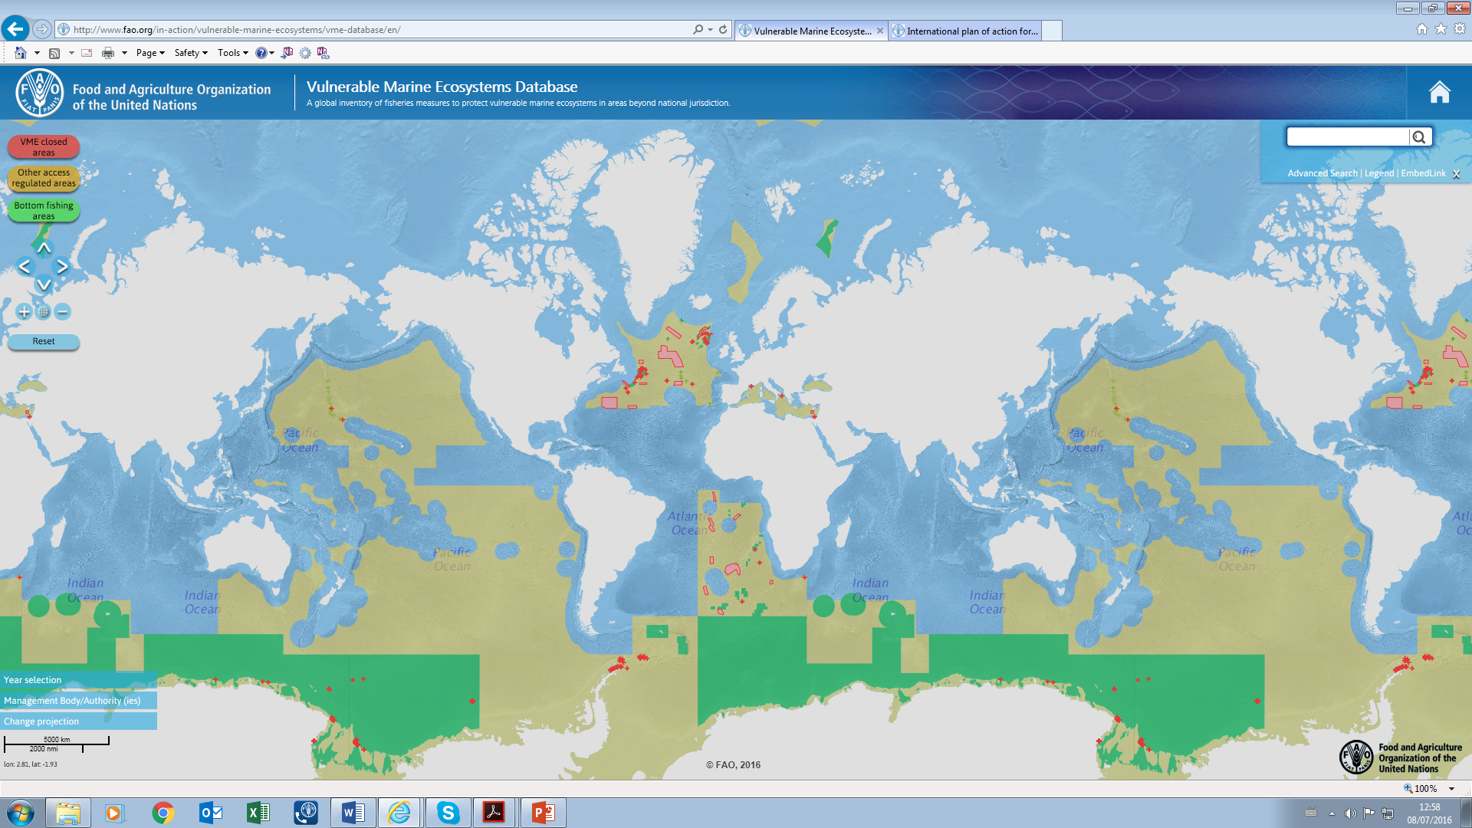
RFMO Measures related to VMEs
http://www.fao.org/in-action/vulnerable-marine-ecosystems/en/
Notes:
RFMOs have taken action to address the issue of potential significant impacts on VMEs-
Approaches and processes have been different: depending on information and capacity available in different regions.
New science and new structures have been set up to address these issues- and included in the fisheries management process
VME database show all measures taken by RFMOs in relation to VMEs- Include an interactive maps and fact sheets that can follow measures /changes in measures through time
Complementary also a Technical paper under development that documents the VME practices and processes in different regions

Slide 9

GENERAL ASSEMBLY WORKSHOP
ON IMPLEMENTATION OF GENERAL ASSEMBLY RESOLUTIONS ADDRESSING THE IMPACTS OF BOTTOM FISHING ON VULNERABLE MARINE ECOSYSTEMS AND THE LONG-TERM SUSTAINABILITY OF DEEP-SEA FISH STOCKS
  1-2 August 2016, New York
  Discuss implementation of:
  Relevant paragraphs of resolution 64/72 (113, 117 and 119 to 124) and resolution 66/68 (121, 126, 129, 130, 132 to 134)
                on sustainable fisheries, addressing the impacts of bottom fishing on vulnerable marine ecosystems and the long-term sustainability of deep-sea fish stocks
  Important occasion for RFMOs to show what has been done to address these resolutions, as well as for states and fishing industry
Notes:
Workshop format:
UNDOLAOS: Compile paper on what has been done (background paper)
Panel discussions on different topics including:
Focus on experience and the special requirements of developing states in addressing the impacts of bottom fisheries on vulnerable marine ecosystems and the long term sustainability of deep sea fish stocks
The way forward in addressing the impacts of bottom fishing on vulnerable marine ecosystems and the long term sustainability of deep sea fish stocks: challenges, opportunities and best practices

Slide 10
Biodiversity in Areas Beyond National jurisdiction
Notes:
Moving on to a more broad based discussion at the UNGA looking at Biodiversity in a broader perspective..

Slide 11
Ad Hoc Open-ended Informal Working Group to Study Issues Relating to the Conservation and
Sustainable Use of Marine BBNJ- BBNJ Process
UNGA created the BBNJ Working Group to discuss the conservation and sustainable use of marine biodiversity in ABNJ.
Commencement of discussions in 2004; Concluded January 2015
Issues:
Are there weaknesses and gaps in the current international framework ?
Do these necessitate the adoption of a new instrument?
  Implementing agreement to the United Nations Convention on the Law of the Sea (UNCLOS) on the conservation and sustainable use of marine biodiversity in ABNJ
Notes:
In 2004 the United Nations General Assembly established an Ad Hoc Open-ended Informal Working Group (WG) to study the feasibility of an implementing agreement on the conservation and sustainable use of marine biological diversity of areas beyond national jurisdiction (BBNJ).

Slide 12
BBNJ process
The 2011 package:
the conservation and sustainable use of marine biodiversity in areas beyond national jurisdiction, in particular, together and as a whole:
marine genetic resources, including questions on the sharing of benefits
measures such as area-based management tools, including marine protected areas
environmental impact assessments
capacity building and the transfer of marine technology;
Notes:
Discussions very broad in scope and many exchanges, but then focused in on some key areas of discussion emerged through these discussions- focusing on certain areas

Slide 13
BBNJ Process (cont)
Three meetings (2014-15) of the BBNJ Working Group, specifically convened to discuss “the scope, parameters and feasibility of an international instrument under UNCLOS”.
“develop an international legally-binding instrument under the Convention on the conservation and sustainable use of marine biological diversity of areas beyond national jurisdiction and to that end”
Two-step approach:
a Preparatory Committee (PrepCom) will make recommendations to the UNGA on the elements of a draft text by the end of 2017;
the UNGA will then decide on the convening and date of an intergovernmental conference by the end of its 72nd session (i.e. September 2018).
Notes:
The WG agreed on a set of recommendations provided in resolution 69/292 of June 2015 to develop an implementing agreement on BBNJ.
BBNJ WG recommendations..:
…………………….
4. Stress the need for the comprehensive global regime to better address the conservation and sustainable use of marine biodiversity beyond areas of national jurisdiction and having considered the feasibility of developing an international instrument under the Convention;
5. Decide to develop an international legally-binding instrument under the Convention on the conservation and sustainable use of marine biological diversity of areas beyond national jurisdiction and to that end:
prior to holding an intergovernmental conference, decide to establish a preparatory committee, open to all Member States of the United Nations, members of specialized agencies, and Parties to the Convention, with others invited as observers in accordance with past practice of the United Nations, to make substantive recommendations to the General Assembly on the elements of a draft text of an international legally-binding instrument under the Convention, taking into account the various reports of the Co-Chairs on the work of the Ad Hoc Open-ended Informal Working Group established pursuant to paragraph 73 of General Assembly resolution 59/24. The preparatory Committee will start its work in 2016 and by the end of 2017 will report to the General Assembly on its progress. b) before the end of the seventy-second session of the General Assembly, and taking into account the aforementioned report of the preparatory committee, will decide on the convening and on the starting date of an intergovernmental conference, under the auspices of the United Nations, to consider the recommendations of the preparatory committee on the elements and to elaborate the text of an international legally-binding instrument under the Convention.
6. Decide that negotiations shall address the topics identified in the package agreed in 2011, namely the conservation and sustainable use of marine biodiversity in areas beyond national jurisdiction, in particular, together and as a whole, marine genetic resources, including questions on the sharing of benefits, measures such as area-based management tools, including marine protected areas, environmental impact assessments and capacity building and the transfer of marine technology;
7. Recognize that the process indicated in paragraph 5 should not undermine existing relevant legal instruments and frameworks and relevant global, regional and sectoral bodies;
,,,,,,,,,
Prep com established by UNGA res 69/292

Slide 14
Prep Con established by UNGA res 69/292: to develop an international legally binding instrument under UNCLOS on the conservation and sustainable use of marine biological diversity of areas beyond national jurisdiction.
Two meetings in 2016: April and August
Notes:
In its resolution 69/292 of 19 June 2015, the General Assembly decided to develop an international legally binding instrument under the United Nations Convention on the Law of the Sea (UNCLOS) on the conservation and sustainable use of marine biological diversity of areas beyond national jurisdiction.
To that end, it decided to establish, prior to holding an intergovernmental conference, a Preparatory Committee, to make substantive recommendations to the General Assembly on the elements of a draft text of an international legally binding instrument under UNCLOS, taking into account the various reports of the Co-Chairs on the work of the Ad Hoc Open-ended Informal Working Group to study issues relating to the conservation and sustainable use of marine biological diversity beyond areas of national jurisdiction.
Meetings of the Preparatory Committee and secretariat
The Preparatory Committee will start its work in 2016 and, by the end of 2017, report to the Assembly on its progress.

Slide 15
Prep Con first session: 28 March- 8 April 2016
Discussions on:
Elements of the 2011 package
Started discussions on considerations for objective and scope of an implementing agreement, guiding principles and the use of terms
Fisheries frequently mentioned including role of RFMOs.
FAO has prepared an overview for the consideration of COFI to document ongoing work in ABNJ with respect to Fisheries as well as other processes e.g. aquatic genetic resources (Annex to COFI paper on Global and regional Processes)
Notes:
The first session of the Preparatory Committee (PrepCom) was held on 28 March – 8 April 2016.
The PrepCom considered the four elements of the ‘2011 Package’ identified in Resolution 66/231, namely: Marine Genetic Resources (MGRs); Area Based Management Tools (ABMT), including Marine Protected Areas (MPA); Environmental Impact Assessments (EIA); and Capacity Building and Transfer of Technology. An Informal Working group was established for each of these elements (a summary of the key issues raised under each Informal Working Group is found in Appendix I). In addition, the PrepCom commenced consideration of the objective and scope of the implementing agreement, guiding principles, and the use of terms.

Slide 16
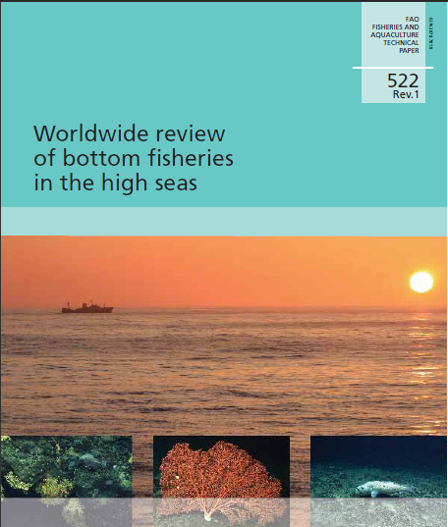
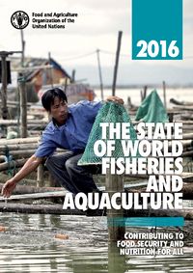
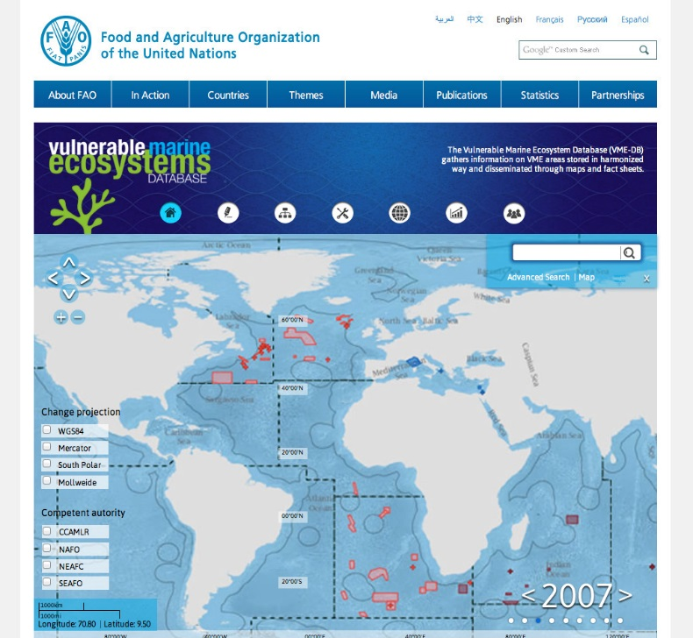
Prep Con first session: 28 March- 8 April 2016
Some key discussion issues:
The application of the common heritage of mankind principle to Marine genetic resources beyond national jurisdiction
Requirement for access and benefit sharing arrangements for marine genetic resources beyond national jurisdiction;
How would genetic resources be defined and the need to distinguish fish as a commodity vs the genetic material
Multisectoral harmonization of area based management tools
Multisectoral requirement for Environmental Impact Assessments.
How to ensure capacity development and technology transfer
Second session: 26 August- 9 September
Notes:
Important in the discussions to highlight existing frameworks and activities: as well as existing guidance- In the case of fisheries Guidance exist at differet level from RFBS or Globally.
Need to share best practice
- RSN can refer to paper to COFI which contains more details.
important to be present to provide inputs on existing mechanisms and processes.
As mentioned above: resolution recognize that that the process indicated in paragraph 5 should not undermine existing relevant legal instruments and frameworks and relevant global, regional and sectoral bodies;

Slide 17
Cooperation between FAO, UNEP and CBD
Notes:
Long record of attendance of FAO at CBD SBSTTA and COP, and sometimes CBD at FAO-COFI; also several joint/collaborative activities, such as those listed here:
CBD
Several collaborative workshops/expert meetings:
Impacts Of Destructive Fishing Practices, … On Marine Biodiversity And Habitats; (Rome 2009)
Addressing Biodiversity Concerns In Sustainable Fisheries (Bergen, Norway 2011)
Improving Progress Reporting and Working Towards Implementation of Aichi Biodiversity Target 6 (Rome, Italy, 2016)
FAO and/or fisheries experts at EBSA Description workshops and CBD experts at Deep-sea Fisheries and VME meetings
FAO experts providing training in EAF at CBD Sustainable Ocean Initiative Workshops
CBD partner to the ABNJ Programme (ABNJ Deep Seas project)
Also:
- Korea meeting in September om discussions on discussions of targets, and bringing together RFBs and RSP (in collaboration with FAO and UNEP)
- CBD COP 13, : 4 - 17 December 2016 - Cancun, Mexico: key topic is Mainstreaming Biodiversity within and between sectors: including fisheries and aquaculture; (See COFI Inf note 24 for some of the elements related to fisheries and aquaculture discussed in the context of the CBD)
UNEP
Participation in each others meetings e.g. UNEP at COFI and FAO at the global conference for the regional seas organisations
Collaboration on a range of topics relating to fisheries and the environment
lost and abandoned fishing gear
marine debris
microplastics
biodiversity
ocean health
Collaboration between RFBs and Regional Seas Organisations
joint implementation of projects: deep-sea fisheries, LMEs etc)
Currently there is an MoU between FAO and UNEP that governs overall collaboration
Will only give you some highlights of one of the most recent joint activities: i) the Expert group on reporting of target 6; The report of this meeting is also provided as an inf document to the meeting and it will also be presented at a side event on Wednesday- i) activities in relation to collaboration between RFBs and regional seas
The ABNJ Programme partnership will be presented in a side event on Monday

Slide 18






Expert Meeting on Improving Progress Reporting and
Working Towards Implementation of Aichi
Biodiversity Target 6
Rome, Italy, 9-11 February 2016
Involved 35 experts with knowledge and experience in the fields of fisheries and/or biodiversity attending in their individual capacity
Notes:
In decision X/2, the 10th meeting (2010) of the Conference of the Parties for the Convention on Biological Diversity (CBD), adopted a revised and updated Strategic Plan for Biodiversity, including Aichi Biodiversity Targets for the 2011 – 2020 period.
The Aichi Biodiversity Targets are to be met by States to achieve the 5 Strategic Goals laid out in the Strategic Plan.
Target 6- Often referred to as the fisheries target-
Jointly organized by the UN (FAO), the Secretariat of the CBD) and the IUCN Fisheries Expert Group (IUCN-CEM-FEG) and coordinated by the European Bureau on Conservation and Development (EBCD).
Joint Relevance with FAO Obvious
All part of The Ecosystem Approach to Fisheries
The Reykjavik Declaration On Responsible Fisheries In The Marine Ecosystem 2001
FAO Technical Guidelines For Responsible Fisheries; Fisheries Management -. The Ecosystem Approach to Fisheries 4, Suppl. 2
Equally central to CBD Strategic Plan
Target 6 under Strategic Goal B: Reduce the direct pressures on biodiversity and promote sustainable use
Fisheries also relevant to Strategic Goal 1 (Mainstreaming) and several other Targets (2,3, 4, 7, 10, 11, 12 13 and arguably others
--------------------------
Additional information:
Strategic Goal A
Address the underlying causes of biodiversity loss by mainstreaming biodiversity across government and society
Strategic Goal B
Reduce the direct pressures on biodiversity and promote sustainable use
Strategic Goal C
To improve the status of biodiversity by safeguarding ecosystems, species and genetic diversity
Strategic Goal D
Enhance the benefits to all from biodiversity and ecosystem services
Strategic Goal E
Enhance implementation through participatory planning, knowledge management and capacity building

Slide 19
Aichi Biodiversity Targets
Strategic Goal B (Reduce the direct pressures on biodiversity and promote sustainable use
Target 6:
By 2020 all fish and invertebrate stocks and aquatic plants are managed and harvested sustainably, legally and applying ecosystem based approaches, so that overfishing is avoided,
recovery plans and measures are in place for all depleted species,
fisheries have no significant adverse impacts on threatened species and vulnerable ecosystems
and the impacts of fisheries on stocks, species and ecosystems are within safe ecological limits.
Notes:
5 Strategic Goals, 20 targets
In decision X/2, the 10th meeting (2010) of the Conference of the Parties for the Convention on Biological Diversity (CBD), adopted a revised and updated Strategic Plan for Biodiversity, including Aichi Biodiversity Targets for the 2011 – 2020 period.
Target 6- can be broken into sub-components- looking at the sustainable harvest of target stocks, stressing the need for harvesting plans for depleted stocks,
Fisheries to have no significant impact on threated species and vulnerable ecosystems and the fact that impact need to be within safe biological limits..
The relevance to FAO, regional and national fisheries organizations is obvious- and there was therefore a need to understand better how and if fisheries can contribute to achieve these biodiversity goals-

Slide 20

The expert meeting aimed to:
Develop elements for a potential conceptual framework to monitor progress towards the achievement of Aichi Target 6;
Identify existing reporting frameworks and mechanisms that can be used to support reporting on Aichi Target 6;
Identify ways in which the CBD and FAO, and the fisheries and biodiversity communities in general, can further enhance collaborative approaches to monitoring and reporting on Aichi Target 6.

Slide 21
Recommendations relevant to improved reporting
..exploring the opportunities for greater harmonization/collaboration.
Web-based questionnaire used by FAO and the related reporting process could offer a useful means of collecting information for reporting on Aichi Target 6…..
For transboundary stocks, parties to RFBs could use the RFBs agreed assessment as the core information sources Target 6 reporting…
Notes:
Full text:
Early steps towards 2020 should include the Secretariats of the two organizations exploring the opportunities for greater harmonization/collaboration.
Web-based questionnaire used by FAO and the related reporting process could offer a useful means of collecting information for reporting on Aichi Target 6 and discussions indicated that modifications could be made if necessary by FAO and CBD to ensure full consistency with the arguments of Aichi Target 6
For transboundary stocks, parties to RFBs could use the RFBs agreed assessment as the core information sources Target 6 reporting, the issue could be discussed at the next Coordinating Meeting of RFBs, organized at the same time as the FAO Committee on Fisheries (COFI) in Rome

Slide 22
Recommendations relevant to improved reporting
Evaluating the performance of ecosystem indicators of fishing impacts and make …recommendations and establish guidelines to determine safe ecological limits (i.e. reference levels) for ecosystem impacts of fishing.
…encourage the owners of regional and global data sets relevant for the evaluation of Target 6 implementation to put the data at disposal of the community.
Notes:
Full text:
Evaluating the performance of ecosystem indicators of fishing impacts and make specific recommendations and establish guidelines to determine safe ecological limits (i.e. reference levels) for ecosystem impacts of fishing.
The meeting advised therefore that efforts be made by CBD and FAO to encourage the owners of regional and global data sets relevant for the evaluation of Target 6 implementation to put the data at disposal of the community.

Slide 23
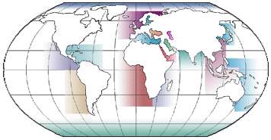
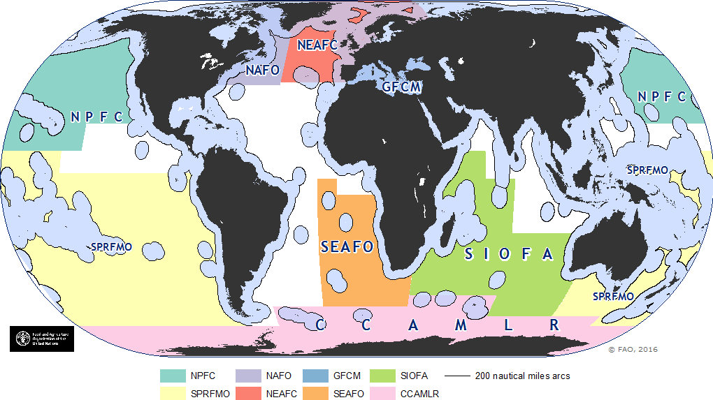
Facilitating discussions between RFBs and RSPs. Why?
Need for awareness raising, dialogue and coordination between different actors
Examples that show benefit of collaboration between fisheries and environmental bodies on topic of common concern
Respecting mandates, building on respective strengths
Notes:
Importance of oceans and coastal zones, Marine environment under pressure from various sources
Example: Regional seas organisations have fisheries target: instead of creating own processes- how can fisheries provide them with required information?

Slide 24
Underlying principles and collaboration ladder
4. Joint measures across sectors and levels 3. Adjustment of behaviour within own sector 2. Common discussions and deliberations, coordinating world views Information and knowledge sharing (mediation)
Recognize different steps of collaboration
Optimal coordination level depends on objectives, problem fields and other contextual factors
Regional discussions:
West Africa: July 2014 (Abidjan), Nairobi (2014)
RECOFI/ROPME: April 2016 (Dubai, UAE)
SWIOFC/IOTC/Nairobi Convention: June 2016 (Seychelles)
Notes:
With organisations competencies and mandate (West Africa comple: CECAF/SRFC/COREP/FCWC/SEAFO/ Abidjan convention: )
Cooperation can imply different types of alignment. Hanssen & al. (2013 and 2014) have developed a "ladder of coordination" to be used as an analytical tool in assessing the types and levels of coordination. In this Project, a similar "ladder of cooperation" will be used as a basis for defining the indicators for the types and levels of cooperation taking place in the Project regarding sustainable management.
Figure: Ladder of cooperation (Hanssen et. al 2013 and 2014)
The figure illustrates that each step of this cumulative ladder increases the level of cooperation and mutual dependence between actors, with the lowest level being mutual exchange of information and knowledge. The second step is deliberation that might lead to coordinated world views. Hierarchical instruments are often used for these two coordination purposes, for example, by information distribution and guidance material from national authorities to local authorities. National authorities and regional bodies can play a hierarchical role as an interpreter of scientific knowledge. However, also a network-oriented mechanism can be used for these types of coordination, as network arenas are assumed to be effective for mutual knowledge sharing and coordination of problem-understanding and world views. Learning and interpretation are often considered to require direct communication between all relevant actors.
At the third step, the actors are actually adjusting their actions based on the information sharing and deliberation that have taken place. This type of coordination can be enforced or happen through self-regulation or self-adjustment, for instance by changing a sector policy.
The fourth step of the ladder is joint action and joint measures across sectors and levels (regional and national levels).
The optimal coordination level depends on the objectives, problem fields and other contextual factors, as there are costs related to higher levels of coordination. Thus an important task in the Project is to test and recommend the types and levels of coordination that are needed in the policy field of sustainable ocean management, who are actors, and which are the mechanisms and instruments that are fruitful for ensuring these types of coordination.
Regional meetings organized: some indicative potential areas of collaboration:
Areas of collaboration: Biodiversity, Vulnerable species, Mammals, Sharks
Informing
Doing
Sharing

Slide 25
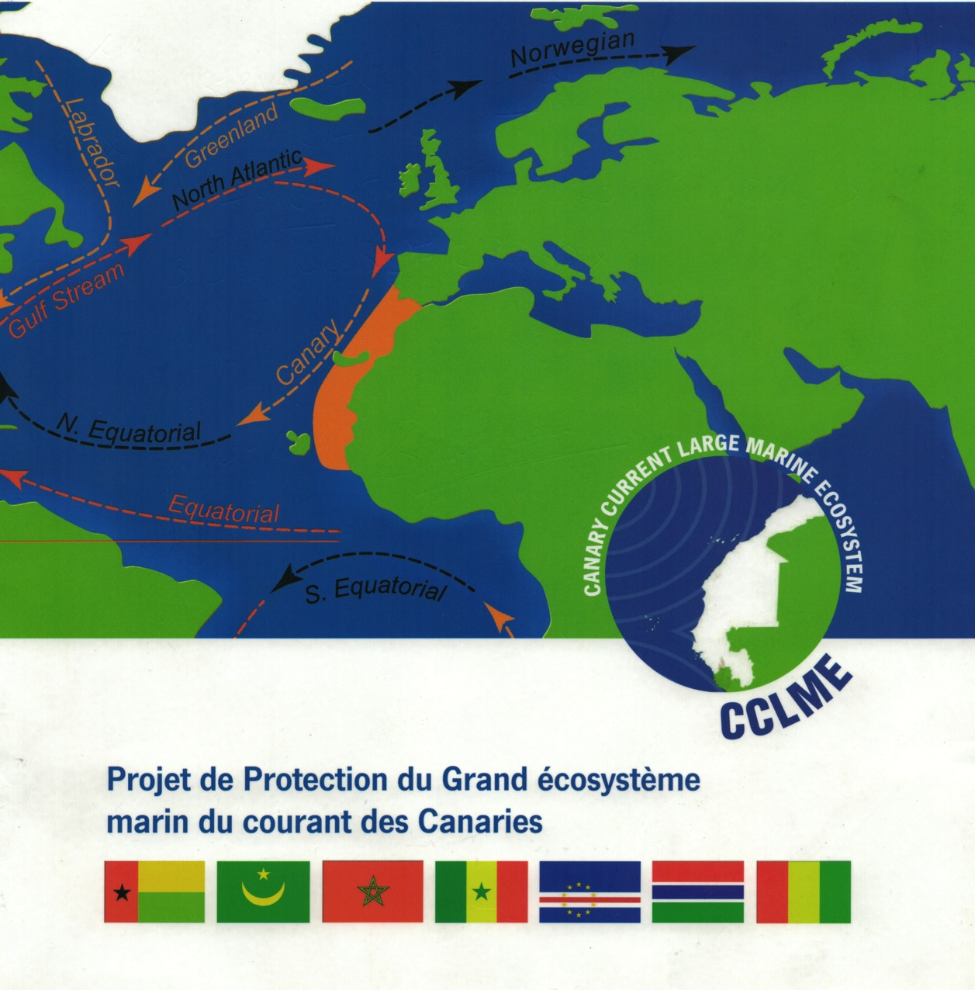
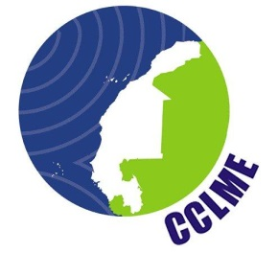
CANARY CURRENT LARGE MARINE ECOSYSTEM
Key transboundary issues, Strategic Action Programme and proposed Governance
Overarching transboundary Issues:
    Decline in living marine resources
    Degradation of habitats
    Deterioration in water quality
Current situation described and documented in the Transboundary Diagnostic Analysis
Strategic Action Programme
outlines key actions to address above issues
  promotes partnerships for action
  calls for financial investments by partners
Notes:
Example of an LME that FAO and UNEP jointly implement

Slide 26
Other Relevant Processes
Notes:
TO BE PRESENTED IF TIME IS AVAILABL AND IF THERE IS AN INTEREST; IF NO TIME JUMP TO CONCLUDING SLIDE

Slide 27
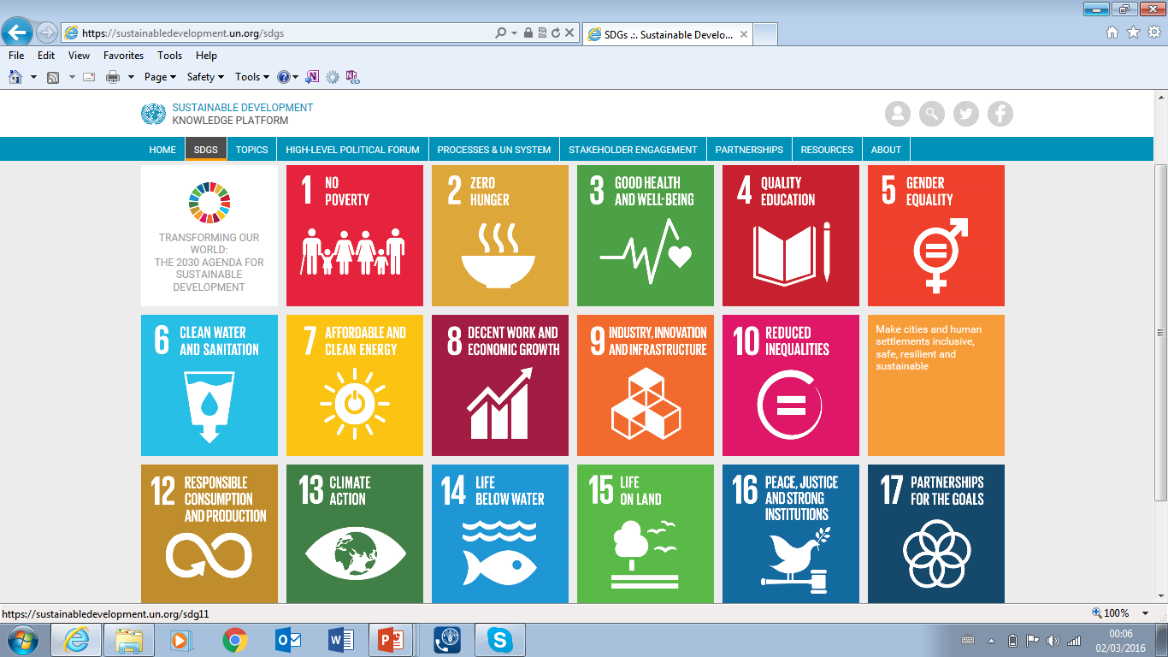




















New set of goals and targets that UN Member States will be expected to use to frame their agendas and political policies until 2030.
SDG 14: Conserve and sustainably use the oceans, seas and marine resources for sustainable development (10 targets)
Notes:
New set of goals and targets that UN Member States will be expected to use to frame their agendas and political policies until 2030.
17 SDGs; SDG 14 relates directly to Oceans
Additional Info on Selected Targets:
14.2: By 2020, sustainably manage and protect marine and coastal ecosystems to avoid significant adverse impacts, including by strengthening their resilience, and take action for their restoration in order to achieve healthy and productive oceans
14.4: By 2020, effectively regulate harvesting and end overfishing, illegal, unreported and unregulated fishing and destructive fishing practices and implement science-based management plans, in order to restore fish stocks in the shortest time feasible….
14.5: By 2020, conserve at least 10 per cent of coastal and marine areas, consistent with national and international law and based on the best available scientific information
14.6: By 2020, prohibit certain forms of fisheries subsidies which contribute to overcapacity and overfishing, eliminate subsidies that contribute to IUU fishing and refrain from introducing new such subsidies, recognizing that appropriate and effective species and differential treatment for developing and least developed countries should be an integral part of the World Trade Organization fisheries subsidies negotiation
14.a: Increase scientific knowledge, develop research capacity and transfer marine technology, taking into account the Intergovernmental Oceanographic Commission Criteria and Guidelines on the Transfer of Marine Technology, in order to improve ocean health and to enhance the contribution of marine biodiversity to the development of developing countries, in particular small island developing States and least developed countries
14.b: Provide access for small-scale artisanal fishers to marine resources and markets
14.c: Enhance the conservation and sustainable use of oceans and their resources by implementing international law as reflected in UNCLOS, which provides the legal framework for the conservation and sustainable use of oceans and their resources, as recalled in paragraph 158 of The Future We Want

Slide 28
Indicators for SDG 14 targets
Inter-Agency and Expert Group on SDG indicators (IAEG) has issued the final list of indicators. FAO will be reporting on four SDG14 targets using the following agreed indicators.
SDG target | Agreed Indicator
14.4 By 2020, effectively regulate harvesting and end overfishing, illegal, unreported and unregulated fishing and destructive fishing practices and implement science-based management plans, in order to restore fish stocks in the shortest time feasible, at least to levels that can produce maximum sustainable yield as determined by their biological characteristics | 14.4.1 Proportion of fish stocks within biologically sustainable levels
14.6 By 2020, prohibit certain forms of fisheries subsidies which contribute to overcapacity and overfishing, eliminate subsidies that contribute to illegal, unreported and unregulated fishing and refrain from introducing new such subsidies, recognizing that appropriate and effective special and differential treatment for developing and least developed countries should be an integral part of the World Trade Organization fisheries subsidies negotiation | 14.6.1 Progress by countries in the degree of implementation of international instruments aiming to combat illegal, unreported and unregulated fishing
14.b Provide access for small-scale artisanal fishers to marine resources and markets | 14.b.1 Progress by countries in the degree of application of a legal/regulatory/policy/institutional framework which recognizes and protects access rights for small-scale fisheries

Slide 29
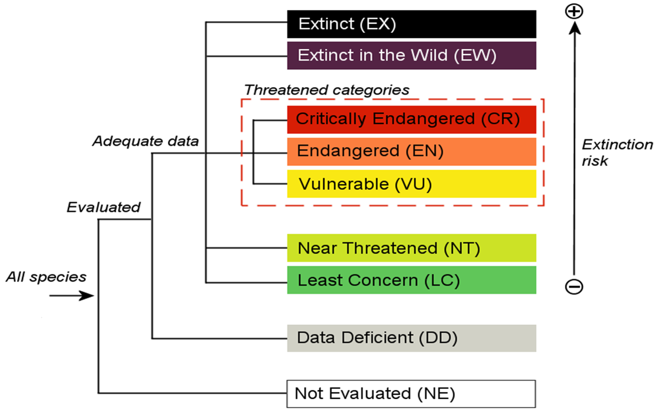
IUCN Red List Categories
Notes:
SLIDES ON IUCN AND CITES FROM KIM FRIEDMAN:
The IUCN Red List is produced by IUCN.
IUCN is one of the oldest and largest international conservation organizations. It was created in 1948, and has been creating Red Data Books and Red Lists for more than 60 years, though the Union also works on other issues related to the conservation of nature in addition to species work.
IUCN is made up of >1000 Member organizations (including States, governmental organizations and NGOs), >1000 staff located all around the world, and 10,000 scientists and experts that form the different IUCN commissions.
Of the six Commissions, the Species Survival Commission is the largest and works directly with the production of the IUCN Red List.
The classification is conducted using more of an expert judgement approach-
Whereby assessor is asked to consider and document data uncertainty, and to record the range of possible values for the assessment :
Record the range of possible values in the assessment documentation based on the available data.
State the range of potential categories the species may qualify for.
Use all available information on population, habitat, threats, etc. to select the most plausible category from that range.
When interpreting uncertain data, the Assessors attitude is important. We recommend:
a low dispute tolerance (representing attitude towards uncertainty) be adopted to include the whole range of uncertainty.
EXTINCT (EX) - no reasonable doubt that the last individual has died. A taxon is presumed Extinct when exhaustive surveys in known and/or expected habitat, at appropriate times (diurnal, seasonal, annual), throughout its historic range have failed to record an individual. Surveys should be over a time frame appropriate to the taxon's life cycle and life form.
EXTINCT IN THE WILD (EW) - it is known only to survive in cultivation, in captivity or as a naturalized population (or populations) well outside the past range. A taxon is presumed Extinct in the Wild when exhaustive surveys in known and/or expected habitat, at appropriate times (diurnal, seasonal, annual), throughout its historic range have failed to record an individual. Surveys should be over a time frame appropriate to the taxon's life cycle and life form.
CRITICALLY ENDANGERED (CR) - the best available evidence indicates that it meets any of the criteria A to E for Critically Endangered (see Section V), and it is therefore considered to be facing an extremely high risk of extinction in the wild.
ENDANGERED (EN) - the best available evidence indicates that it meets any of the criteria A to E for Endangered (see Section V), and it is therefore considered to be facing a very high risk of extinction in the wild.
VULNERABLE (VU) - the best available evidence indicates that it meets any of the criteria A to E for Vulnerable (see Section V), and it is therefore considered to be facing a high risk of extinction in the wild.
NEAR THREATENED (NT) - it has been evaluated against the criteria but does not qualify for Critically Endangered, Endangered or Vulnerable now, but is close to qualifying for or is likely to qualify for a threatened category in the near future.
LEAST CONCERN (LC) - when it has been evaluated against the criteria and does not qualify for Critically Endangered, Endangered, Vulnerable or Near Threatened. Widespread and abundant taxa are included in this category.
DATA DEFICIENT (DD) - inadequate information to make a direct, or indirect, assessment of its risk of extinction based on its distribution and/or population status. A taxon in this category may be well studied, and its biology well known, but appropriate data on abundance and/or distribution are lacking. Data Deficient is therefore not a category of threat. Listing of taxa in this category indicates that more information is required and acknowledges the possibility that future research will show that threatened classification is appropriate. It is important to make positive use of whatever data are available. In many cases great care should be exercised in choosing between DD and a threatened status. If the range of a taxon is suspected to be relatively circumscribed, and a considerable period of time has elapsed since the last record of the taxon, threatened status may well be justified.

Slide 30
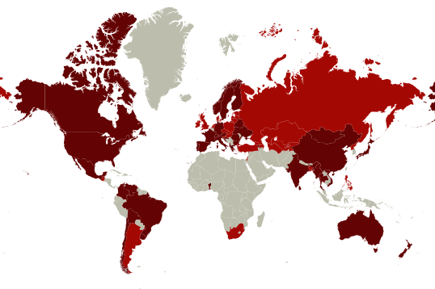

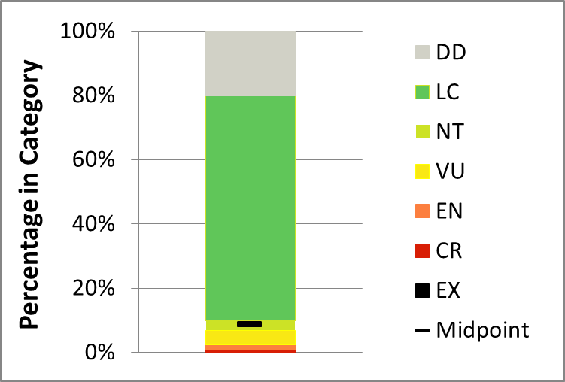
Marine Fishes on the IUCN Red List
n = 7,644
Red List and Red List Index have only started to examine fish more seriously
Poor representation – by species or area, but new species being added
IUCN is looking for funding to run their assessments
Notes:
Fish have a low relative extinction risk to other groups
This is as of July 2016, and includes 7,644 fishes tagged as marine (including ~600 spp. tagged as both marine and freshwater).

Slide 31


CITES SPECIES LISTS
Appendix I: Species threatened with extinction. Trade permitted only in exceptional circumstances
Appendix II: Species not necessarily threatened with extinction, but in which trade must be controlled in order to avoid utilization incompatible with their survival
Notes:
CITES Appendices or LISTS
species afforded different levels or types of protection through control of International Trade
"Trade" means export, re-export, import and introduction from the sea;

Slide 32
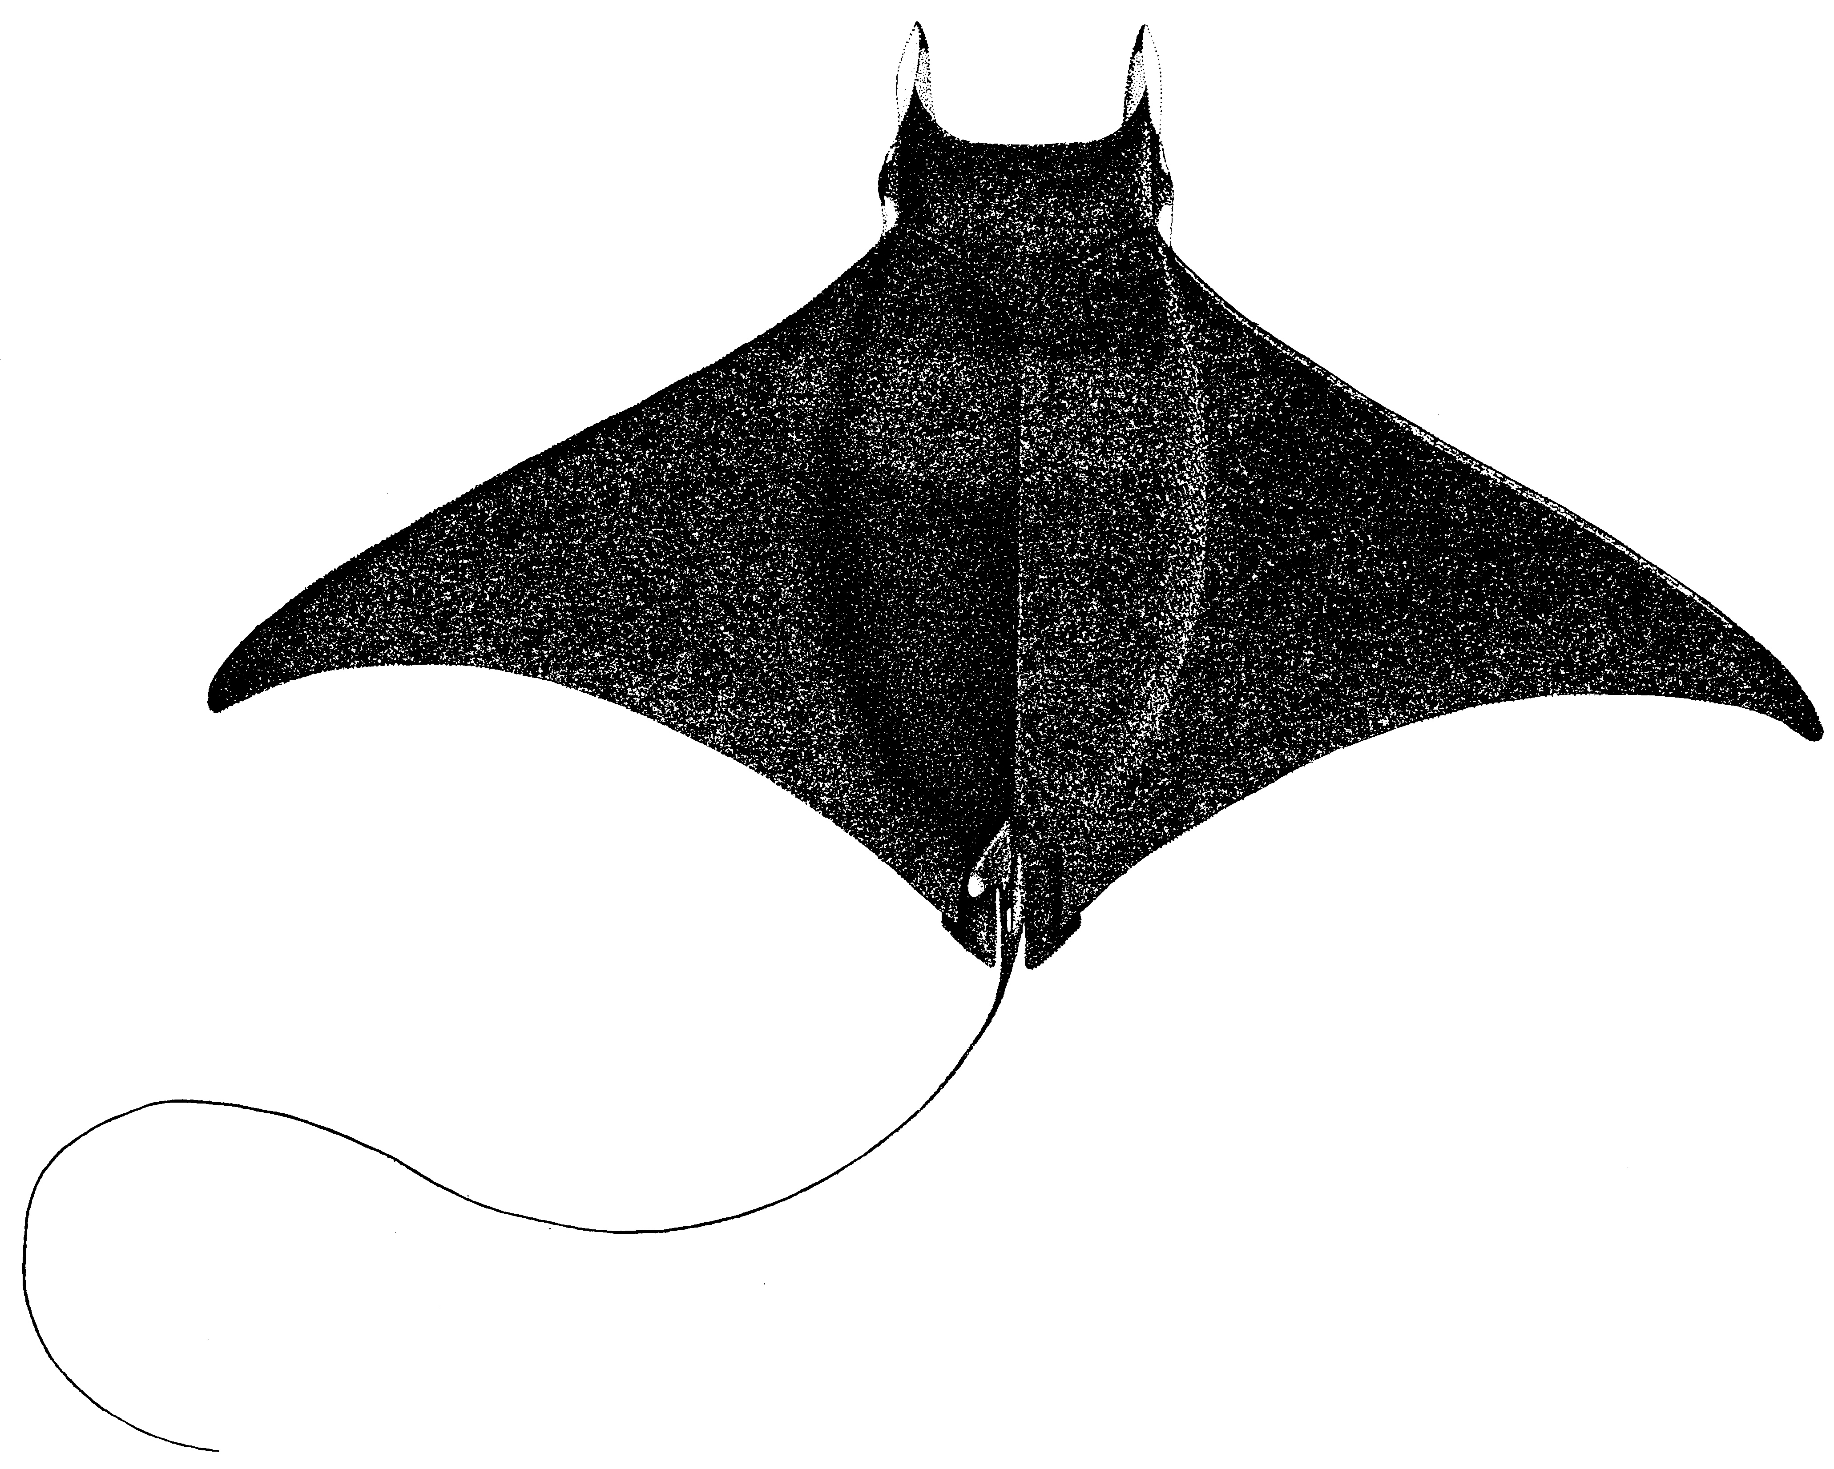
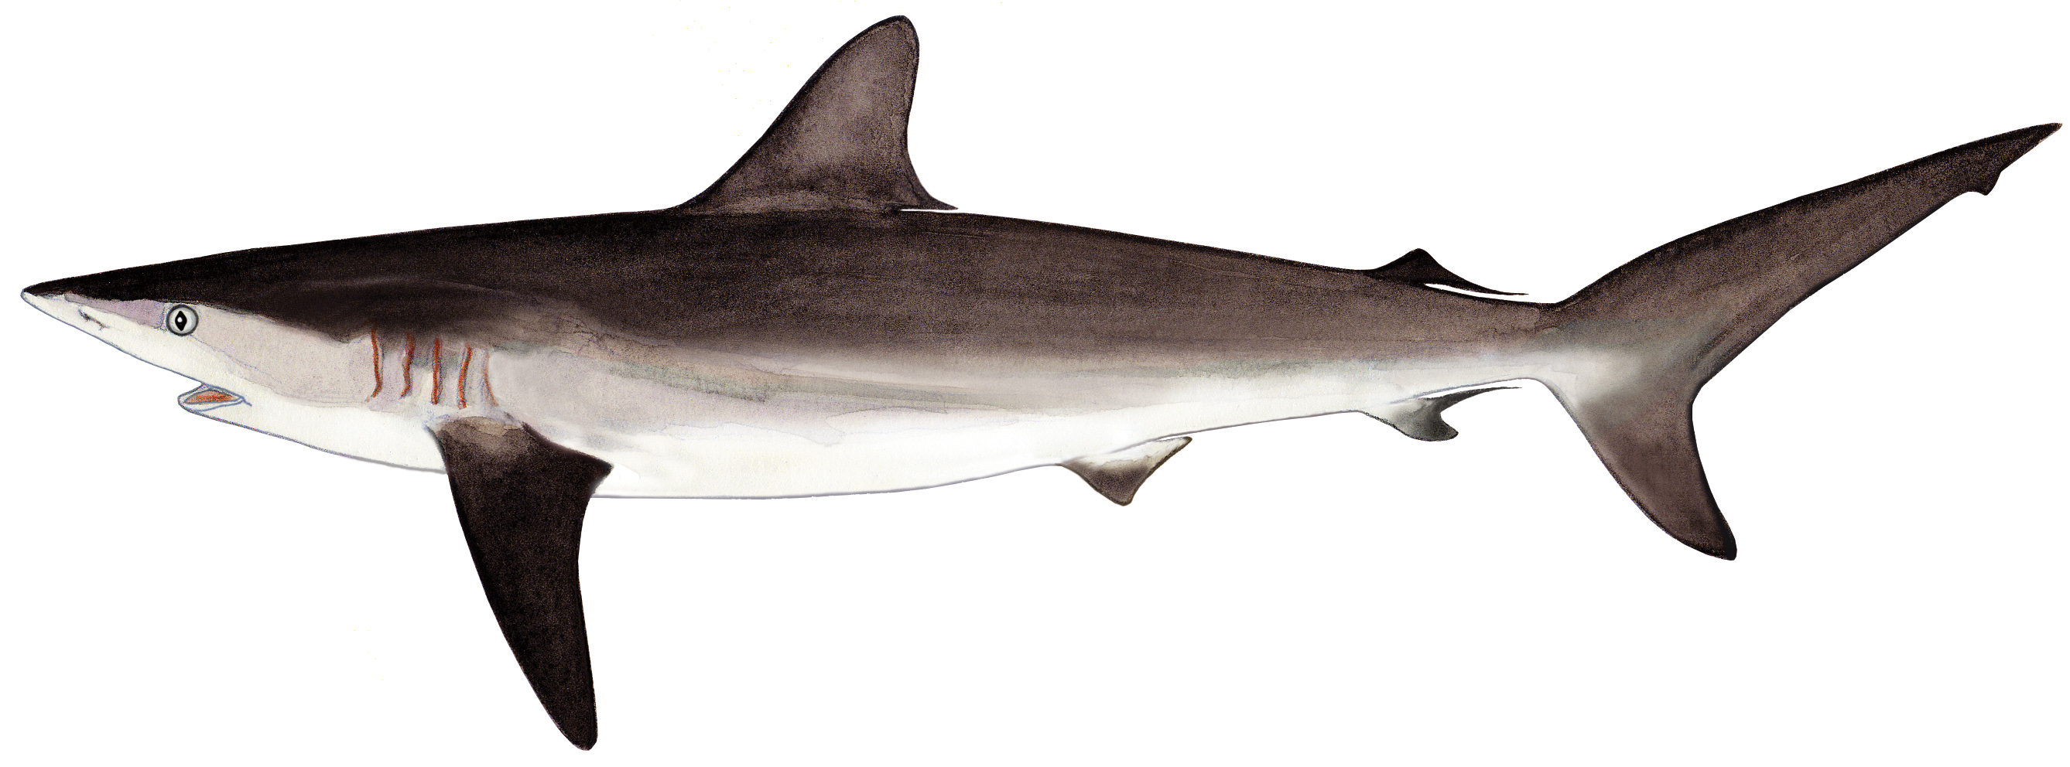
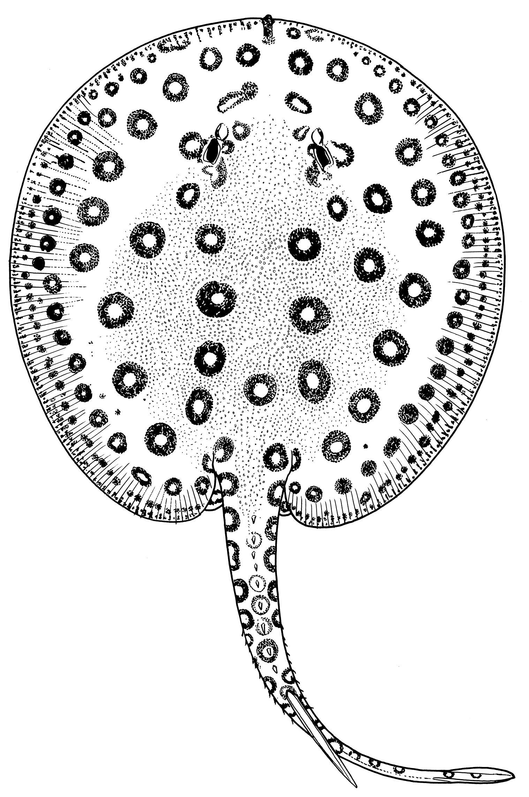
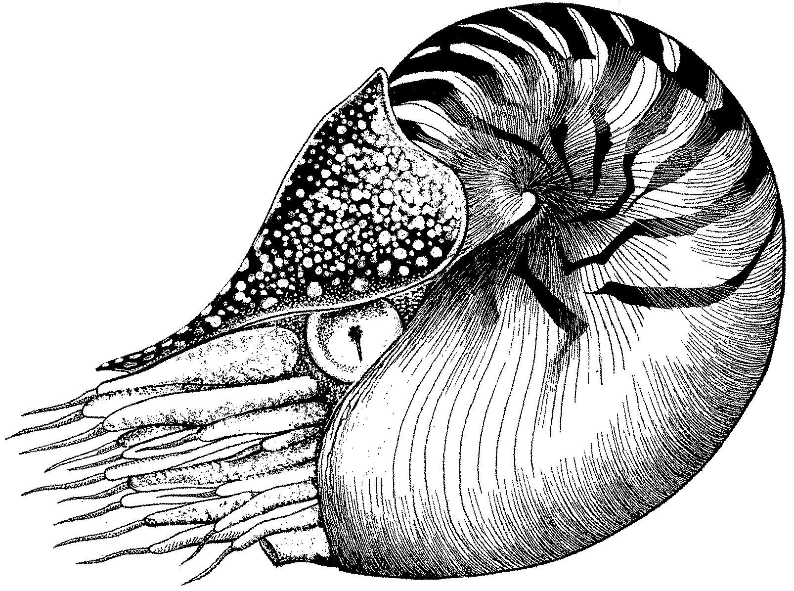
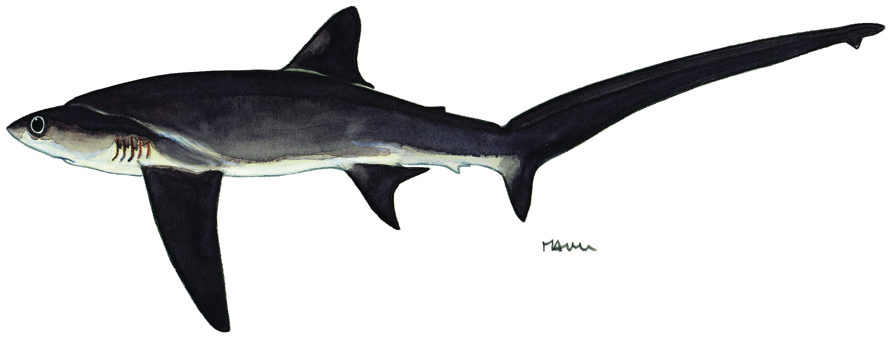
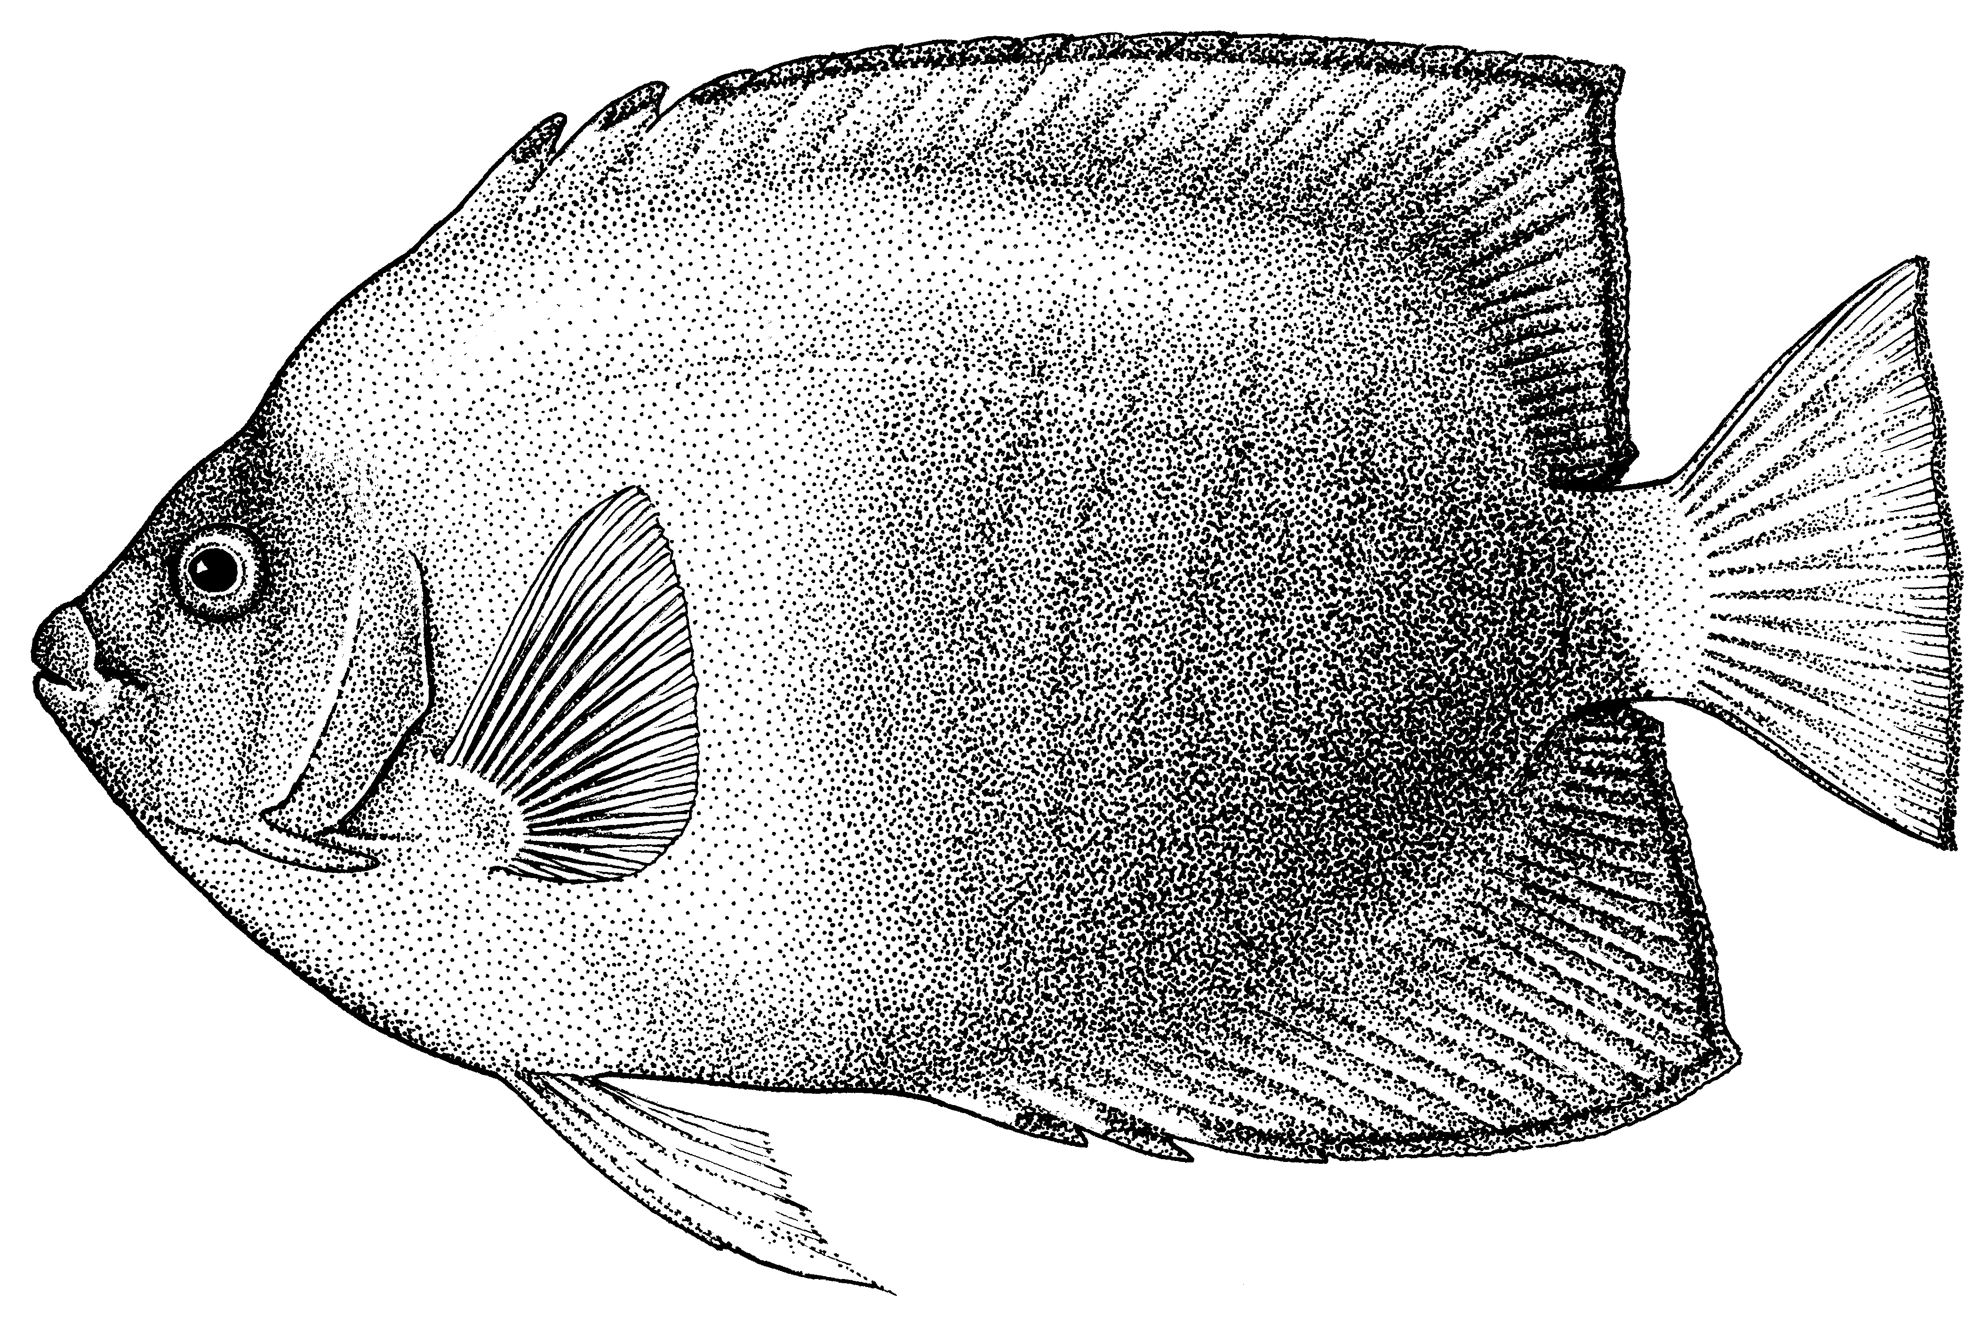
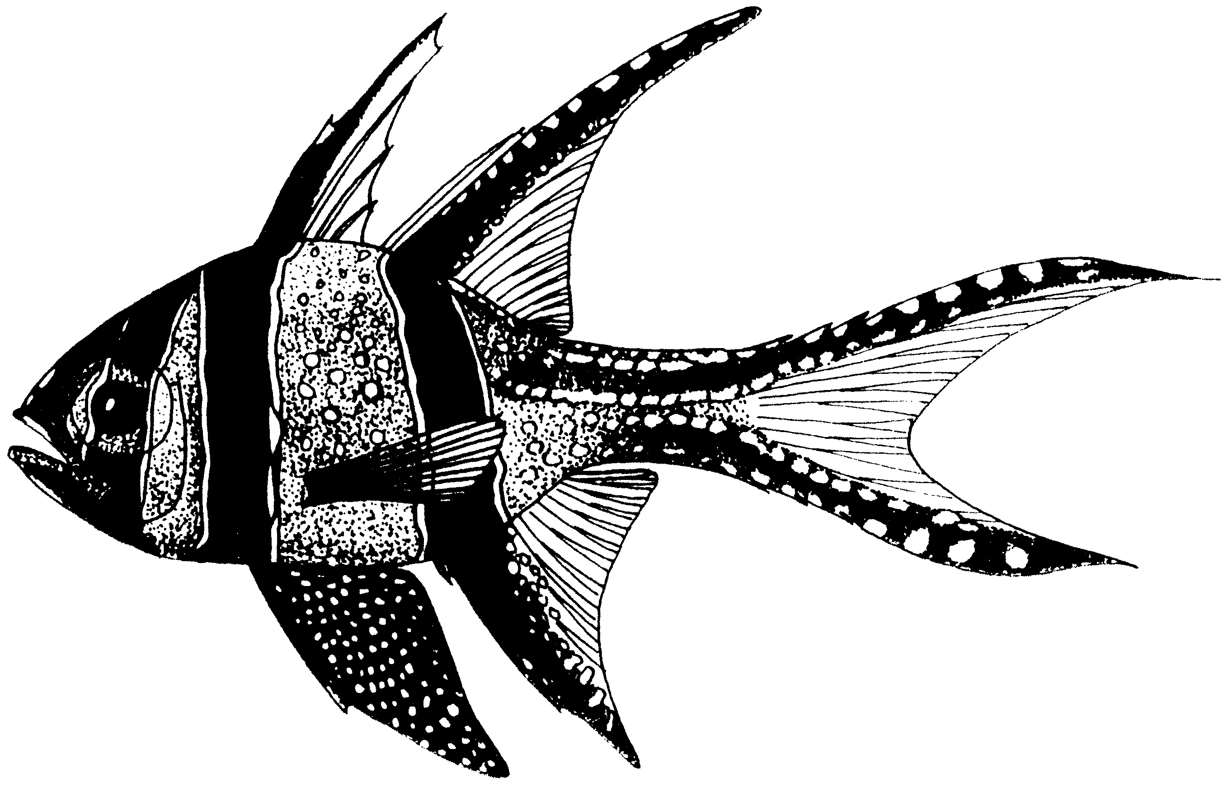
List of aquatic commercial species for which proposals have been made for CoP17 (https://cites.org/eng/cop/17/prop/index.php):
Thresher sharks (Alopias superciliosus, bigeye thresher shark, Alopias vulpinus, common thresher shark and Alopias pelagicus, pelagic thresher shark; proposed by Sri Lanka);
Silky shark (Carcharhinus falciformis; proposed by Maldives);
Mobula rays (Mobula tarapacana, sicklefin devil ray, Mobula japonica, spinetail devil ray, Mobula mobular, giant devil ray, Mobula thurstoni, bentfin devil ray, Mobula eregoodootenkee, longhorned pygmy devil ray, Mobula kuhlii, shortfin pygmy devil ray, Mobula hypostoma, Atlantic pygmy devil ray, Mobula rochebrunei, Guinean pygmy devil ray, Mobula munkiana, Munk’s pygmy devil ray and any putative species of Mobula; proposed by Fiji);
Banggai cardinalfish (Pterapogon kauderni; proposed by EU);
Ocellate river stingray (Potamotrygon motoro; proposed by Bolivia); and
All Nautilidae (Allonautilus spp. Allonautilus perforatus, Allonautilus scrobiculatus, Nautilus belauensis, Nautilus macromphalus, Nautilus pompilius, Nautilus repertus, Nautilus stenomphalus; proposed by Fiji, India and USA);
Clarion angelfish (Holacanthus clarionensis, proposed by Mexico).

Slide 33

FAO CITES and COP17
27th April
vi) COP
i) Species listing proposals written
ii) Species proposals submitted to CITES
iii) FAO expert panel
convenes
iv) FAO expert report finalised
v) CITES
deliberate
IUCN/TRAFFIC
assessment
Notes:
Set of criteria-
observed, inferred or projected decrease in
Not just abundance but also
area of distribution; or
area of habitat

Slide 34
CONCLUDING REMARKS
Fisheries is key to ocean issues world wide
  Also in for a addressing primarily environment and biodiversity issue, but also trade
  Both at regional and global scale
This year there are many important ocean discussions
  Important that Fisheries can contribute knowledge to these discussions
RFBs/RFMOs are addressing many biodiversity issues in the context of improving fisheries management, in different contexts and forms

Slide 35

Thank you

