Slide 1
6th Meeting of the Regional Fishery Body Secretariats’ Network
FAO Headquarters, 9 July 2016
Strengthening of the RFBs/RFMOs through the
Part VII Assistance Fund of the UNFSA
Presentation by Mr Guðni Bragason,
Senior Advisor,
Fisheries and Aquaculture Department, FAO
6th Meeting of the Regional fishery Body Secretariats’ Network

Slide 2
RFBs/RFMOs based on UN Fish Stocks Agreement
RFBs and RFMOs are based on the UN Fish Stocks Agreement (UNFSA) from 1995. (Agreement for the Implementation of the Provisions of the UN Convention on the Law of the Sea of 10 December 1982 relating to the Conservation and Management of Straddling Fish Stocks and Highly Migratory Fish Stocks).
UN Convention on the Law of the sea of 10 December 1982.
UNFSA calls for strengthening the role of regional fisheries management organizations and arrangements.
Art. 25 of the UNFSA requires State Parties to cooperate through regional organizations, and to assist developing states to enable them to participate in high sea fisheries.
The proper functioning of RFMOs is important for the effectiveness of the Fish Stocks Agreement.

Slide 3
New momentum to focus on oceans and RFBs/RFMOs
  Sustainable Development Goal 14, in September 2015 gives a clear guidance: Conserve and sustainably use the oceans, seas and marine resources for sustainable development,
  Paris Climate Change Agreement in December 2015 noted “…the importance of ensuring the integrity of all ecosystems, including oceans, …”.
  Negotiation on an instrument for the conservation and sustainable use of marine biological diversity of areas beyond national jurisdiction (BBNJ) in 2016
  FAO Committee on Fisheries (COFI 32) meeting in July in Rome and the ongoing FAO Blue Growth Initiative (BGI)
  High-level UN Conference on Fisheries in Fiji 2017

Slide 4
Assistance Fund under the Part VII of the UNFSA
Art. 25 in the Part VII of the UNFSA requires State Parties to cooperate through regional organizations, and to assist developing states to enable them to participate in high sea fisheries.
Art. 26 calls for the establishment of special funds to assist developing states.
Under Part VII of the UNFSA a special fund, was established in 2003 by the UN General Assembly (Resolution A/58/14, Art. 10), to assist developing countries in the implementation of the UNFSA.
The Part VII Fund is under the administration of FAO, which has established a Trust Fund account for that purpose.
Mainly being used to fund travels and participation in meetings and workshops.

Slide 5
ToR (Art. 14) define the purpose of assistance:
a) Participation in meetings and activities of RFMOs.
b) Participation in high seas meetings of global organizations.
c) Negotiations for the establishment of new RFMOs and “…strengthen existing subregional and regional fisheries management organizations…”.
d) Building capacity, flag state responsibility, MCS, data, research.
e) Exchange of information.
f) Human Resources, training, assistance.
g) Settlement of disputes.

Slide 6
Present situation with the Part VII Fund:
To date, financial contributions to the Fund have amounted to 1.67 million USD.
Contributing countries: Australia, Canada, Iceland, Lebanon, New Zealand, Norway and the USA.
Contributions, based on applications, have benefitted almost 30 developing states, especially SIDS.
The Part VII Fund is now more or less depleted and in need for additional funding.

Slide 7
Resumed Review Conference of the UNFSA
Resumed Review Conference of the UNFSA, May 2016 in New York, gave the Part VII Fund a good focus.
Encouraged a broader use of the Part VII Assistance Fund, by States and regional fishery bodies (RFBs/RFMOs), on behalf of their developing States Members, in line with purposes listed in Article 14 of its Terms of Reference of the Fund.
Encouraged RFBs/RFMOs to pro-active in identifying and developing initiatives, supported by the Fund, of benefit to developing states.
Positively considered the possibility of accepting voluntary financial contributions from donors for specific projects supporting the implementation of the Agreement.

Slide 8
Recent efforts
Member countries have been approached, with extensive information material.
Meetings with 65 Permanent Representations out of ca. 135 based in Rome.
Information sent to all Permanent Representations, including those ca 55 not residing in Rome
Letter to all Permanent Representatives from FAO and DOALOS.
The COFI meeting will be used to further the issue

Slide 9
Strengthening RFMOs through the Part VII Fund
Need to follow-up on the 2003 General Assembly resolution A/58/14 establishing the Part VII Fund, and make it more effective in assisting the developing countries .
Under Art. 11 of the Fund’s ToR, the UN and FAO invite member states, intergovernmental organizations, international financial organizations and NGOs to make voluntary financial contributions to the Fund.
The Resumed Review Conference of the UNFSA called for widening the scope of the Part VII Fund and open up for more diverse applications. More contributions would give the Fund more possibilities to support to projects.
Member countries have been approached, i. a. with a letter from FAO and DOALOS 2016.
RFBs/RFMOs of importance for the conservation, management and development of aquatic resources.

Slide 10
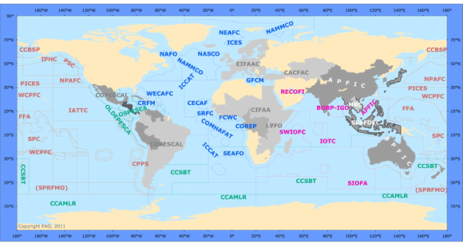
Global coverage of RFBs

