Slide 1
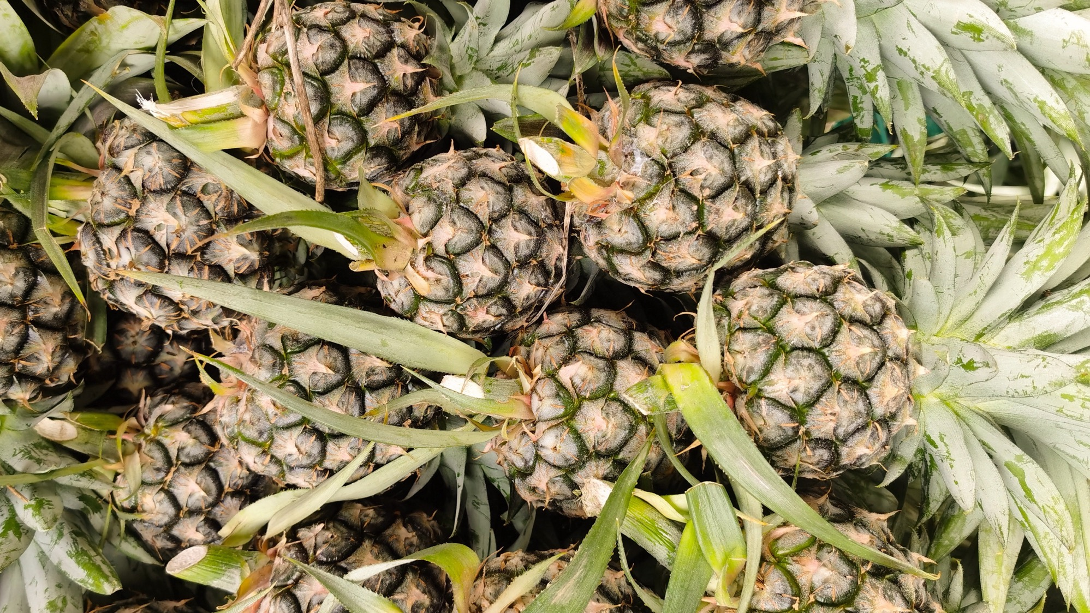


Measuring carbon and water footprints in pineapple value chains
Introductory session

Slide 2


Content
  Challenges and opportunities in the pineapple sector
  What carbon and water footprint measurements are and why these are important
  Measuring carbon and water footprints in the pineapple sector
  Reducing greenhouse gas (GHG) emissions and water impacts in pineapple value chains

Slide 3

1.
Current challenges in the pineapple sector

Slide 4




Current challenges in the pineapple sector
Cultivation is climatically vulnerable in tropical regions.
Fast growing international demand for pineapple.
Rising requirements from export markets to report on environmental impacts and GHG emissions.
Important source of economic growth, livelihoods, food and nutrition security for producing countries.

Slide 5
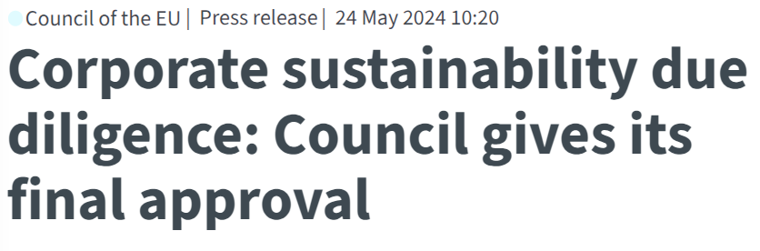
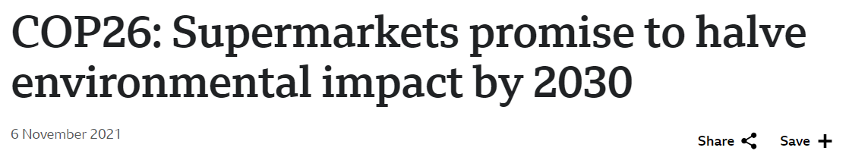
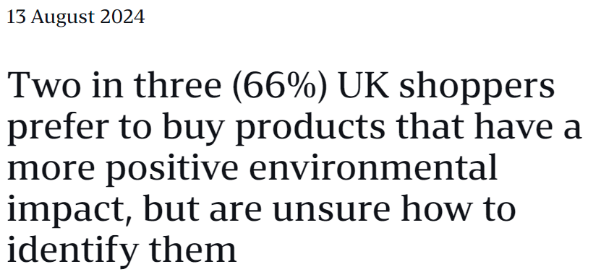
Current challenges in the tropical fruit sector

Slide 6
2.
What are carbon and water footprint measurements and why are these important?

Slide 7


What is carbon footprint measurement?
Refers to the total amount of greenhouse gases (GHG) that are generated by human activity.
Potential to warm the planet once released into the atmosphere at a specific time.
Human-driven climate change

Slide 8
What is water footprint measurement?
It measures the potential environmental impacts related to water.
Consumption or consumptive use
Degradation or degradative use
corresponds to
corresponds to
Water that was used by the organization, and as a result did not return to the same watershed from which it was extracted.
Activities that can potentially affect or worsen the water quality.
for example:
for example:
Water that is lost through evaporation, evapotranspiration or discharge to a different watershed.
Application of products to soil and air that may reach water sources, or application of these products directly to water that may affect water quality
Impact category:
Impact category:
Shortage
Eutrophication in fresh & salt water
Ecotoxicity and Human toxicity

Slide 9

Why is it important to calculate these footprints?
Meet the demands from international markets and consumers
Opportunity to enhance input management and reduce operational costs
Reducing environmental impact of operations and increasing compliance with environmental requirements (1.5 °C target)
Enhanced brand image and reputation (product differentiation and business opportunities)
Robust information for decision-making

Slide 10
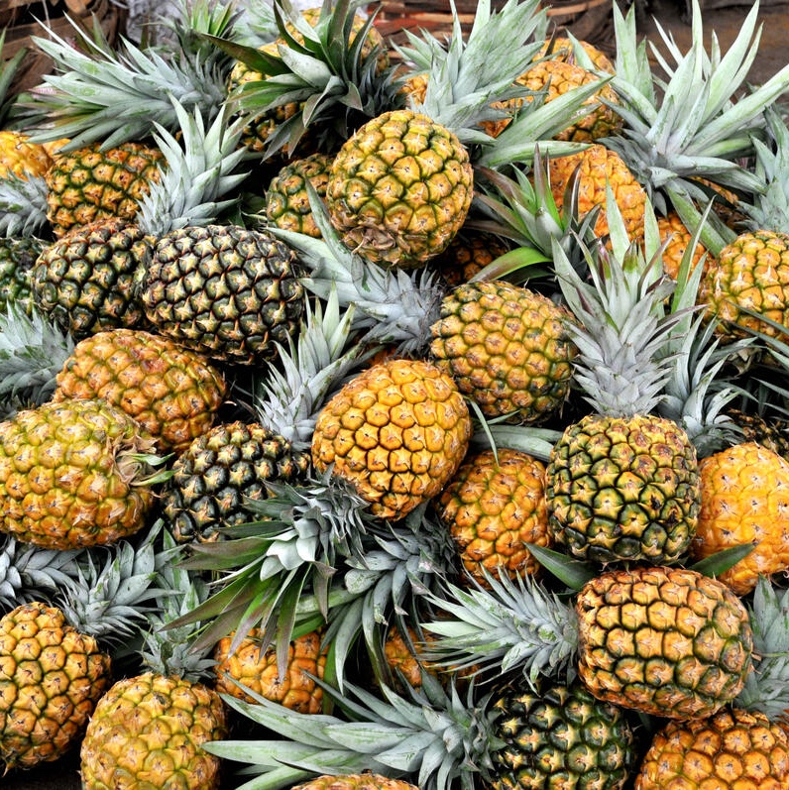
What other benefits do you see in measuring the carbon and water footprints?

Slide 11
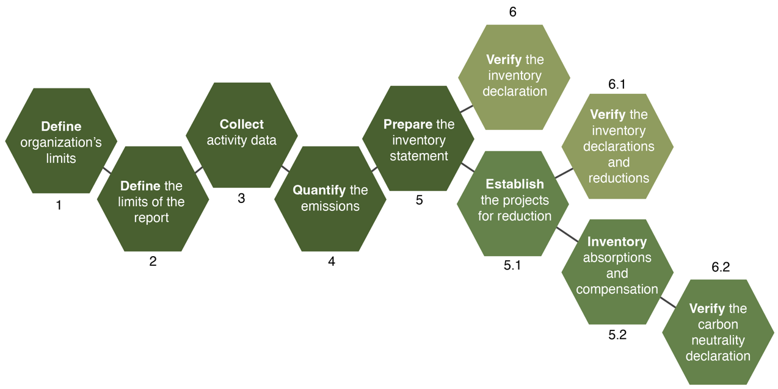
What does a verifiable carbon footprint study look like?

Slide 12
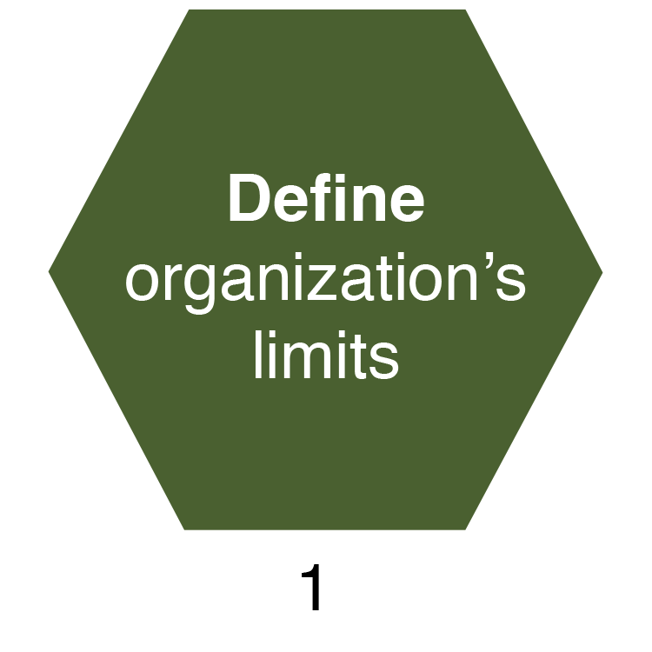
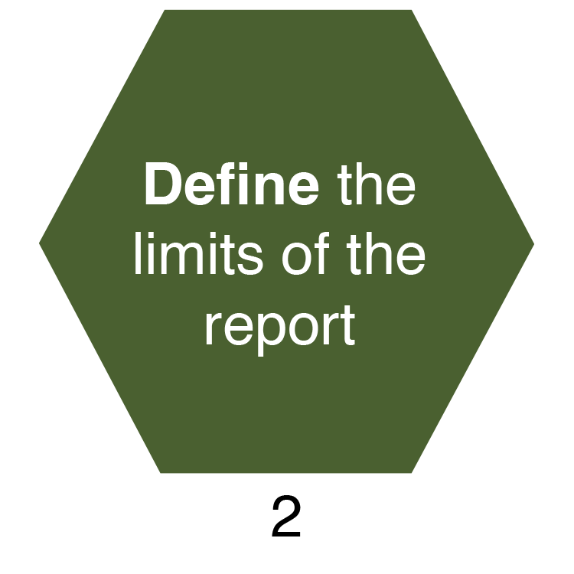
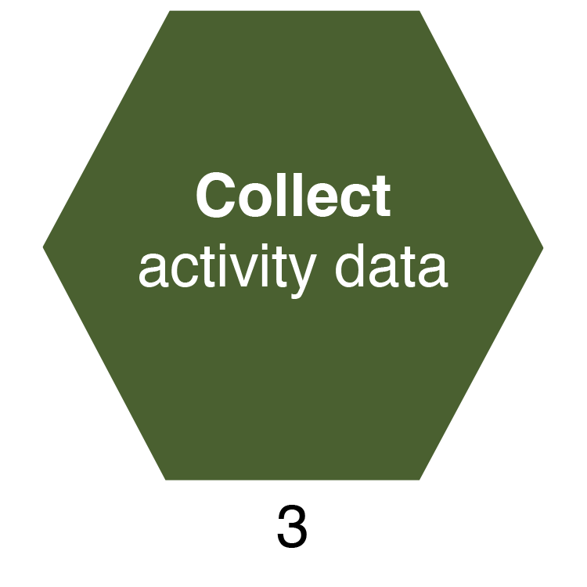
What does a verifiable carbon footprint study look like? (continued)
Define the physical areas that delimit the company
Define direct and indirect emissions and set a baseline year
Compile information
on each
emission-generating activity

Slide 13
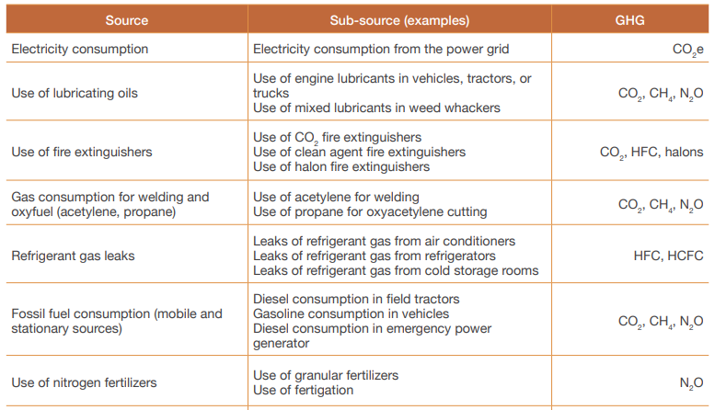
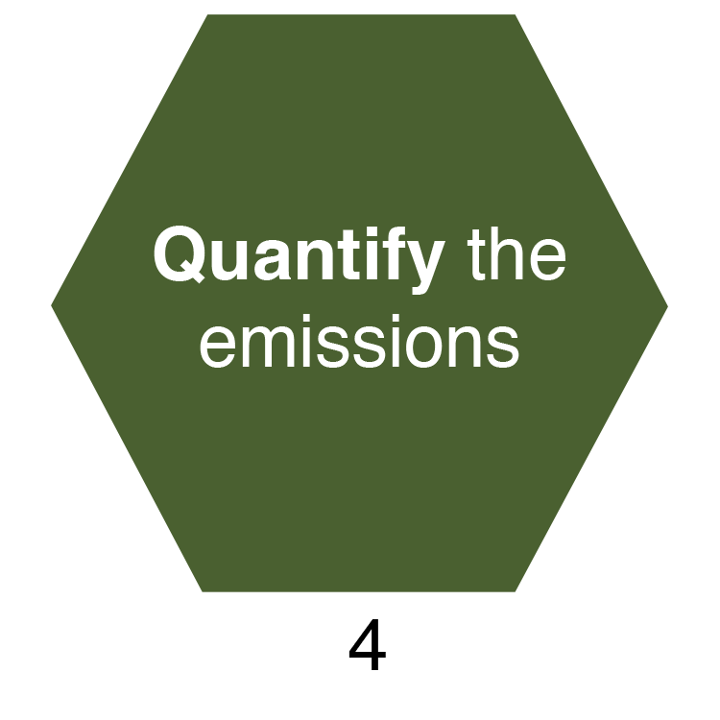
What does a verifiable carbon footprint study look like? (continued)

Slide 14
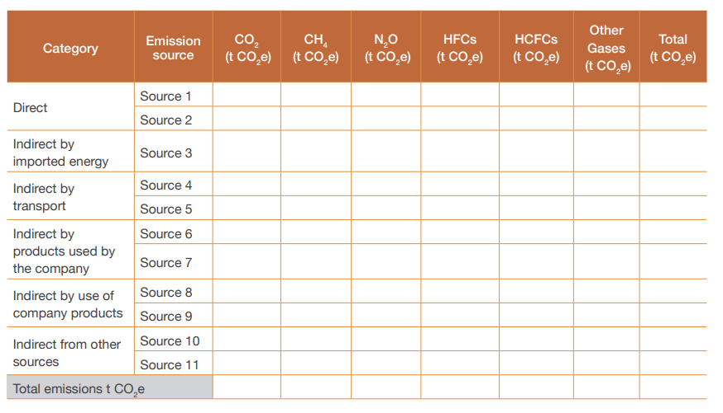
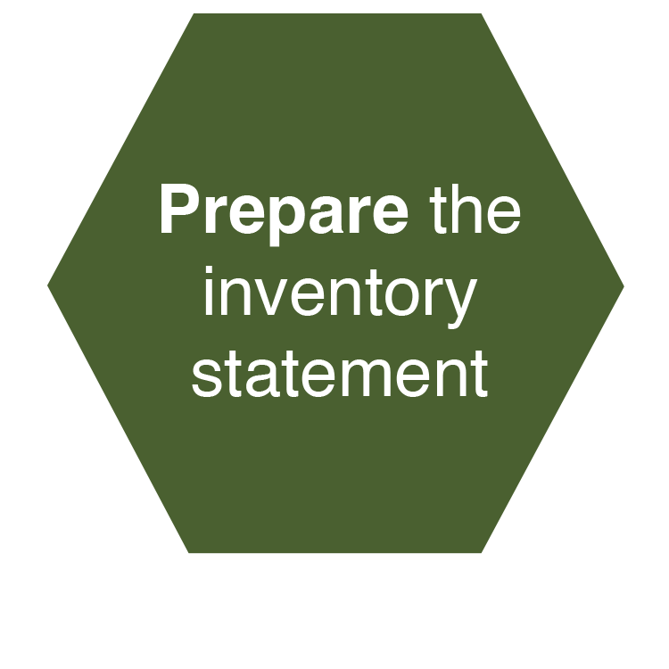
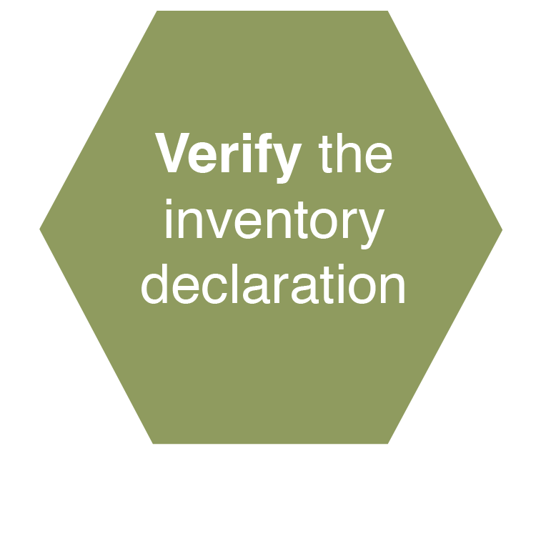
What does a verifiable carbon footprint study look like? (continued)

Slide 15
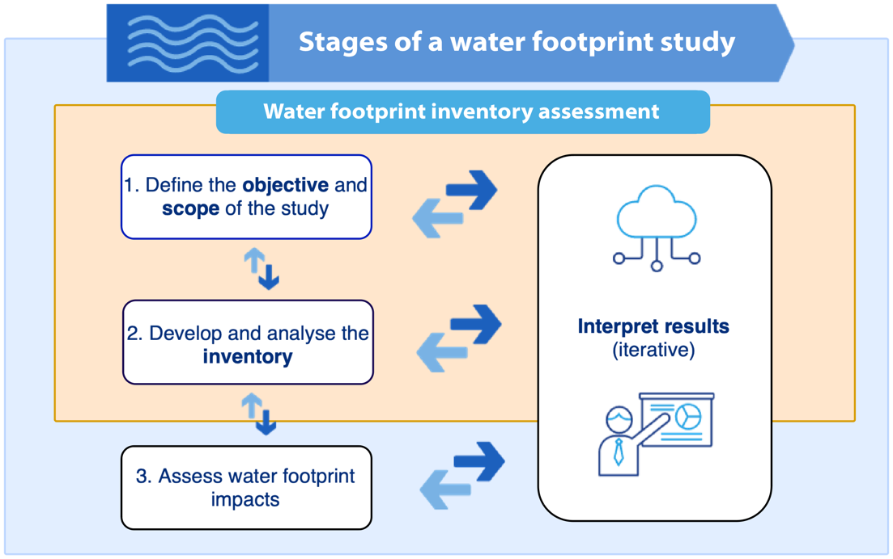
What does a verifiable water footprint study look like?

Slide 16
Step 1. Define the objective and scope of the study
What does a verifiable water footprint study look like? (continued)
Function of the organization
Years of study
Impact category selected
Assumptions and decisions
Data and data quality
Facilities included
Study system and limits
Geographical location
Impact estimation and methodology
Expression of results
Exclusions, limitations, cut-off criteria and uncertainties

Slide 17
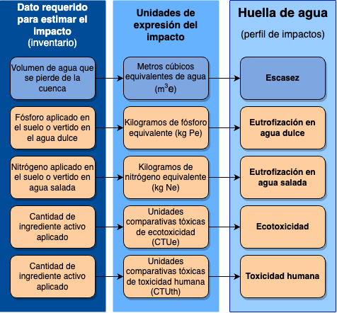
Step 2. Develop and analyze the inventory
What does a verifiable water footprint study look like? (continued)
Data needed to estimate impacts (inventory)
Impact expression units
Water footprint
(impact profile)
Volume of a water lost from the watershed
Cubic meters of water equivalent (m3e)
Shortage
Phosphorus applied to soil or discharged into freshwater
Kilograms of phosphorus equivalent (kg Pe)
Freshwater eutrophication
Nitrogen applied to soil or discharged into salt water
Kilograms of nitrogen equivalent (kg Ne)
Saltwater eutrophication
Quantity of active amount applied
Comparative toxic ecotoxicity units (CTUe)
Ecotoxicity
Quantity of active ingredient applied
Comparative toxic units of human toxicity (CTUth)
Écotoxicité
Human toxicity

Slide 18




Step 3. Assess water footprint impacts
What does a verifiable water footprint study look like? (continued)
Methodologies:
Water footprint profile
Impact | Field | Packing house | Total
Shortage (m³e)
Freshwater eutrophication (kg Pe)
Saltwater eutrophication (kg Ne)
Ecotoxicity (CTUe)
Human toxicity (CTUh)
AWARE
→ Shortage
→ Freshwater eutrophication
→ Saltwater eutrophication
ReCiPe
USEtox
→ Ecotoxicity
→ Human toxicity
The ‘severity’ of the impacts are context specific as it depends on the water availability, types of soils and climatic characteristics of the area
© Noun Project

Slide 19

3.
Measuring carbon and water footprints in the pineapple sector

Slide 20
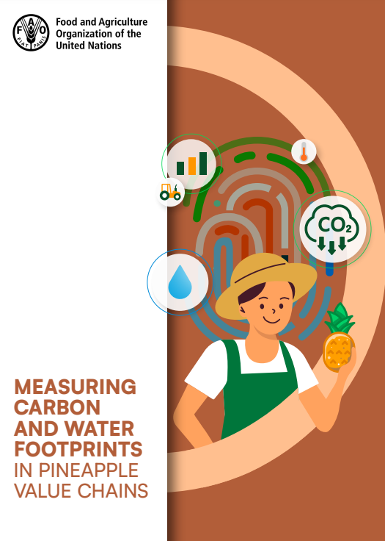
Measuring the carbon and water footprint in the pineapple sector
    Guide developed by the FAO Responsible Fruits Project
    Why?
    Respond to the need for measurement of footprints (prioritized by the industry) and market demand
    Provide a quantitative framework for measuring carbon and water footprints
    Enable users to measure footprints autonomously
    Support the reduction of environmental impacts of pineapple production and trade
    Optimization of processes, efficiency and cost savings
    Contribute to risk mitigation and prevention (aligned with responsible business conduct)

Slide 21
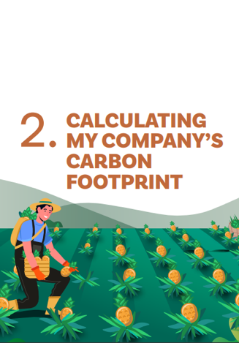
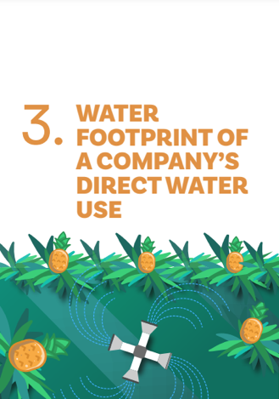
Development of the guide
    Building on the experience of measuring carbon and water footprints in banana value chains (World Banana Forum) and adapting this to the pineapple industry.
    Based on internationally recognized methodologies (ISO 14064 for carbon and ISO 14046 for water).
    Validation with six export-oriented pineapple producing and packing companies and cooperatives in Costa Rica.

Slide 22
Scope of carbon and water footprint measurement:
Cultivation and harvesting
Transport to port
Packing plant
Port
International shipping
Sales point
Final consumer
Land preparation
Bedding preparation
Sowing
Application of technological packages
Fruit reception
Fruit washing
Sorting and packaging
Refrigeration
Container loading
Transportation from the packing plant to the port
Carbon
footprint
Processes outside the scope of the guide
Irrigation
Rain for crop hydration
Water use in fumigation mixtures and improvers
Equipment wash
Sanitary facilities
Fruit washing
Fungicide spraying
Facility cleaning
Sanitary facilities
Pediluvium (footbath)
Faucets
Dining area
Vehicle cleaning
Water
footprint
Processes included

Slide 23
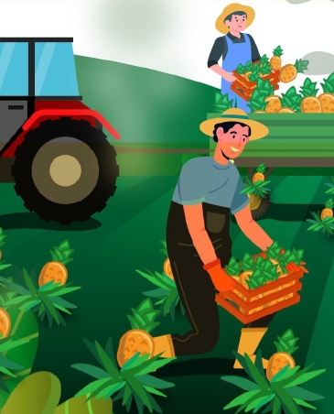
Contents: Carbon footprint measurement guide
1
Carbon footprint calculation overview
Scope of an emissions inventory
Identification of emission sources
Consolidation of carbon footprint results
Emissions reduction opportunity (measures)
Inventory uncertainty
2
Carbon footprint of the company:
3
4
5
6

Slide 24
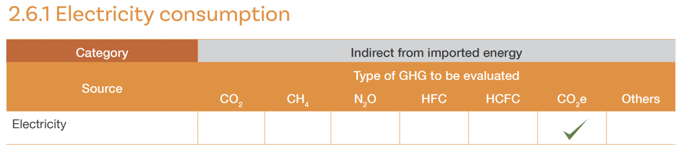
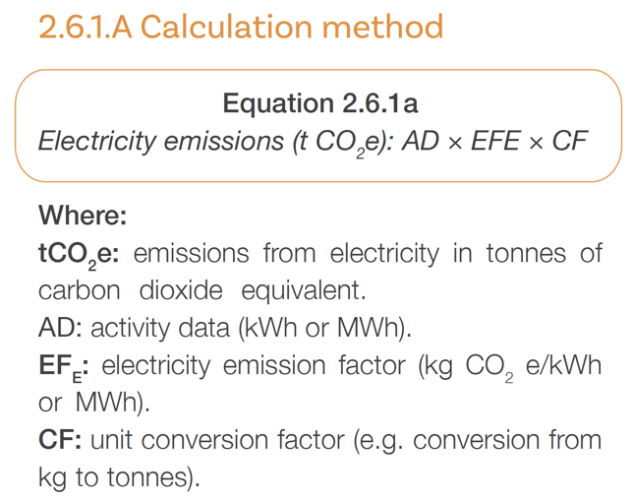
Example: guidance to identify and calculate GHG emissions

Slide 25
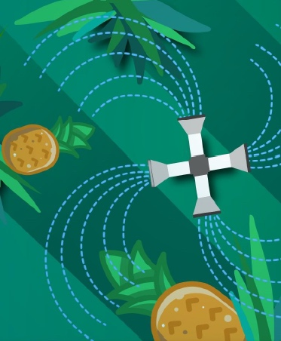
Contents: Water footprint measurement guide
1
Overview of water footprint calculation
Scope of the water footprint
Water balance identification and product usage
Assessing water footprint impacts
Water footprint report
Water footprint reduction measures
2
Water footprint of the company:
3
4
5
6
25

Slide 26
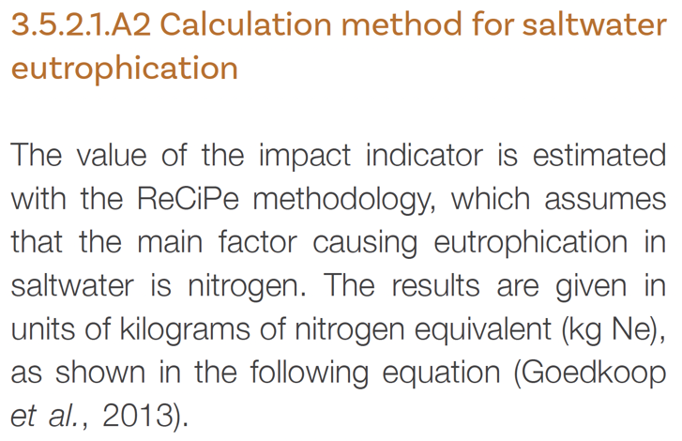
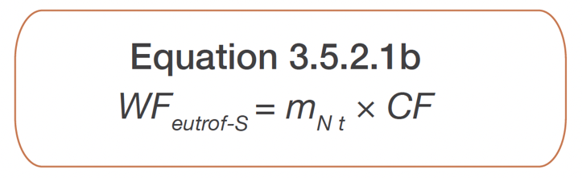
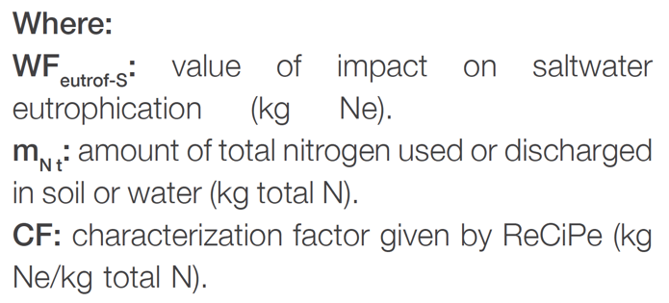
Example: guidance to identify and calculate the impacts on water

Slide 27
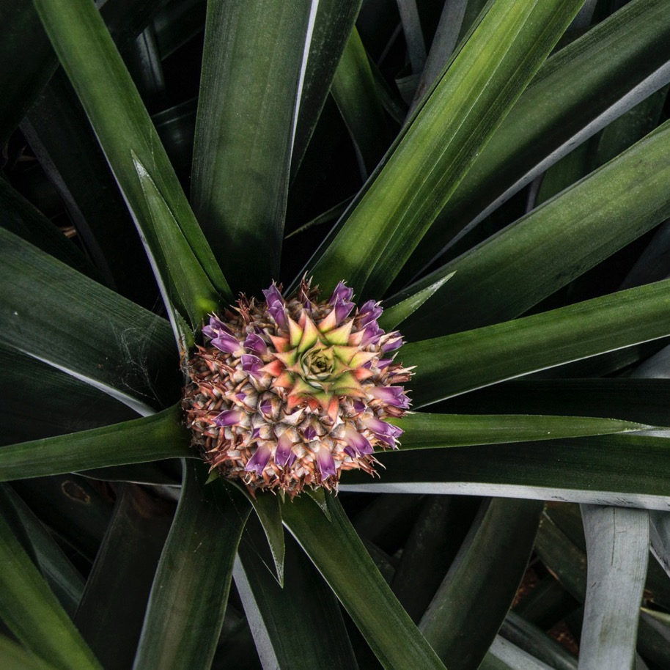
How do you think this tool can be used in your company?

Slide 28
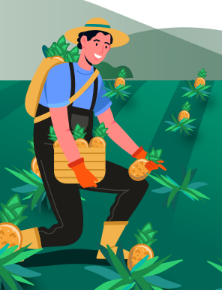
5.
Reducing GHG emissions and water impacts in pineapple value chains

Slide 29






Recommendations to reduce the carbon footprint
Inputs: Optimized use of agrochemicals, use of integrated pest and nutrition management.
Solid waste and wastewater disposal: Lower organic matter load in wastewater, water reuse & circulation, water consumption optimization, separation & recycling.
Energy: Clean and well-functioning energy systems
Stubble management and tillage: tillage practices with lower emissions, reincorporation of organic matter in the soil.
Fuels: Efficient vehicles, optimization of routes, fuel-saving devices
Refrigerant gases and fire extinguishers: Maintenance, monitoring and replacement
© oun Project

Slide 30


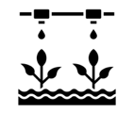




Recommendations to reduce the water footprint
Shortage
Degradation (quality)
Water treatment, recirculation and reuse
Rational use of agrochemicals (integrated pest management, nutrient management)
Efficient irrigation technologies
Integrated solid waste management
Rainwater harvesting
Integrated liquid waste management
Reforestation and forest protection
Soil and biodiversity protection

Slide 31


Thank you!
https://bit.ly/responsible-fruits
Responsible-Fruits@fao.org

