Slide 1

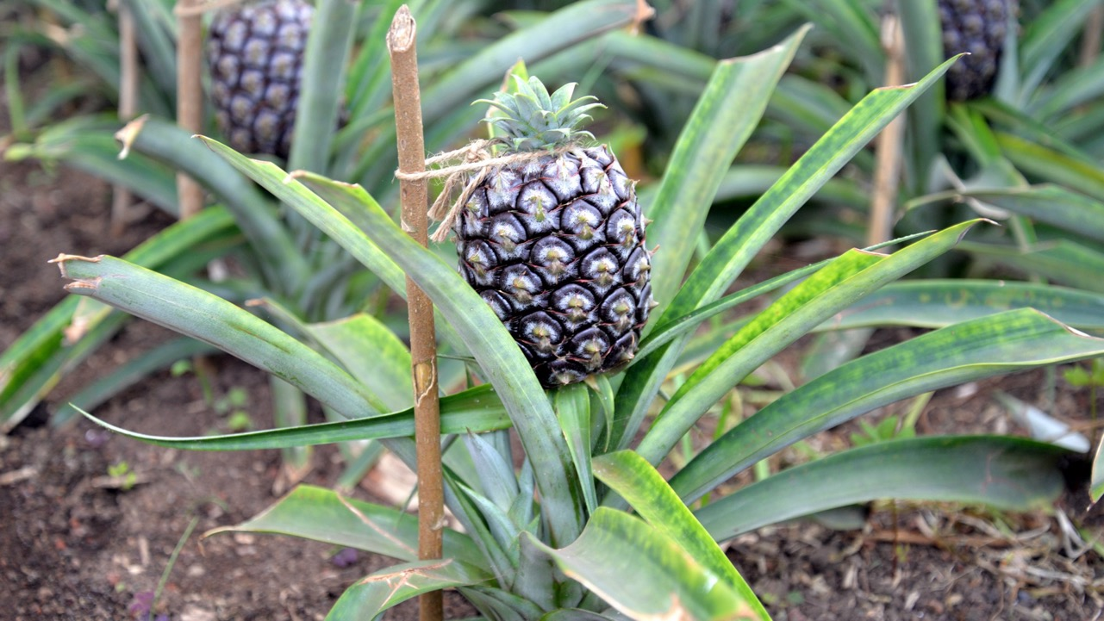

Carbon footprint measurement in pineapple value chains

Slide 2


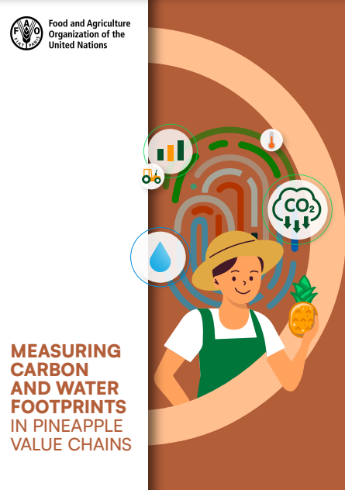

Objective:
To introduce the pineapple sector companies to the use of the carbon footprint measurement guide for pineapple value chains.
Reference:
This guide used references such as the international voluntary standard ISO 14064 ”Greenhouse gases-part 1: specification with guidance, at the organization level, for the quantification and reporting of greenhouse gas emissions and removals”, the GHG :Protocol guidelines, and the Intergovernmental panel on Climate Change (IPCC) Guidelines.

Slide 3
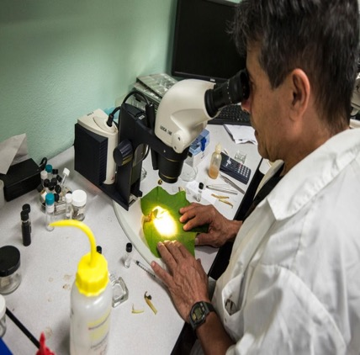
Who is the target audience
of this guide:
Due to the high degree of technical difficulty, the guide is aimed at:
technical personnel;
environmental engineers;
personnel responsible for preparing the quantification of the carbon footprint within companies; or
professionals in related areas.
©FAO

Slide 4

i
Contents of this course: How is a carbon footprint calculated?
1
1
Carbon footprint calculation overview
Scope of an emissions inventory
Identification of emission sources
Consolidation of carbon footprint results
Emissions reduction opportunity (measures)
Inventory uncertainty
2
2
3
4
5
3
6

Slide 5
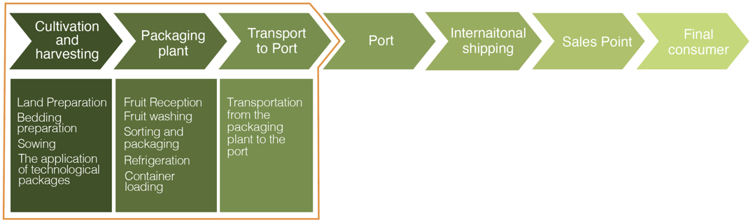
Processes considered within the scope of the carbon footprint measurement guide:
Processes outside the scope of the guide
Processes included

Slide 6
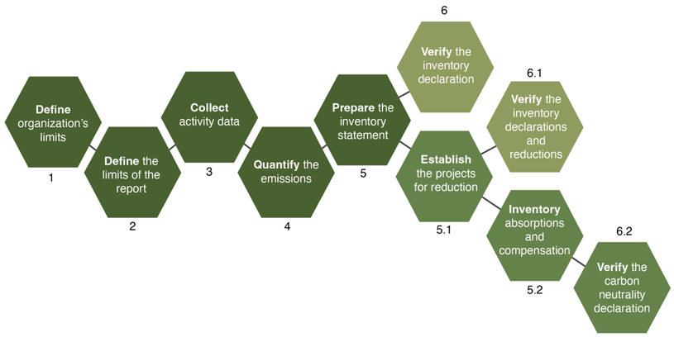
Recommended steps towards carbon footprint quantification and reporting:

Slide 7
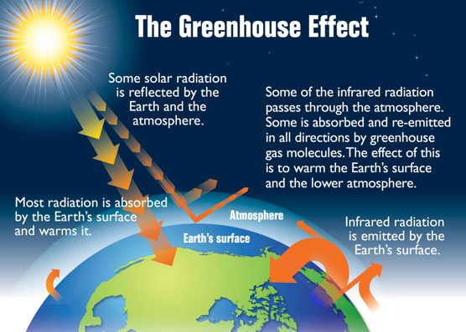
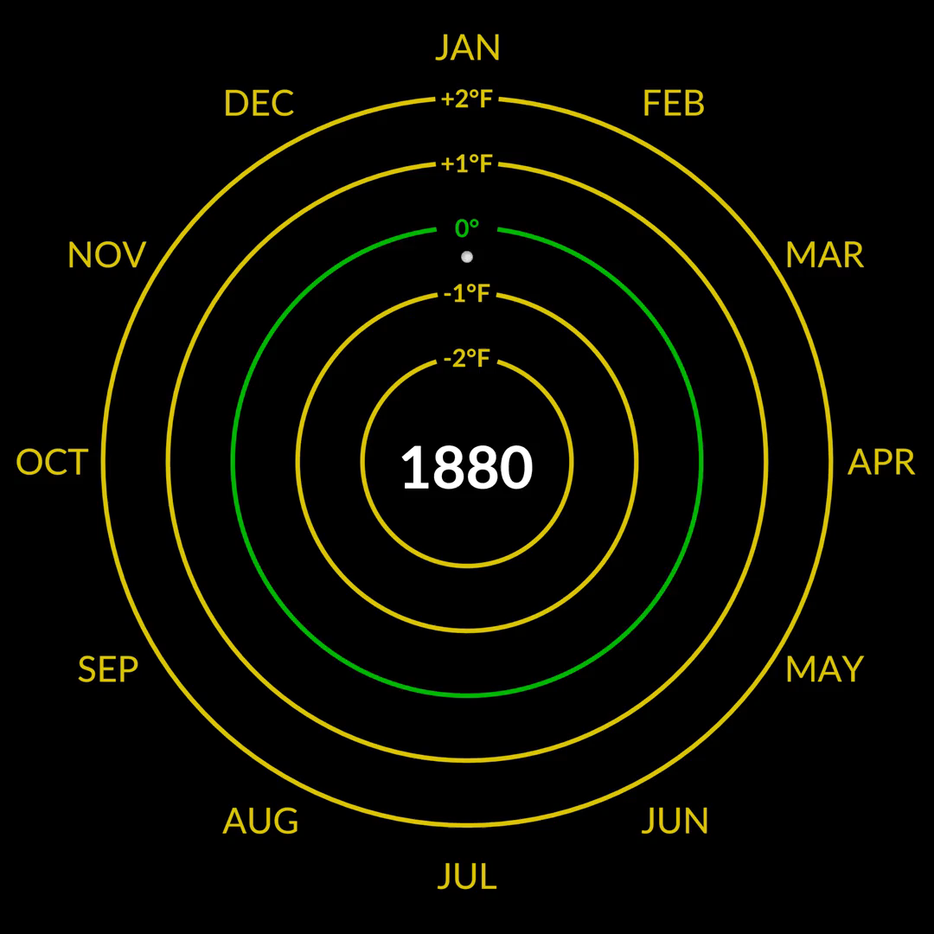
Natural process:
Basic concepts
Climate change:

Slide 8









Greenhouse gas (GHG):
Basic concepts
GHG emission source:
GHG emission:
CO₂e
Gaseous components in the atmosphere, both naturally occurring and human-made, that can absorb and emit radiation.
Any activity or process that releases GHG emissions into the atmosphere (INTECO, 2019).
It refers to the total amount of one or more GHGs that have been released into the atmosphere at a specific time.

Slide 9

Basic concepts
Specific quantitative measure of the activity (source) generating the emissions; which will allow accounting of the impact on emissions.
For example: kWh, liters of fuel , kg of refrigerant gas, kg of nitrogen fertilizer applied to the soil, among others…

Slide 10
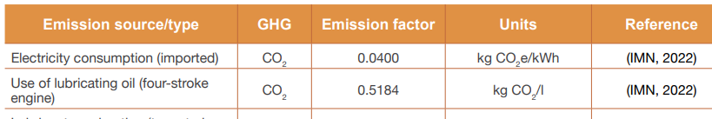
Basic concepts
The factor of emission relates the activity data to the emission of a specific GHG. There are differentiated emission factors that determine emissions by type of GHG. For example:

Slide 11
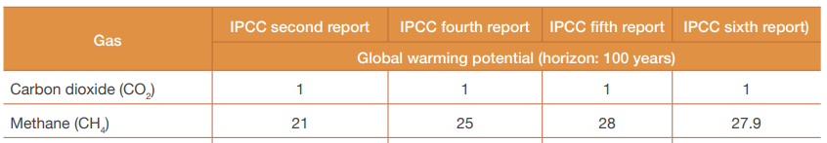
Basic concepts
It is a value that describes the greenhouse impact of a given GHG, in relation to CO₂, enabling the reporting of all emission in terms of CO₂ . For example:

Slide 12
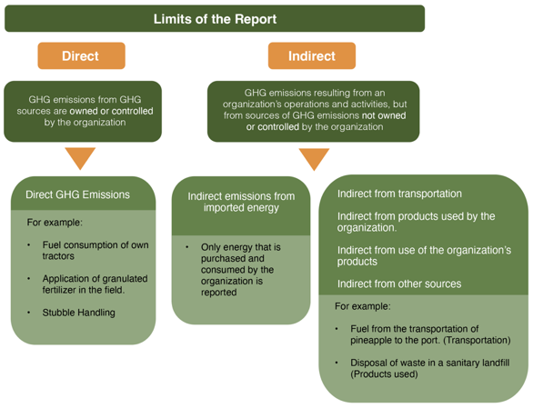


Organizational boundaries:
Basic concepts
These refer to the company areas that define its boundaries, including physical facilities, cultivation, processing, packing and shipping areas, along with the chosen consolidation approach for inventory quantification.

Slide 13
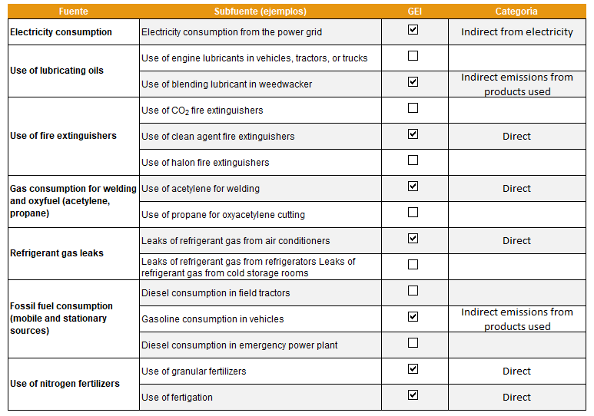
Identification of emission sources
Source
Sub-source (examples)
GHG
Category
Emission sources must be identified within the limits established by category.
Using a checklist and conducting facility walk-throughs to identify emission sources is considered good practice.
For example:

Slide 14
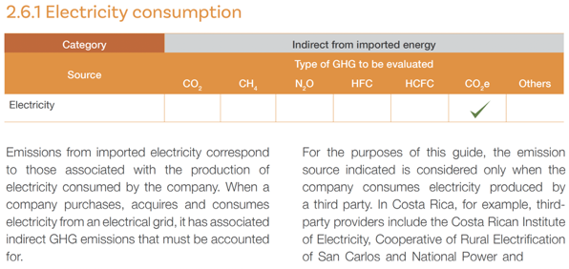
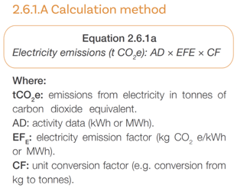
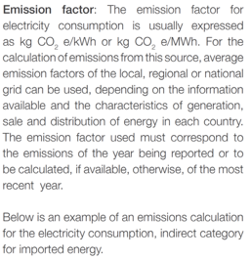

Main emissions sources (continued)
The guide offers orientation for identifying GHGs. Each GHG must be quantified for its respective emission source, using the appropriate calculation methodology.
For example:

Slide 15
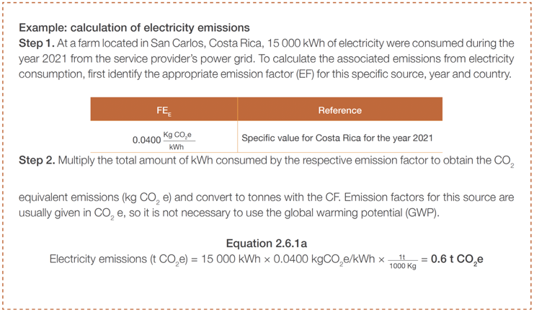
Main emissions sources (continued)
The guide provides practical examples for calculating GHG emissions by source to guide the user in applying the methodology.
For example:

Slide 16
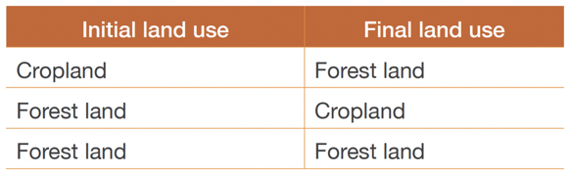
Main emissions sources (continued)
The guide considers three carbon change scenarios based on land usage.
Land use and management directly influence various ecosystem processes that affect GHG fluxes, potentially leading to either GHG emissions or their removal.

Slide 17
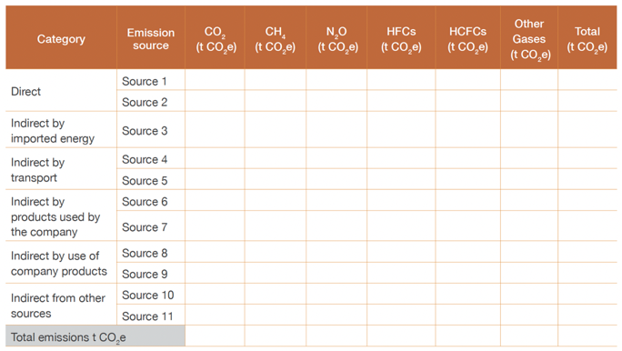
Consolidation of carbon footprint results
After evaluating all emission sources identified by the company, the results are consolidated by source category and GHG type.
The results are expressed in tons of carbon dioxide equivalent (CO₂e).
This process will help the company analyse emissions during the evaluation period, facilitate future comparisons, and assess performance improvements.
For example:

Slide 18
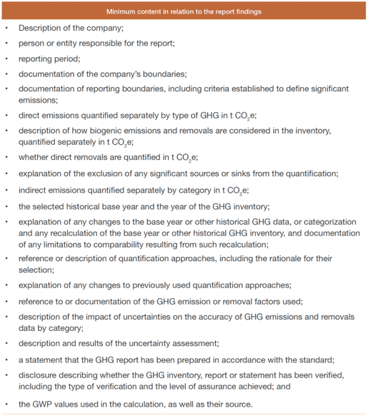
Consolidation of carbon
footprint results (continued)
The emissions inventory results are typically presented in a report intended for all stakeholders.
This document must meet minimum content requirements in accordance with the INTE-ISO 14064-1 standard.

Slide 19
Reduction of emissions
The reduction of GHG emissions is fundamental of the management of an emission inventory.
… it allows reducing the GHG emissions through the implementation of actions planned by the company.
Determining the carbon footprint makes it possible to:
identify potential opportunities to reduce emissions, and
contribute to mitigating the effects of climate change.
Once the emission sources have been identified and the company's GHG emissions have been accounted for, reduction strategies must be established to manage these sources and reduce GHG emissions.

Slide 20
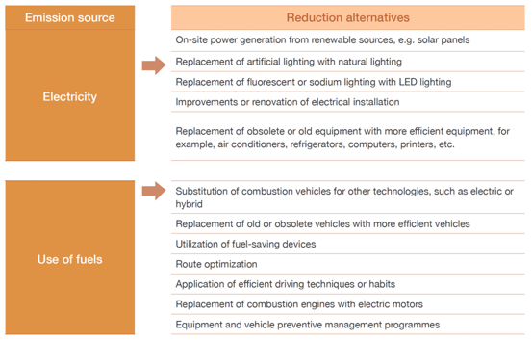
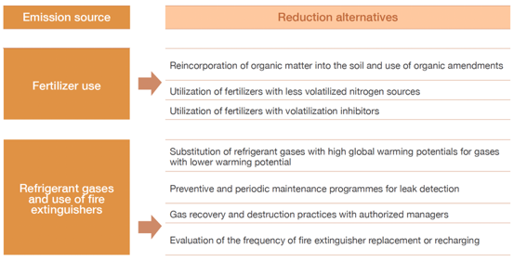
Reduction of emissions (continued)
Examples of emission reduction options:

Slide 21
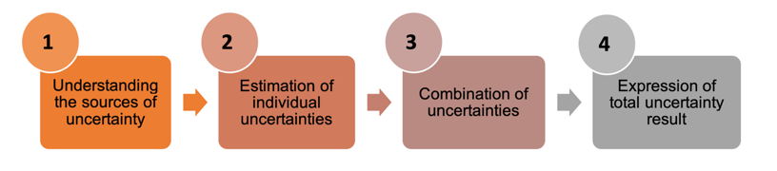
Inventory uncertainty
Uncertainty analysis is an important element of an inventory of emissions and removals.
It is used as a mean to prioritize efforts to reduce uncertainty in future inventories and to guide decisions on the application of methodologies.
The guide provides a general guidance on uncertainty analysis.
General steps for uncertainty assessment

Slide 22
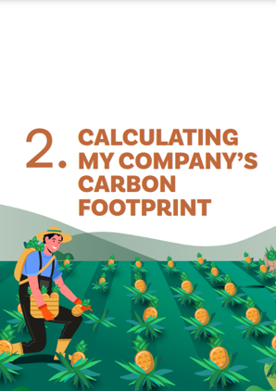
Why to use the carbon footprint measurement guide in pineapple companies?
Provides detailed guidance for the elaboration of the carbon footprint in the sector.
Contains case examples for the application of the calculation methodologies for each emission source.
Addresses relevant emission sources for the sector.
It is the first carbon footprint measurement guide available to the pineapple value chain.

Slide 23

Some limitations
It does not include evaluation criteria for the determination of significant indirect sources. Instead, it allows each company to define its own criteria.
This guide is applicable to elaborate the carbon footprint at the company level, it is not applicable to develop a carbon footprint for a product.

Slide 24




Thank you!
https://bit.ly/responsible-fruits
Responsible-Fruits@fao.org

