Slide 1



Monitoring, evaluation and learning
Generating evidence for sustainability and resilience
in the tropical fruit sector

Slide 2


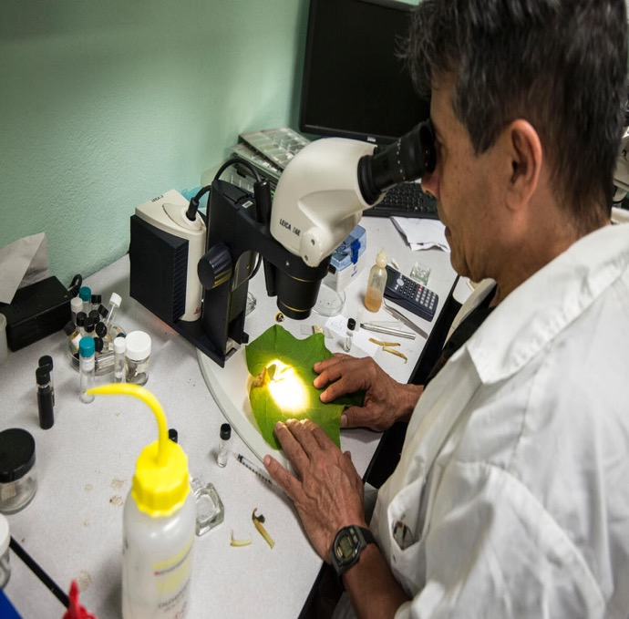

i
1
What will you learn in this course?
2
What is monitoring, evaluation and learning (MEL).
Why MEL can support your business to become more resilient and sustainable.
3
© FAO/Ezequiel Becerra
How to start developing a MEL system for your business.

Slide 3
How will we get there?
i
1
1
Definitions
Understand what MEL is.
2
Importance
How MEL supports the resilience and sustainability of value chains.
2
Let’s start!
3
Implement
Learn the steps to put MEL into practice.
3

Slide 4
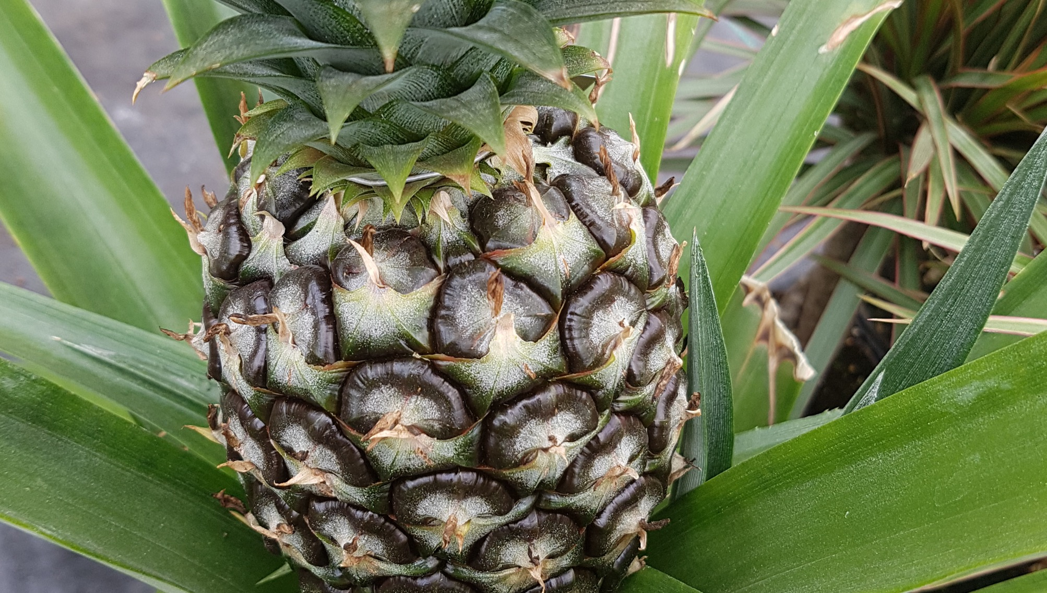
Part 1.
What is monitoring, evaluation and learning (MEL)?
©FAO

Slide 5
What is monitoring, evaluation and learning (MEL)?
i
1
MEL is the process of collecting data on your business' performance to make informed decisions that will ultimately improve your operations.
2
When focused on resilience and sustainability, MEL helps businesses measure their:
a) positive impact on environmental, social and economic wellbeing (sustainability).
b) ability to withstand, adapt to, and recover from various shocks, stresses, and risks (resilience).
3

Slide 6



i
Each component has a different purpose:
1
Monitoring (M)
Evaluation (E)
Learning (L)
2
Continuous assessment of the activity implemented by your business.
Deeper, objective assessment of the achievements of your activities or programmes.
Translate M&E findings into knowledge to improve and/or develop new activities.
“How do you know that your activities are happening the way you planned?”
“Are the interventions contributing to your business’ resilience and sustainability goals?”
“What and how should your business improve based on the new information?”
3
Notes:
Notes for trainers:
This is an animated slide.
Each box on the slide will appear as you click or press the ‘next’ button. It is advised that you click/press ‘next’ as you explain each box.

Slide 7
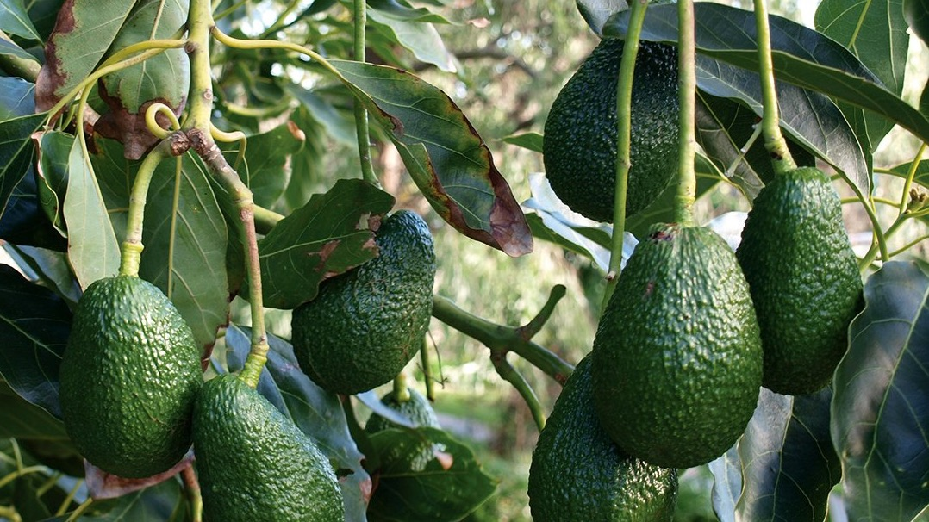
Part 2.
Why is MEL important to the resilience and sustainability of tropical fruit businesses?

Slide 8
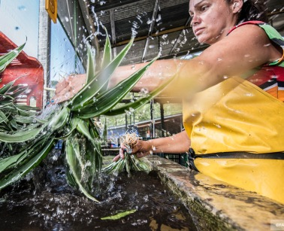
MEL supports:
i
1
Establishing mechanisms and metrics to identify risks, track progress and measure impact.
Creating a plan to address current and future risks.
Learning from results.
Evidence generation that back up sustainability claims and reporting.
Accountability and transparency.
2
3
©FAO
Notes:
Content extracted from the technical guide:
Establishes mechanisms and metrics to identify risks, track progress in addressing resilience and sustainability risks, and measure impact, so you can tell whether and how you’re contributing to sustainability and how your business is becoming better prepared to future shocks and stressors.
Supports the creation of a plan to address, mitigate, and prevent current and future risks.
Generates learning from results, guiding improvements in business operations to enhance resilience and sustainability.
Produces robust evidence to support sustainability claims and report on how your business is addressing concerns.
Improves accountability and transparency by sharing information with relevant stakeholders.
This all contributes to responsible business conduct practices and is directly connected to due diligence processes.

Slide 9
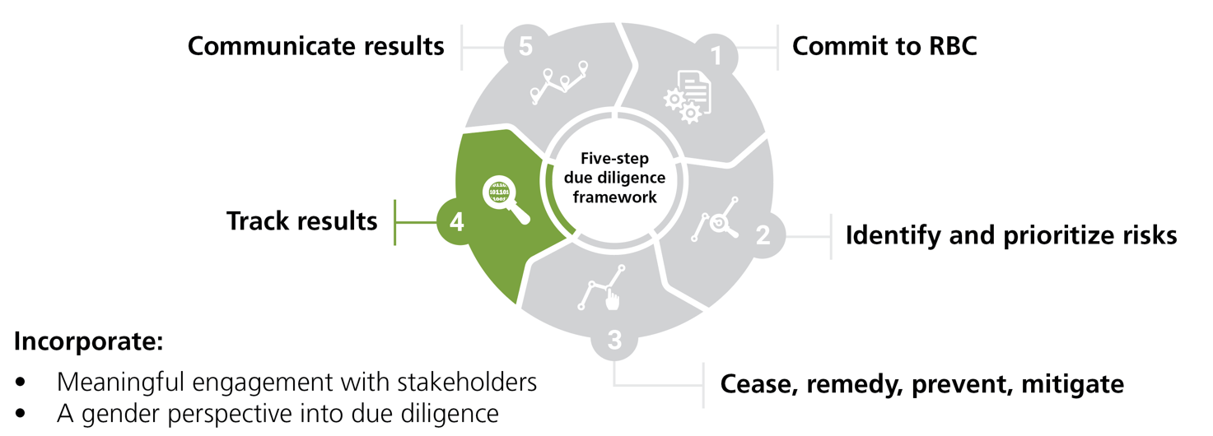
i
1
MEL contributes directly to responsible business conduct (RBC) and due diligence.
2
3
Notes:
Content extracted from the technical guide:
MEL is an integral part of responsible business conduct (RBC) and due diligence processes. RBC means operating your business activities in a way that avoids negative social and environmental impacts resulting from your own business activities and those of your partners. Due diligence is the process through which businesses put their commitment to RBC into practice. The due diligence process usually follows 5 steps, and in step 4, companies track how they are progressing towards their actions toward address sustainability risks and the negative impacts of their activities and those produced by their business relationships on the environment and society.
As you know, adopting RBC practices is increasingly important as due diligence requirements are becoming mandatory for businesses in some of the main importing markets where tropical fruits are consumed.

Slide 10
Key aspects to consider when designing a MEL system:
i
1
Design your MEL system before starting any activities.
Engage senior management and key staff to align objectives and improve decision-making.
Ensure traceability of your business processes and activities.
Include MEL in your budget.
Assign clear responsibilities for tracking activities and results across your business.
Understand stakeholder information needs to generate useful information only.
2
3
Notes:
Content extracted from the technical guide:
MEL systems need to be designed before any activity takes place. By doing so, your business will be able to truly evaluate the effectiveness and impact of its activities and strategies and gather important lessons for improving operations in the future.
Engagement from senior management and other relevant staff is essential. This commitment is vital to ensure that there is a common understanding of why generating robust evidence of your business resilience and sustainability strategy is needed for decision making and to improve the way your business operates.
Make traceability a reality. Your business needs to be able to access information of the functioning of its different processes and activities. This requires strong internal business controls and transparency in the delivery of business operations.
Include MEL in your business’ budget. Tracking and assessment activities are usually underbudgeted as they are not perceived as essential to business operations. Adequate planning and budgeting for these tasks will allow your business to generate high-quality information needed to make more effective decisions, improve your activities as you learn from them, and to increase transparency.
Assign responsibilities. Your business should determine who will be responsible for tracking the implementation of activities and the results to different units or offices. This will be based on the nature of the information that needs to be collected.
Understand information requirements from different stakeholders. This will allow you to generate the evidence that is required and prevent from generating evidence that might have no use.

Slide 11

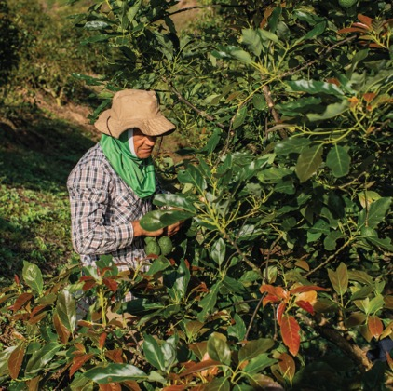
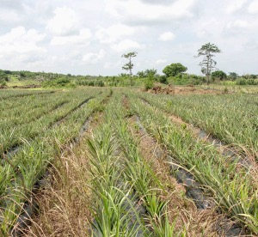
i
Note!
1
Your MEL system for sustainability and resilience building activities should be fully connected to your business’ own priorities.
2
©iStock
The capacity and resources of your business also impact its development. MEL activities should build on existing processes!
3
©iStock
Notes:
Content extracted from the technical guide:
It is advised that the design of your MEL system be largely based on internal processes already undertaken by your business to comply with voluntary sustainability standards (e.g. certification schemes), audits, market regulations, legal obligations and/or other sustainability reporting requirements. Leveraging on existing information for your MEL system can help avoid assessment fatigue and increase efficiency in the way your business tracks and reports on progress made.

Slide 12
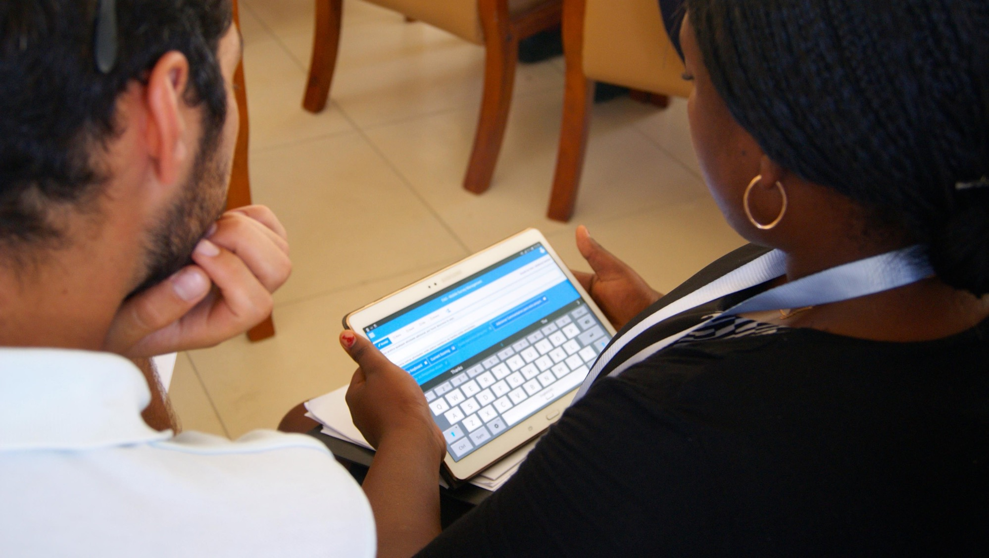
Part 3.
Putting MEL into practice
©FAO

Slide 13
What’s the process to develop a MEL system?
i
1. Understand the context
3. Identify the target audience of your MEL system
4. Select the indicators
5. Select the MEL tools
6. Analyse the data collected
7. Report on the results and make decisions
2. Develop a resilience and sustainability strategy for your business
1
2
3
The process is iterative and not always linear!
Notes:
Content extracted from the technical guide:
The development and implementation of a MEL system usually follows an approach like the one on the slide.
In this approach, businesses need to first have a very good understanding of the context in which they operate and identify the main issues they face (e.g. climate change, profitability, legal obligations).
This understanding allows them to determine their goals and objectives, and how to achieve them.
These components will all be outlined in a resilience and sustainability strategy.
The strategy will then be the basis for businesses to define how they will measure progress toward their objectives and assess their success in achieving them.
Businesses will ideally report these findings to the relevant stakeholders, and if needed, make adjustments in their operations, process or policies to improve their performance or maximize their impact.
We will discuss each of these steps in detail in the following slides.
You should note that it is not always possible to follow the sequenced approach proposed in the figure, and in fact, the process of developing a MEL system is iterative and not fully linear.
That is, you might need to go back and forth between the different steps to adjust as you progress and learn from your operations, achievements and challenges.

Slide 14





Step 1. Understand the context
i
1
Analyse the environmental and socioeconomic situation in which your main business activities evolve, including:
Main risks impacting your operations.
Operations and people exposed to the risks.
2
Capacity of your business to address the risks.
Timing of the risks.
3
Notes:
Content extracted from the technical guide:
The starting point to develop a resilience and sustainability strategy for your business is to have a very good knowledge and understanding of the context in which its operations take place. This means, analysing the environmental and socioeconomic situation in which the main business activities (e.g. production, packing, processing, transporting, exporting) evolve. This includes the identification of:
Main risks impacting the functionality of the operations and how they will be affecting the continuity of your business in the future. These include shocks and stresses such as extreme weather events, upcoming changes in market regulations or laws, or reputational concerns.
Time when the risks might take place, i.e. whether they will occur in the short, mid or long terms.
Stakeholders and areas of your business that might be exposed to the effects of shocks, stresses and risks the most. For instance, small-scale producers you source fruits from or hire d migrant labourers working in your plantations.
Business’s capacities (knowledge, skills and resources) available to address the issues identified, and which capacities your business still needs to develop to face future risks.
By understanding the context of your operations, your business will be able to define its vision and ultimate goal for its resilience and sustainability strategy. This understanding will allow your business to set priorities for action in order to improve its performance and outline the steps needed to achieve these objectives.

Slide 15


Step 2. Develop a resilience and sustainability strategy for your business
i
1
The strategy lays out what your business wants to achieve and how it will get there:
Set out resilience and sustainability short- and long-term goals.
Define how to achieve the goals (activities, actions, programmes, etc.)
Theory of change
(ToC)
2
Logical framework
(log frame)
3

Slide 16
i
How to build a resilience and sustainability strategy?
1
Designed in reverse order!
4.
Define the activities
3.
Set the outputs (short-term targets)
2.
Define the outcomes
(mid-term targets)
1.
Set the resilience and sustainability goal
2
What actions are you taking/implementing to deliver the outputs?
(Fully controlled by your business!)
What is your business doing to achieve the outcomes?
What needs to happen to reach your goal?
What do you want to ultimately achieve?
(NOT Fully controlled by your business!)
3
Shocks, stresses and risks
Populations or landscapes benefited from the strategy
Notes:
Notes for the trainer:
This slide contains embedded animations.
The trainer should explain that the resilience and sustainability strategy is designed in reverse. Businesses begin by setting their resilience and sustainability goals. Based on these goals, they will then determine how their programs, activities, and overall interventions will lead to achieving them. This process is illustrated by the orange arrow at the top of the image.
The trainer should also mention that, when designing the overarching strategy, businesses should consider the shocks, stressors, and risks they aim to address, as well as the populations or landscapes that will benefit from this strategy. By doing so, businesses can create strategies that effectively address areas potentially hindering their long-term sustainability and resilience. This is illustrated by the blue dotted line and blue text at the bottom of the image.

Slide 17


Let’s take this example of Company’s A goal:
“In the next decade – despite extreme weather events – the company will consolidate its position in national and international markets, by offering safe, healthy and sustainably produced fruits, increasing the profitability of growers and wellbeing of all workers.”
Company A’s goal
What short- and mid-term steps and activities are necessary for Company A to achieve this goal?

Slide 18
Example (continued)
4.
Define the activities
3.
Set the outputs
2.
Define the outcomes
1.
Goal
Training of farmers on IPM
Purchase of inputs with lower chemical load
Seminar delivered on phytosanitary regulations and MRL
By 2025, at least 50 % of producers have reduced the use of agrochemicals by 15 % of annual consumption.
By 2030, at least 30 % of all fruit grown and sourced by the company is produced using sustainable agricultural practices.
“In the next decade – despite extreme weather events – the company will consolidate its position in international markets, by offering safe and sustainably produced fruits, increasing the profitability of growers and wellbeing of all workers.”
Extreme weather events and stricter environmental and social regulations in markets
Beneficiaries: the business, company growers and workers
Notes:
IPM=Integrated pest management; MRL=maximum residue limits
Notes:
Notes for the trainer:
This slide contains embedded animations.
Before going into each point, it is suggested that the trainer opens the floor so participants can share their thoughts and ideas for every single component.
The trainer should highlight that the blue text on the bottom refers to both shocks, stressors, and risks Company A is aiming to address i.e. extreme weather events and stricter environmental and social regulations in exporting markets), as well as the populations or landscapes that will benefit from this strategy (i.e. the business as a whole and company growers and workers). This also makes a direct reference to Step 1 – context understating.

Slide 19
Example (continued)
“In the next decade – despite extreme weather events – the company will consolidate its position in national and international markets, by offering safe, healthy and sustainably produced fruits, increasing the profitability of growers and wellbeing of all workers.”
To address extreme weather events:
Invest in climate-proofing technologies (irrigation, inputs, etc.)
To improve workers’ wellbeing:
Put occupational health and safety protocols in place
Provide fair and formal contractual arrangements
Company A’s goal
To produce safe and healthy food:
Reduce agrochemical use
To improve grower’s profitability:
Establish fair and formal contractual arrangements with growers and suppliers
Improve consumer awareness on production challenges
To produce sustainably:
Increase capacity of growers to reduce water use (training)
Notes:
Notes for the trainer:
This slide contains embedded animations.

Slide 20



Step 3. Identify the target audience of your MEL system
i
1
Identify and prioritize the stakeholders who will use the information and learning generated through your MEL system.
Internal users
External users
2
Those with a high stake in the business activities and who make decisions.
Those not directly engaged with the business but with an interest in its activities.
Ex: board of directors, senior management, divisional directors, and local communities (if applicable).
Ex: importing companies, consumers, service providers, retailers, certification bodies, policymakers, researchers, etc.
3

Slide 21
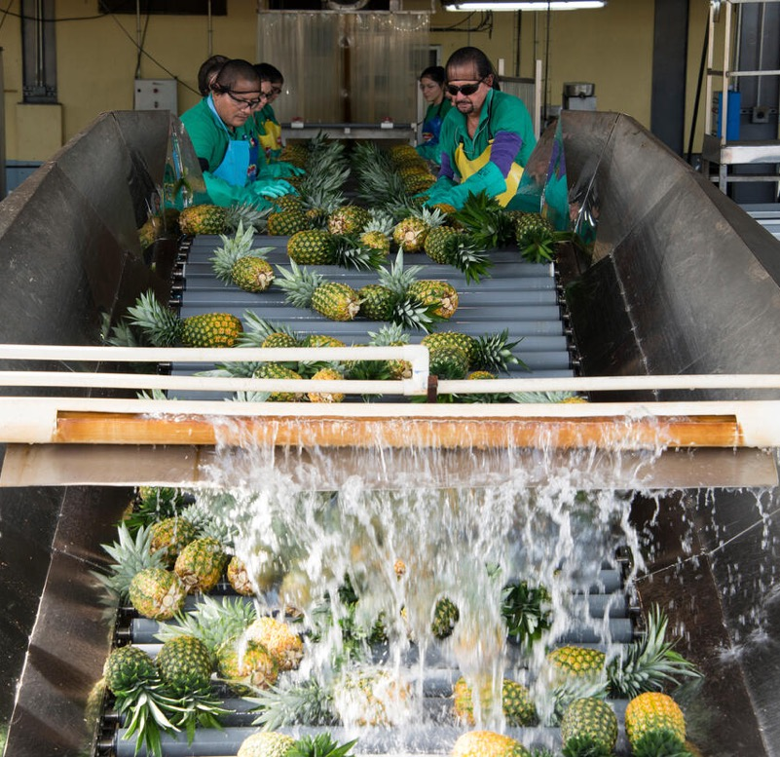
Step 4. Select the indicators
i
1
What is an indicator?
A tool to assess the performance and success of business activities;
an instrument to measure progress towards specific objectives; and,
it is based on objective and concise information.
2
3
Indicators should generate consistent results and track progress under the same conditions over time!
©FAO

Slide 22
Step 4. Select the indicators (continued)
i
1
1.
What?
2.
Who?
3.
How much?
4.
By when?
How to define them?
2
What do you want to measure in your strategy.
Who is your business targeting as part of its strategy.
Quantify what success looks like.
Timeframe by which you are expecting to reach the target.
3

Slide 23
Let’s take this example:
The indicator(s) needs to:
measure if company farmers and external growers improved their efficiency on water used for irrigation.
inform due diligence and certification requirements.
Company A’s short-term goal (output):
By 2027, all farmers and growers have increased their efficiency in water use for irrigation.

Slide 24




Example (continued)
Company’s output:
By 2027, all farmers have increased the efficiency in water use for irrigation
by 30%.
Indicators:
4. By when?
2. Who? &
3. How much?
Number of farmers with high-water efficiency irrigation systems and/or using good water management practices
  → Measures quantity of farmers
Water used for irrigation per hectare
  → Quantifies water used (aligned with certification requirements)
1. What?

Slide 25
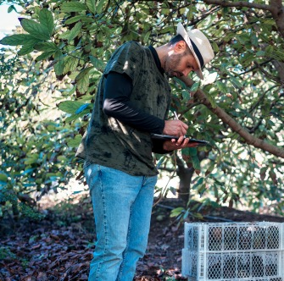
Step 5. Select the MEL tools and collect data
i
What are MEL tools?
Instruments to generate data to measure indicators.
  Surveys, lab tests, reports, check lists, interviews, geospatial information, etc.
1
2
How to select them?
Identify the type and size of the implemented activity (e.g. individual, plot, watershed).
Define the complexity and accuracy of information required.
©iStock
3
Set a budget.
Focus on the actual data needs of your business!

Slide 26



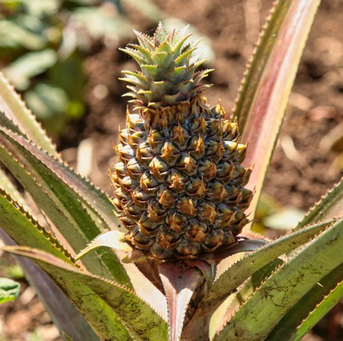

i
Step 6. Analyse the data
1
Why analyse data?
To get insights on what has worked and what has not worked in your strategy
To facilitate learning and enable strategy and operational adjustments.
To guide decision-making, including investment decisions.
2
3
… without a proper analysis of your results, the time and resources devoted to developing your strategy and collecting data will be wasted.
Notes:
Data analysis is one of the most critical aspects of your resilience and sustainability strategy. Without a proper analysis and reporting of your results, evidence generation produced to inform your business’ strategy, the time and resources devoted to developing your ToC and collecting data will have been wasted.

Slide 27
i
Types of analyses
1
Frequency
Descriptive statistics
2
3
Notes:
Data analysis is one of the most critical aspects of your resilience and sustainability strategy. Without a proper analysis and reporting of your results, evidence generation produced to inform your business’ strategy, the time and resources devoted to developing your ToC and collecting data will have been wasted.

Slide 28
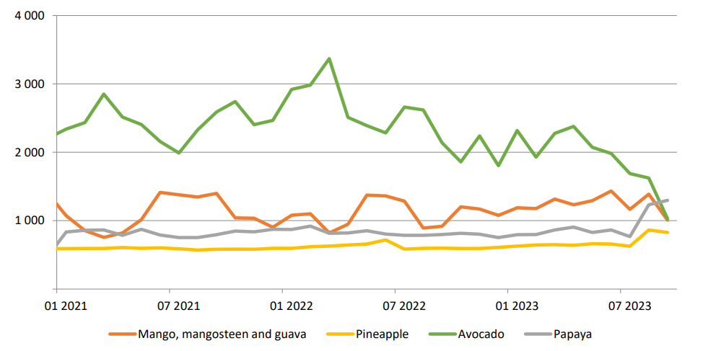
i
Types of analyses
1
Trends
Attribution analysis
Major tropical fruits: World average export unit values, January 2021 to August/September 2023, USD/tonne
Draw on your resilience strategy.
Check behaviour of key indicators,
Check differences in groups for different activities you might have implemented.
Analyse trends (as discussed)
Hold consultations to understand the impact of your activities and strategy.
2
3
Notes:
Data analysis is one of the most critical aspects of your resilience and sustainability strategy. Without a proper analysis and reporting of your results, evidence generation produced to inform your business’ strategy, the time and resources devoted to developing your ToC and collecting data will have been wasted.

Slide 29
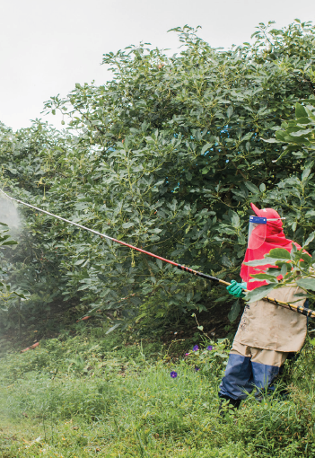



Step 7. Report on the results and make decisions
i
1
Focus on:
Identifying and communicating what worked well according to your strategy and commitments (e.g. certifications, pledges to comply with international standards).
2
Highlighting the bottlenecks encountered and specify areas needing improvement to enhance your sustainability and resilience.
Important:
It needs to be done in good faith; ensure transparency, accuracy, consistency and completeness, and avoid greenwashing.
Full data disclosure isn’t mandatory if it threatens commercial confidentiality or security.
3
Notes:
Notes for the trainer:
In this slide, the trainer should remind participants that reporting:
Needs to be tailored based on stakeholder needs, as outlined in Step 3.
The communication frequency (e.g., annually or biannually) should be decided.
Companies might need to choose a reporting format: sustainability templates, VSS forms, company-designed mechanisms, or a combination.
Should consider business size, value chain partner information needs, and local/importing market reporting requirements when choosing communication methods.

Slide 30
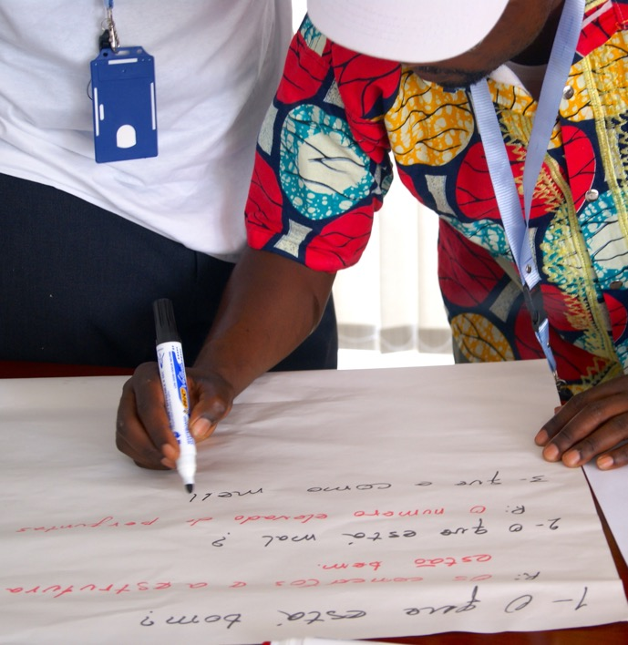
Step 7. Report on the results and make decisions (continued)
i
1
Resources to structure a sustainability report in the context of sustainability and RBC:
The Global Reporting Initiative (GRI) 13: Agriculture, Aquaculture and Fishing Sectors standards.
The European Union’s Corporate Sustainability Reporting Directive (CSRD) guidance to report on social and environmental information.
European Sustainability Reporting Standards (ESRS).
UN Global Compact’s Communication on progress guidebook.
2
3
©FAO

Slide 31
Step 7. Report on the results and make decisions (continued)
i
1
The Carbon Disclosure Project for climate change, forests and water security impacts.
The Sustainability Disclosure Standards.
The Accountability Framework Initiative’s Operational Guidance on Reporting, Disclosure and Claims.
2
3
©FAO

Slide 32

i
We reached the end!
1
Today we learned:
What MEL is and how it can support resilience and sustainability in your business.
MEL is key to measure your progress and success regarding the sustainability and business operations.
2
MEL can support your business to increase its transparency and can enhance the reputation of your brand!
3
MEL is aligned with responsible business conduct and directly contributes to due diligence and reporting required by some markets.
Notes:
Notes for trainers:
This is an automated slide.

Slide 33





Thank you!
https://bit.ly/responsible-fruits
Responsible-Fruits@fao.org

